Slide 1
GEOMETRICAL ALGORITHMS
From slice data to a usable structure
Recover the boundary first. Then build a useful interior structure.
Core claim
Final idea
This is one pipeline, not a list of unrelated algorithms. We solve boundary recovery and interior organization together.
Convex hull is the baseline. Winding gives inside-outside logic for the real boundary. Delaunay gives candidate interior edges. Winding filters those edges.
GA presentation · 01

Slide 2
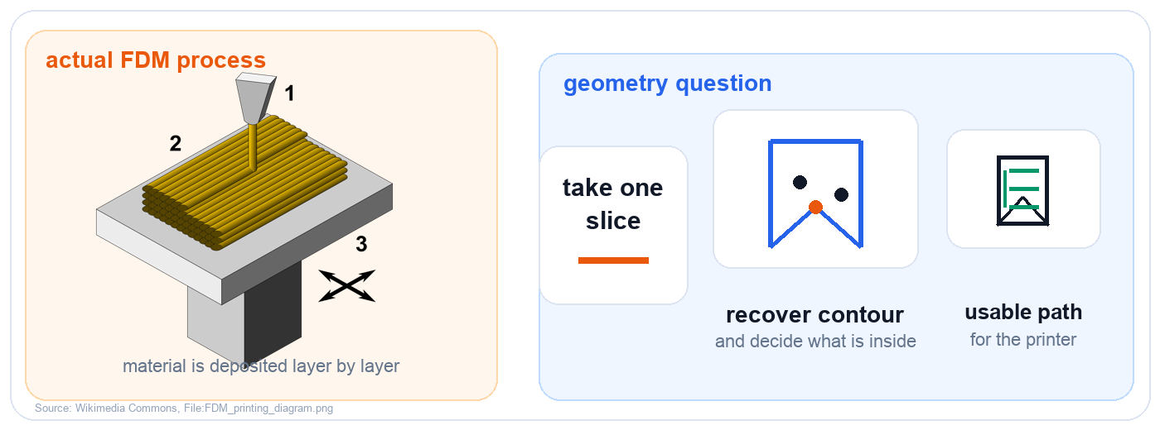
FDM MOTIVATION
Why FDM gives us this problem
Why this matters
Link to the talk
Each printed layer becomes a 2D geometry problem: contour, inside-outside logic, and a usable path.
That is why boundary recovery and interior structure belong to the same pipeline.
GA presentation · 02

Slide 3
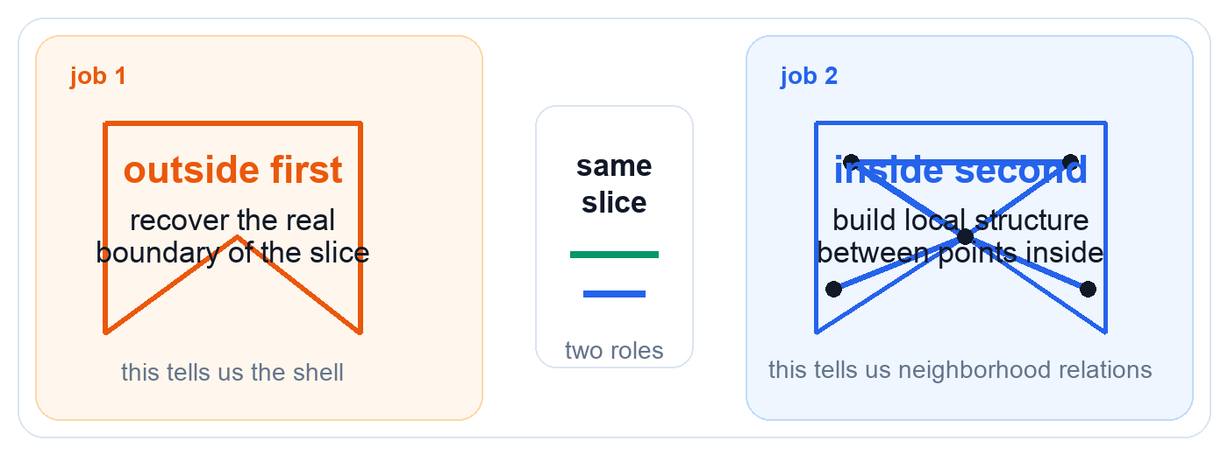
PROBLEM SPLIT
One slice has two jobs
Boundary alone is not enough. The inside must also be organized.
Reading the slide
Why this matters
The same slice is viewed twice: first as a boundary problem, then as an interior organization problem.
This split is the reason the presentation has two phases instead of trying to force one algorithm to do everything.
GA presentation · 03

Slide 4
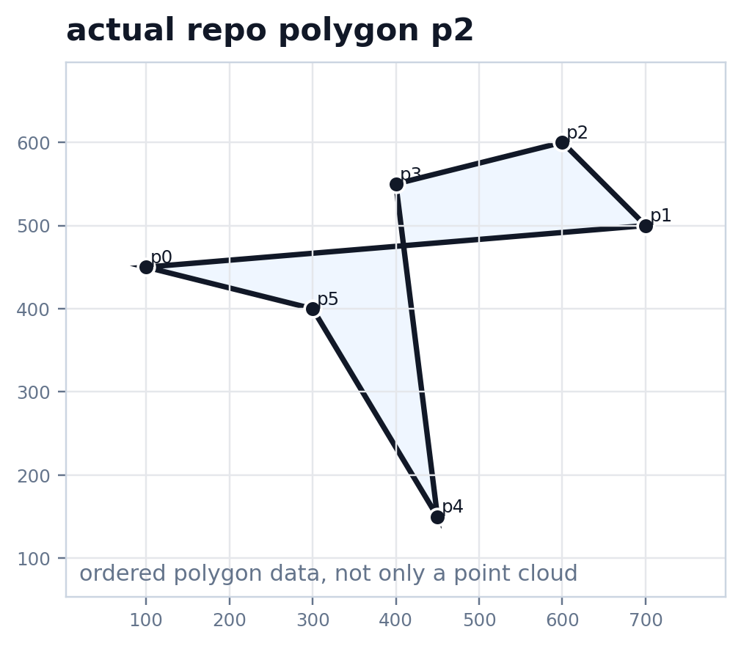
RUNNING EXAMPLE
Our slice-like input is the repo polygon `p2`
We use one real repo polygon through the talk so the algorithms stay connected.
Why `p2` is useful
It is not convex. So the example immediately exposes where a simple outer envelope loses information.
What to notice
There is a visible inward part of the shape. That feature must survive if we want the real boundary.
Why we keep one dataset
It lets the audience compare all algorithms on the same geometry instead of changing examples every slide.
GA presentation · 04

Slide 5
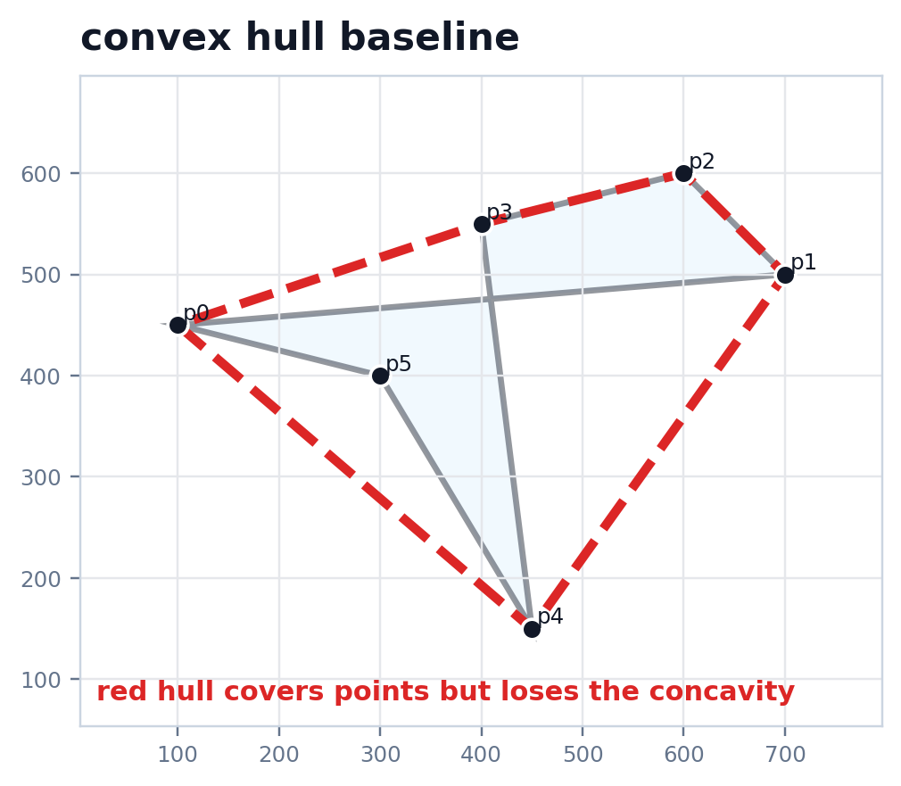
BASELINE
Convex hull is a clean baseline, but it changes the shape
Our monotone chain view sorts the points, builds two stacks, and keeps only convex turns.
What the algorithm does
It keeps only the points needed for the smallest convex envelope around the set.
What the demo shows
Candidate point, orientation test, stack before, stack after, and the push-or-pop decision.
Why it fails here
The real shape is concave. The hull fills that inward part, so it is the wrong boundary for this slice.
GA presentation · 05

Slide 6
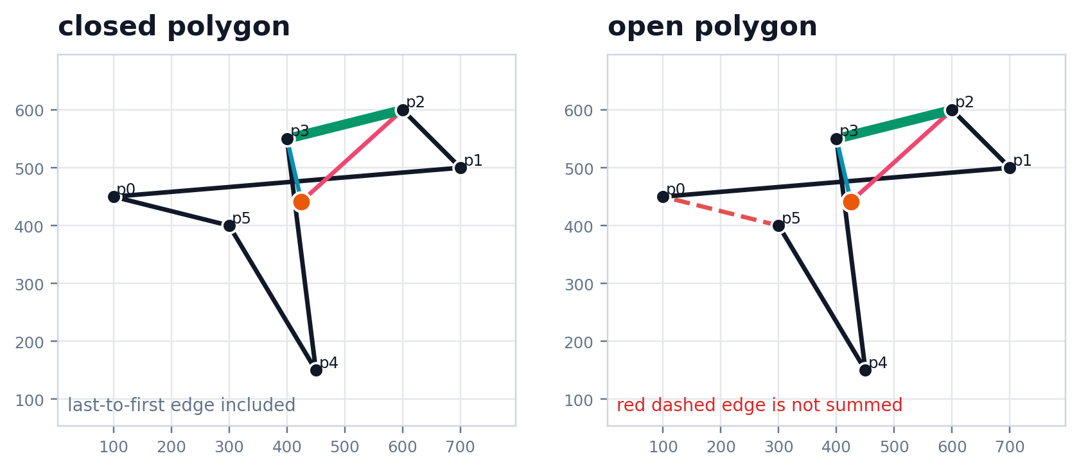
BOUNDARY RECOVERY
Winding number asks the right boundary question
Instead of forcing a convex cover, it tests inside versus outside directly.
Main idea
Process one edge at a time and add its signed angle contribution around a query point.
Why it is better
It respects the actual polygon. It does not flatten concavities the way convex hull does.
What to show in the app
Current edge in green, query point in orange, and the running winding value after each edge.
GA presentation · 06

Slide 7
BOUNDARY ASSUMPTION
Closed and open polygons are not the same
The final edge matters. If the loop is not closed, the winding sum changes.
Closed mode
The last vertex connects back to the first one, so the query point sees the full loop.
Open mode
That final edge is missing. The algorithm does not silently invent it, so the result changes.
Why this slide matters
It makes the boundary assumption explicit and gives a clean transition from hulls to inside-outside tests.
GA presentation · 07

Slide 8
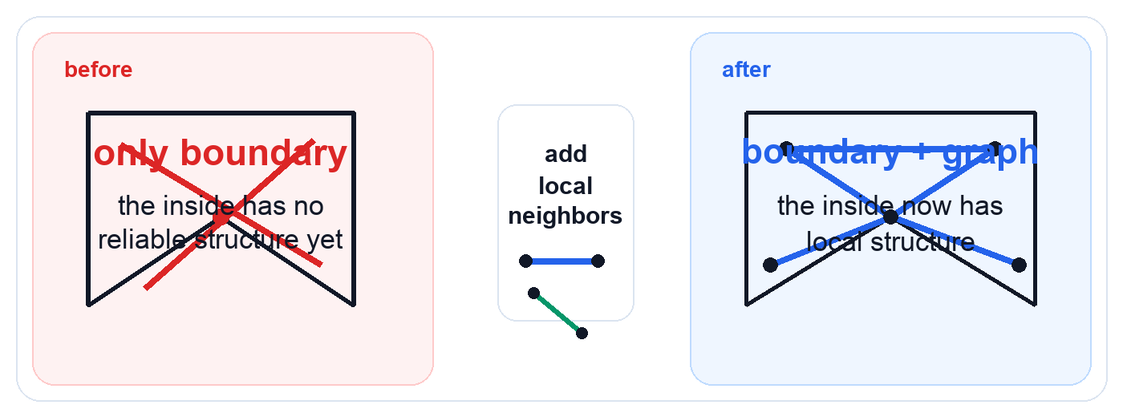
INTERIOR GOAL
Why we need interior structure
The contour gives the shell, but the inside still needs a local geometric organization.
Main point
Bridge forward
A contour tells us where the slice ends, but it says almost nothing about relations inside the slice.
Voronoi and Delaunay are useful because they add interior organization without abandoning the geometry of the slice.
GA presentation · 08

Slide 9
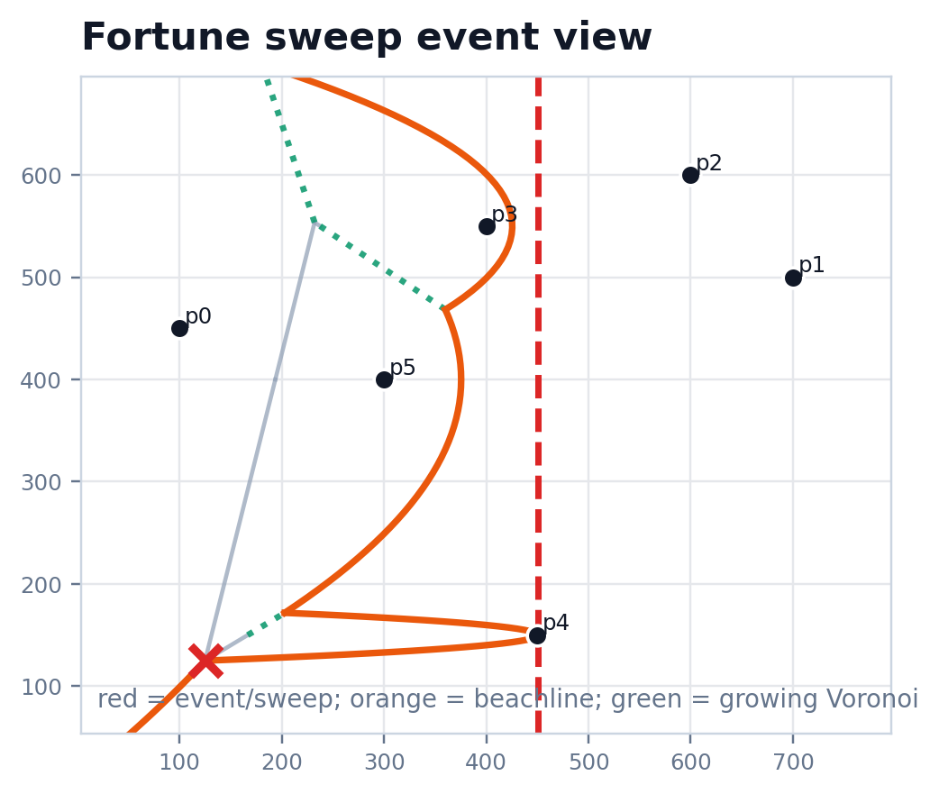
VORONOI CONSTRUCTION
Fortune sweep builds the Voronoi structure event by event
Site and circle events change the beachline and gradually produce the interior geometry.
Who is processed
At each step the event is either a new site or a circle event where one beachline arc disappears.
What changes
The beachline changes, Voronoi segments start growing, and some edges become final.
What to say in the demo
Show one site event and one circle event. The goal is the mechanism, not every low-level detail.
GA presentation · 09

Slide 10
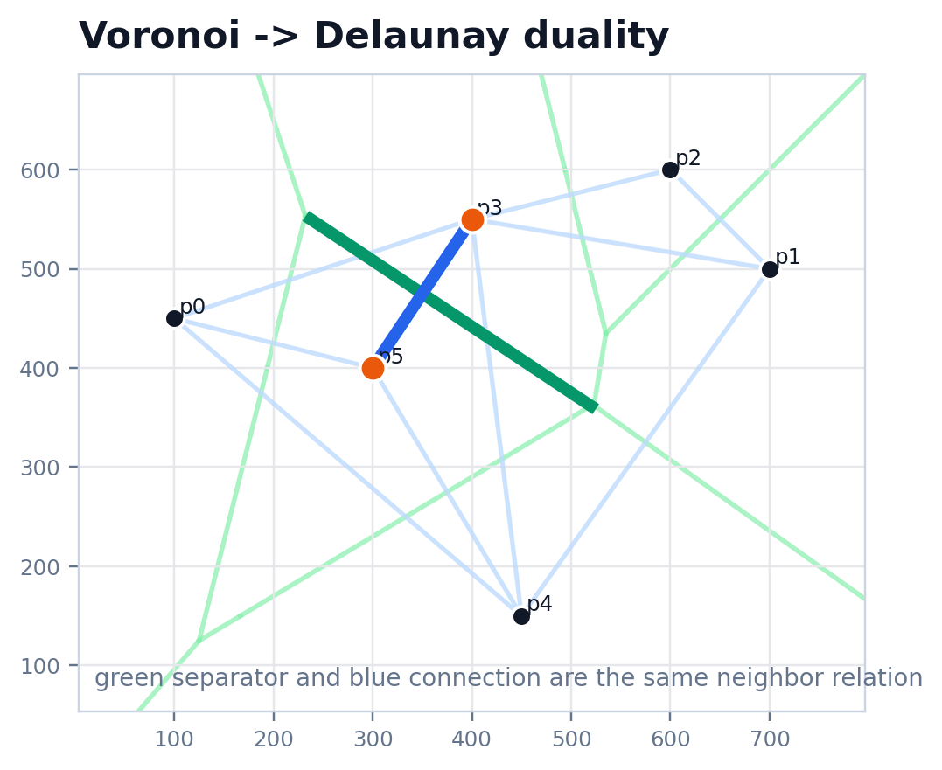
INTERIOR GRAPH
Delaunay gives the interior neighbor graph
It is better than arbitrary links because it comes from Voronoi region adjacency.
Why Delaunay is principled
If two Voronoi regions touch, their sites become neighbors. So the graph is grounded in nearest-site geometry.
Why it is better
It preserves local neighborhood relations instead of inventing random or long interior connections.
But not enough alone
Raw Delaunay does not know which edges fall outside the intended boundary. So we still need the winding test.
GA presentation · 10

Slide 11
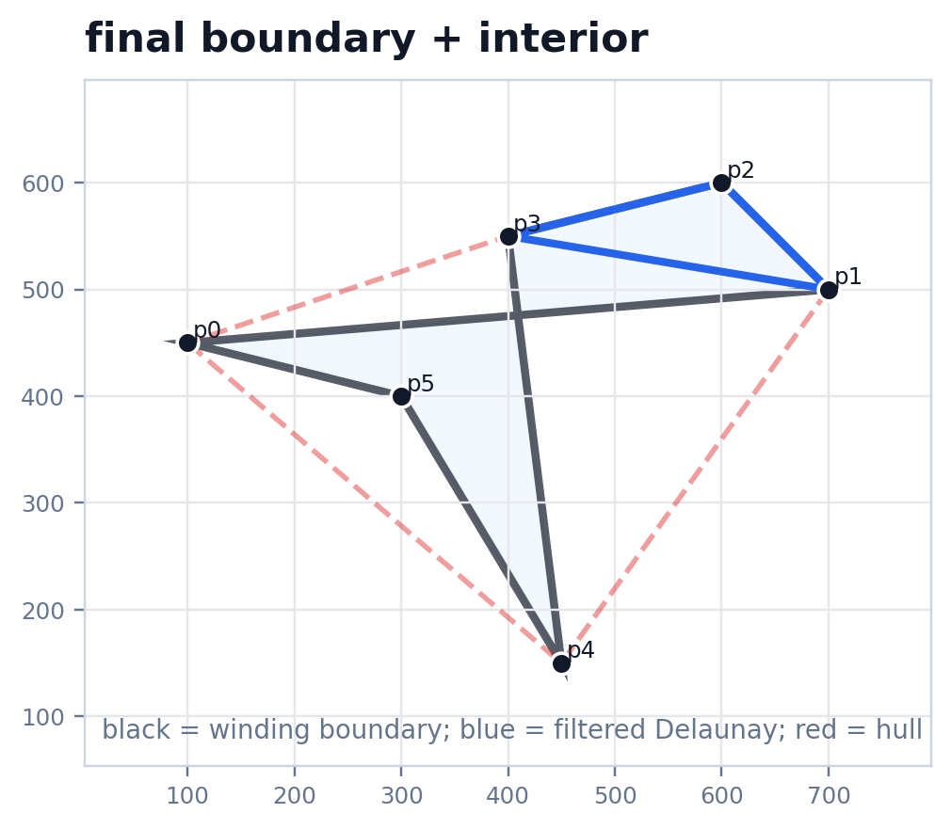
FINAL PIPELINE
Winding filters Delaunay into the final interior structure
Delaunay proposes candidate edges. Winding keeps only the ones that stay inside the shape.
Filter rule
Take one Delaunay edge, test its midpoint with winding number, keep it if the midpoint is inside.
Final picture
Black is the recovered boundary. Blue is the interior graph that survives the boundary test.
End message
Convex hull gives the baseline, winding gives the real boundary logic, and Delaunay gives the interior candidates.
GA presentation · 11

