Slide 1

CYBERBIT
Validating Phishing URLs WITH RANDOM FOREST CLASSIFIER
WILLIAM TIOZZO, YEJI JU, JERRY LUO

Slide 2
01
Overview
INITIAL TARGETS
02
MODELS
03
DATASETS
04
TRAINING
05
TUNING
06
RESULTS

Slide 3
TARGETS
Validate phishing websites through features of URL
Crucial for businesses determine a valid source of partnership
Analyzation of malicious URLS through multiple perspectives

Slide 4

MODEL —
Random Forest Classifier
Used for both classification and regression problems
Collection of decision tree classifiers that each do their best to offer an output
Final output determined by a winner class
Both Classification and Regression

Slide 5
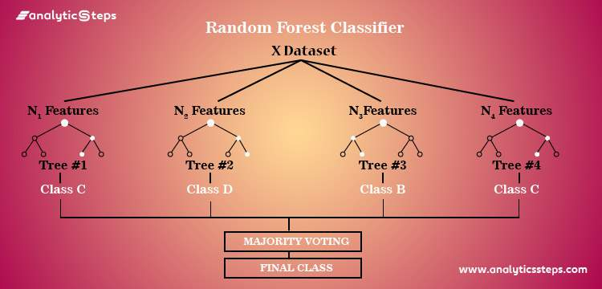
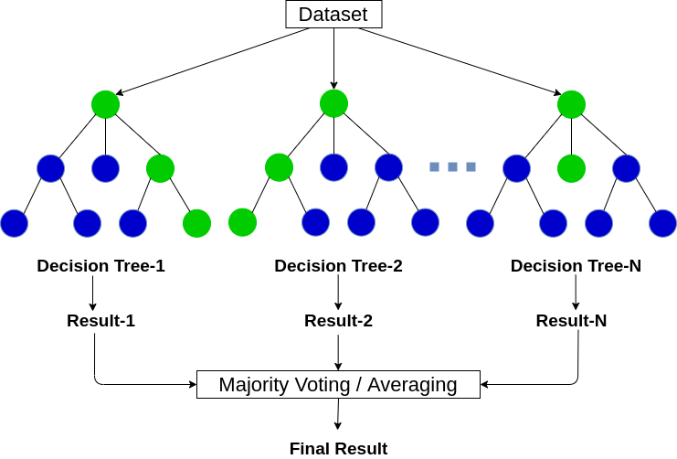

Slide 6

WHY Random Forest Classifier?
Finding data from similar projects on Github, stack over flow …
Out of all projects, random forest showed a greater advantage in terms of accuracy, most of which are above 80%

Slide 7
DATASET USED FOR TRAINING
https://www.kaggle.com/eswarchandt/phishing-website-detector
Collection of website URLs for over 11000 + websites, each sample has 30 website parameters and class label identifying it as phishing website or not (1, -1)
https://github.com/shreyagopal/Phishing-Website-Detection-by-Machine-Learning-Techiniques/blob/master/DataFiles/4.phishing.csv
Using pandas to concatenate dataset1 and dataset2

Slide 8
Dataset Features
http://paypal.com-webappsuserid29348325limited.active-userid.com/webapps/89980/
http://
active-userid.com
/webapps/89980/
com-webappsuserid29348325limited
paypal
Protocols
Domain name
Path
Subdomain item 1
Subdomain item 2

Slide 9
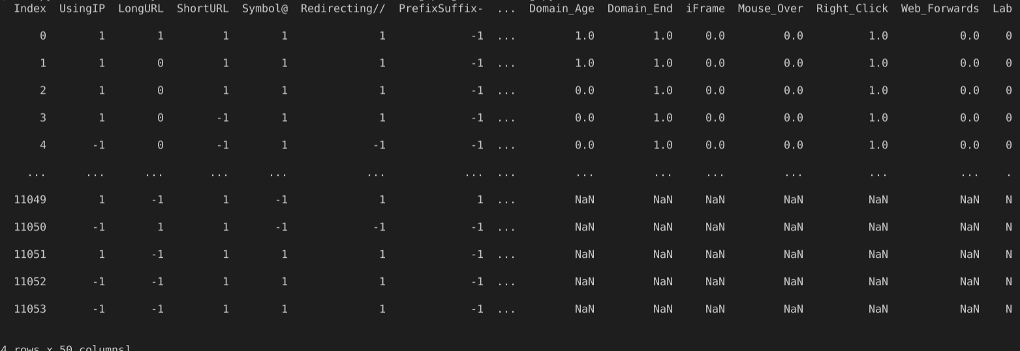
Panda Concatenate
NaN represents “Not a Number” and is a common missing data representation.
NaN represents ‘not a number’ and is a common missing data representation.

Slide 10

TRAINING
n_estimators determine the number of trees in the forest, by default set to 100
Random_state parameter controls both the randomness of the bootstrapping (machine learning algorithm designed to improve the stability and accuracy of machine learning algorithms)
Max_depth is the maximum depth of the tree set to 1

Slide 11
HYPERPARAMETER TUNING
Hyperparameter optimization or tuning is the problem of choosing a set of optimal hyperparameters for a learning algorithm
Eg: Increasing the max_depth parameter allowed the accuracy to improve from 78% to around 85%

Slide 12
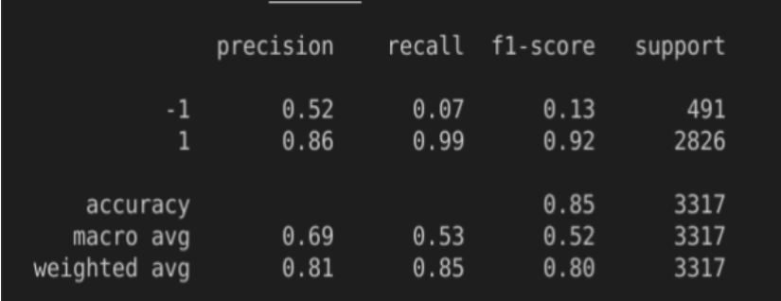
Classification Report
used to measure the quality of predictions from a classification algorithm
Precision
Number of identified members of class divided by all times the model predicted the class
Recall
Number of members of class that the classifier identified correctly divided by total number of members in that class
F1 Score
Combines precision and recall into one metric, if precision and recall are both high, F1 will be high too

Slide 13
Validation curve is important diagnostic tool that shows the sensitivity between changes in a machine learning model’s accuracy with change in parameters of the model
Data
Overfitting: Occurs when training curve reaches a higher score relatively quickly and validation curve is lagging behind
Detailed data shown on the next slide!
Underfitting: Both validation and training scores are low, the model is too simple or it is informed by too few features (dataset has very few features)
Validation Curve

Slide 14

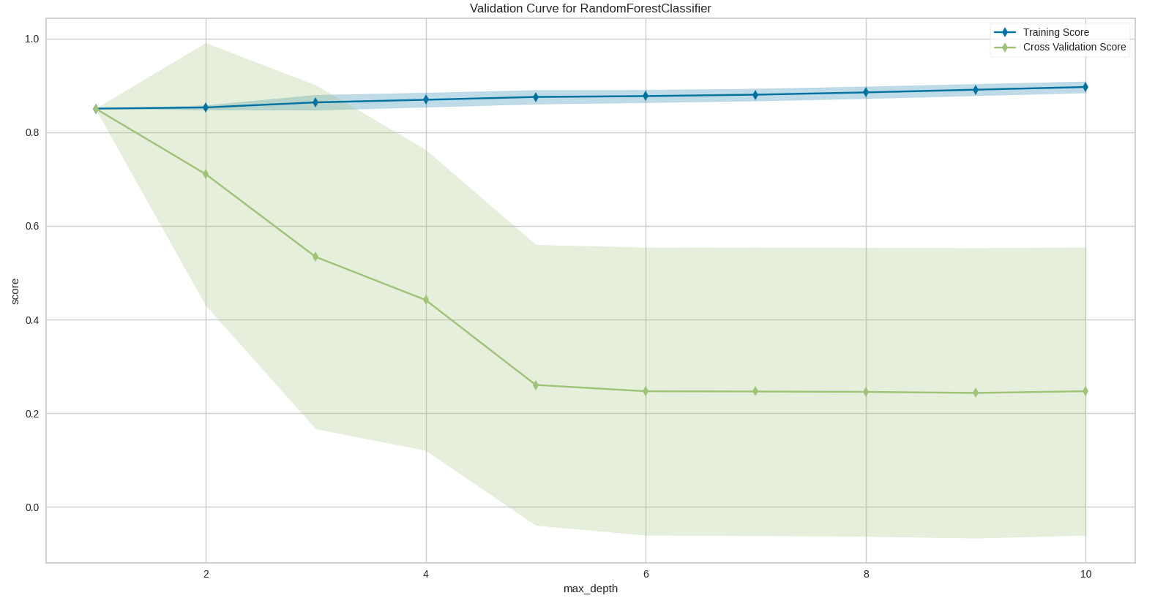
Validation Curve
Max Depth represents the maximum depth of a tree. The maximum nodes expanded for a single tree.

Slide 15
GridSearchCV is a process of performing hyperparameter tuning to automize the process of determining the optimal values for a given value
Finding the optimal parameters manually could take a significant amount of time
By giving grid a range of different parameters, grid can automize and find the best parameters for the model
GridSearchCV
Optimizing accuracy with GridSearchCV

Slide 16
RESULTS WITH GRID
{‘bootstrap': True, 'max_depth': 4, 'max_features': 3, 'min_samples_leaf': 4, 'min_samples_split': 8, 'n_estimators': 100}
More than 100 types of combination
Bootstrap used to estimate the skill of machine learning models when making predictions not including the training data
Max_feature determines the max number of features a random forest is allowed to try in a individual tree
N_estimators determine the number of decision trees best for the model and training data
Internet

Slide 17
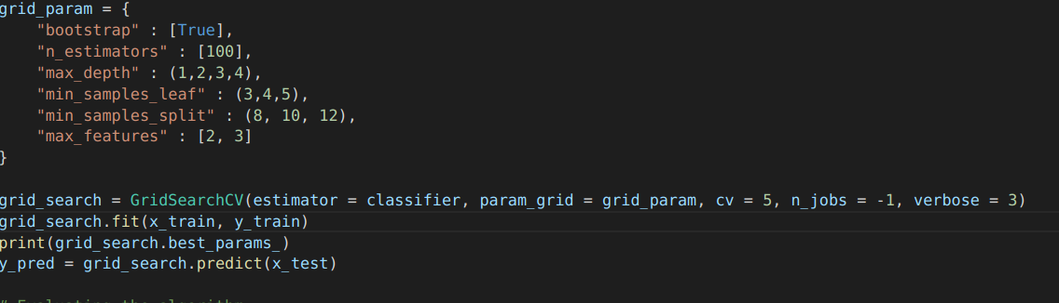
RESULTS FROM GRID

Slide 18

Future Steps to Take
Construct graphical user interface through browser extensions
Specific analysis on why URL is malicious through pi charts, bar graphs …
Mass data collection for malicious URLS, construct own database for new malicious URLS and feed to model
Maximize our accuracy via methods through something similar to GridSearchCV

Slide 19
01
Validating malicious URLs with random forest classifiers resulted in an accuracy of around 78%, optimization was required to increase accuracy.
Summary
02
For optimization, hyper parameterization was the first option, increasing one parameter (max_depth) allowed the accuracy to increase to 85%.
03
To maximize our accuracy, another option to further increase accuracy score was by using GridSearchCV which unfortunately did not help.
04
Random forest classifier proved to be a great model for URL validation with a finalized accuracy of 85%.

Slide 20
THANK YOU

