Slide 1
Iris Flower Classification Using Machine Learning
Advanced Computer Programming
Group 5
Instructor: DINH-TRUNG VU
Members:邱仁宏-109022066 陳逸凱-110021085 林哲熙-110022106

Slide 2
Project Introduction
• Apply machine learning techniques to classify iris flowers.
• Use the Iris dataset provided by Scikit-Learn.
• Compare different classification algorithms.

Slide 3
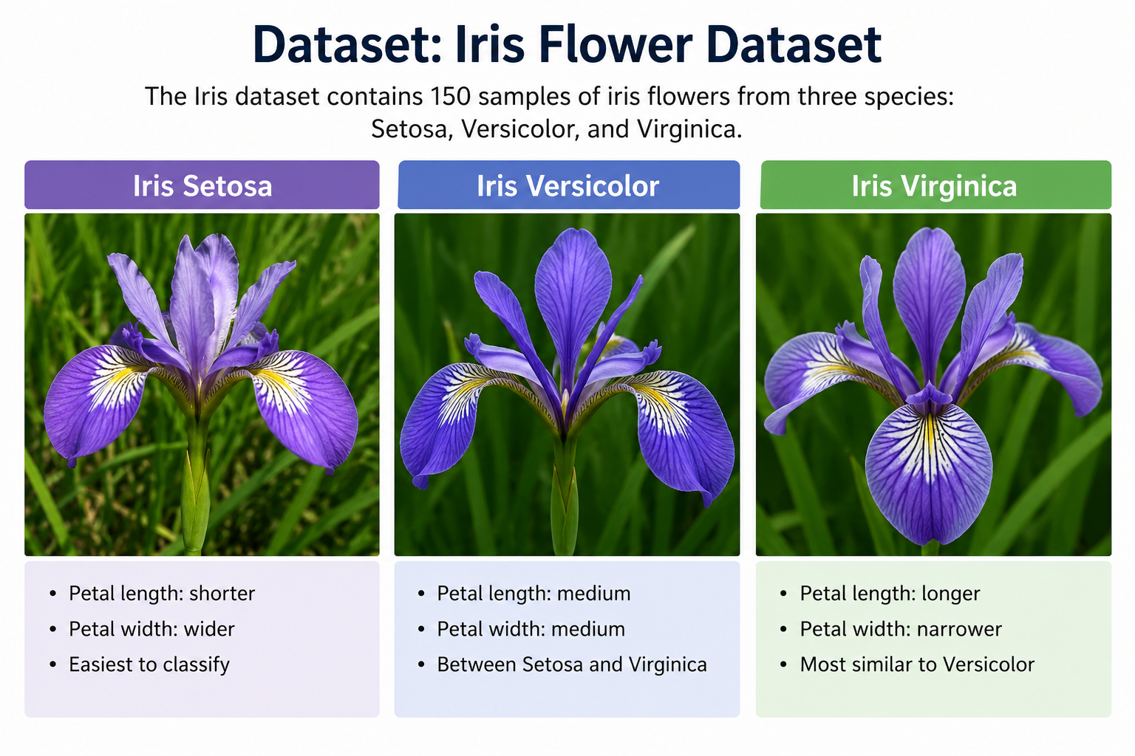
Dataset
• Total samples: 150
• Number of features: 4
• Number of classes: 3
Species:
- Setosa
Versicolor
- Virginica

Slide 4
Dataset
Features:
- Sepal Length
- Sepal Width
- Petal Length
- Petal Width

Slide 5
Machine Learning Models
• KNN
• Decision Tree
• Random Forest

Slide 6
Data Preprocessing
• Training set: 80%
• Testing set: 20%
• random_state = 42
• train_test_split()

Slide 7
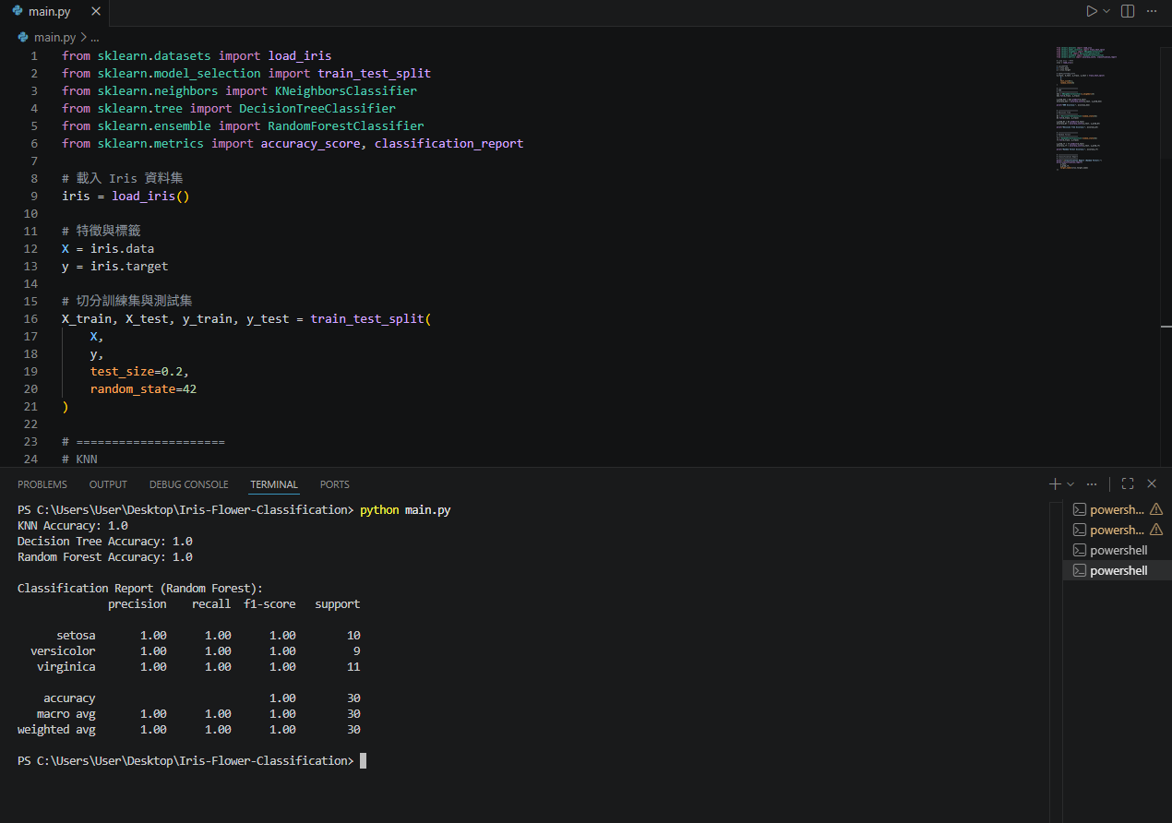
Data Preprocessing

Slide 8
Implementation
• Libraries: Scikit-Learn
• Functions:
• fit()
• predict()
• classification_report()
• accuracy_score()
• Insert main.py screenshot here

Slide 9
Results
• Accuracy:
• KNN:100%
• Decision Tree:100%
• Random Forest:100%
• Insert VS Code results screenshot here

Slide 10
Conclusion
• Successfully classified iris flowers.
• Compared three models.
• All models achieved 100% accuracy.
• Improved understanding of machine learning workflows.

