Slide 1
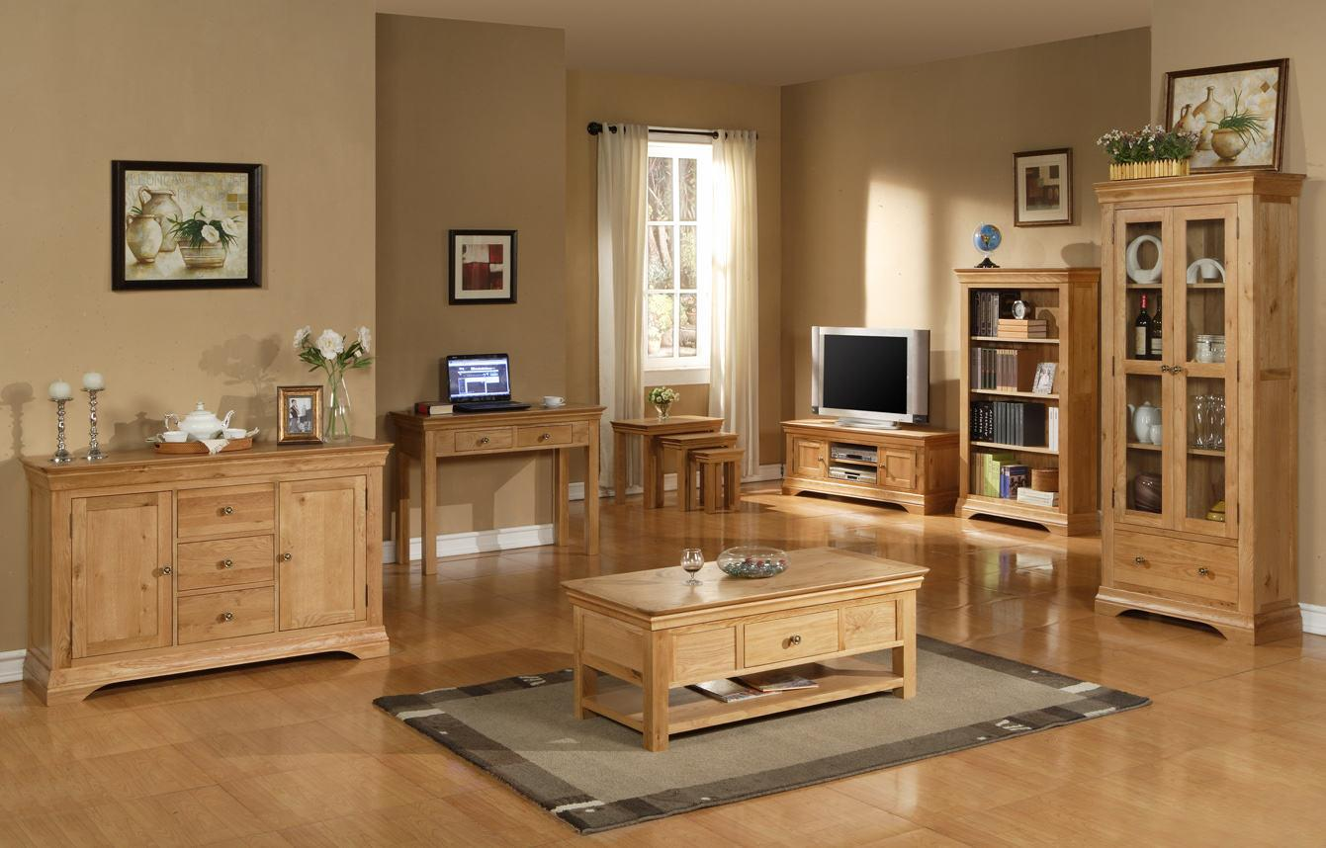
DAMG7275 Team3 Final Project
Wood Furniture Database
Xingyu Gao, Linxin Liu

Slide 2
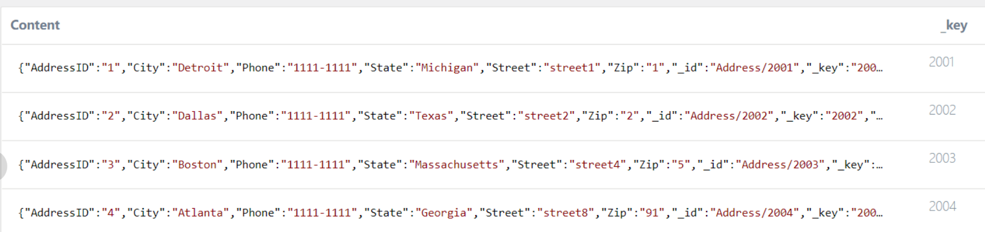

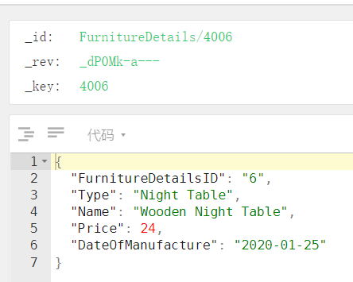
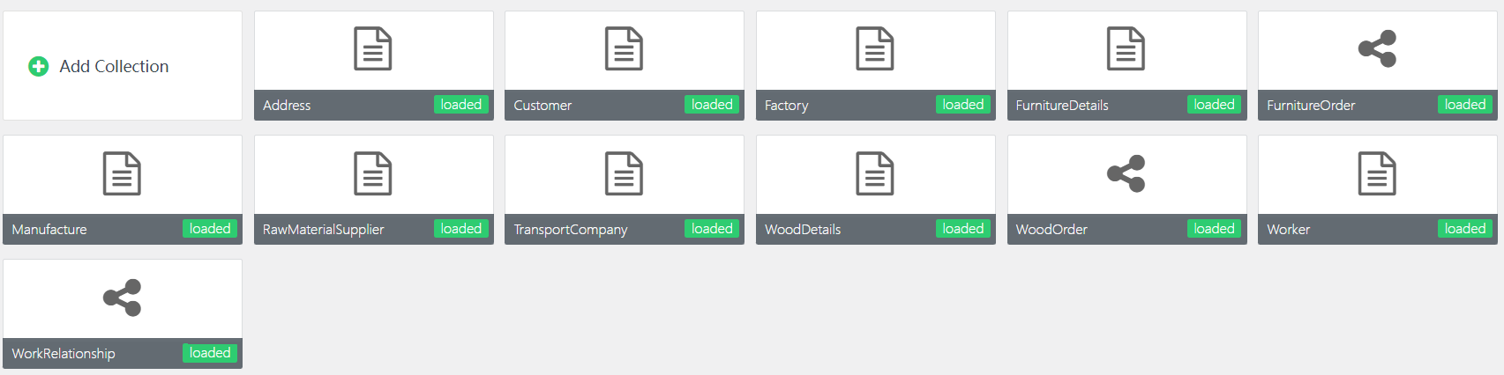

Slide 3
Part1: ERD
Relationship

Slide 4
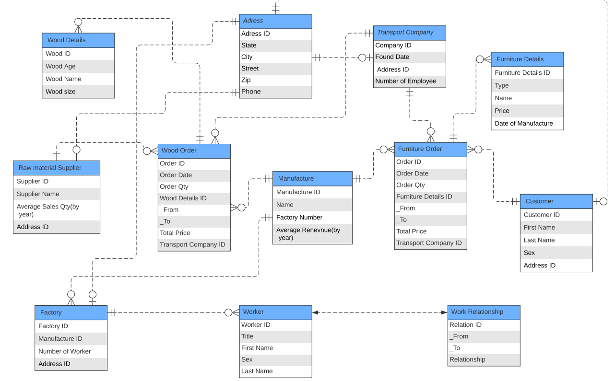
Porvider
Manufacture
Customer

Slide 5
Part2: Database Implementation
How we implement Auto Refresh
Some Graphs of DataBase

Slide 6
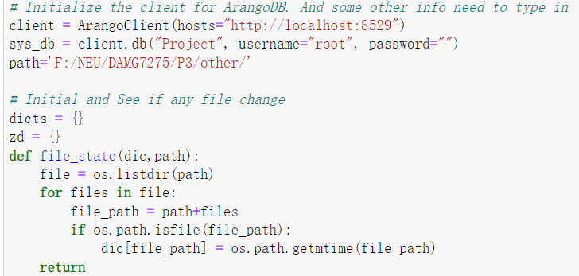
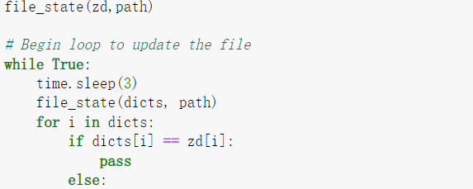
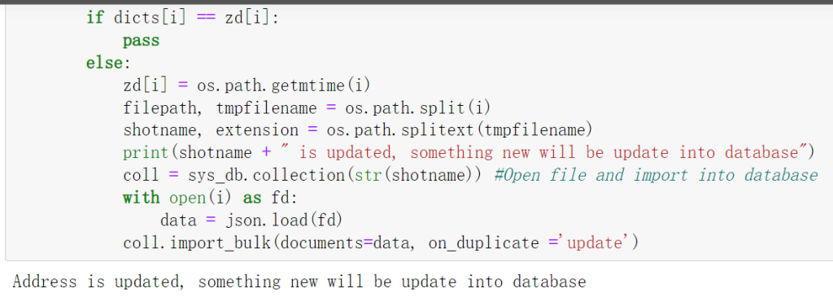
How we implement Auto Refresh

Slide 7
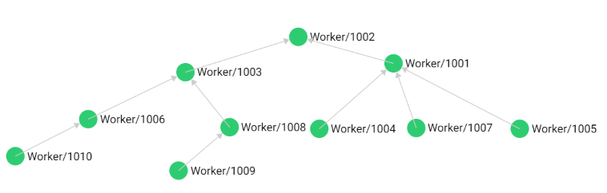
Some Data Graph in ArangoDB
workerID | Last Name | First Name | Sex | Title
1001 | Fong | Alex | M | Manager
1002 | Philips | Ben | M | Manager
1003 | Wei | Xu | M | Manager
1004 | Wang | Andy | M | Manager
1005 | Liu | Zach | M | Manager
1006 | Kors | Michael | M | Manager
1007 | Ford | Tom | M | Manager
1008 | Armani | Giorgio | M | Manager
1009 | Hermes | Louis | M | Manager
1010 | Fendi | Bran | M | Manager
Workers in Factory

Slide 8
Part3: Report
Visualize by using Tableau

Slide 9
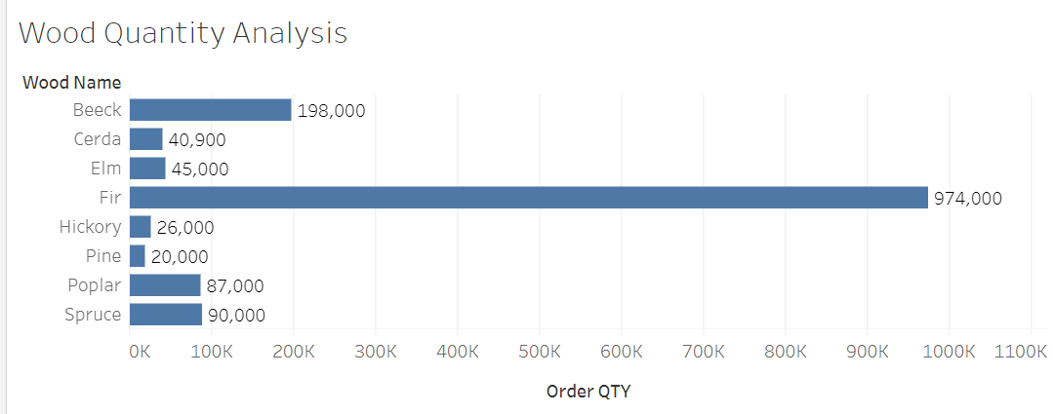
Wood Quantity Analysis
For r in WoodOrder
For e in WoodDetails
Filter r.WoodDetailsID==e._key
Let x=merge(r,e) sort r.OrderQty DESC Return { "Order QTY": x.OrderQty, "Wood Name": x.Name}
Order QTY | Wood Name
934000 | Fir
198000 | Beeck
90000 | Spruce
77000 | Poplar
45000 | Elm
40900 | Cerda
40000 | Fir
26000 | Hickory
20000 | Pine
10000 | Poplar

Slide 10
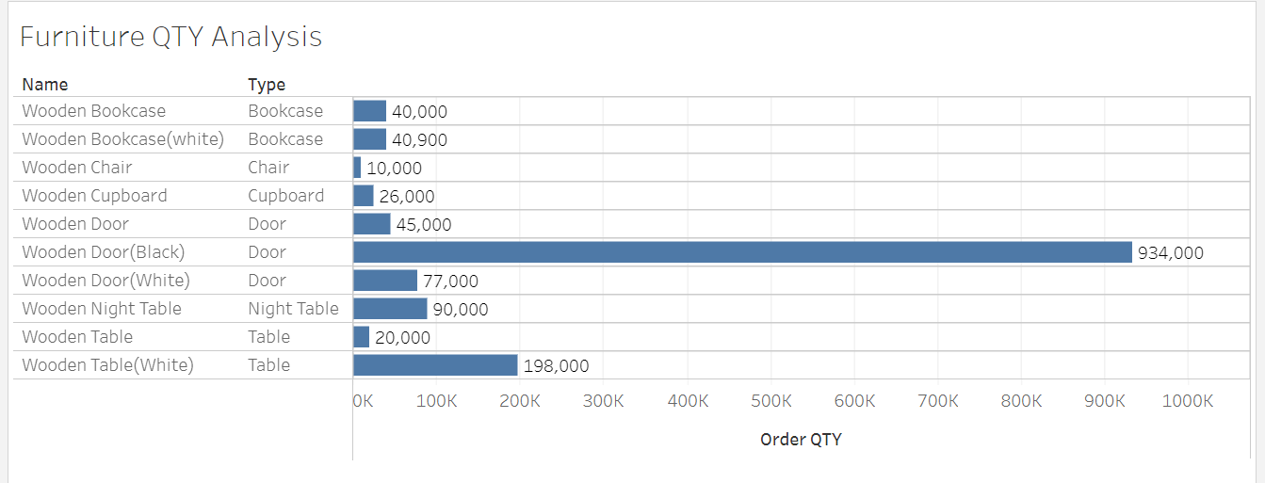
Furniture Qty Analysis
For a in FurnitureOrder
For b in FurnitureDetails
Filter a.FurnitureDetailsID==b.FurnitureDetailsID
Let x=merge(a,b) sort a.OrderQty DESC Return { "Type": x.Type, "Name": x.Name , "Order QTY": x.OrderQty}

Slide 11
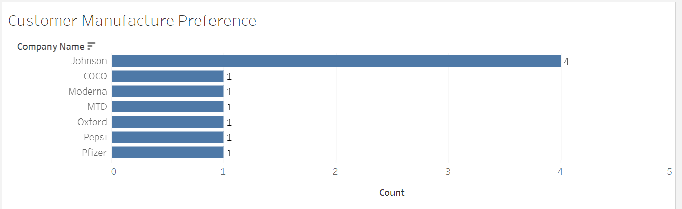
For a in FurnitureOrder
For b in FurnitureDetails
For c in Customer
For d in Manufacture
Filter a.FurnitureDetailsID==b.FurnitureDetailsID and a._from == c._id and a._to==d._id
Let x=merge(a,b, c, d)
collect nums = d.Name
aggregate counts = count(d.Name) into group
sort counts DESC
return {"Company Name": nums, "Count":counts}
Customer Prefrence
Customer FirstName | Customer LastName | Manufacture | Name | Order QTY
Adam | West | Johnson | Wooden Door(Black) | 934000
Eliot | Giles | Johnson | Wooden Table(White) | 198000
John | Barns | Oxford | Wooden Night Table | 90000
Jimmy | Fallon | MTD | Wooden Door(White) | 77000
Ken | North | Johnson | Wooden Door | 45000
Katherine | Hormes | Pepsi | Wooden Bookcase(white) | 40900
Anne | Berlin | Pfizer | Wooden Bookcase | 40000
Andrea | Trump | COCO | Wooden Cupboard | 26000
Fiona | Good | Moderna | Wooden Table | 20000
Anna | Kennedy | Johnson | Wooden Chair | 10000

Slide 12
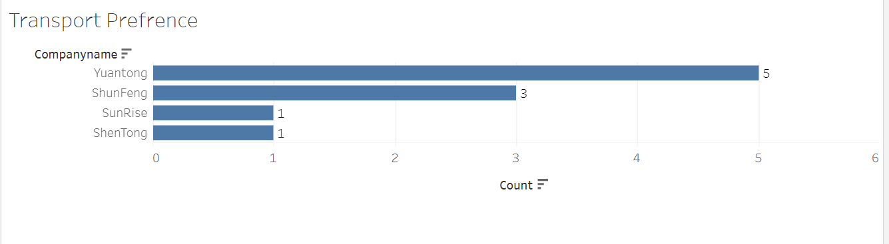
Transport Prefrerence
For a in FurnitureOrder
For b in TransportCompany
For c in Customer
Filter a.TransportCompanyID==b._key
and a._from == c._id
Let x=merge(a,b, c)
collect nums = b.CompanyName
aggregate counts = count(b.CompanyName)
into group
sort counts DESC
return {"Companyname":nums, "Count":counts}
Companyname | Count
Yuantong | 5
ShunFeng | 3
ShenTong | 1
SunRise | 1

Slide 13
Thank You

