Slide 1
You Are Who You Know and How You Behave: Attribute Inference Attacks via Users’ Social Friends and Behaviors
PaperSummary
HE Yi Xin
1155164941
LIN You Guang
1155169171

Slide 2
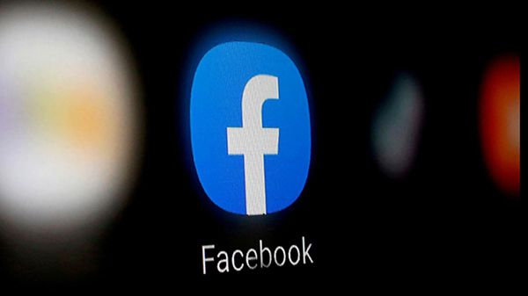
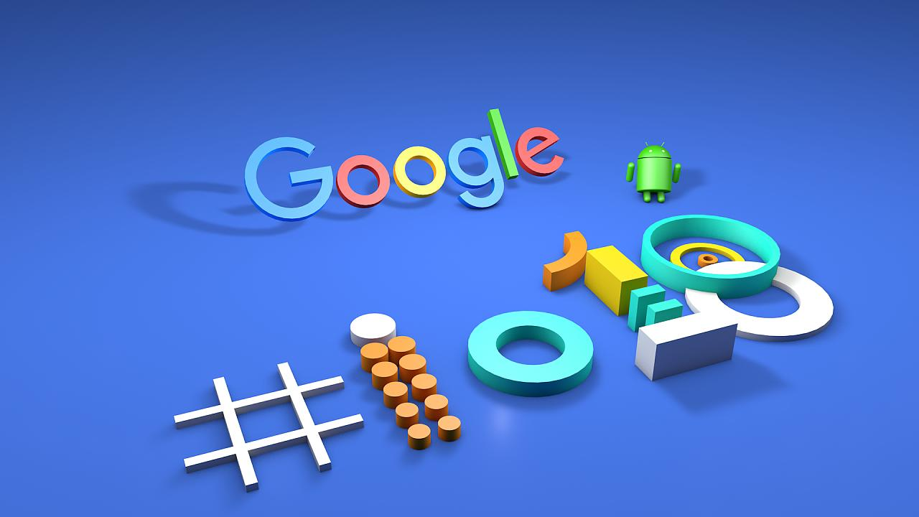
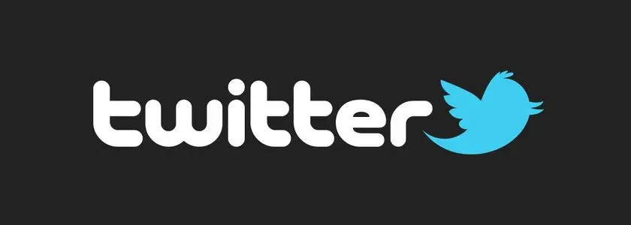
Introduction —— Popularity of online social network
Notes:
Online social network 已经成为我们生活中很重要的一部分。随着我们对他们的使用，我们的信息被它们悄无声息地记录着。
As we use them, they silently record our information.

Slide 3
Introduction —— Information type in SON ( Public VS Private )
Public information
Friends Lists
User behaviors
Like/share/review webpages and apps
Self-­‐reported attributes
Education, employment, location
Private information
Personal interests Sexual orientation Drug usage
Religious view
Notes:
我们可以将这些信息分成两类。公开信息包括x x xx xx 私有信息 xx xx 这篇文章主要讲了使用公开信息去推断目标用户的属性。

Slide 4
Introduction —— Attribute Inference Attacks
Given public information of some users
Infer private attributes of some target users
Notes:
There are two main uses of this attack. —— Complete incomplete information.
而这些信息可以被用于属性推断攻击。主要有两种，一种是利用公开信息进行仿真
1、Given public information of some users
将公开的缺漏信息或不完整的属性数据补充完整。In this attribute inference attack, an attacker aims to propagate attribute information of social network users with publicly visible attributes to users with missing or incomplete attribute data.
2、Infer private attributes of some target user

Slide 5
Introduction —— Existing Attribute Inference Attacks
Friend based: you are who you know
Behavior based: you are how you behave
Notes:
existing attacks can be categoried into two groups
The first category is friend based, that is know as you are who you know
1、Infer user's attributes through user's friend and the social structure.
And the second category is behavior based, which is
2、Based on the public attributes of users that are similar to him/her and the similarities between users are identified by using their behavioral data.

Slide 6
Introduction —— The big problem of the paper
Attacks leverage either the user’s friends or the user’s behavior achieve limited success rates.
So, Why not combine them together
Is it better than the single one?
Notes:
However， the existing attacks leverage either the user’s publicly available social friends or the user’s behavioral records achieve limited success rates. So，the write come up with a idea that combine this two attacks together.

Slide 7
Introduction —— Special problem to be addressed
How to design new attacks that integrate social friends and behavioral records?
How is the performance of this new method ?
Notes:
So the problem become qualitatively different if we consider both social friends and behavioral records
How to design new attacks that integrate social friends and behavioral records? because features derived from them differ from each other, show different sparsity, and are at different scales.
can be a challenge.

Slide 8
Introduction —— Previous work and problem
Previous Work
1. various attacks such as account compromise, malicious applications, and fake accounts
—— can not infer user attributes that users do not provide in their profiles
2. using users’ writing style or using a user’s tweets and her neighbors’ tweets
to infer attributes
—— didn’t consider social structures nor user behaviors.
3. via sentiment-oriented mining
—— orthogonal to the work that writer focus on
4. using social structure and behavior
—— have higher computational complexity and it is challenging for them to
have theoretical guarantees as our attack
Notes:
Except the friend based and behavior based attribute inference attack, there are also have other approaches to implement attribute attack. They all have different shortcomings, and the author's method can solve these weakness.

Slide 9
Their method
1、Social-behavior-attribute (SBA) network model——Integrate social structures, user behaviors, and their interactions
2、Vote distribution attack (VIAL) —— Based on the SBA network model，perform attribute inference.
Notes:
To address this challenge, they develop a novel model to integrate social friends and behavioral records and design new attacks based on their model. I will introduce it in detail in a later chapter.

Slide 10
Significance
A new attribute inference attack was introduced.
Attribute inference is a serious practical privacy attack to online social network users.
Private user attributes are statistically correlated with publicly available information.
Notes:
The author raises our awareness of attacks on attribute inference.

Slide 11
Road map
Threat model
Our attack algorithm
Evaluation
Conclusion
Notes:
So this is the roadmap of this talk, we will first show out the threat model and introduce our attack algorithm then we wil present the evaluation and draw a conclusion.

Slide 12
Problem Definition and Threat Model
Attackers
Cyber criminal
OSN provider
Advertiser
Data broker
Attack procedure
Attacker collects publicly available friends, user attributes, and behaviors
Use our algorithm to infer private attributes of target users
Notes:
The attacker could be any party who has interests in user attributes. The attacker could be a cyber criminal, online social network provider, advertiser, even the data broker. Explain one of them，online social network providers and advertisers could use the user attributes for targeted advertisements.
Suppose that the attacker want to infer users' private attributes, he first need to

Slide 13
Problem Definition and Threat Model
Implication/Application of attribute inference attacks
Privacy threat
Targeted advertisement
Targeted phishing attacks
Breaking “security question” based user authentication
Perform further attacks
Help profile users across social networks
Help combine online profile with offline data
Notes:
Well, all attacks have application/implication, such as xxxxx,

Slide 14
Attack Algorithm: High-Level Overview
Construct a Social-Behavior-Attribute (SBA) network to unify friends, attributes, and behavior information
For a target user, find the most “similar” attributes on the SBA network based on homophily
Homophily: users that have similar attributes share similar friends and behaviors
Unique assumption and trick
Assume the users and the service providers are not taking other steps (e.g., obfuscating social friends or behaviors) to defend against inference attacks.
The vote distribution attack (VIAL) algorithm is designed under the SBA network to perform attribute inference.
Notes:
Via combining social structures and user behaviors that are publicly available in online social networks. To this end, we first propose a social-behavior-attribute (SBA) network model to gracefully integrate social structures, user behaviors, and their interactions with user attributes. Based on the SBA network model, they design a vote distribution attack (VIAL) to perform attribute inference. And they demonstrate the effectiveness of our attack both theoretically and empirically.(in pi re kou ly)
The information filled in by the user is accurate.
Which means that , so the writer base on this idea to get the attribute to attack the user

Slide 15
Social-­‐‑Behavior-­‐‑Attribute (SBA) Network
Computer Science
Male
Biology
Google Inc.
u1
u2 u3
u4
u5
u6
Angry Birds
social node social link
WhatsApp Messager Facebook
behavior node behavior link
Pinterest
attribute node attribute link
Notes:
So here is more details of how can we construct these SBA network, supposely
介绍一下每个颜色的点代表啥，举个例子（红的是app或电影）
Each Social node is a Google+ dataset's user
Social Link is the connection of any two social nodes
When the user reviews an item (means that once used) in the Google play dataset, connect him and that item (Using similar items could indicate similar interests, user characteristics, and user attributes.)
If the user has an attribute value, connect him to that attribute value. (Attibute is major, employee, and cities lived, and Attribute value is the thing under these three things)
we have different link to capture the structure to all the information in the network
phase 2 gain from phase 1
So that is the basic idea how can we get the attribute to the target user

Slide 16
Vote Distribution Attack (VIAL) Algorithm
Phase I:
Iteratively distribute a fixed vote capacity from the targeted user v to the rest of users
Phase II:
Each user votes his/her own attributes using his/her vote capacity
The target user is predicted to have the attribute values that receive the highest votes
Notes:
Then based on the network, they propose the vial algorithm, the algorithm has two phase, the first is

Slide 17
Phase I —— Distributing Vote Capacity
A user receives a high vote capacity if the user and the targeted user are structurally similar
Distribution via three local rules
Dividing
Backtracking
Aggregating
Notes:
In order to make sure A user receives a high vote capacity if the user and the targeted user are structurally similar**
the via three local rules

Slide 18
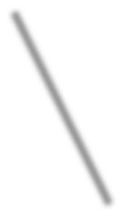

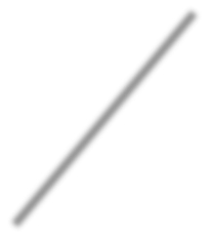

Local Rule I: Dividing
Attribute-sharing social neighbors
Social neighbors
Behavior-sharing social neighbors
Notes:
For the dividing rules, each user will divide its vote capacity to its neighbors, in particular, because all network is
there are three different neighbors
two users share the same attribute , same behavior ...

Slide 19


Local Rule II: Backtracking
Targeted user
Take a portion of a user’s vote capacity back to the targeted user
Notes:
If the user is more similarity to the target user, they would have more capacity, so this is the basic idea for the backtracking
A larger backtracking strength enforces more vote capacity to be distributed among the social nodes that are closer to t arget user in the SBA network

Slide 20


Local Rule III: Aggregating
Compute a new vote capacity for a user by aggregating the vote capacities from its neighbors
Notes:
So with three local rules, we can just iteratively to distribute this capacity until it is converge so in this way each users would have its own capacity

Slide 21

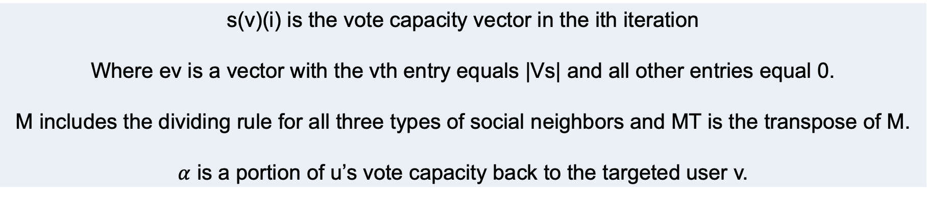
Matrix representation
s(v)(i) is the vote capacity vector in the ith iteration
Where ev is a vector with the vth entry equals |Vs| and all other entries equal 0.
M includes the dividing rule for all three types of social neighbors and MT is the transpose of M.
$α$ is a portion of u’s vote capacity back to the targeted user v.
Notes:
We derive the Phase I of our attack using matrix terminologies, which makes it easier to iteratively compute the vote capacities.
The three rules are combined into an iterative formula.

Slide 22
Phase II:
In the end of Phase I, each user has a certain vote capacity
Each user divides its vote capacity to its own attributes
Each attribute sums the received votes
Attributes with the highest votes are predicted to belong to the targeted user

Slide 23
Evaluation Data
One snapshot of Google+ from Gong et al. (IMC’12)
Friends
Publicly available attributes
Collect behaviors from Google Play
Liked/reviewed apps, movies, books, etc.
Linked by a 21-digit universal ID Google assigns for each user

Slide 24
Evaluation Data
Considered attributes
Major (62)
Employer(78)
Cities lived (70)
Construct a SBA network
#nodes |  |  | #links
social | behavior | attri. | social | behavior | attri.
1,111,905 | 48,706 | 210 | 5,328,308 | 3,635,231 | 269,997

Slide 25
Evaluation Setting
Randomly sample a set of users, 1050 in total
Remove their attributes as ground-truth
Treat them as targeted users
Predict top-K attributes for each targeted user
Measure Precision, Recall, and F-Score
Repeat experiments 10 times and average the evaluation metrics

Slide 26
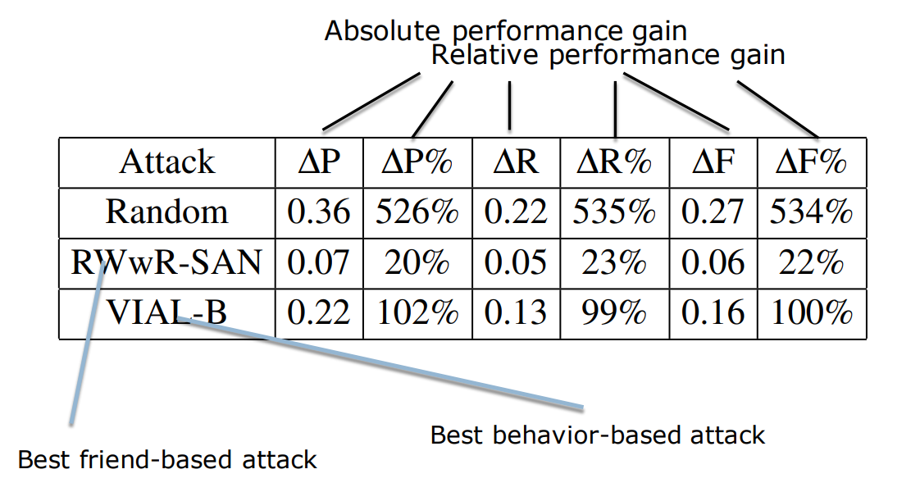
Comparing with (Best) Friend-based and Behavior-based Attacks
VIAL attacks are significantly more accurate than existing ones

Slide 27
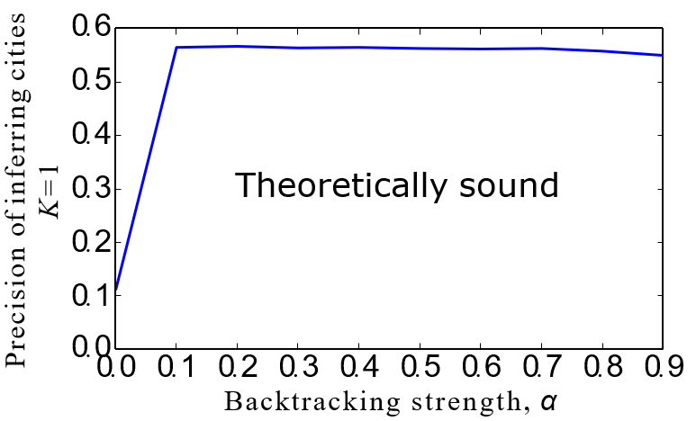
Backtracking is Important
Backtracking substantially improves attack success rates

Slide 28
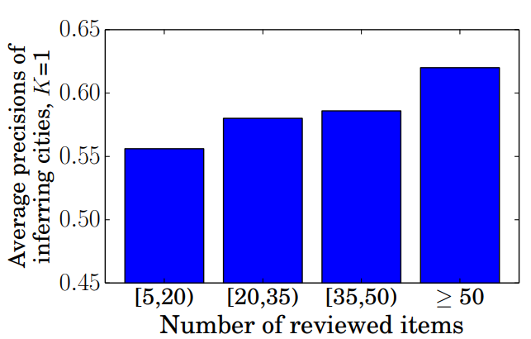
Sharing More Behaviors Makes You More Vulnerable
Attack success rates are higher when more behaviors are available

Slide 29
Confidence Estimation
Produce a confidence score for each targeted user to measure how confident we are about its inference
Choose to attack targeted users whose confidence scores are higher than a threshold
Trade-off between attack success rates and #attacked targeted users
Higher threshold -> higher success rates & less attacked users

Slide 30
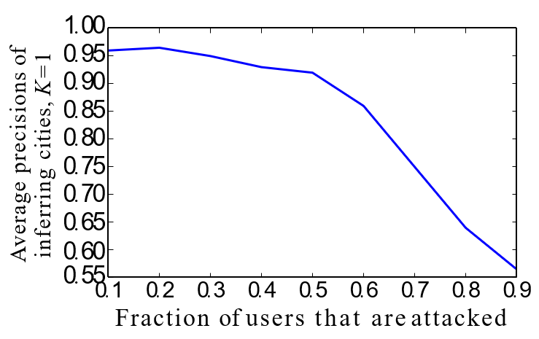
Trade-off Result
Success rates can be significantly improved when selectively attacking half of targeted users

Slide 31
Key Contributions
Proposed a novel method to perform attribute inference attacks considering both social friends and user behaviors, which is more effective than previous methods.
Proposed a SBA network model to integrate social structures, user behaviors and user attributes.
Designed the VIAL algorithm under SBA model to perform attribute inference.
Demonstrated the effectiveness of VIAL both theoretically and empirically. Convergence of the algorithm is proved and the importance of backtracking is demonstrated.
Demonstrated other factors that affect the algorithm’s performance such as number of target users’ reviewed items and utilization of confidence estimation.

Slide 32
Weaknesses and future work
For the algorithm
The effectiveness of the algorithm is based on the assumption that users’ online public information truly reflects who they are and how they behave, which is often not the case in real-life scenario.
The authors mentioned that weights in the matrix M could be learned using machine learning approaches to further improve the attack performance. However, weight training could be time-costing and not scalable to a huge online social network.
For evaluation
The authors only integrated top-K common attribute values shared by users into the SBA network. However, they also observed that most attribute values are owned by a small number of users. Their experiments inevitably miss the uncommon attributes of target users.

Slide 33
Weaknesses and future work
For evaluation
The authors observed that LG-B-I and LG-B-II achieve very close performances, which indicates that the rating scores carry little information about user attributes. This is not convincing enough in that rating scores may only have little effect on performances in the logistics regression model.

