Slide 1
K-Means VS Online K-Means
Which One is better?
PaperSummary
Xie Weihao
1155162650
LIN You Guang
1155169171

Slide 2
Introduction —— K-Means
A algorithm to cluster data.
Step 1: define K values first.
Step2: for each data we give a cluster identifier from 1 to k.
Step3: Calculate new cluster center and update it many times.

Slide 3
Introduction —— Online K-Means
Step1: assign cluster identifier to data immediately until give k cluster identifiers.
Step2: find the min distance between two vectors and use the data to calculate the f which will decide how many clusters in the end of the process.
Step3: after 3k(1 + log(n)) times, double f and try to cluster more accuracy.
Notes:
There are two main uses of this attack. —— Complete incomplete information.
而这些信息可以被用于属性推断攻击。主要有两种，一种是利用公开信息进行仿真
1、Given public information of some users
将公开的缺漏信息或不完整的属性数据补充完整。In this attribute inference attack, an attacker aims to propagate attribute information of social network users with publicly visible attributes to users with missing or incomplete attribute data.
2、Infer private attributes of some target user

Slide 4
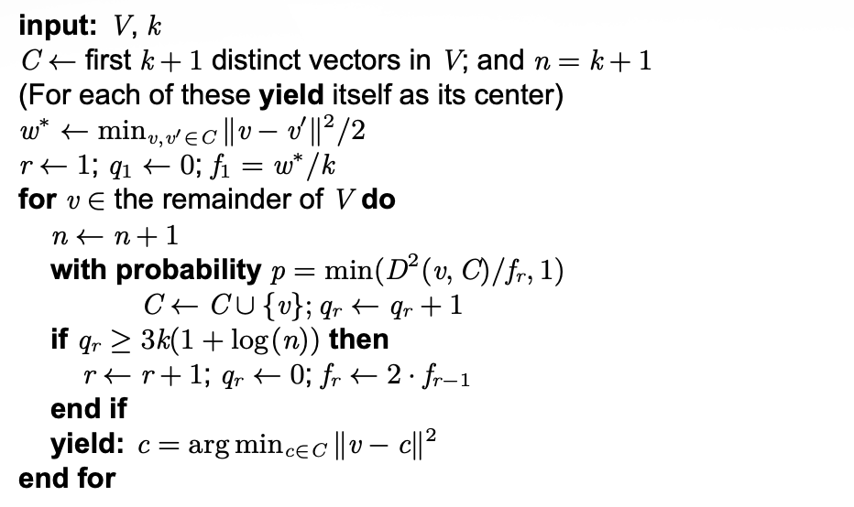
Introduction —— Online K-Means
Notes:
existing attacks can be categoried into two groups
The first category is friend based, that is know as you are who you know
1、Infer user's attributes through user's friend and the social structure.
And the second category is behavior based, which is
2、Based on the public attributes of users that are similar to him/her and the similarities between users are identified by using their behavioral data.

Slide 5
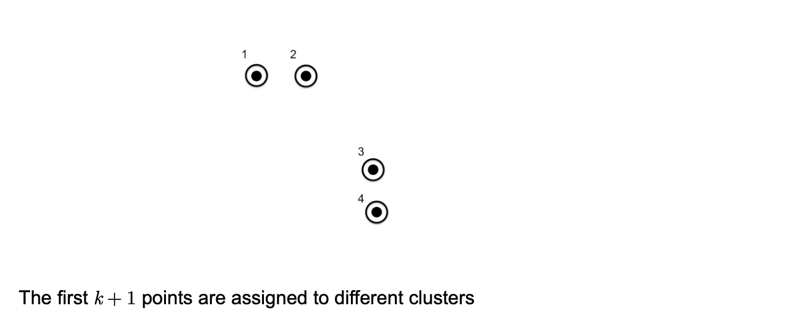
Example to understand Online K-Means
Notes:
However， the existing attacks leverage either the user’s publicly available social friends or the user’s behavioral records achieve limited success rates. So，the write come up with a idea that combine this two attacks together.

Slide 6
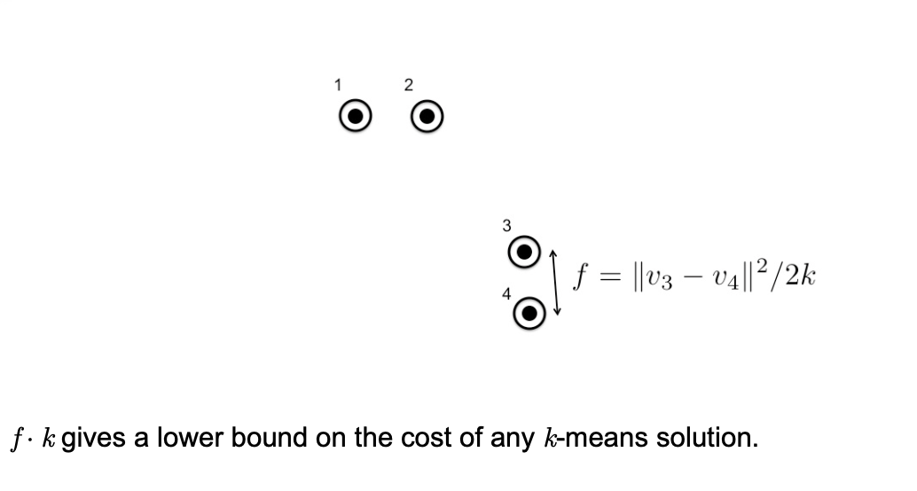
Example to understand Online K-Means
Notes:
However， the existing attacks leverage either the user’s publicly available social friends or the user’s behavioral records achieve limited success rates. So，the write come up with a idea that combine this two attacks together.

Slide 7
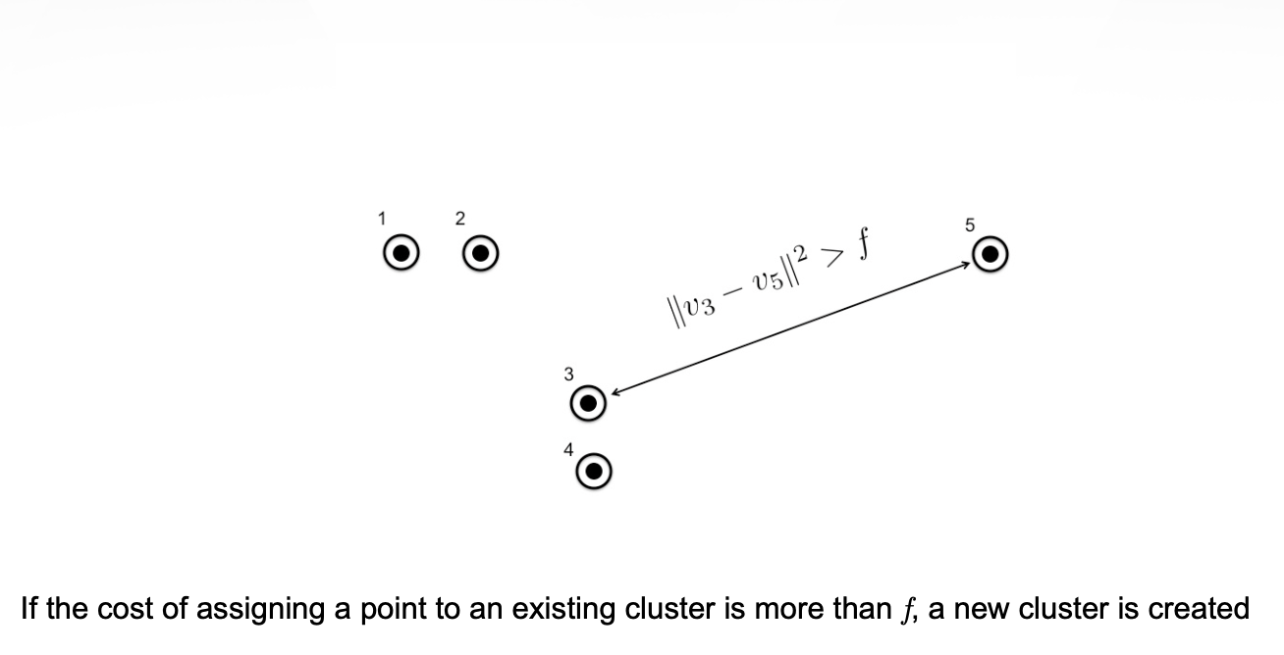
Example to understand Online K-Means
Notes:
However， the existing attacks leverage either the user’s publicly available social friends or the user’s behavioral records achieve limited success rates. So，the write come up with a idea that combine this two attacks together.

Slide 8
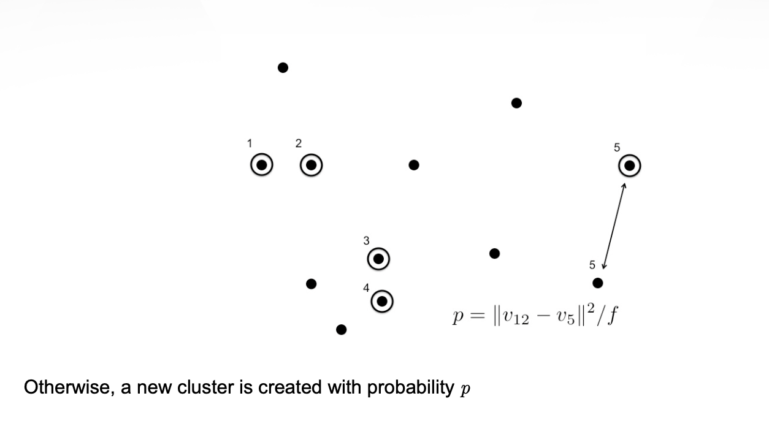
Example to understand Online K-Means
Notes:
However， the existing attacks leverage either the user’s publicly available social friends or the user’s behavioral records achieve limited success rates. So，the write come up with a idea that combine this two attacks together.

Slide 9
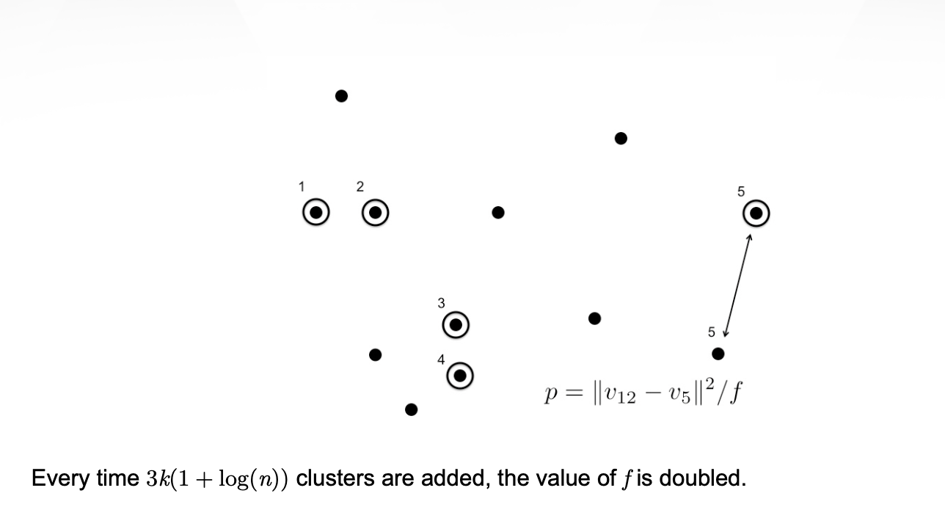
Example to understand Online K-Means
Notes:
However， the existing attacks leverage either the user’s publicly available social friends or the user’s behavioral records achieve limited success rates. So，the write come up with a idea that combine this two attacks together.

Slide 10
Difference of Online K-Means
To be competitive with k-means, online k-means must use more than k clusters.
The algorithm does not create too many clusters.
The cost of the clustering is not much worse than optimal
Notes:
So the problem become qualitatively different if we consider both social friends and behavioral records
How to design new attacks that integrate social friends and behavioral records? because features derived from them differ from each other, show different sparsity, and are at different scales.
can be a challenge.

Slide 11
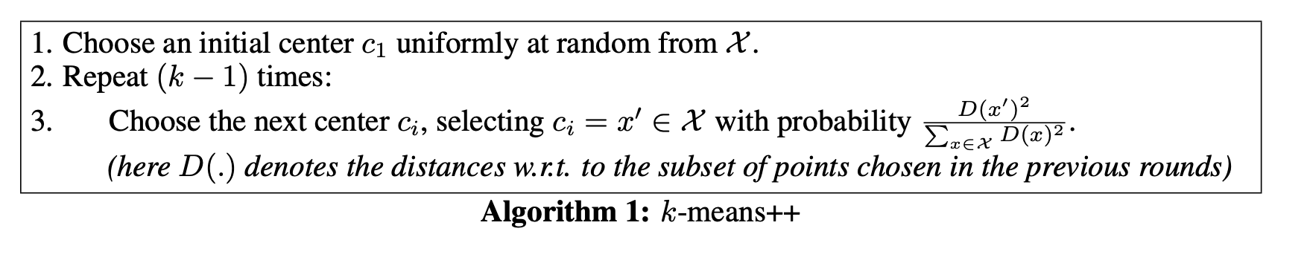
Introduction —— K-Means#
The advantages of careful and liberal seeding
Notes:
Except the friend based and behavior based attribute inference attack, there are also have other approaches to implement attribute attack. They all have different shortcomings, and the author's method can solve these weakness.

Slide 12
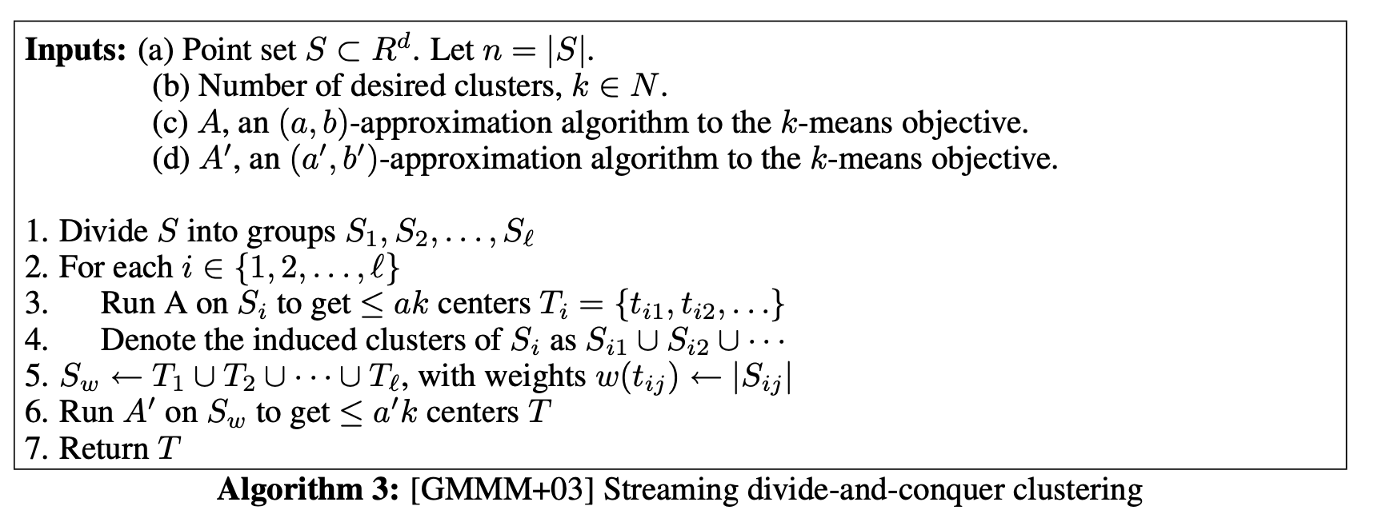
Introduction —— GMMM+03
combine multiple bi-criterion approximation algorithms
Notes:
Except the friend based and behavior based attribute inference attack, there are also have other approaches to implement attribute attack. They all have different shortcomings, and the author's method can solve these weakness.

Slide 13
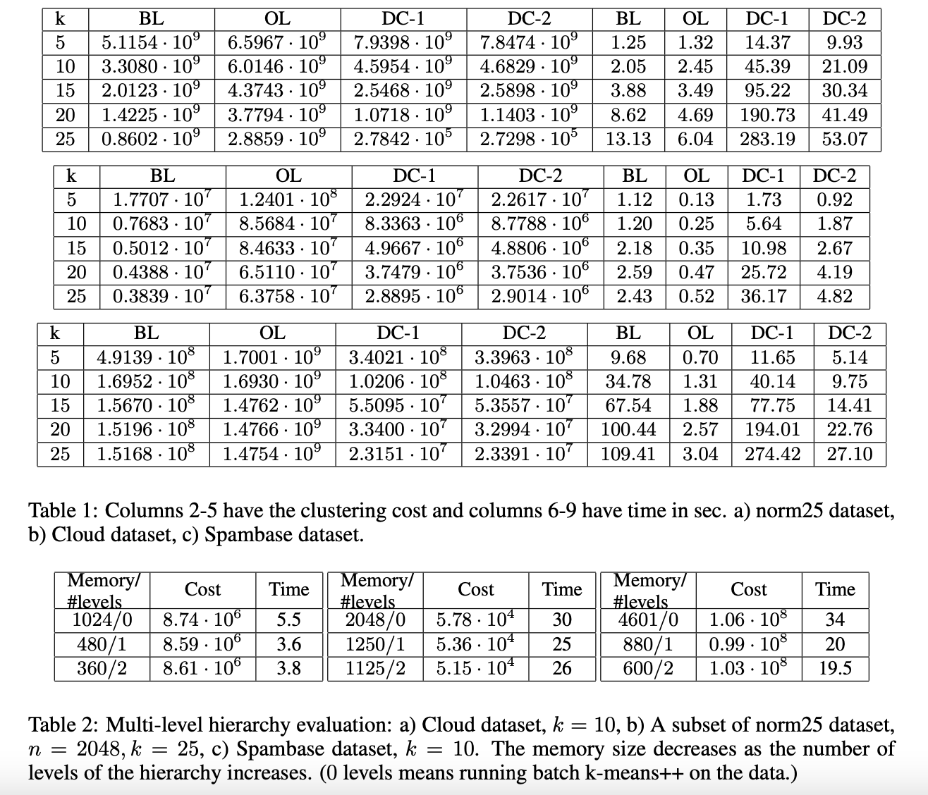
Experiment
Notes:
To address this challenge, they develop a novel model to integrate social friends and behavioral records and design new attacks based on their model. I will introduce it in detail in a later chapter.

Slide 14
An Algorithm for Online K-Means Clustering
PaperSummary
LIN You Guang
1155169171

Slide 15
Introduction
The big problem of this paper

Slide 16
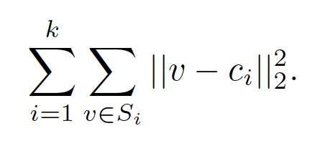
Introduction
Typical model —— K-means
Offline setting
Streaming model
Notes:
One of the most basic and well-studied optimization models in unsupervised Machine Learning is k-means clustering.
In this problem we are given the set V of n points (or vectors) in Euclidian space. The goal is to partition V into k sets called clusters S1; : : : ; Sk and choose one cluster center ci for each cluster Si to minimize. In the standard offline setting, the set of input points is
known in advance and the data access model is unrestricted. Even so, obtaining provably good solutions to this problem is difficult.
In the streaming model the algorithm must consume the data in one pass and is allowed to keep only a small amount of information. Nevertheless, it must output its final decisions when the stream has ended. In contrast, the online model of computation does not allow to postpone clustering decisions In this setting, an a priori unknown number of points arrive one by one in an arbitrary order. When a new point arrives the algorithm must either put it in one of the existingNote that this problem is conceptually non trivial even if one could afford unbounded computational power at every iteration. This is because the quality of current choices depend on the unknown (yet unseen) remainder of the stream.clusters or open a new cluster (consisting of a single point).

Slide 17
Introduction
In this paper, we consider the very restricted setting in the intersection of these two models. We require the algorithm outputs a single cluster identifier for each point online while using space and time at most poly-logarithmic in the length of the stream. This setting is harder than the streaming model.

Slide 18
Introduction
The specific problem to be addressed by this paper
How to build a streaming k-means algorithm
Notes:
In the streaming model the algorithm must consume the data in one pass and is allowed to keep only a small amount of information. Nevertheless, it must output its final decisions when the stream has ended. In this setting, an a priori unknown number of points arrive one by one in
an arbitrary order. When a new point arrives the algorithm must either put it in one of the existingNote that this problem is conceptually non trivial even if one could afford unbounded computational power at every iteration. This is because the quality of current choices depend on the unknown (yet unseen) remainder of the stream.clusters or open a new cluster (consisting of a single point).

Slide 19
Motivation
The results of k-means were shown to provide powerful unsupervised features on par —— feature learning.
The importance of such an online k-means model was already recognized in machine learning community

Slide 20
Prior Art
Offline setting where the set of all points is known in Advance.
Streaming model —— reduces the number of passes needed over the data and enables improved parallelization

Slide 21
Introduction
Has that specific problem been studied before? What is the unique assumption/insight/observation/trick/… that had led to the solution proposed in this paper?

Slide 22
Introduction
Interestingly, their algorithm is often referred to as “the doubling algorithm” since the cluster diameters double as the algorithm receives more points. In our work the facility location cost is doubled which is technically different but intuitively related.

Slide 23
Introduction
Online K-means ( No prior knowledge )
Semi-online K-means ( Having a lower bound )
Notes:
In this work we provide algorithms for both online k-means and semi-online k-means. In the semi-online model we assume having a lower bound, w, for the total optimal cost of k-means, W, as well as an estimate for n, the length of the stream.
In the fully online model we do not assume any prior knowledge

Slide 24
Algorithm
Algorithm

Slide 25
Algorithm
1. Semi-Online k-means Algorithm

Slide 26
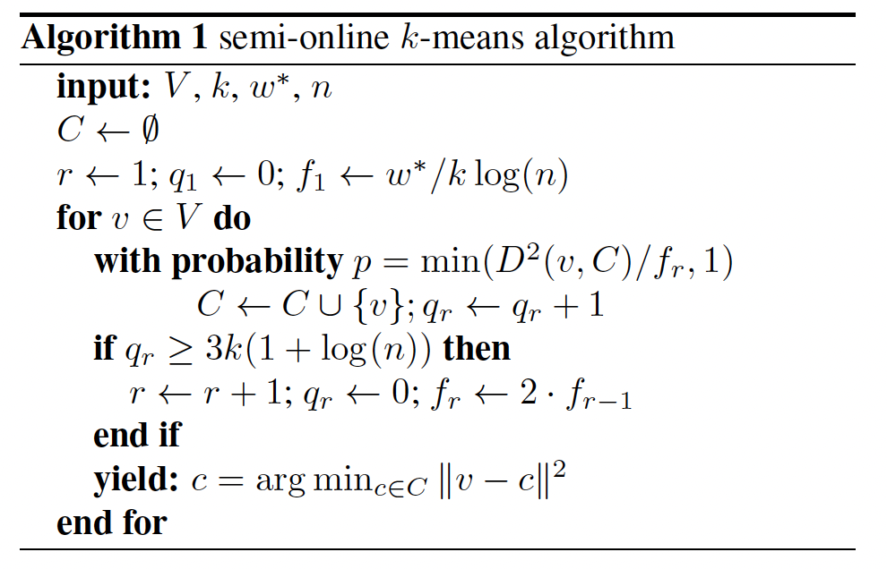
Algorithm
Notes:
For the facility cost, start with f1 which is known to be too low. By doing that the algorithm is “encouraged” to open many facilities (centers) which keeps the service costs low. If the algorithm detect that too many facilities were opened, it can conclude that the current facility cost is too low. It therefore doubles the facility cost of opening future facilities (centers). It is easy to see that the facility cost cannot be doubled many times without making opening new clusters prohibitively expensive.

Slide 27
Algorithm
2. Fully Online k-means Algorithm

Slide 28
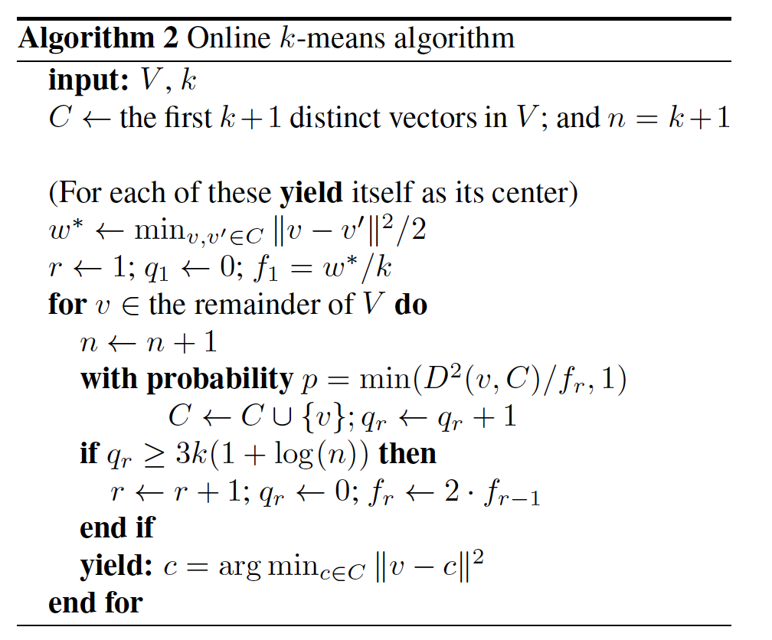
Algorithm
Notes:
Algorithm 2 is fully online yet it defers from Algorithm 1 in only a few aspects. First, since n is unknown, the initial facility cost and the doubling condition cannot depend on it. Second, it must generate its own lower bound w based on a short prefix of points in the stream. Note that w is trivially smaller that W. Any clustering of k + 1 points must put at least two points in one cluster, incurring a cost of kv 􀀀 v0k2=2 minv;v0 kv 􀀀 v0k2=2.

Slide 29
Algorithm
3. modifications to the algorithm

Slide 30
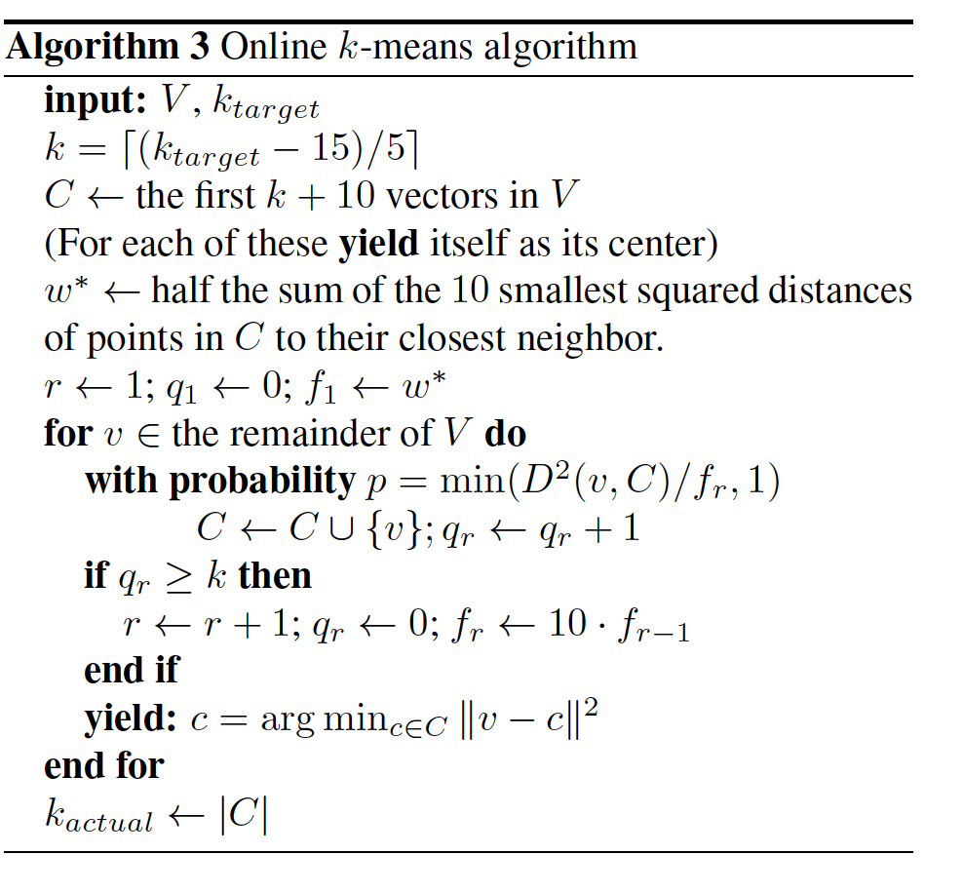
Algorithm
Notes:
While experimenting with the algorithm, we discovered that some log factors were, in fact, too pessimistic in practice. We also had to make some pragmatic decisions about, for example, how to set the initial facility cost. As another practical adjustment we introduce the notion of ktarget and kactual. The value of ktarget is the number of clusters we would like the algorithm to output while kactual is the actual number of clusters generated. Internally, the algorithm operates with a value of k = d(ktarget 􀀀 15)=5e. This is a heuristic (entirely adhoc) conversion that compensates for the k-actual being larger than k by design.

Slide 31
Experimental
How had the authors evaluated their solutions? Is the evaluation part convincing? Is there anything missed in the evaluation part?

Slide 32
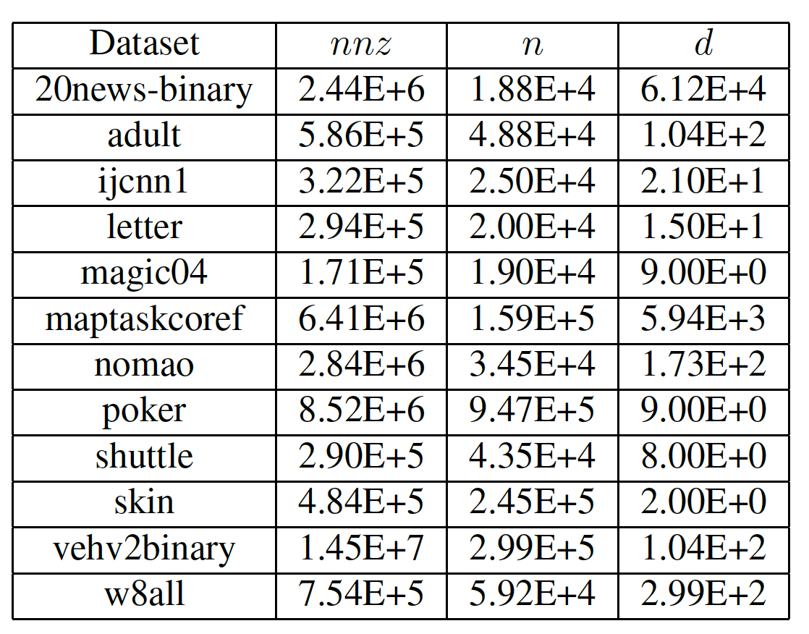
Experimental —— Datasets on 12 different datasets 1
Notes:
To evaluate our algorithm we executed it on 12 different datasets. All the datasets that we used are conveniently aggregated on the LibSvm website [14] and on the UCI dataset collection [7]. Some basic information about each dataset is given in Table 1.
Feature engineering for the sake of online learning is one of the motivations for this work. For that reason, we apply standard stochastic gradient descent linear learning with the squared loss on these data. Once with the raw features and once with the k-means features added. In some cases we see a small decrease in accuracy due to slower convergence of the learning on a larger feature set. This effect should theoretically be nullified in the presence of more data. In other cases, however, we see a significant uptick in classification accuracy.

Slide 33
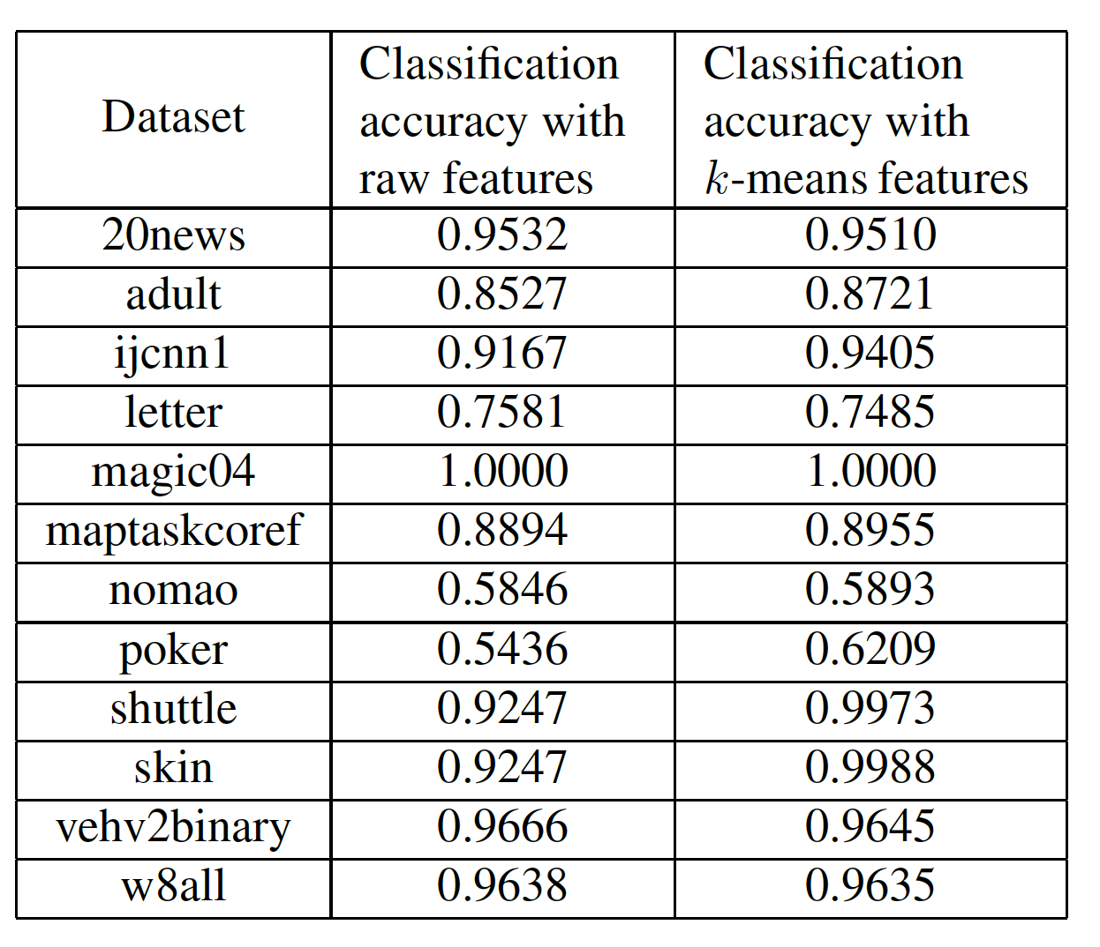
Experimental —— Datasets on 12 different datasets 2
Notes:
Feature engineering for the sake of online learning is one of the motivations for this work. For that reason, we apply standard stochastic gradient descent linear learning with the squared loss on these data. Once with the raw features and once with the k-means features added. In some cases we see a small decrease in accuracy due to slower convergence of the learning on a larger feature set. This effect should theoretically be nullified in the presence of more data. In other cases, however, we see a significant uptick in classification accuracy.
Corroborating the observations of [11] we report that adding k-means feature, particularly to low dimensional datasets, is very beneficial for improving classification accuracy. Indeed enabling online machine leaning to take advantage of this phenomenon is one of the motivations for performing k-means online.

Slide 34
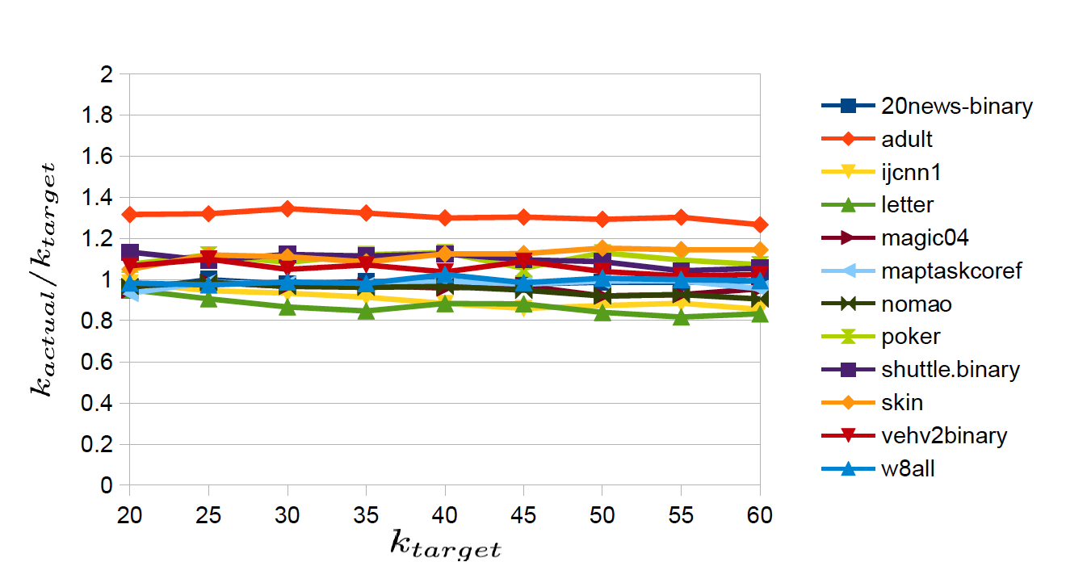
Experimental —— Number of cluster | actual vs target
Notes:
One of the artifacts of applying our online k-means algorithm is that the number of clusters is not exactly known a priory. But as we see in Figure 1, the number of resulting clusters is rather predictable and controllable. Figure 1 gives the ratio between the number of clusters output by the algorithm, kactual, and the specified target ktarget. The results reported are mean values of 3 runs for every parameter setting. The observed standard deviation of kactual is typically in the range [0; 3] and never exceeded 0:1 ktarget in any experiment. Figure 1 clearly shows that the ratio kactual=ktarget is roughly constant and close 1:0. Interestingly, the main differentiator is the choice of dataset.

Slide 35
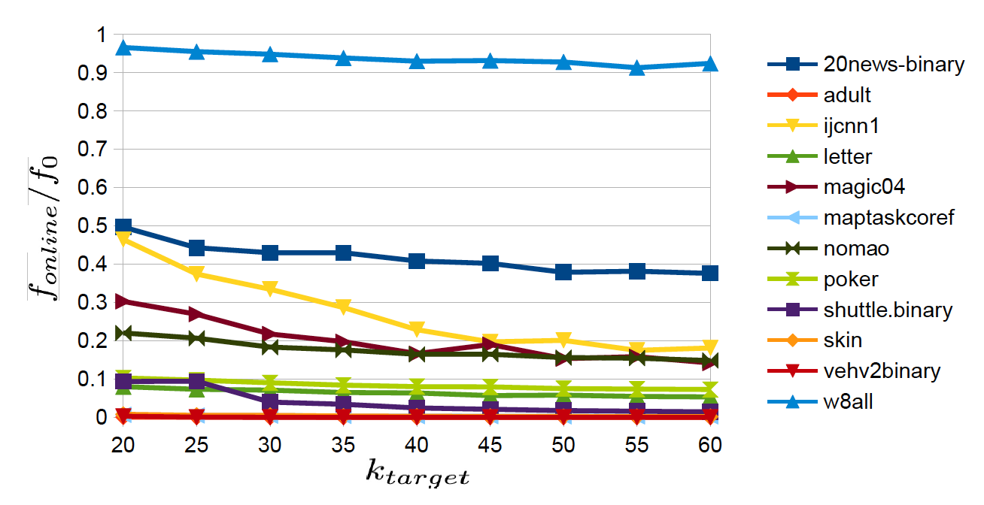
Experimental —— Online k-means clustering cost (f-online) as a function of k-target for the different datasets.
Notes:
Throughout this section, we measure the online k-means clustering cost with respect to different baselines. We report averages of at least 3 different independent execu-tions for every parameter setting. In Figure 2 the reader can see the online k-means clustering cost for the set of centers chosen online by our algorithm for different values of ktarget and different datasets. For normalization, each cost is divided by f0, the sum of squares of all vector norms in the dataset (akin to the theoretical k-means cost of having one center at the origin). Note that some datasets are inherently unclusterable. Even using many cluster centers, the k-means objective does not decrease substantially. Nevertheless, as expected, the k-means cost obtained by the online algorithm, fonline, decreases as a function of ktarget.

Slide 36
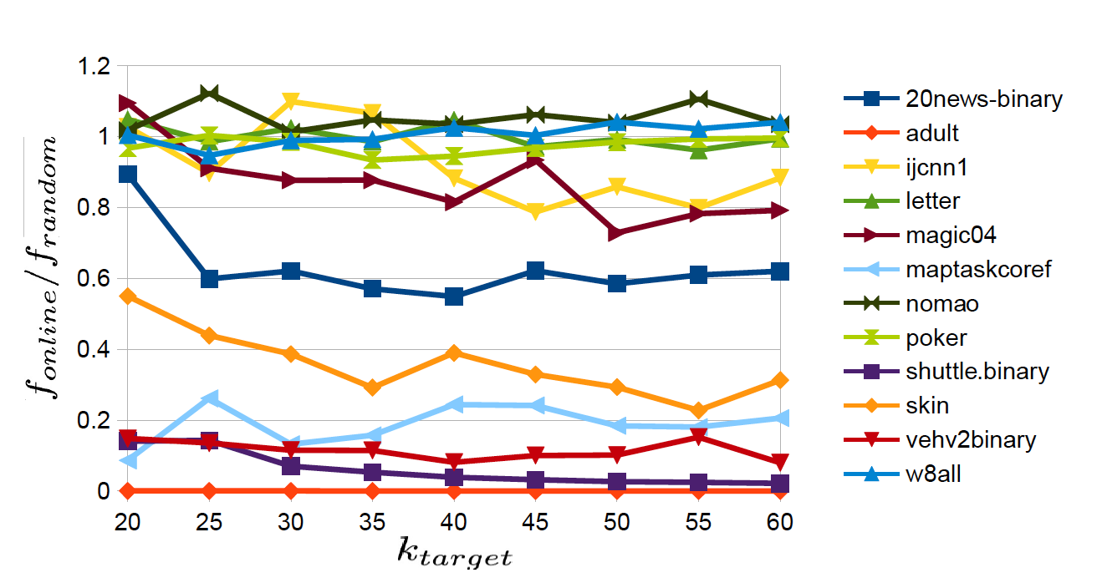
Experimental —— Online k-means clustering cost (f-online) as a function of k-target for the different datasets.
Notes:
The next experiment compares online k-means to k-means++. For every value of ktarget we ran online k-means to obtain both fonline and kactual. Then, we invoke k-means++ using kactual clusters and computed its cost, fkmpp. This experiment was repeated 3 times for each dataset and each value of ktarget. The mean results are reported in Figure 4.

Slide 37
Weakness
The author only gives the ratio, but not the specific data of the experiment. So the result is not enough convinced.
The model is not universal, but it is data sensitive.

Slide 38
Summarize
K-means++
k-means++ is an offline algorithm —— k passes over the data
k-means++ is usually better in terms of cost.
Streaming K-means
Online computational model
K-means #
our streaming methods achieve much lower cost than Online Lloyd’s, for all settings of k, and lower cost than Batch Lloyd’s for most settings of k
K-Means# is almost the same as the k-means++ algorithm except that in each round of choosing centers. The running time of the above algorithm is clearly O(ndk log k).
Notes:
Unsurprisingly, k-means++ is usually better in terms of cost. But, the reader should keep in mind that k-means++ is an offline algorithm that requires k passes over the data compared with the online computational model of our algorithm.

