Slide 1
Exploring Government Funding to Businesses
Presented to TBS by Team 2325:
Quanhan Xi, Qianxiang Zang, Saran Vadlamudi, Linyi Guo

Slide 2
Mapping G&C Data Geographically
~ 358k rows in original dataset “Proactive Disclosure”.
~ 116k rows in our cleaned dataset.
Each row corresponds to a specific grant or contribution dating back to 2006.
Our cleaned set: 2013-2019, and removing missing-data samples.
Value
Geographic Information (province, postal code, etc.)
Type and title of recipient (Not-for-profit, Aboriginal, etc.)
Program start/end date
Department
Etc...
Interactive application developed via RShiny.

Slide 3
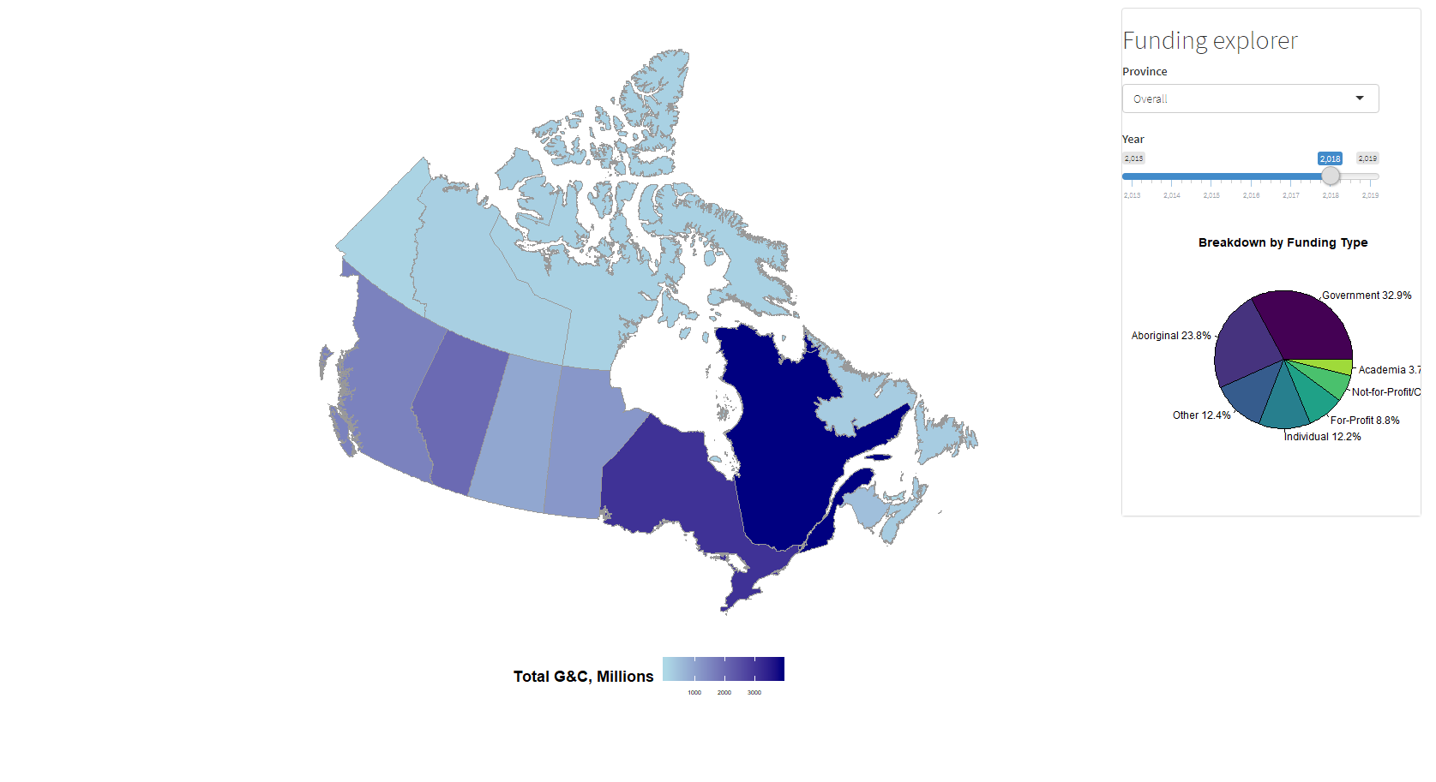
Filter by Province
Filter by Year
Gradient darkness scaled by relative total G&C amount
Breakdown by recipient type

Slide 4
Area Breakdown via Forward Sortation Areas
Forward Sortation Areas (FSA): First 3 characters of postal code.
Postal District: First letter of postal code.
Generally subdivided into equal population size.
E.g., Toronto, Montreal, and the entirety of SK, AB, BC all have one postal district.
We construct socio-economically similar regions in Canada by grouping 2-4 postal districts.
SE Ontario
E Quebec & Maritimes
NW Quebec, Labrador, & Islands
BC & Alberta
W Ontario & Praries
Territories

Slide 5
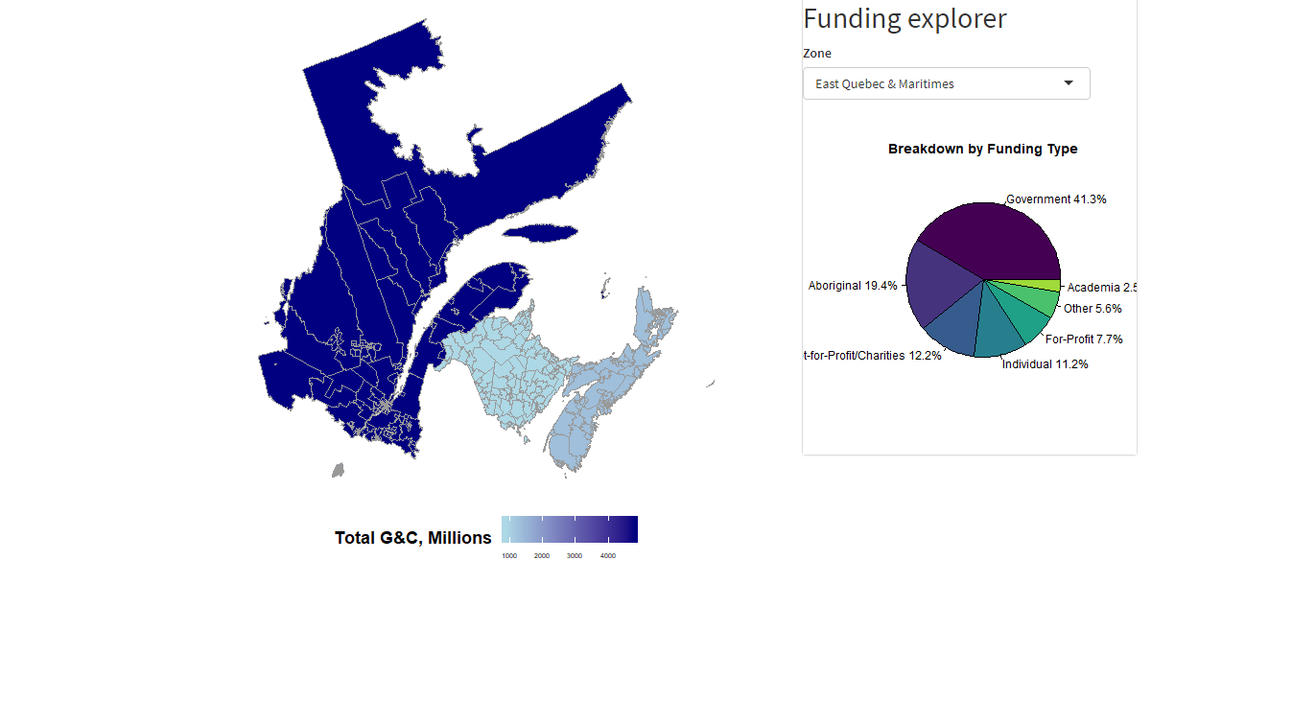
Filter by Region
Gradient darkness scaled by relative total G&C amount
Breakdown by recipient type
Above: E Quebec & Maritimes has 4 Districts: E Quebec, Montreal, NB, and NS.

Slide 6
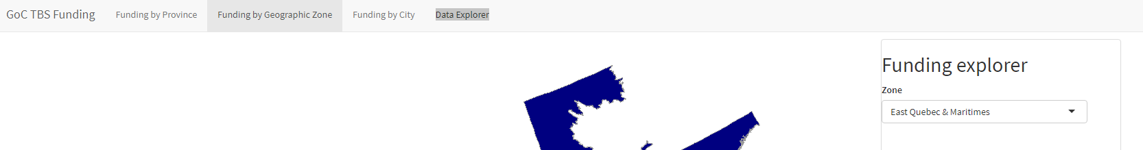
Other Features
Ablility to switch between tabs:
Data Explorer: Interactive database consisting of our cleaned data
Can filter by province, min amount, max amount.

