Slide 1

Time Series Analysis and Seasonal Adjustment
Steve Matthews, steve.matthews@canada.ca
Chief, Time Series Research and Analysis Centre / Chef, Centre de Ressource pour la recherche et l’analyse en series chronologiques
Statistics Canada / Statistique Canada

Slide 2
Statistics Canada – Mandate and Objectives
Mandate
Under the Statistics Act, Statistics Canada is required to collect, compile, analyse, abstract and publish statistical information relating to the commercial, industrial, financial, social, economic and general activities and condition of the people of Canada.
Statistics Canada has two main objectives:
To provide statistical information and analysis about Canada’s economic and social structure to:
develop and evaluate public policies and programs
improve public and private decision-making for the benefit of all Canadians.
To promote sound statistical standards and practices by:
using common concepts and classifications to provide better quality data.
working with the provinces and territories to achieve greater efficiency in data collection and less duplication.
reducing the burden on respondents through greater use of data sharing agreements (sources used include annual tax records, monthly employee payroll records and customs records)
improving statistical methods and systems through joint research studies and projects.

Slide 3
Statistics Canada – Methodology Branch
“The Statistical Methods Program ensures that state-of-the-art statistical theory and survey methods are developed and used by the programs of Statistics Canada.”
Methodology Branch
> 300 statisticians
Economic Statistics Methods Division
> 100 statisticians
Responsible for statistical support for establishment statistics (survey design, etc.)
Statistical Support Centre for Time Series Analysis And Economic Generalized Systems
Includes Time Series Research and Analysis Centre (approx. 12 statisticians)
Support for time series analysis throughout Statistics Canada
Main projects include: Seasonal Adjustment, Benchmarking and Reconciliation, Modelling

Slide 4
Modelling – Why?
To support…
back-casting - create historical data in support of analysis of current estimates
Internal forecasts – validation of outputs, seasonal adjustment
general analysis and decomposition –assist understanding of underlying causes and effects
nowcasting – to provide estimates in real time

Slide 5
Modelling - How
Common features of a time series model:
Seasonal Pattern – monthly, daily
Long-term trend - growth
Irregular – unexplained noise
Relationship with previous values - autocorrelation
Relationships with other variables - current or previous values

Slide 6
Modelling – How?
Types of models:
ARIMA (including S-ARIMA and ARIMA-X)
Exponential Smoothing Models
State Space Models

Slide 7
Modelling – ARIMA and S-ARIMA
The general ARIMA model incorporates :
patterns from previous observations (Auto-Regressive)
transformations to stabilize mean and variance (Integration)
patterns in the random errors (Moving Average)
The S-ARIMA model includes seasonal features
incorporates these same aspects, but at seasonal frequencies
Notes:
Standard results from the generalized linear regression for inference on the regression parameters apply.
Use the check spec to produce various diagnostics statistics using the residuals from the fitted model.

Slide 8
Modelling - regARIMA
Combining the ARIMA model:
With a linear Regression Model:
we get the general regARIMA model:
Notes:
Standard results from the generalized linear regression for inference on the regression parameters apply.
Use the check spec to produce various diagnostics statistics using the residuals from the fitted model.

Slide 9
Modelling - regARIMA
ARIMA modelling involves specifying transformations, lags and regressors
Process outlined in Box and Jenkins (1977)
Apply transformations to give constant mean and variance (stationarity)
Determine order of MA and AR components using autocorrelation functions
Determine auxiliary variables to include
Softwares also include automatic modelling procedures, algorithms to estimate parameters (maximum likelihood)
Possible to include relationships with auxiliary values across time (transfer functions)
Notes:
Standard results from the generalized linear regression for inference on the regression parameters apply.
Use the check spec to produce various diagnostics statistics using the residuals from the fitted model.

Slide 10
Modelling – Exponential Smoothing Models
“The workhorse of forecasting models”
Simple calculations, easy to understand and apply
Adaptive and Robust – often give better results than complicated models
Possible to include auxiliary variables
Modelled value is weighted average of previous values
weights decrease exponentially further back in time

Slide 11
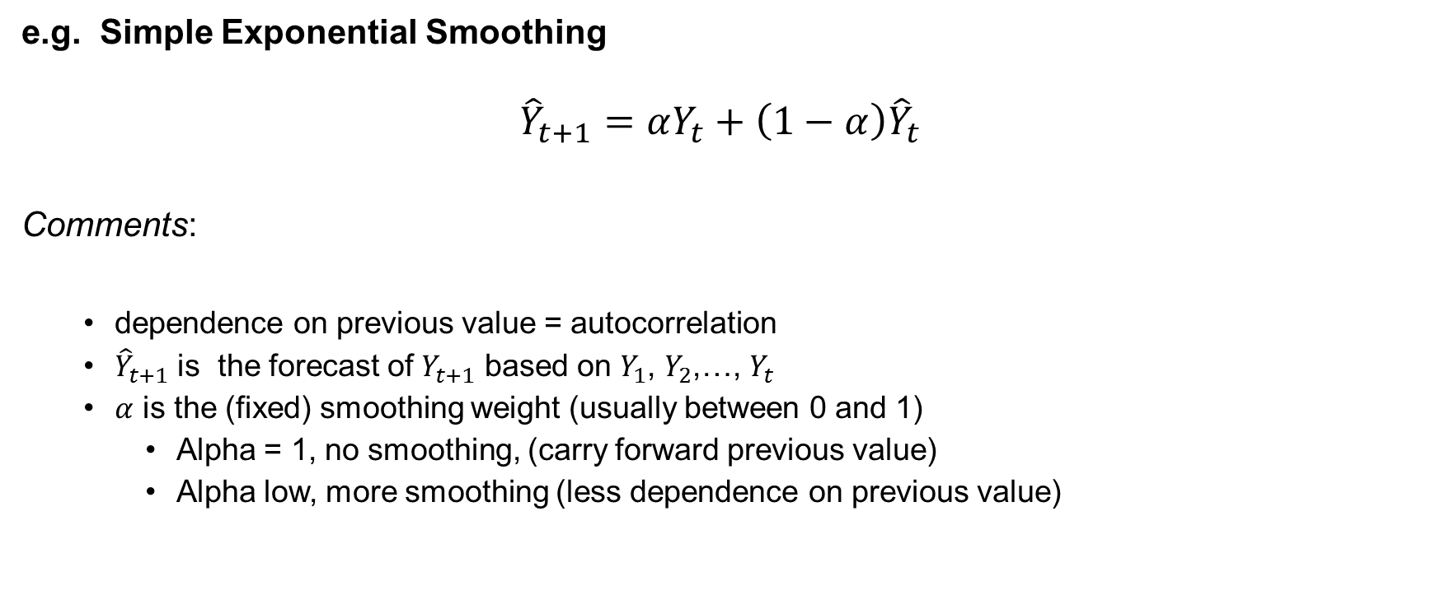
Modelling – Exponential Smoothing Models
e.g. Simple Exponential Smoothing
$${\hat{Y}}_{t+1}=αY_{t}+{\left(1−α\right)\hat{Y}}_{t}$$
Comments:
dependence on previous value =­­ autocorrelation
${\hat{Y}}_{t+1}$ is the forecast of $Y_{t+1}$ based on $Y_{1}$, $Y_{2}$,…, $Y_{t}$
$α$ is the (fixed) smoothing weight (usually between 0 and 1)
Alpha = 1, no smoothing, (carry forward previous value)
Alpha low, more smoothing (less dependence on previous value)

Slide 12
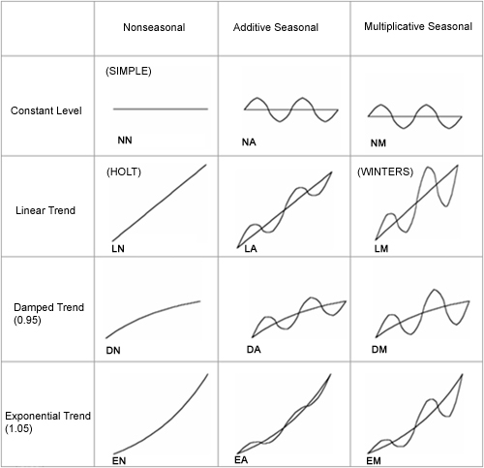
Modelling – Exponential Smoothing Models
Model is determined by:
i) Shape of trend - determined by visual inspection or goodness of fit tests
ii) Shape of seasonality - determined by visual inspection or goodness of fit tests
iii) Value of smoothing parameters - found to minimize model error

Slide 13
Modelling – State Space Models
Structural Time Series Models
Specify components (states) and how they evolve over time
estimate model using the Kalman Filter
filter pass for preliminary estimates of initial states
smoothing pass to finalize estimates and variances
Generalized to handle missing values, complex time series problems
ARIMA is a special case

Slide 14


Modelling – Linear Gaussian model
Measurement equation:
State equation:
$$y_{t}=Z_{t}α_{t}+ε_{t}$$
Random error(s)
Observation(s)
Coefficient(s)
State(s)
$$α_{t+1}=T_{t}α_{t}+{R_{t}n}_{t}$$
Future State(s)
Transition Matrix
State(s)
Random error(s)

Slide 15
Modelling
Current Research and Development
Nowcasting / Real-time estimation – consider publication
strategies to build and maintain models (high volume)
development of quality indicators
communication (revisions)
Multivariate models – more complex analysis and validation
Forecasting and analysis of short series
State space models for seasonal adjustment?

Slide 16
Seasonal Adjustment – What is it
What is seasonal adjustment?
https://www.youtube.com/watch?v=ccgmdVsrVAw / https://www.youtube.com/watch?v=l5A0ZDMzsv8
How can I learn more?
https://www.statcan.gc.ca/eng/dai/btd/sad-faq / https://www.statcan.gc.ca/fra/quo/bdd/dd-faq
And more to come…

Slide 17
Seasonal Adjustment
How does Statistics Canada apply seasonal adjustment?
Use X-12-ARIMA method
ARIMA modelling component
Data transformation
Outlier detection and treatment
Calendar effect regressors (moving holiday, trading day effects)
Forecasting
Application of Moving average filters / smoothers
Decompose into Trend-Cycle, Irregular and Seasonal
Down-weighting of extreme values

Slide 18
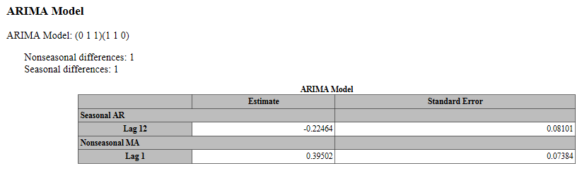
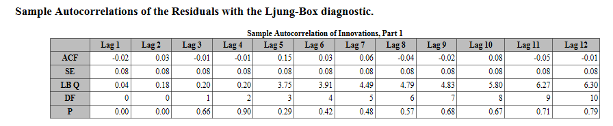
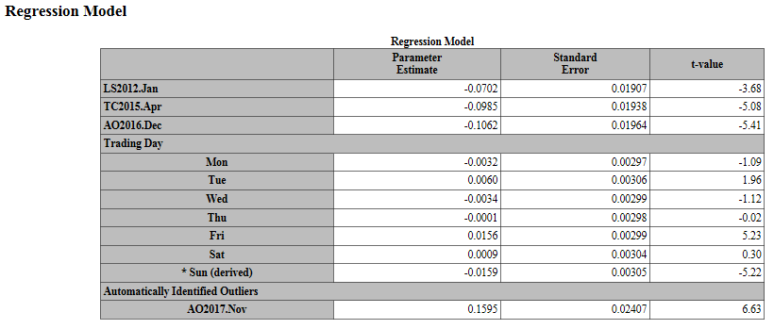
Seasonal Adjustment - ARIMA modelling
Determine order of model
Validate residuals
Verify regression model

Slide 19
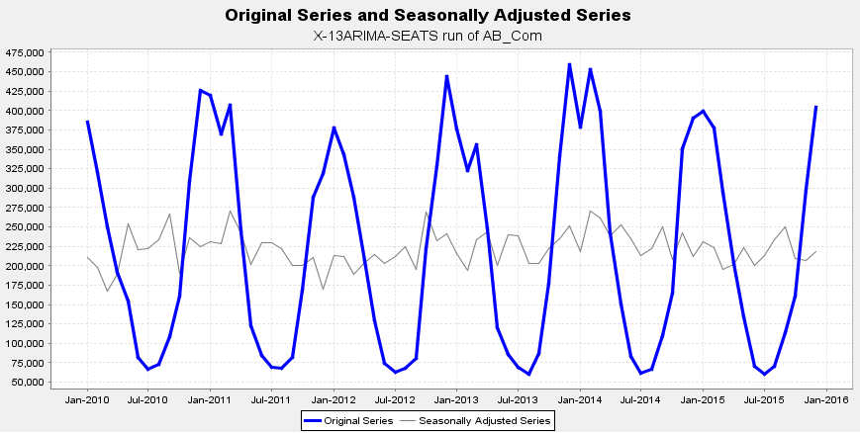
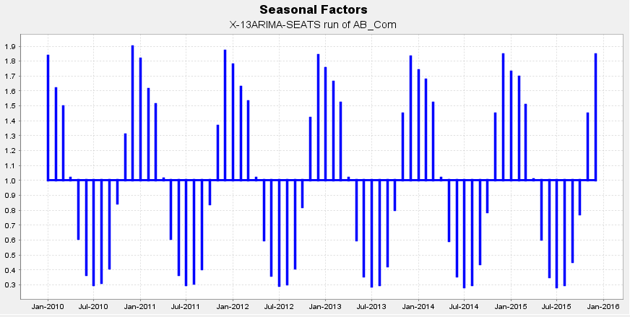
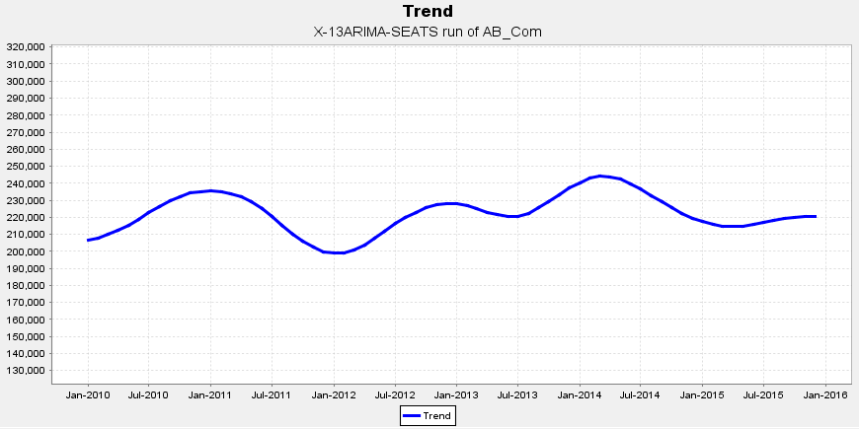
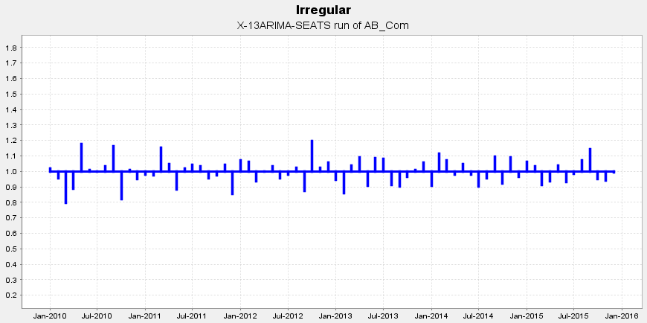
Seasonal Adjustment - Application of Moving Averages
ORIGINAL = SEASONAL + TREND-CYCLE + IRREGULAR
SEASONALLY ADJUSTED = TREND-CYCLE + IRREGULAR

Slide 20
Seasonal Adjustment Support
Assign Parameters to apply the X-12-ARIMA method
ARIMA model – order of model, regressors, number of forecasts
Moving average – extreme value tolerances, length of moving averages
Support for interpretation of results
Validation of process / help analysts to interpret results
Attend briefings to senior management
Capacity building (FAQ, videos)

Slide 21
Seasonal Adjustment Support
Current Research and Development
Comparison with model-based methods
Variance Estimation for seasonally adjusted series
Automation of metadata selection (machine learning)
Data Visualization (seasonal adjustment dashboard)
Potential improvements for special cases
Seasonal Adjustment of High-Frequency data

Slide 22
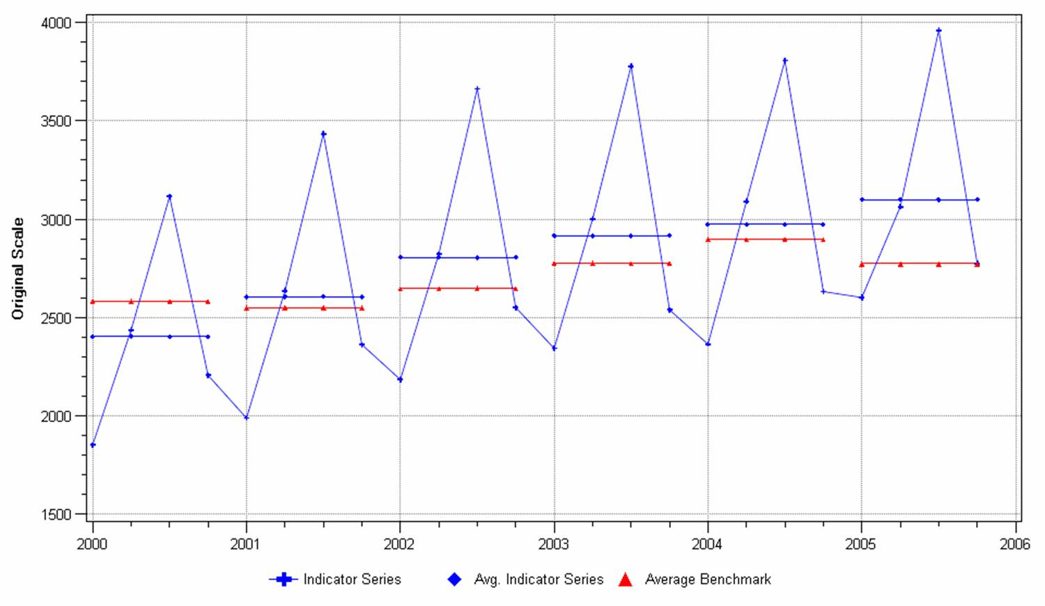
Benchmarking and Reconciliation
Benchmarking – Creating a consistent time series from series of different frequencies, e.g. quarterly and annual

Slide 23
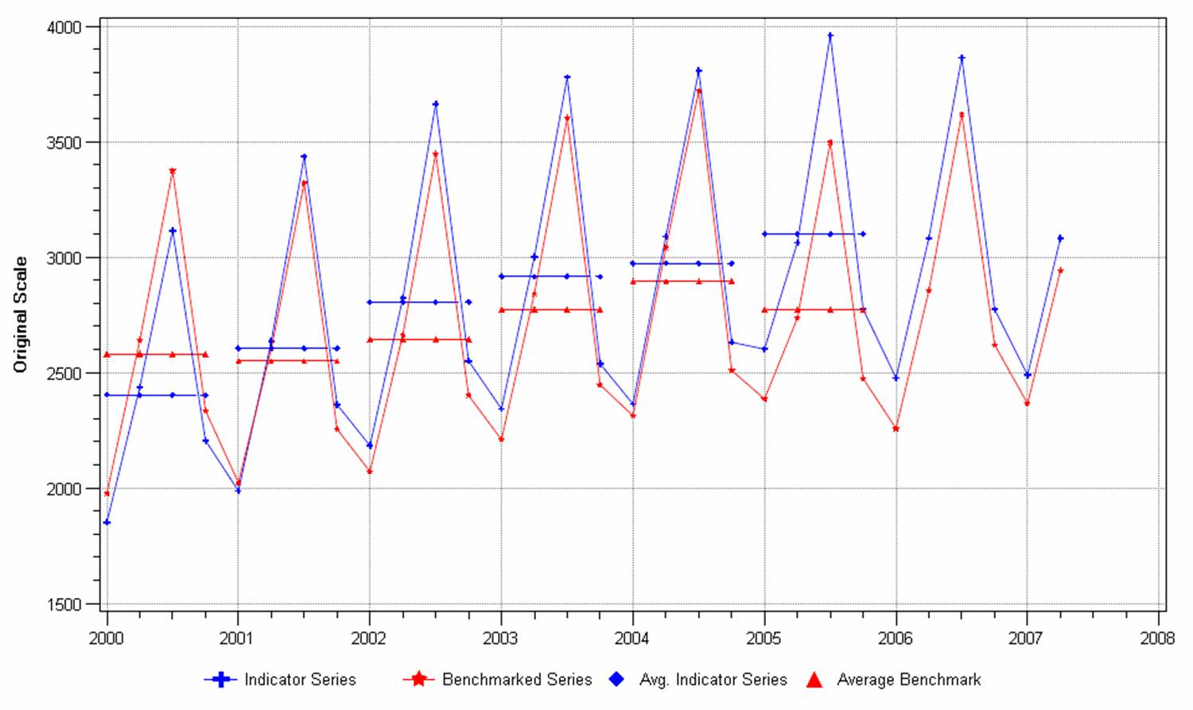
Benchmarking and Reconciliation
Combine strengths of each series
Higher-frequency series gives best estimates of period-to-period change
Lower frequency series gives best estimates of overall level

Slide 24
Benchmarking and Reconciliation
Solution derived through a regression approach (Dagum and Cholette, 1997):
Minimize:
With linear constraints:

Slide 25
Benchmarking and Reconciliation
Balancing – creating a consistent system of time series that respects known constraints
e.g. 2 dimensions
Often referred to as raking but a closed form solution (regression-based) exists
Geo1 Geok
Ind1
Indj

Slide 26
Benchmarking and Reconciliation
National Total
e.g. 2 dimensions
Jan
Geo1 Geok
Feb
Dec
Ind1
Comp1
…
Indj
Industrial Total
Annual Totals

Slide 27
Benchmarking and Reconciliation
Can be approached as an optimization problem:
e.g. Raking:
Minimize
With linear constraints

Slide 28
Reconciliation – Main Method: Time Series Model
The model is:
In matrix form:
Notes:
La réconciliation estimera le paramètre thêta.

Slide 29

Benchmarking and Reconciliation
Can be solved through matrix algebra as the solution to a regression:
x is the vector of the component series to be raked.
$\hat{θ}$ is the raked/reconciled values of x.
V_{e} is the variance matrix of e. V_{e}=diag(c_{m} * x_{m}), where c_{m} is the alterability coefficient associated with x_{m}.
G is the design matrix of additivity rules (contemporaneous and, if needed, temporal).
g is the vector of constraints (marginal total and temporal, if needed, values).
V_{ε} is the variance matrix of ε. V_{ε}=diag(c_{g}* g), where c_{g} is the vector of alterability coefficients associated with g.

Slide 30
Benchmarking and Reconciliation
Support and development for generalized system: G-SERIES
Current Research and Development
Apply benchmarking and reconciliation simultaneously ?
Constrained benchmarking
Pre and post-processing for optimization (re-scaling, etc.)

Slide 31
If this sounds interesting …
Let’s talk! Steve.Matthews@Canada.ca
Consider MA Recruitment Campaign!
Details at: www.statcan.gc.ca/MArecruitment
THANK YOU!

