Slide 1


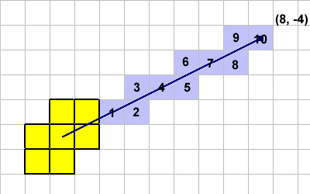

Slide 2
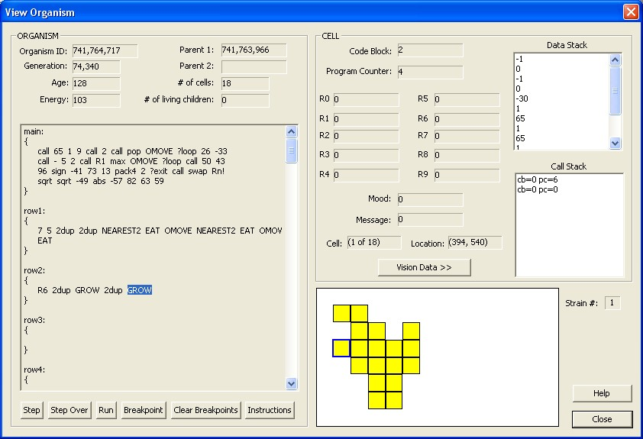
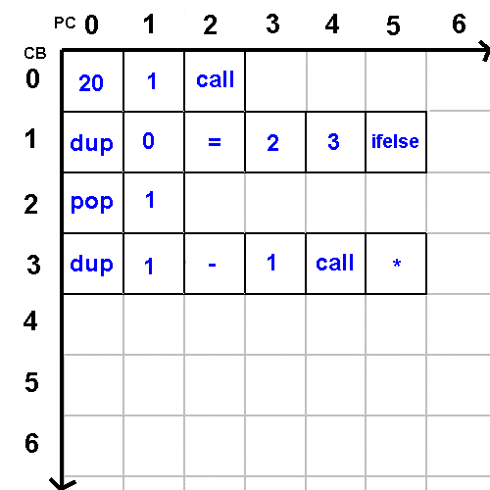

Slide 3
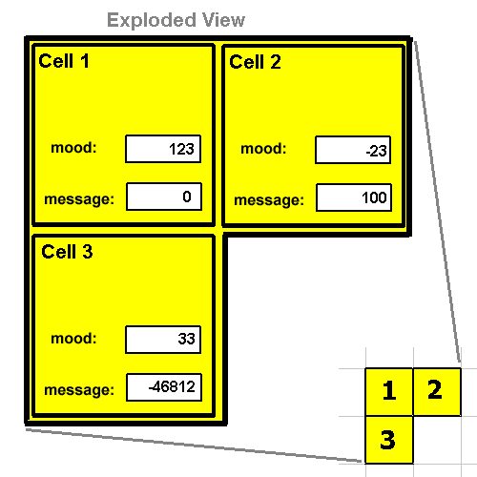
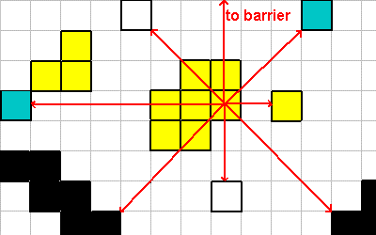
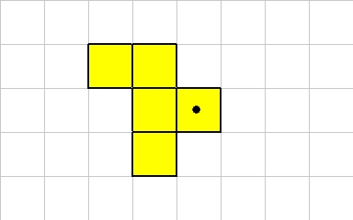
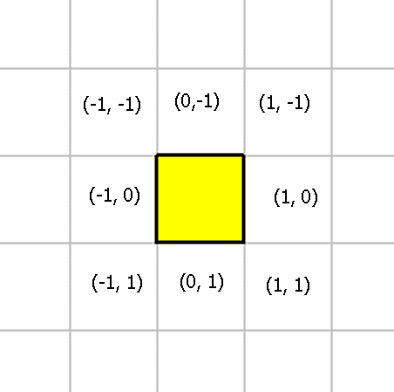
Organism Instructions
Interactions
OMOVE
ROTATE
CMOVE
GROW
MAKE-SPORE
EAT
Vision
LOOK
WHAT
WHERE
NEAREST
FARTHEST
NEAREST2
FARTHEST2
Cells
MOOD
MOOD!
BROADCAST
SEND
RECV
Self
ENERGY
AGE
NUM-CELLS
HAS-NEIGHBOR

Slide 4
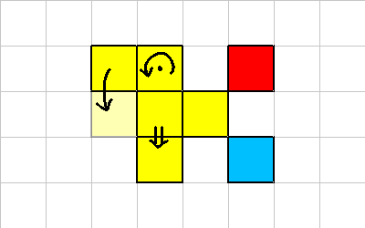
Organism Instructions
Interactions
OMOVE
ROTATE
CMOVE
GROW
MAKE-SPORE
EAT

Slide 5
Organism Instructions
Vision
LOOK
WHAT
WHERE
NEAREST
FARTHEST
NEAREST2
FARTHEST2

Slide 6
Organism Instructions
Cells
MOOD
MOOD!
BROADCAST
SEND
RECV
Self
ENERGY
AGE
NUM-CELLS
HAS-NEIGHBOR

Slide 7
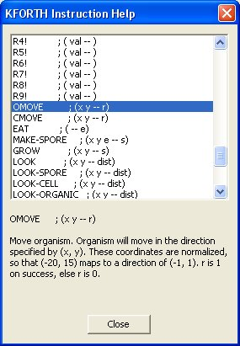

Slide 8
KFORTH Instructions
Stack
call
if
ifelse
?loop
?exit
pop
CB
Positioning
dup
swap
over
rot
pick
?dup
-rot
2swap
2over
2dup
2pop
nip
tuck
Stack Arithmetic
1+
1-
2+
2-
2/
2*
abs
sqrt
Operator, Arithmetic
+
~
*
/
mod
/mod
negate
2negate
Operator, Logic
=
<>
<
>
<=
>=
0=
or
and
not
invert
xor
min
max

Slide 9
KFORTH Instructions
Register
Rn
R0
R1
R2
R3
R4
R5
R6
R7
R8
R9
Register
Rn!
R0!
R1!
R2!
R3!
R4!
R5!
R6!
R7!
R8!
R9!
Bit Manipulation
sign
pack2
unpack2
pack4
unpack4

