Slide 1

Mount Everest
16-Mar 2017

Slide 2
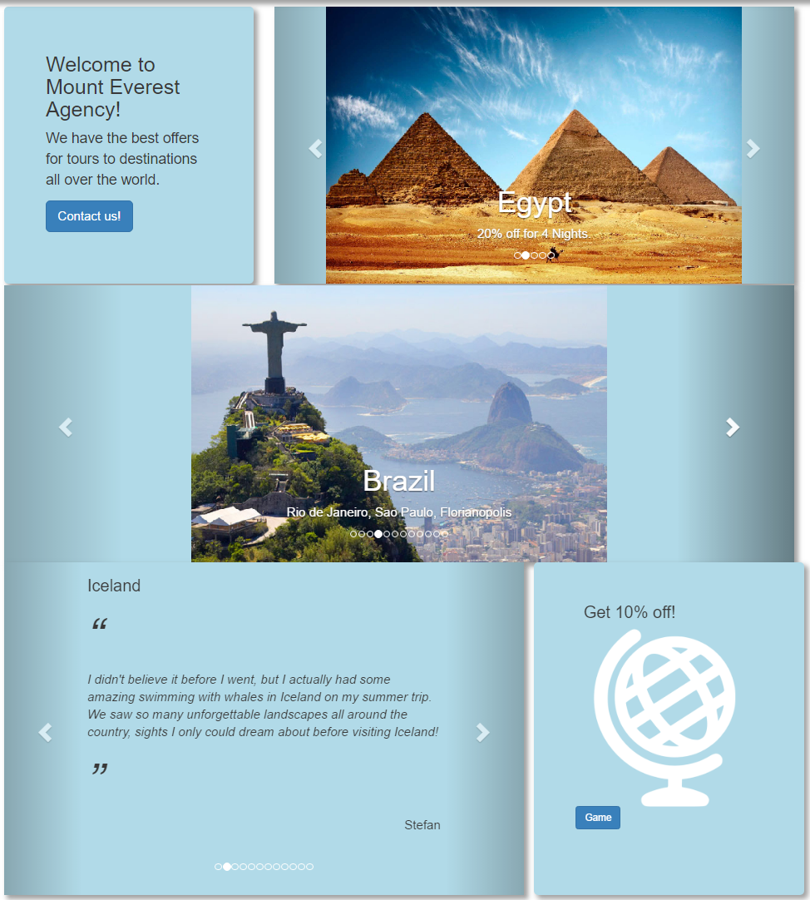
Home Page

Slide 3
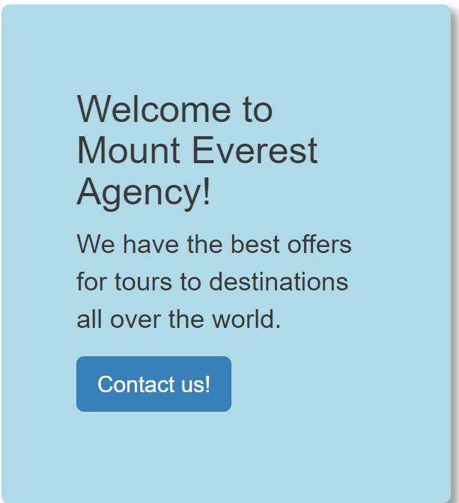
Welcome Jumbotron

Slide 4

Offers Carrousel

Slide 5

Destination Carrousel

Slide 6
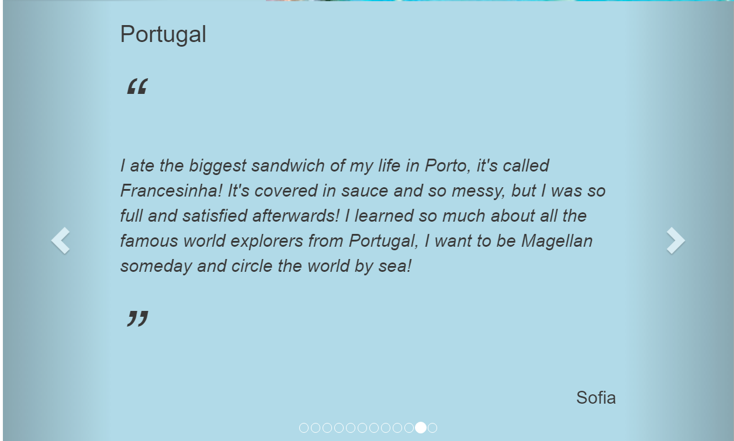
Testimonials Carrousel

Slide 7

Game Jumbotron

Slide 8
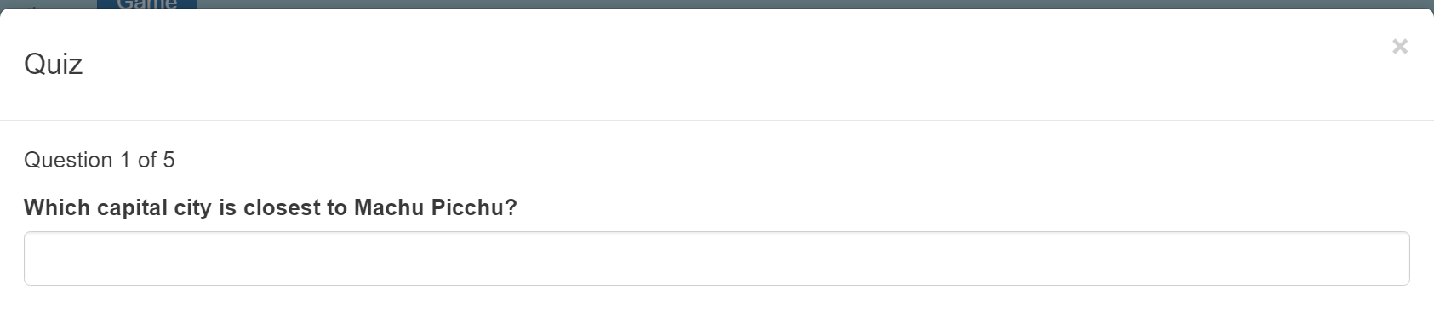
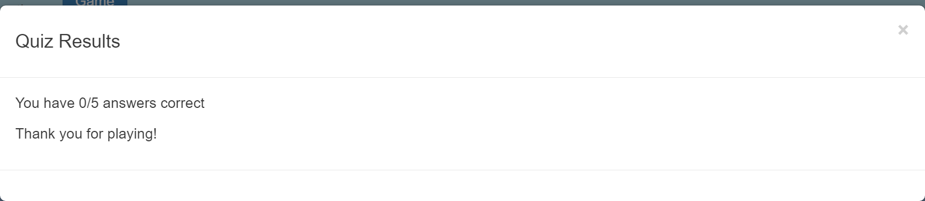
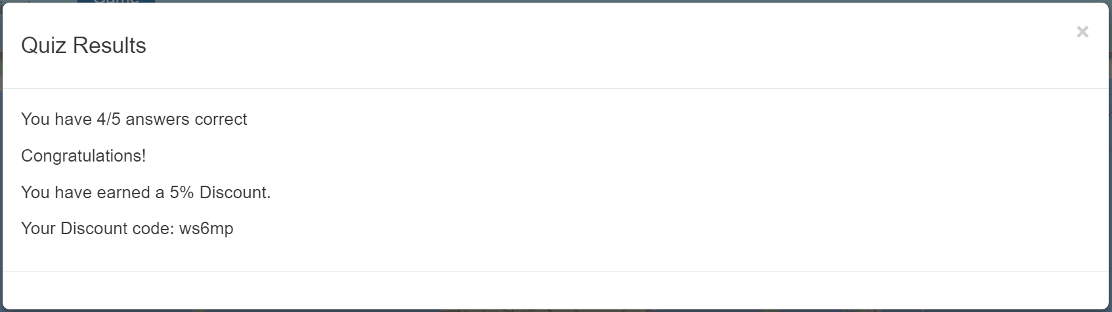
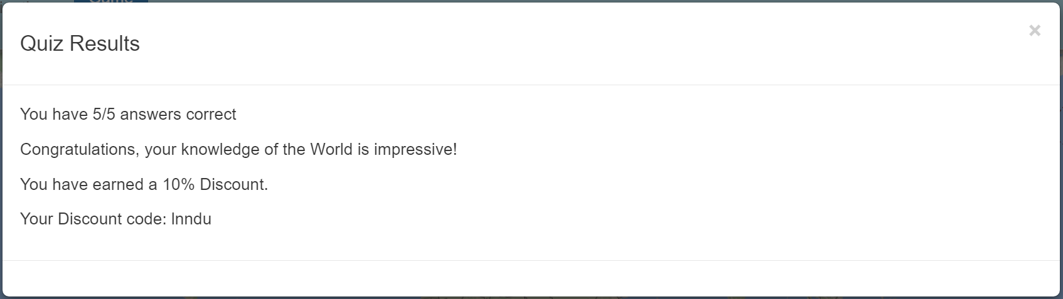
Game

Slide 9
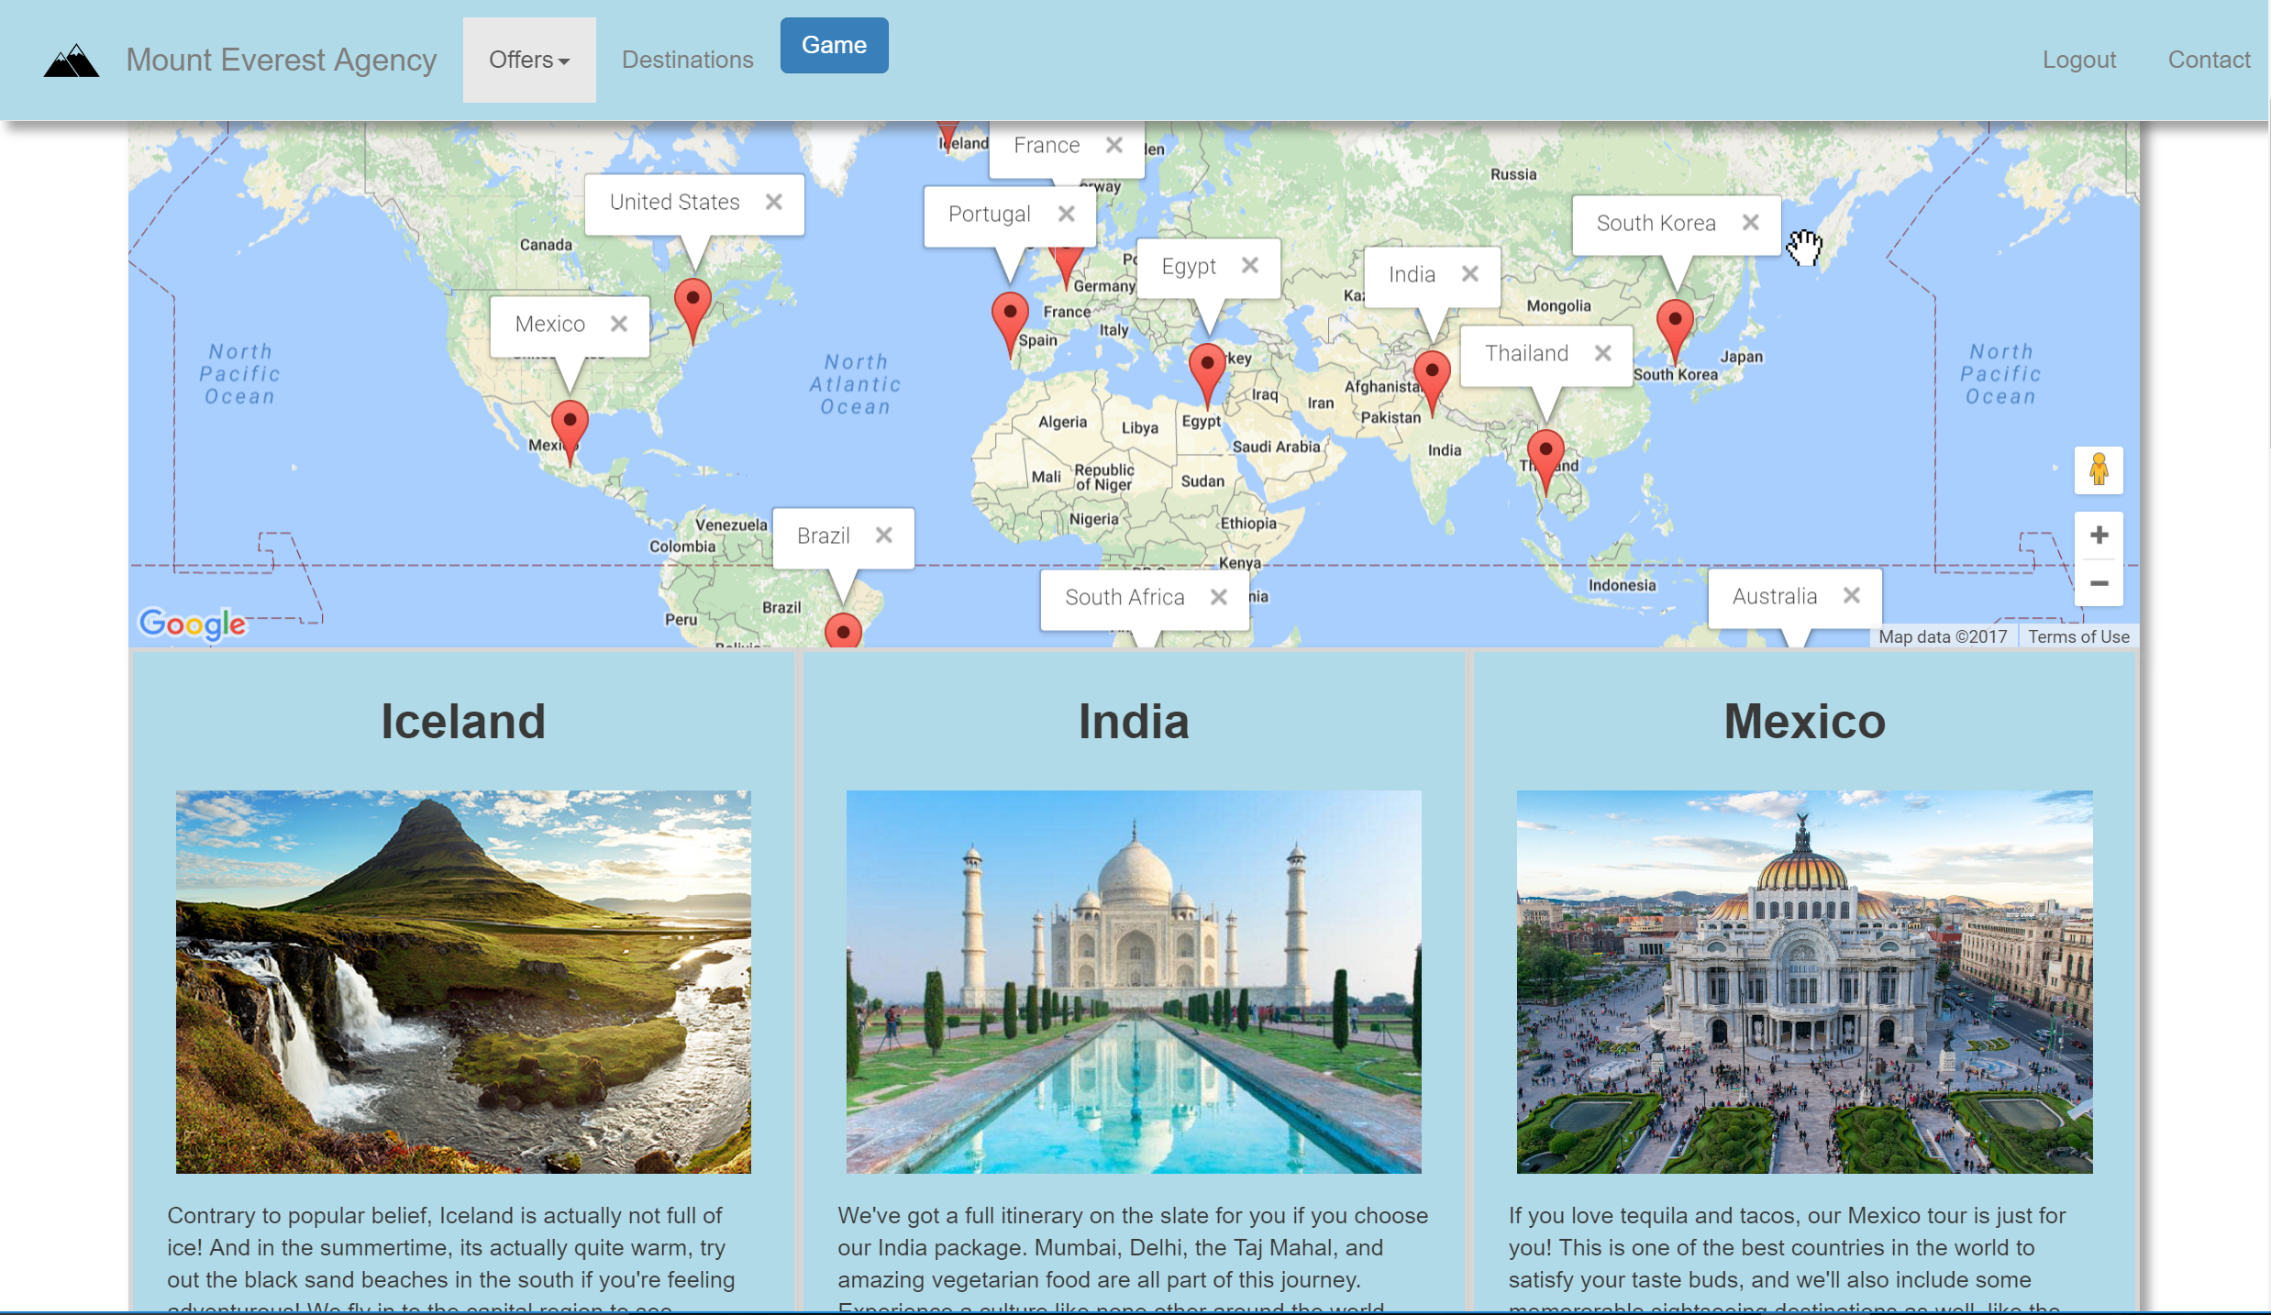
Destinations

Slide 10
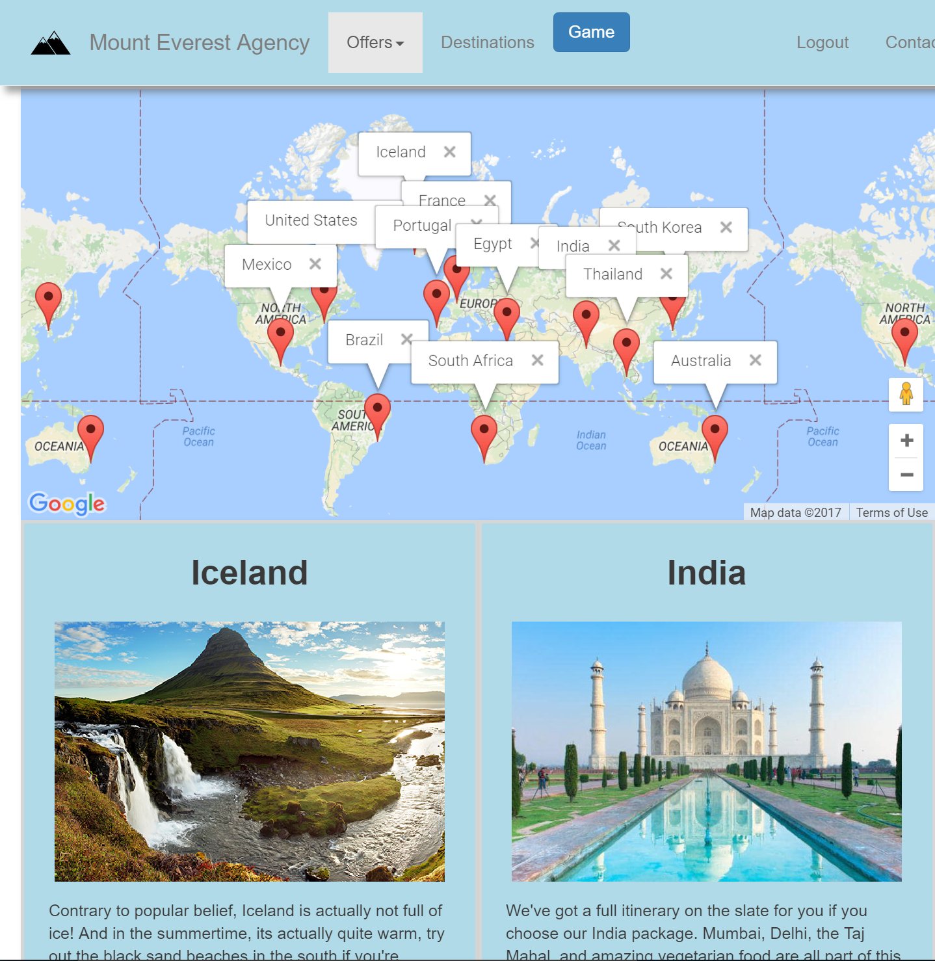
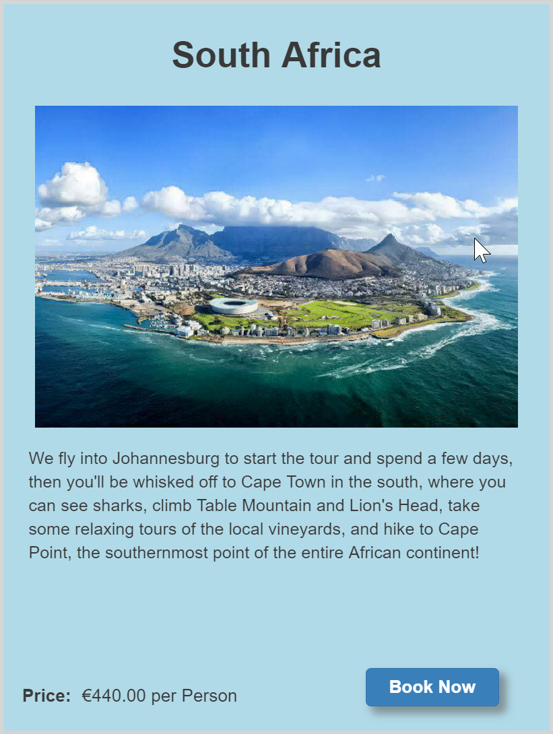
Responsive

Slide 11
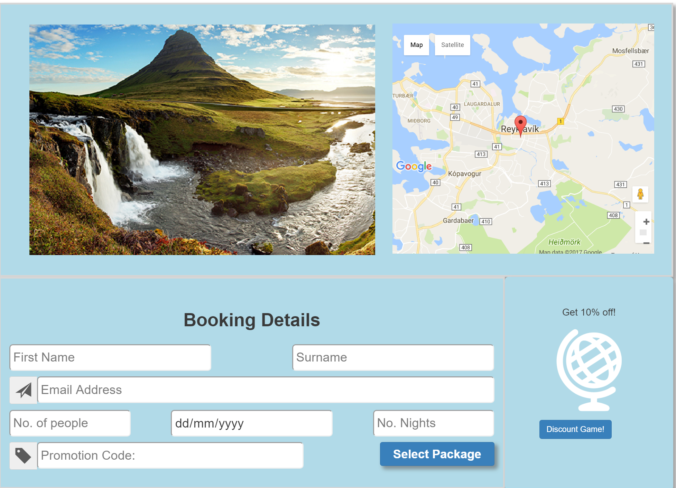
Booking Page

Slide 12
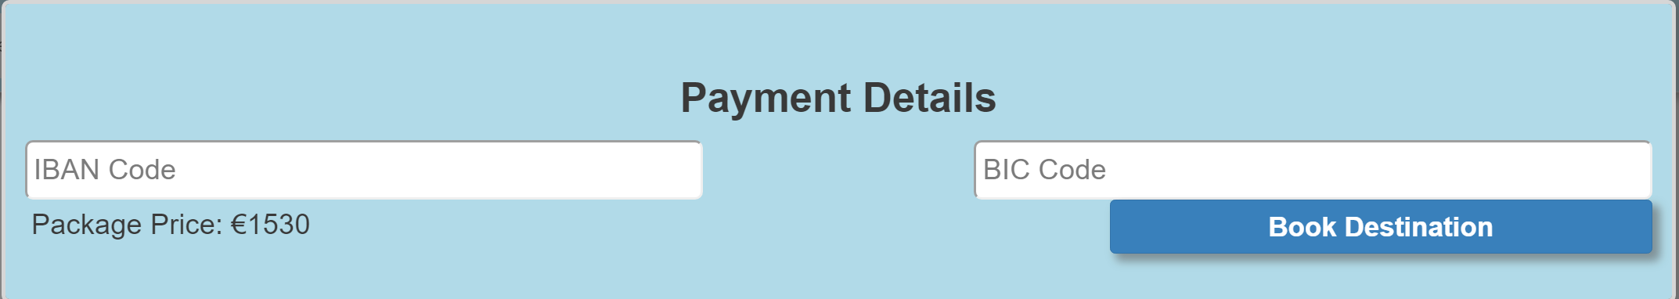
Payment Details

Slide 13
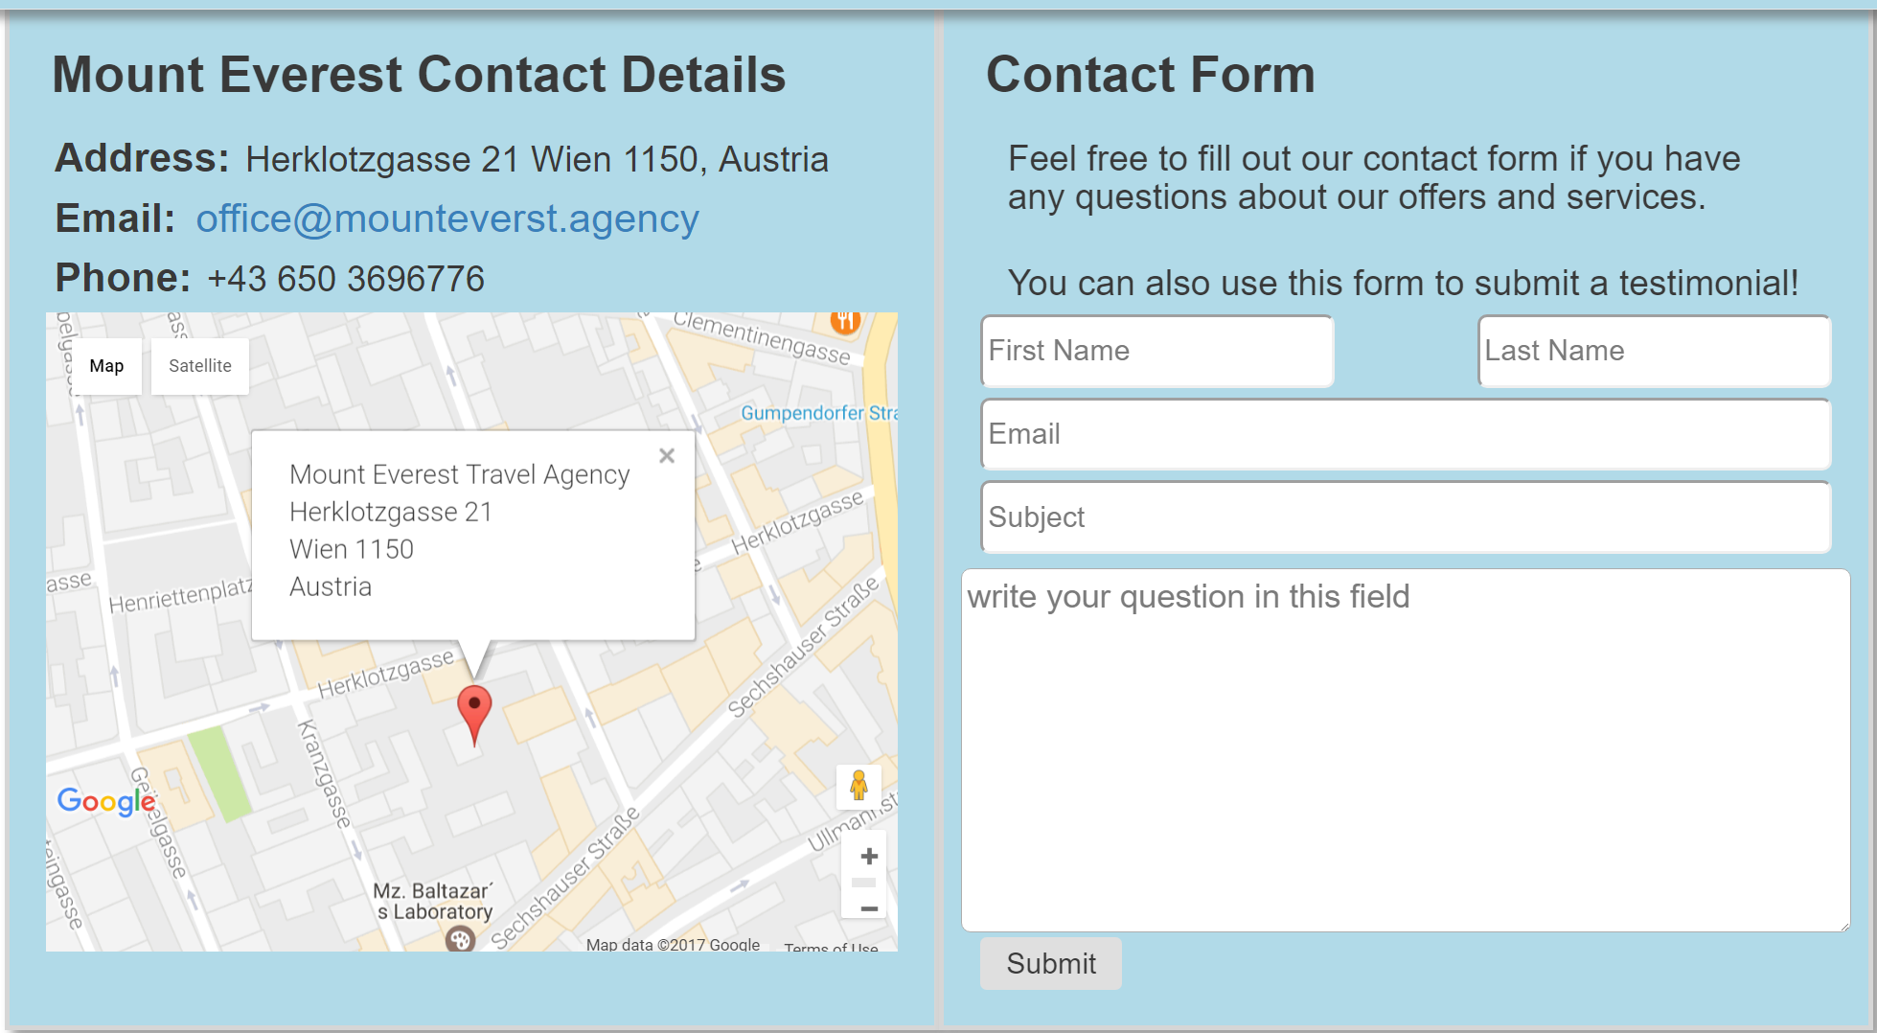
Contact Us

Slide 14
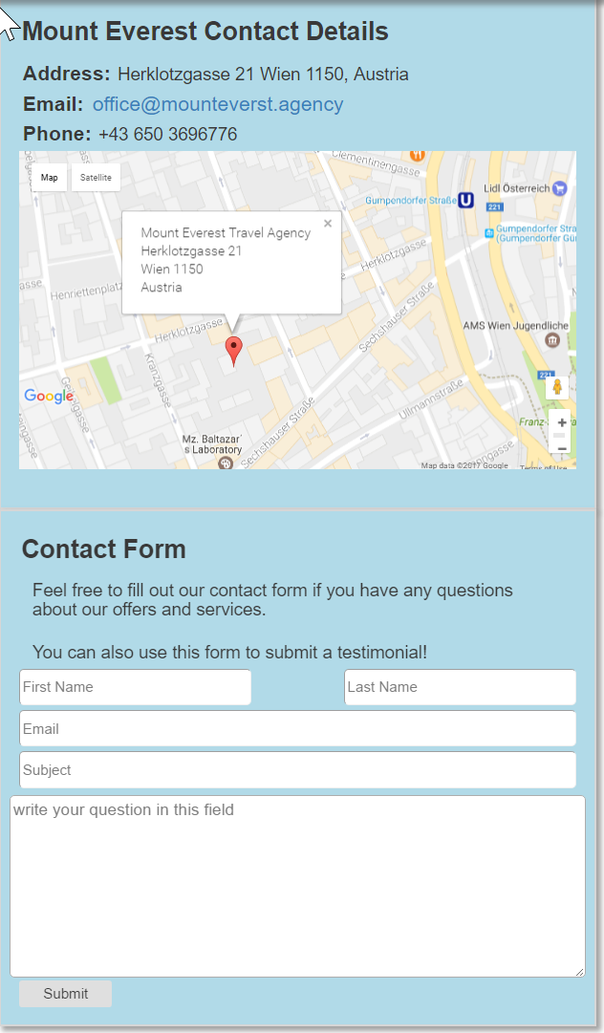
Dynamic Display

