Slide 1
WebGPU Workshop
Lio Qing

Slide 2
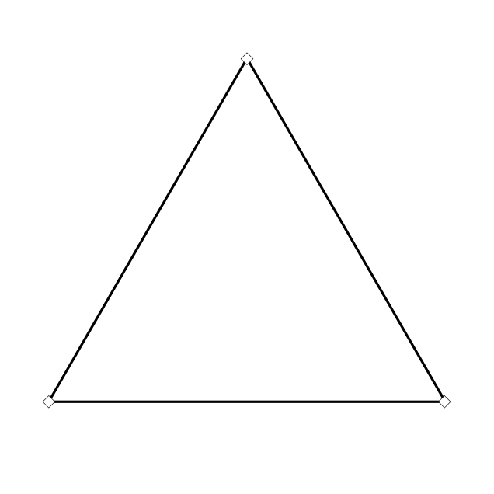
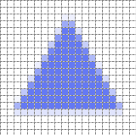
What does GPU do?
Process for each vertex
Vertex Shader
Process for each pixel
Fragment Shader

Slide 3
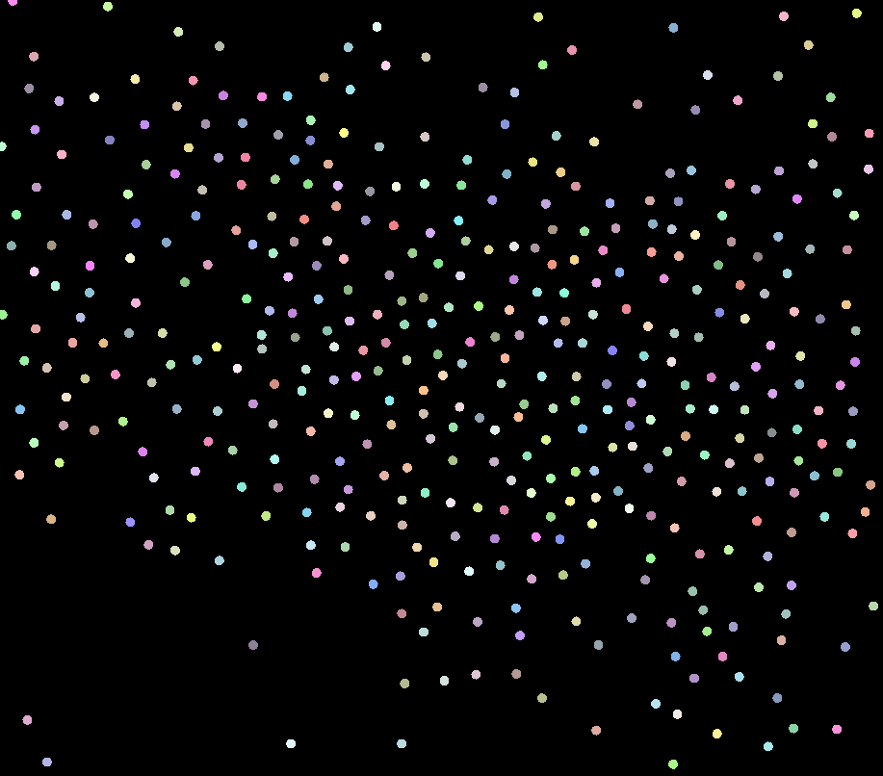
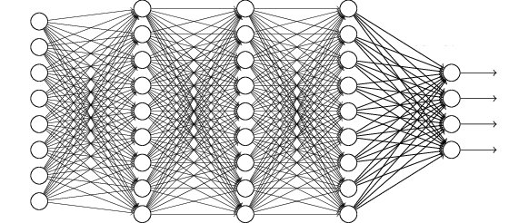
What does GPU do?
Process for each whatever data
Compute Shader
Process for each vertex
Vertex Shader
Process for each pixel
Fragment Shader

Slide 4

Try out particle simulations
https://lioqing.com/webgpu-workshop-2025
Switch between the CPU and GPU modes
Observe and think about the performance difference

Slide 5
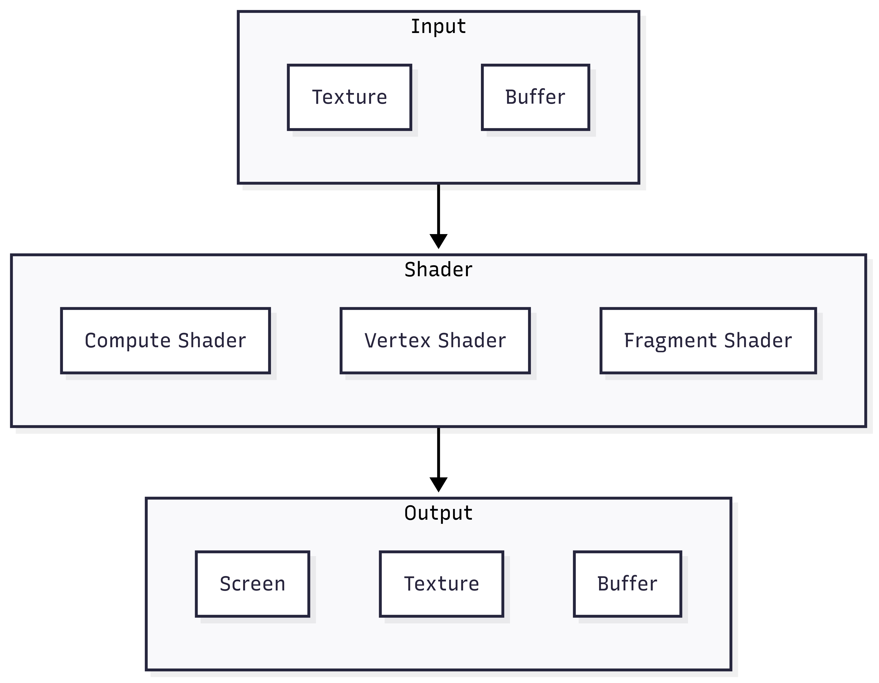
Pipeline
Today’s focus

Slide 6
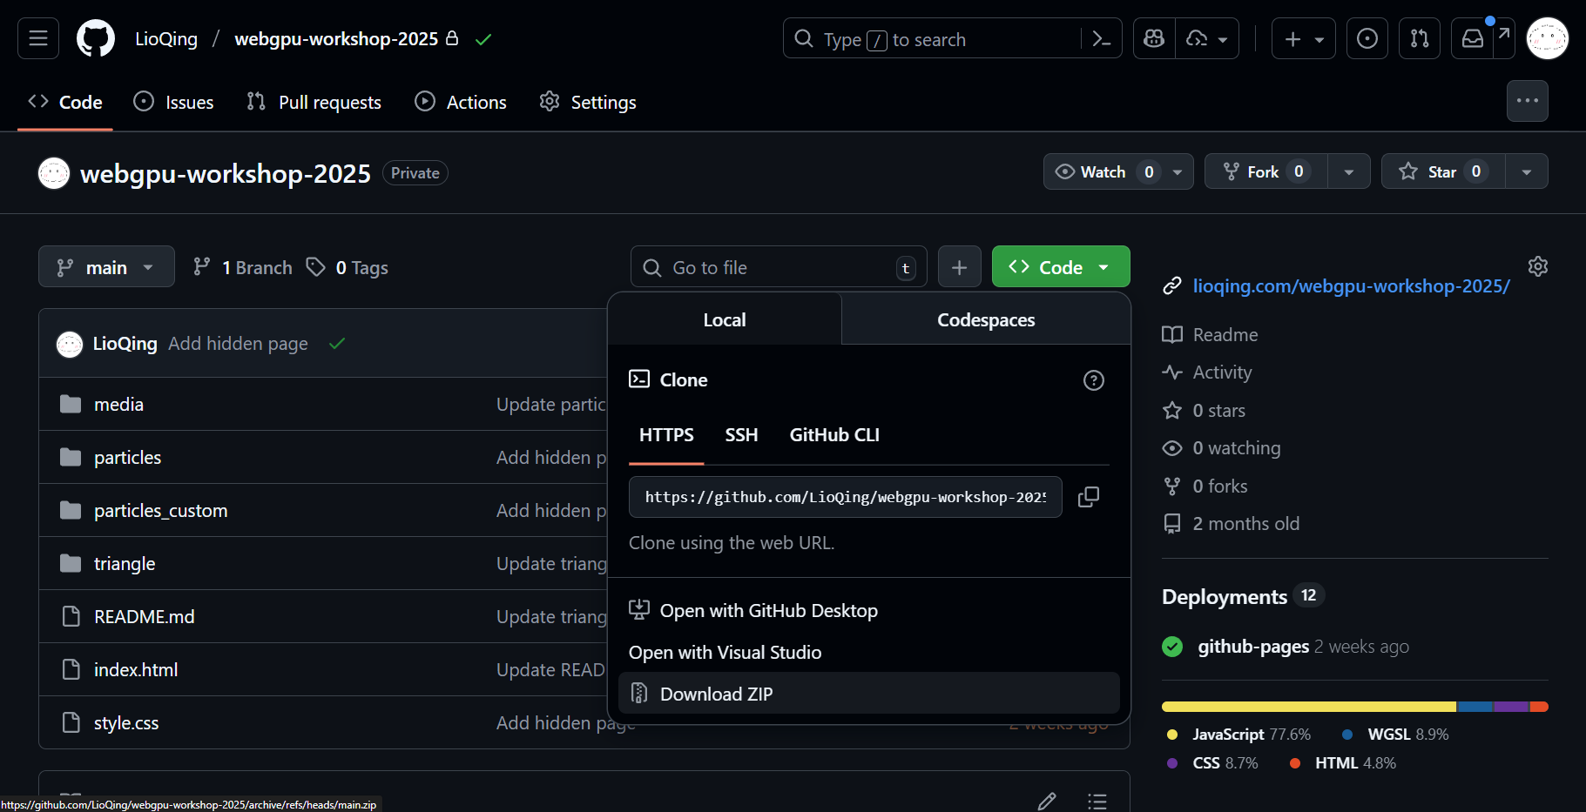
Get the code (optional)
Git: git clone https://github.com/LioQing/webgpu-workshop-2025.git
Zip: Go to https://github.com/LioQing/webgpu-workshop-2025

Slide 7


Why use GPU?
GPU can carry out specific operation on a large amount of data at the same time.
Analogy – write the multiplication table from 1 to 9:
CPU - 1 university student
vs.
GPU - 10 middle school students
vs.

Slide 8

When to use GPU?
When there is large amount of data:
With the same data format
Need to be processed with the same operation
1
2
3
4
5
Data format & content: “Given your desk number i”
Operation: “Write down i×1 up to i×9”
6
7
8
9
10

Slide 9
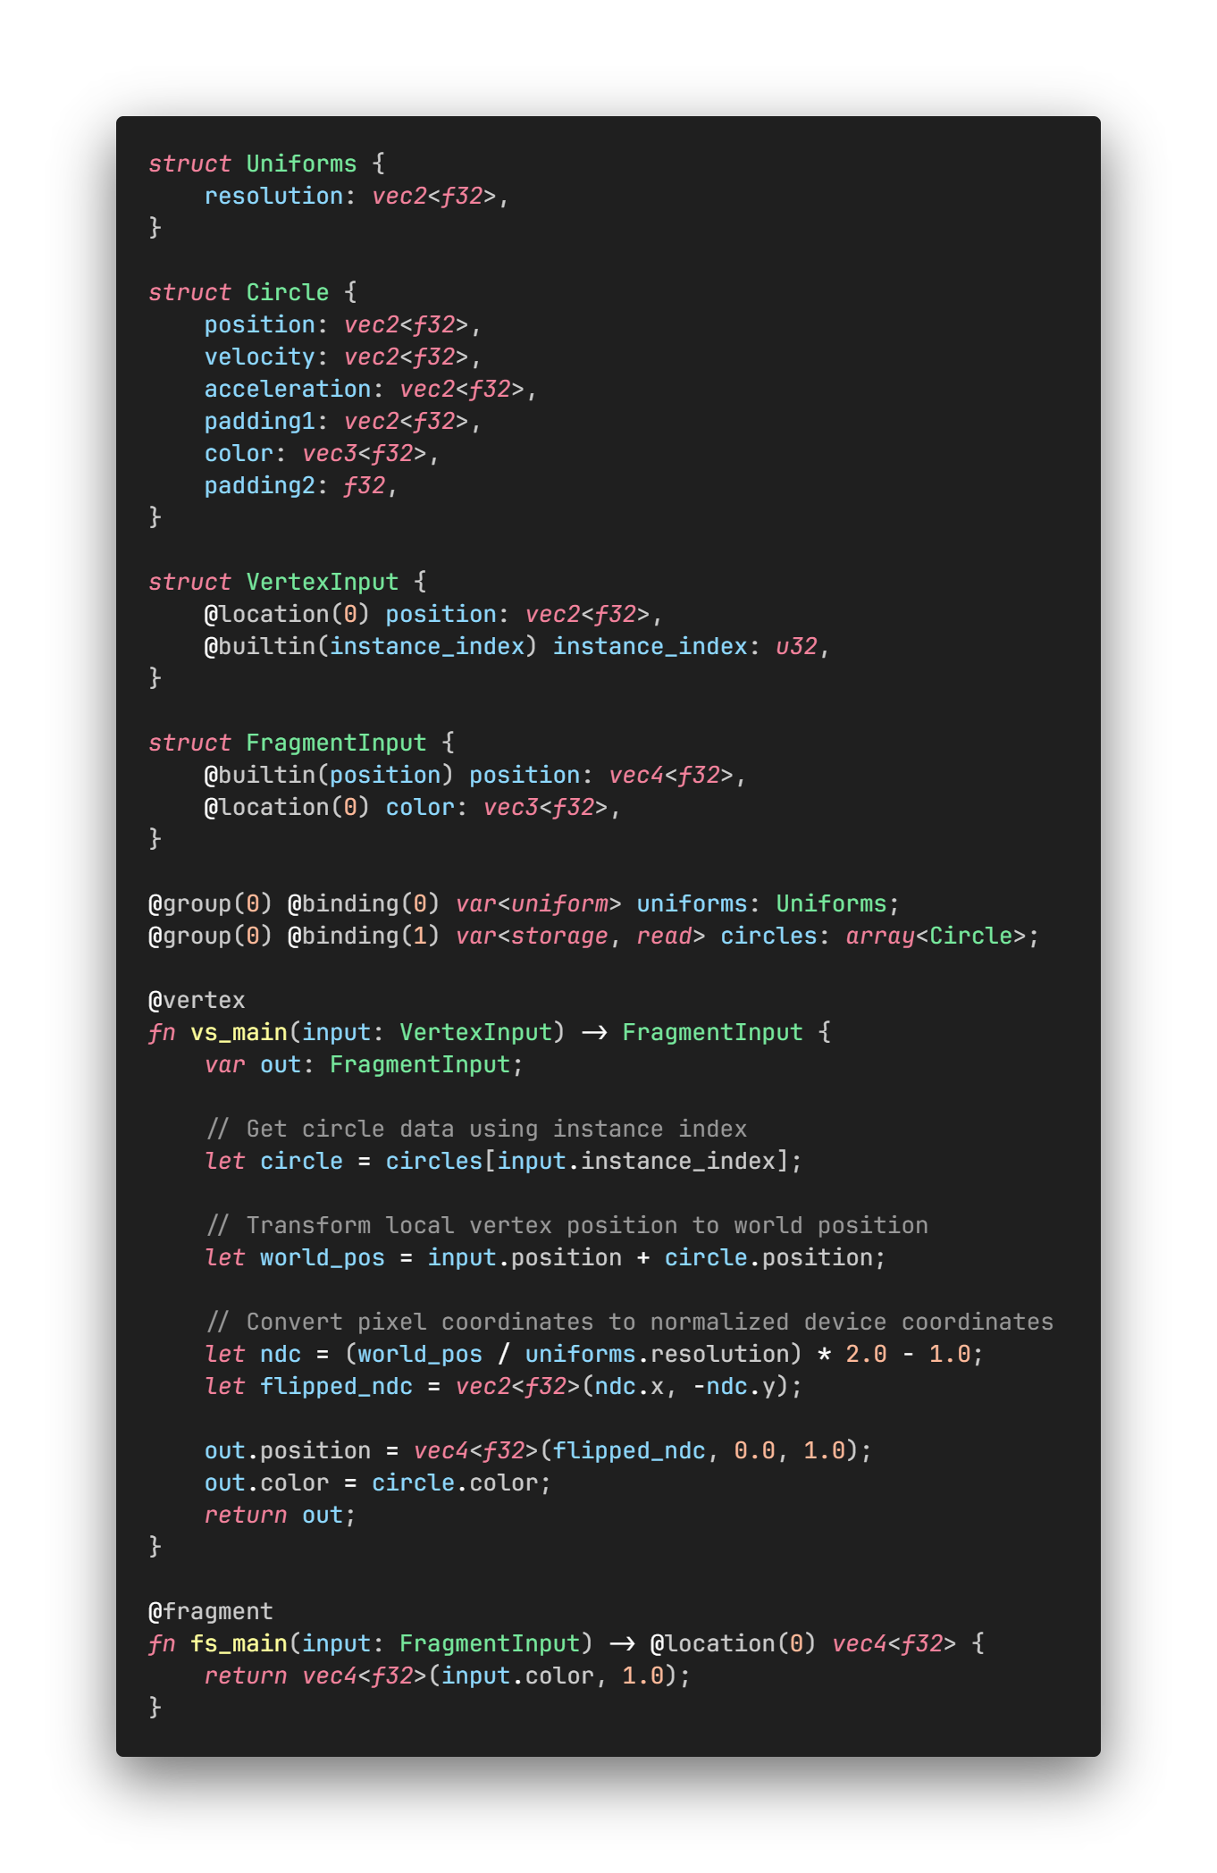
Render shader
Data format
All of our circles have the same data format
Data content
Uniforms: same across all vertex/fragment
Circles: each circle’s property
Operation
Vertex and fragment shaders for working with the vertices and the pixels

Slide 10
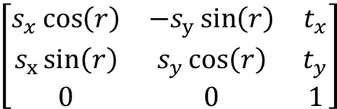
Apply a transform to the triangle
$$\left[\begin{matrix}s_{x}\cos\left(r\right) & {−s}_{y}\sin\left(r\right) & t_{x} \\ s_{x}\sin\left(r\right) & s_{y}\cos\left(r\right) & t_{y} \\ 0 & 0 & 1\end{matrix}\right]$$
let position = vec2<f32>(100.0, -100.0);
let rotation = 1.0; // In radians
let scale = vec2<f32>(1.0, 2.0);
let transform = mat3x3<f32>(
vec3<f32>(scale.x * cos(rotation), scale.x * sin(rotation), 0.0),
vec3<f32>(-scale.y * sin(rotation), scale.y * cos(rotation), 0.0),
vec3<f32>(position.x, position.y, 1.0),
);
let origin = uniforms.resolution / 2.0;
let position_origin = input.position - origin;
let position_homogeneous = vec3<f32>(position_origin, 1.0);
let position_transformed_homogeneous = transform * position_homogeneous;
let position_transformed_origin = position_transformed_homogeneous.xy;
let position_transformed = position_transformed_origin + origin;

Slide 11
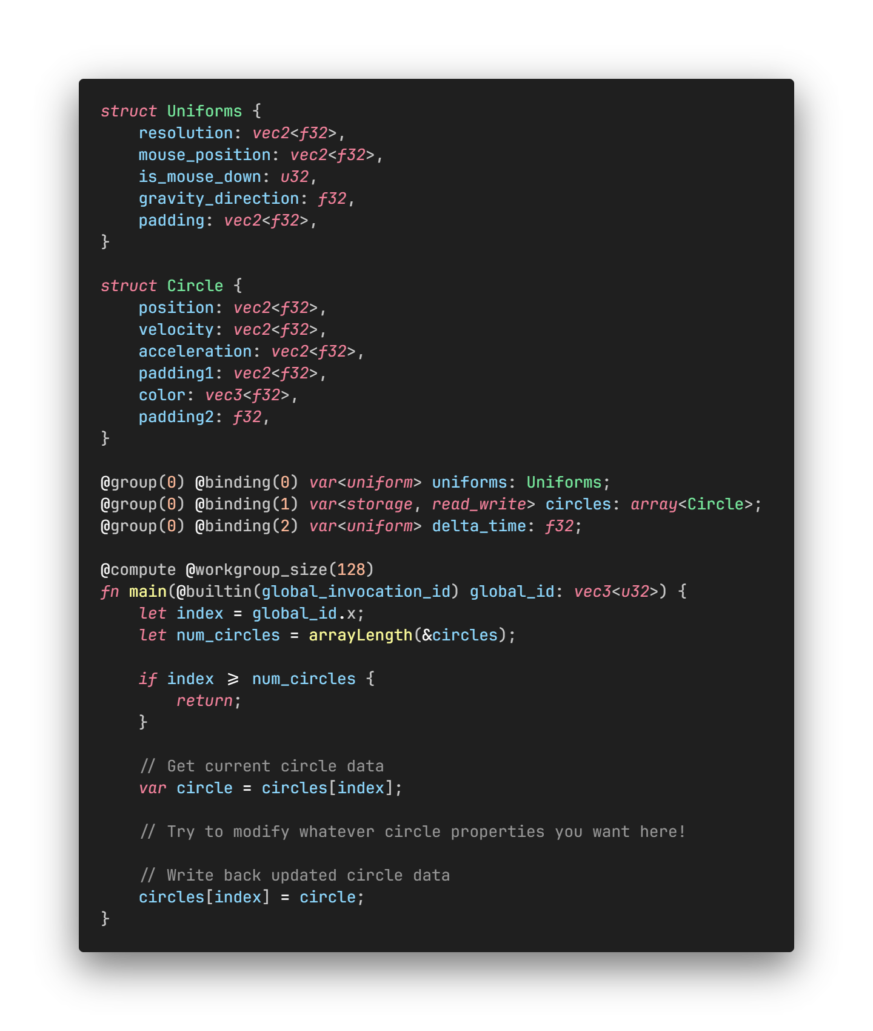
Compute shader
Data format
All of our circles have the same data format
Data content
Uniforms: interactions
Circles: each circle’s property
Delta time: time since last frame in second
Operation
WebGPU gives us “global_invocation_id” which is basically the index we use to get the current circle for operation.

Slide 12
In-browser compute shader editor
https://lioqing.com/webgpu-workshop-2025/particles/index.html
https://lioqing.com/webgpu-workshop-2025/particles_custom/index.html

Slide 13

Animate a sine wave given mouse position
$$y = 100 ⋅ \sin{((x + i) ⋅10)}$$
// Make the circles form a straight line
let index_norm = f32(index) / f32(num_circles);
circle.position = vec2<f32>(
index_norm * uniforms.resolution.x,
uniforms.resolution.y / 2.0,
);
// Add a sine wave offset according to mouse position
let x = uniforms.mouse_position.x / uniforms.resolution.x;
circle.position.y += 100.0 * sin((x + index_norm) * 10.0);

Slide 14

Simulate gravity
$$a=\frac{GM_{1}M_{2}}{r^{2}}; v=aΔt; s=vΔt$$
for (var i: u32 = 0u; i < num_circles; i += 1) {
if i == index { continue; }
let other_circle = circles[i];
let offset = other_circle.position - circle.position;
let direction = normalize(offset);
let distance = length(offset);
if distance <= CIRCLE_RADIUS * 2.0 { continue; }
let g = 100.0 / (distance * distance);
circle.acceleration = direction * g;
circle.velocity += circle.acceleration * delta_time;
circle.position += circle.velocity * delta_time;
}

