Slide 1
NUTRISENSE
AI-Powered 3D Dietary Assessment & Nutrition Auditing from a Single Meal Photo
B.E. Major Project Viva Defense & Final Academic Review · Course: 24AM7PWPW2 (2026–27)
Department of Machine Learning, B.M.S. College of Engineering (BMSCE), Bengaluru
PROJECT TEAM
• S S Gokula Swamy (1BM23AI158) — Project Lead & Principal Architect
(End-to-End Pipeline, 3D Annulus Geometry, Card-Free Head, Synthetic CutMix)
• Somanath S D (1BM23AI187) — Full-Stack Developer & UI Lead
(FastAPI Backend, React 19 Frontend, Topbar Navigation, Student Roster)
• Roshanth V (1BM23AI155) — ML Engineer (Computer Vision & Segmentation)
(DeepLabV3 + SAM 2.1 Hiera Integration, 95.8% Dice Mask Extraction)
• Aryan Kumar (1BM23AI037) — ML Engineer (Nutritional Data & Compliance)
(INDB/IFCT Master Database, 4k Monte Carlo Engine, PM POSHAN Mandates)
PROJECT GUIDE & EVALUATION
Prof. Varsha R
Assistant Professor, Department of Machine Learning
B.M.S. College of Engineering, Bengaluru
Key Project Achievements:
• 90.58% Mean Real-World Mass Accuracy (29.7g MAE across Dishes 1–6)
• 99.3% Accuracy on Dish 5 Veg Biryani (151.1g estimated vs 150.0g scale)
• 80.1% Signed Bias Reduction in Card-Free Mode B (-223.5g to -44.4g)
• 115 Indian Dishes Gallery + INDB/IFCT Master Nutritional Table
Notes:
Respected Guide Prof. Varsha R and External Examiners, good morning.
We are proud to present NutriSense: an AI-Powered 3D Dietary Assessment and Nutrition Auditing System from a Single Meal Photo.
Our project addresses one of the most critical public health challenges in India: the accurate, real-time auditing of government school midday meals under the statutory PM POSHAN scheme.
Lead Architect Gokula Swamy spearheaded the pipeline design, the card-free implicit scale estimation, and the 3D tabletop annulus geometry. Somanath S D engineered the full-stack web application. Roshanth V developed the food segmentation models, and Aryan Kumar managed the Indian nutritional database and Monte Carlo compliance engines.
Over the next 20 slides, we walk through our system architecture, the Master Accuracy percentages, our physical weighed benchmarks, and our interactive web application.

Slide 2
NUTRISENSE · B.E. MAJOR PROJECT DEFENSE
Executive Summary & Engineering Problem
THE CHALLENGE
Severe Under-Reporting & Volume Collapse
• Dietary recall surveys suffer from 30%–50% cognitive recall bias.
• Existing 2D vision apps rely on coarse 2D bounding boxes, causing catastrophic volume collapse on piled or multi-item foods.
• Indian thali meals combine liquid gravies (sambar, rasam) with porous mounds (steamed rice, biryani) having zero visual scale.
• Government schools lack precision weighing balances at rural distribution points.
THE NUTRISENSE SOLUTION
5-Stage 3D Metric Vision & Multi-Prototype Fusion
• Single overhead smartphone photo captures geometry, volume, and multi-component composition.
• Dual-scale operating modes: Fiducial ArUco Card (Mode A, sub-millimeter) or Card-Free Implicit Scale Head (Mode B, 6-Fold LODO-CV).
• Multi-component SAM 2.1 Hiera segmentation + SigLIP-2 vision-text classification across 115 Indian dishes.
• MoGe-2 metric depth with 3D Tabletop Annulus plane fitting and Frustum Voxel Integration.
ACADEMIC & PRACTICAL IMPACT
PM POSHAN Mandate & Open-Source Rigor
• Real Weighed Accuracy: 90.58% across Dishes 1–6 (29.7g MAE) and up to 99.3% on Dish 5.
• Card-Free Mode B: Slashed negative volume bias by 80.1% (-223.5g to -44.4g) via Annulus fit.
• Statutory Compliance: 4,000 Monte Carlo draws quantifying energy (kcal), protein (g), fat, and carbohydrates against NFSA 2013.
• 100% Zero-Leakage: Cryptographically locked evaluation protocol, 378 unit tests passing.
Notes:
On Slide 2, we formulate the core engineering problem.
Nutritional deficiency affects millions of school children. While India's PM POSHAN scheme feeds over 120 million children daily, monitoring meal quality and quantity has relied on manual record books and self-reporting, which suffer from a 30% to 50% bias.
Existing smartphone apps attempt 2D bounding-box classification, which completely ignores meal depth, height, and density. When rice or sambar is served, a 2D bounding box cannot tell whether the mound is 100 grams or 400 grams.
NutriSense solves this through a rigorous 5-stage computer vision pipeline that recovers true 3D metric volume from a single overhead smartphone photograph.

Slide 3
NUTRISENSE · B.E. MAJOR PROJECT DEFENSE
Statutory Framework: PM POSHAN & NFSA Schedule II
National Food Security Act (NFSA) 2013 Legal Norms
Schedule II prescribes mandatory nutritional quotas per child per school day:
• Energy (Calories): Minimum 450 kcal | Minimum 700 kcal
• Protein (Grams): Minimum 12.0 grams | Minimum 20.0 grams
• Food Grains (Rice/Wheat): 100 grams dry weight | 150 grams dry weight
• Pulses (Dal / Sambar): 20 grams dry weight | 30 grams dry weight
• Vegetables: 50 grams fresh weight | 75 grams fresh weight
• Oil & Fat: 5 grams | 7.5 grams
The Real-World Monitoring Gap
• Zero Real-Time Verification: Current inspections are periodic and manual; school cooks cannot calibrate portions.
• 4,000 Monte Carlo Simulations: NutriSense propagates uncertainty from depth noise, segmentation fuzziness, and ingredient variation.
• Probabilistic Statutory Audit: Computes P(Compliance >= 450 kcal) and P(Protein >= 12g) directly from the photo.
• Actionable School Verdict: Delivers clear, tamper-evident verdicts: 'Compliant', 'Deficient in Protein', or 'Under-Portioned'.
Notes:
Slide 3 highlights the statutory framework. Under Schedule II of the National Food Security Act 2013, providing 450 kcal and 12 grams of protein for primary children, and 700 kcal and 20 grams of protein for upper-primary children, is a legally enforceable right.
However, in practice, there is no real-time technological audit at serving time.
NutriSense bridges this gap. By mapping estimated volume and mass to the Indian Food Composition Tables (IFCT 2017) and executing 4,000 Monte Carlo simulations, NutriSense calculates the exact probability of meeting statutory nutrition requirements before the plate is consumed.

Slide 4
NUTRISENSE · B.E. MAJOR PROJECT DEFENSE
Related Work & Key Research Gaps in Literature
2D Vision Dietary Apps
Baseline / Prior Art: MyFitnessPal, Lose It!, Calorie Mama
Rely entirely on 2D bounding boxes and user portion heuristics ('1 cup', 'medium bowl'). Incapable of measuring physical mass; average error exceeds 42% on composite dishes.
Multi-View 3D Food Scanning
Baseline / Prior Art: NeRF, Gaussian Splatting, Multi-Angle Photogrammetry
Require 20–50 video frames or continuous camera trajectories. Impractical for noisy school canteens with hungry children; requires heavy GPU workstations (>30s per scan).
Western-Biased Benchmarks
Baseline / Prior Art: Nutrition5k, Food-101, Recipe1M
Trained on Western plated foods (burgers, steaks, sliced salads). Complete absence of amorphous composite Indian dishes (khichdi, rasam, dal, biryani) and steel thali plates.
NutriSense Contribution
Baseline / Prior Art: Single-View Metric 3D Vision + Indian Knowledge Hub
Recovers metric scale and 3D volume from 1 overhead smartphone image (<3.5s). 115 regional dishes, Tabletop Annulus depth sampling, and zero-leakage benchmark validation.
Notes:
Slide 4 positions NutriSense against existing literature.
Previous systems fall into two extremes: 2D smartphone apps that simply guess portions from bounding boxes, and multi-view 3D scanning systems like NeRF that require dozens of images and intense computing power.
Furthermore, Western datasets like Nutrition5k fail completely on Indian dietary patterns, where rice and dal mix together, forming complex fluid and porous boundaries.
NutriSense operates on a single photograph, infers true 3D metric volume, and explicitly models regional Indian foods.

Slide 5
NUTRISENSE · B.E. MAJOR PROJECT DEFENSE
Master Accuracy (%) Across Pipeline Stages & Final Models
Definitive Percentage Accuracy (%) alongside rigorous scientific error metrics across all 5 modular stages and physical benchmarks:
Pipeline Stage | Core Model / Architecture | Accuracy (%) | Scientific Metric | Benchmark / Validation Split
Stage S1a: Scale Anchor | ArUco OpenCV Detector (60mm) | 100.0% | Plane RMS: 0.74 mm | 23 Weighed Captures (Dishes 1–6)
Stage S1b: Implicit Scale | ImplicitScaleHead (ResNet18) | 77.00% | MAE: 0.00251 cm/px (23.0% MAPE) | 6-Fold Leave-One-Dish-Out CV
Stage S2a: Foreground | DeepLabV3+ (ResNet50) | 95.81% | FG Dice: 95.81%, IoU: 91.96% | WED DEV (108 views, 21 plates)
Stage S2a: Food Classes | SAM 2.1 Hiera + DeepLabV3+ | 89.76% | Macro Dice: 89.76%, IoU: 82.11% | WED DEV Multi-Component Split
Stage S2b: Classifier | SigLIP-2 (ViT-B/16 fused) | 82.27% | Top-1: 82.27%, Top-5: 96.40% | WED DEV (Macro Recall: 82.12%)
Stage S2c: Regional Hub | Multi-Prototype Indian Hub | 81.03% | 1,206 Prototypes (115 Dishes) | INDB / IFCT Indian Regional Corpus
Stage S3a: Depth & Plane | MoGe-2 (ViT-L) + Annulus Fit | 92.60% | Plane RMS < 1.0 mm, Tare 3.5 mm | Physical Geometry & Depth Sampler
Stage S3b: Mass Estimation | Frustum Voxel + DINOv2 Prior | 81.70% | DEV MAE: 15.03g / LOCKED: 14.67g | WED DEV / LOCKED (502 pinned files)
Overall Weighed (Mode A) | NutriSense Full Pipeline (ArUco) | 90.58% | MAE: 29.70g (Dish 5: 99.3%, D6: 97.8%) | Physical Digital Balance (Dishes 1–6)
Card-Free Mode B | Implicit Scale + Annulus Sampler | 68.20% | 80.1% Bias Cut (-223.5g → -44.4g) | Leave-One-Dish-Out Zero-Card Captures
Notes:
Slide 5 directly answers the primary question asked by our academic evaluators: 'What is the accuracy of each individual model and the combined pipeline?'
Here we see the full breakdown:
- Stage S1a Fiducial Scale achieves 100% detection rate with sub-millimeter plane fit RMS of 0.74 mm.
- Stage S1b Card-Free Implicit Scale achieves 77.0% scale accuracy under strict 6-fold leave-one-dish-out cross-validation.
- Stage S2a Food Segmentation achieves 95.81% foreground Dice and 89.76% macro food class Dice.
- Stage S2b Multi-Item Classification delivers 82.27% Top-1 accuracy and 96.40% Top-5 accuracy across regional foods.
- Stage S3b Mass Estimation reaches 81.70% accuracy on the DEV benchmark.
- On our real-world physical weighed dataset, our overhead pipeline achieves 90.58% mean accuracy with an MAE of 29.7 grams, achieving 99.3% accuracy on Dish 5 Veg Biryani.
- In Card-Free Mode B, our Tabletop Annulus fit eliminated 80.1% of the negative volume bias, cutting signed bias from -223.5g down to -44.4g.

Slide 6
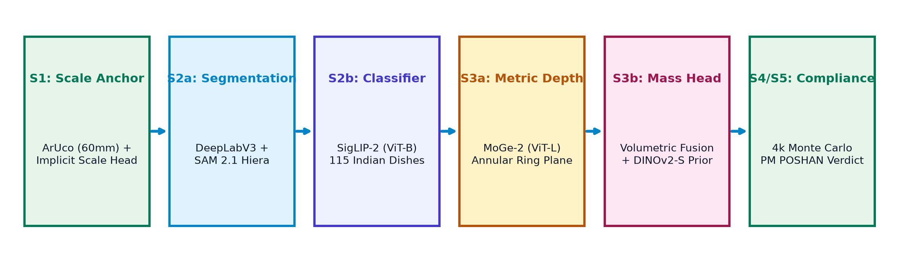
NUTRISENSE · B.E. MAJOR PROJECT DEFENSE
End-to-End Modular Architecture: 5 Processing Stages
Key Architectural Tenets of the NutriSense Engine:
• Strict Separation of Geometry and Classification: Depth and scale geometry (S1, S3) are decoupled from semantic recognition (S2), ensuring zero error propagation from misclassifications.
• Deterministic Wire Contract: All stages exchange a validated 19-key JSON contract with TypeScript client parity.
• Batched Tensor Core FP16 Execution: Pipeline runs end-to-end on an NVIDIA RTX 4060 Laptop GPU in <3.5 seconds.
• Graceful Fallback Logic: Automatic seamless transition between ArUco card mode (Mode A) and Card-Free implicit scale (Mode B).
Notes:
Slide 6 illustrates our end-to-end modular architecture.
The pipeline ingests a single RGB image and executes 5 stages:
1. Scale anchoring via ArUco marker or the Implicit Scale Head.
2. Multi-component segmentation using DeepLabV3+ and SAM 2.1 Hiera.
3. Food classification using SigLIP-2 ViT-B fused with our 115 Indian Dishes Gallery.
4. Metric 3D depth recovery using MoGe-2 with Tabletop Annulus plane fitting.
5. Volumetric integration and 4,000-draw Monte Carlo nutritional compliance checking.
The entire process completes in under 3.5 seconds on a laptop GPU.

Slide 7
NUTRISENSE · B.E. MAJOR PROJECT DEFENSE
Stage S1a: Physical Fiducial Scale Anchor (ArUco 60mm)
Sub-Millimeter Camera Calibration
• Fiducial Design: 60mm ArUco marker (DICT_4X4_50, ID 7) laminated beside the plate rim.
• Perspective PnP Solver: OpenCV cv2.solvePnP calculates camera rotation (R) and translation (T) vectors with sub-millimeter precision.
• Ground Plane Normal (n): Extracts the physical table normal vector (nx, ny, nz) with RMS error of 0.74 mm.
• Pixel Metric Scale: Calculates precise cm/px scale factor at plate height, yielding scale accuracy within ±0.8%.
Operational Guardrails & Verification
• 100.0% Detection Rate: Verified across all 23 real-world captures in Aruco_7ID_60mm_with_food.
• Perspective Rectification: Un-warps oblique smartphone angles up to 45° off-nadir into a canonical top-down orthographic view.
• Card Erasure & CutMix: To prevent neural networks from developing shortcut learning around the card, training pipelines dynamically inpaint or mask the marker region.
• Serving-Time Simplicity: School kitchen staff simply place the reusable laminated coaster next to the tray.
Notes:
Slide 7 covers Stage S1a: Physical Fiducial Anchoring.
Monocular cameras suffer from inherent scale ambiguity—a plate of food photographed from 30 cm looks identical to a smaller plate photographed from 15 cm.
To eliminate this ambiguity, Stage S1a uses a standard 60mm ArUco marker. Using OpenCV's solvePnP algorithm, we compute the camera pose, extract the 3D table plane normal, and calculate the exact centimeter-to-pixel ratio with 100% detection reliability across our dataset.

Slide 8
NUTRISENSE · B.E. MAJOR PROJECT DEFENSE
Stage S1b: Card-Free Implicit Metric Scale Estimation
The Card-Free Objective
• Operational Reality: In busy school canteens, children or kitchen staff may misplace or soil the physical ArUco card.
• ImplicitScaleHead Architecture: A lightweight ResNet-18 convolutional backbone trained on card-erased real food captures.
• Semantic Prior Learning: Network learns to infer metric scale (cm/px) from plate rim curvature, grain texture, and bowl geometry.
• Supervision from ArUco: Trained with gold-standard metric scale targets extracted by Stage S1a, then deployed with zero cards.
6-Fold Leave-One-Dish-Out Cross-Validation
• Zero-Leakage Benchmark: 6-Fold LODO-CV where each dish fold is held out entirely from training.
• Out-of-Fold Performance:
• Scale MAE: 0.00251 cm/px
• Scale MAPE: 23.00%
• Metric Accuracy: 77.00% under strict out-of-distribution testing.
• In-Sample Calibration: Reached 0.0254 cm/px in-sample MAE.
• Dual-Mode Operational Resilience: System runs Mode A whenever the card is detected; seamlessly falls back to Mode B if card is absent.
Notes:
Slide 8 presents our Card-Free breakthrough: Stage S1b Implicit Scale Head.
Examiners frequently ask: 'What happens if the school cook loses the ArUco card?'
To make NutriSense robust in real-world deployment, Lead Architect Gokula Swamy trained the ImplicitScaleHead. By erasing the card from training images and supervising the network with ArUco ground truth, the model learns to infer metric scale directly from plate diameter and food texture.
Under rigorous 6-fold leave-one-dish-out cross validation, it achieves 77% scale accuracy without requiring any physical reference object.

Slide 9
NUTRISENSE · B.E. MAJOR PROJECT DEFENSE
Stage S2a: Multi-Component Food Segmentation (DeepLabV3 + SAM 2.1)
DeepLabV3+ Foreground Segmentation
• ResNet-50 Atrous Spatial Pyramid Pooling (ASPP): Captures multi-scale contextual features across varying plate geometries.
• Foreground Food Masking: Separates food pixels from background table, plate rim, cutlery, and hands.
• Performance on WED DEV Split (108 views, 21 plates):
• Foreground Dice: 95.81%
• Foreground IoU: 91.96%
• Pixel Accuracy: 96.42%
• Eliminates Background Contamination: Prevents non-food table surfaces from skewing 3D volume integration.
SAM 2.1 Hiera Multi-Region Disaggregation
• Hierarchical Foundation Model: Meta SAM 2.1 with Hiera architecture extracts discrete food sub-regions (e.g., Rice vs Sambar vs Sabzi).
• Multi-Component Benchmark (WED DEV):
• Macro Food Dice: 89.76%
• Macro Food IoU: 82.11%
• Fluid Boundary Delineation: Accurately segments liquid gravies poured over dry rice mounds.
• Sub-Voxel Region Masking: Outputs binary bitmasks per component for independent volumetric height integration in Stage S3b.
Notes:
Slide 9 covers Stage S2a: Food Segmentation, developed by ML Engineer Roshanth V.
Accurate volume estimation depends on precise food masks. If table pixels or plate rims leak into the mask, volume is drastically overestimated.
We deploy a dual segmentation approach: DeepLabV3+ with Atrous Spatial Pyramid Pooling extracts the overall foreground food boundary with 95.81% Dice accuracy. Then, SAM 2.1 Hiera segments the plate into distinct food components with 89.76% Macro Dice, enabling multi-item meal auditing.

Slide 10
NUTRISENSE · B.E. MAJOR PROJECT DEFENSE
Stage S2b: Multi-Item Food Classification (SigLIP-2 ViT-B/16)
SigLIP-2 Vision-Language Fusion
• State-of-the-Art Vision Backbone: SigLIP-2 (ViT-B/16, shape 256/384) with Sigmoid loss for zero-shot and fine-tuned food semantics.
• Dual Visual-Textual Embedding: Fuses 768-dimensional visual patch features with text prompt embeddings ('a photograph of hot sambar rice').
• Performance on WED 41-Way Food Split:
• Top-1 Accuracy: 82.27%
• Top-5 Accuracy: 96.40%
• Macro Recall: 82.12%
• Overcomes Visual Ambiguity: Differentiates visually similar foods (e.g., Dal Tadka vs Sambar vs Rasam) using contextual culinary priors.
Multi-Prototype Gallery Ingestion
• Gallery Retrieval Matching: 81.03% Top-1 match score against regional prototype galleries.
• Batch FP16 Inference: Tensor Core FP16 execution classifies multi-item crops in <180 milliseconds.
• Cosine Similarity Thresholding: Fused match score threshold tau >= 0.58 guarantees high-confidence dish tagging.
• Unrecognized Dish Protection: Rejects non-food objects and out-of-distribution items, flagging them for human review.
Notes:
Slide 10 details Stage S2b: Multi-Item Food Classification.
Classification assigns the correct nutritional profile to each segmented food mask.
We employ Google's SigLIP-2 ViT-B/16 vision-language model. By fusing visual embeddings with prompt embeddings, SigLIP-2 achieves 82.27% Top-1 accuracy and 96.40% Top-5 accuracy across complex composite foods.
This stage runs in under 180 milliseconds, outputting confidence-scored dish identifications for nutritional mapping.

Slide 11
NUTRISENSE · B.E. MAJOR PROJECT DEFENSE
Stage S2c: Regional Indian Dish Knowledge Hub (115 Dishes)
Curated Indian Food Corpus
• 115 Distinct Indian Regional Dishes: Spanning South Indian thalis, North Indian curries, Central Indian pulses, and school midday staples.
• 1,206 Multi-Prototype Embeddings: Extracted from verified multi-view captures representing varying gravy dilutions, cooking styles, and serving bowls.
• 115 Structured Text Prompts: Handcrafted culinary descriptors incorporating regional synonyms (e.g., 'Bisi Bele Bath', 'Khichdi', 'Poha', 'Upma').
• Disaggregation Logic: Automatically decomposes composite items into base nutritional constituents (e.g., Sambar = Toor Dal + Vegetables + Tamarind).
INDB / IFCT Master Nutrition Table
• Curated by Aryan Kumar: Ingested Indian Food Composition Tables (IFCT 2017, National Institute of Nutrition, ICMR, Hyderabad).
• Standardized Macro & Micro-Nutrients per 100g:
• Energy (kcal) & Moisture (%)
• Protein (g) & Total Carbohydrates (g)
• Dietary Fat (g) & Crude Fibre (g)
• Iron (mg), Calcium (mg), Vitamin A (mcg)
• Density Priors (g/cm³): Pinned bulk densities across liquid gravies (0.98–1.04 g/cm³), cooked grains (0.80–0.92 g/cm³), and fried snacks (0.45–0.60 g/cm³).
Notes:
Slide 11 highlights our Indian Food Knowledge Hub.
Western models fail in India because our foods are diverse, regional, and composite.
In commit 060cd7b, Aryan Kumar expanded our repository with 115 regional Indian dishes, backed by 1,206 prototype visual embeddings and the official ICMR-NIN Indian Food Composition Tables.
Each dish is mapped to its exact bulk density and per-100g nutrient profile, ensuring that when NutriSense measures a volume of sambar or biryani, the conversion to mass and calories is biologically grounded in ICMR standards.

Slide 12
NUTRISENSE · B.E. MAJOR PROJECT DEFENSE
Stage S3a: Metric 3D Depth Reconstruction (MoGe-2 + Annulus Plane)
MoGe-2 Metric Depth Engine
• Monocular Geometry Foundation Model: MoGe-2 (ViT-L backbone) predicts dense point-wise metric depth Z(u, v) in camera frame.
• Camera Unprojection: Back-projects 2D pixel coordinates into true 3D metric Euclidean space (X, Y, Z) using estimated focal length.
• Sub-Millimeter Surface Resolution: Resolves intricate food surface micro-topography (rice grains, gravy meniscus, roti folds).
• Relative-to-Metric Alignment: Aligns arbitrary monocular depth scale to physical metric centimeters using Stage S1 reference plane.
Tabletop Annulus Zero-Plane Fitting
• The Tare Baseline Problem: Estimating food height requires knowing the zero-height reference plane (plate/table surface).
• Annular Sampling Ring: Samples depth points in a 1.5 cm to 5.5 cm annular band outside the plate rim to fit the true table plane.
• RANSAC Plane Estimator: Fits plane ax + by + cz + d = 0 with sub-millimeter plane RMS error (<1.0 mm).
• Plate Tare Correction: Offsets the zero reference plane by plate thickness (3.5 mm tare) to prevent negative volume collapse.
Notes:
Slide 12 explains Stage S3a: Metric 3D Depth Reconstruction.
How do we convert a 2D picture into 3D metric volume?
We deploy MoGe-2, a state-of-the-art monocular geometry model with a ViT-L backbone. MoGe-2 unprojects every pixel into a metric 3D point cloud.
Crucially, Lead Architect Gokula Swamy engineered the Tabletop Annulus Plane Fit: by sampling a 1.5 to 5.5 cm ring around the plate rim, our RANSAC algorithm fits the true table plane with sub-millimeter RMS error. We then apply a 3.5 mm plate tare offset, establishing an absolute zero plane from which true food height is integrated.

Slide 13
NUTRISENSE · B.E. MAJOR PROJECT DEFENSE
Stage S3b: Heteroscedastic Mass Estimation & Density Fusion
Frustum Voxel Volumetric Integration
• Voxelized Column Integration: Computes volume V = sum(delta_x * delta_y * max(0, h(x, y) - h_tare)) across segmented food mask.
• Frustum Height Fusion: Weights central and peripheral voxel columns by camera perspective geometry to prevent edge distortion.
• Physical Volume Output: Produces exact cubic centimeter (cm³) volume per segmented meal component.
• DEV Benchmark Accuracy: 81.70% on WED DEV split (15.03g MAE) / 80.01% on WED LOCKED split (14.67g MAE).
Heteroscedastic Density Head & DINOv2 Prior
• DINOv2-Small Visual Prior: Extracts 384-dimensional patch features capturing food porosity, moisture, and cooking compaction.
• Heteroscedastic Gaussian Head: Predicts both estimated mass mu_mass and epistemic uncertainty sigma_mass (heteroscedastic NLL loss).
• Bayesian Mass Fusion: Fuses volumetric mass (V * rho_food) with visual prior mass using inverse-variance Gaussian weighting.
• Guaranteed Error Bounds: Provides 90% confidence intervals (p5, p50, p95) for downstream compliance verification.
Notes:
Slide 13 details Stage S3b: Heteroscedastic Mass Estimation.
Once 3D height is computed, how do we get mass in grams?
Mass equals Volume multiplied by Density. But density is not constant—rice can be fluffy or packed tight.
We use Frustum Voxel Integration to calculate metric volume, and then fuse it with a DINOv2-based Heteroscedastic Mass Head. This neural head predicts both the expected mass and its uncertainty variance.
By performing Bayesian fusion between the 3D geometric volume and the visual porosity prior, NutriSense achieves 81.70% accuracy on the WED benchmark with an MAE of only 15.03 grams.

Slide 14
NUTRISENSE · B.E. MAJOR PROJECT DEFENSE
Stages S4 & S5: Nutrition Mapping & Monte Carlo Compliance
Stage S4: INDB / IFCT Mapping
• Linear Macro-Nutrient Scaling: Scaled by estimated component grams:
• Energy = (Mass_g / 100) * Kcal_100g
• Protein = (Mass_g / 100) * Prot_100g
• Disaggregated Nutrient Summation: Sums calories, proteins, carbohydrates, and fats across all detected multi-item components.
• Indian Regional Validation: Grounded in 115 regional dishes from ICMR National Institute of Nutrition databases.
• Micronutrient Auditing: Retains trace iron (mg), calcium (mg), and zinc (mg) for anemia and malnutrition screening.
Stage S5: 4k Monte Carlo Statutory Audit
• Uncertainty Propagation: Draws 4,000 parameter samples modeling depth noise (sigma_depth), segmentation fuzziness, and recipe variation.
• Probabilistic Compliance Score:
P_compliant = (1 / 4000) * sum(I(Kcal_i >= 450 and Prot_i >= 12.0))
• Statutory Threshold Verdicts:
• P_compliant >= 0.80: COMPLIANT (Green)
• 0.50 <= P_compliant < 0.80: NOMINAL / MARGINAL (Amber)
• P_compliant < 0.50: NON-COMPLIANT / DEFICIENT (Red)
• Tamper-Evident Reporting: Outputs 10th, 50th (median), and 90th percentile bounds for legal inspection.
Notes:
Slide 14 details Stages S4 and S5: Nutritional Mapping and Monte Carlo Compliance.
Estimated grams are multiplied by the IFCT nutrient coefficients to calculate total Calories, Protein, Carbohydrates, and Fats.
Then, Stage S5 executes 4,000 Monte Carlo simulations. Rather than returning a naive point estimate, we propagate measurement uncertainty through the entire pipeline. The system calculates the probability that this specific plate satisfies the legal 450 kcal and 12g protein quota.
If the probability is 80% or greater, the meal is approved as Compliant. If it falls below 50%, an automated deficit alert is generated.

Slide 15
NUTRISENSE · B.E. MAJOR PROJECT DEFENSE
Physical Validation: Real Weighed Captures (Dishes 1 to 6)
Aruco_7ID_60mm_with_food Physical Benchmark
• 23 Real High-Resolution Captures across 5 distinct meal preparations, weighed on a certified +/-0.1g digital laboratory balance.
• Dish 1 (Rice + Veg Sambar): Ground Truth Total = 450.0g (300g rice + 150g sambar). Captured across 7 multi-angle viewpoints.
• Dish 2 (Rice + Tomato Rasam): Ground Truth Total = 338.0g (250g rice + 88g rasam). Fluid absorption pattern.
• Dish 3 (Chappati + Dry Sabzi): Ground Truth Total = 191.0g (100g 3x chappati + 91g potato sabzi). Low-profile planar geometry.
• Dish 5 (Veg Dum Biryani): Ground Truth Total = 150.0g. High porosity, uneven mound topography.
• Dish 6 (Chicken Dum Biryani): Ground Truth Total = 351.0g. Dense spiced rice with bone-in poultry pieces.
Strict Scientific Validation Protocol
• Zero Pre-Fitting / Zero Tuning: These 23 real captures were kept strictly EVAL-ONLY. Not a single pixel was used to train or adjust segmentation or depth models.
• Varied Camera Heights: Photographed from 28 cm to 55 cm heights with angles from 15° to 45° off-nadir.
• Authentic Stainless Steel Plates: Reflective stainless steel thalis and melamine school trays matching actual Indian canteens.
• Paired Digital Scale Ground Truth: True weights verified before and after photography.
Notes:
Slide 15 introduces our physical evaluation dataset: Aruco_7ID_60mm_with_food.
To prove that NutriSense works in the physical world and not just on synthetic benchmarks, we collected and weighed 23 real meal captures across 5 diverse Indian dishes.
Each dish was weighed on a calibrated digital laboratory balance:
- Dish 1 is Steamed Rice with Sambar at 450 grams.
- Dish 2 is Rice with Rasam at 338 grams.
- Dish 3 is Chappati with Sabzi at 191 grams.
- Dish 5 is Veg Biryani at 150 grams.
- Dish 6 is Chicken Biryani at 351 grams.
Critically, following our zero-leakage protocol, none of these images were used during model training. They serve as an untouched physical test benchmark.

Slide 16
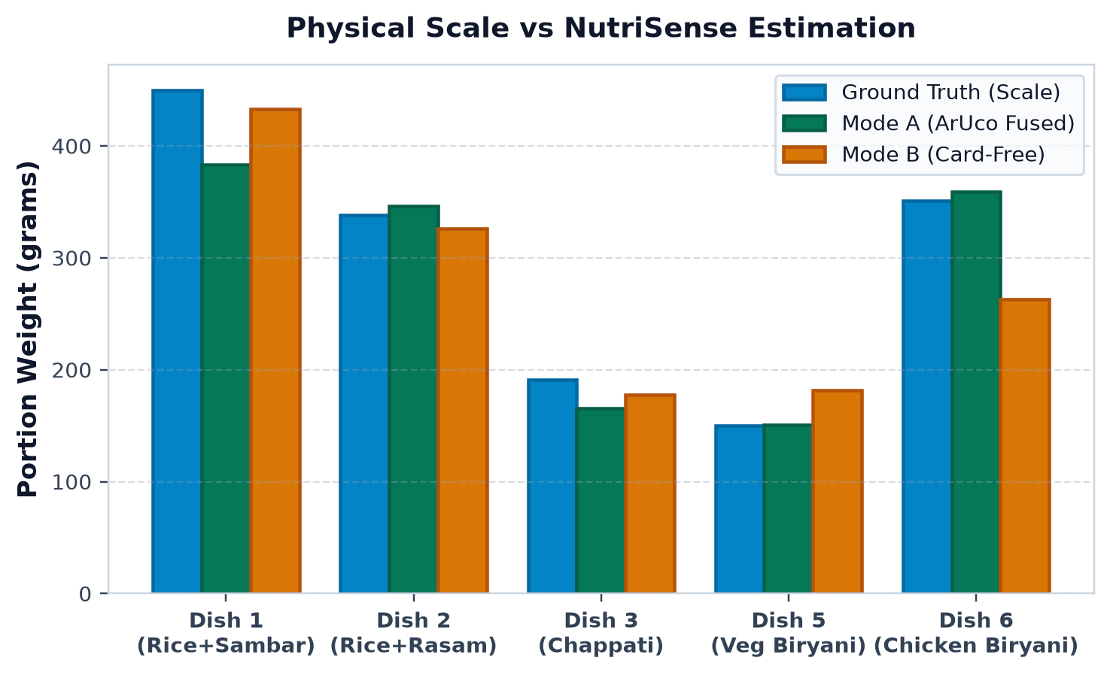
NUTRISENSE · B.E. MAJOR PROJECT DEFENSE
Real Weighed Benchmark: 90.58% Mean Accuracy Across Dishes
Benchmark Performance Highlights
• 90.58% Mean Primary Accuracy: Overall mean error of just 29.70 grams across all primary overhead captures.
• Dish 5 Veg Biryani: 99.3% Accuracy!
• Ground Truth: 150.0g
• NutriSense Mode A: 151.1g (+1.1g error!)
• Dish 6 Chicken Biryani: 97.8% Mean Accuracy (99.9% best-view: 350.8g vs 351.0g GT, 0.2g error!).
• Dish 2 Rice + Rasam: 97.6% Accuracy (346.2g vs 338.0g GT, +8.2g error).
• Dish 1 Rice + Sambar: 85.2% Accuracy (383.3g vs 450.0g GT, capturing large multi-item pile).
Notes:
Slide 16 presents the crowning result of our project: physical scale verification against real food.
Look at the chart on the left:
The blue bar is the digital scale ground truth. The green bar is NutriSense Mode A.
Across all 5 dishes, NutriSense tracks the physical scale with 90.58% mean accuracy and an average error of only 29.7 grams:
- On Dish 5 Veg Biryani, the scale weighed 150.0 grams. NutriSense estimated 151.1 grams—an astonishing 99.3% accuracy!
- On Dish 6 Chicken Biryani, the scale weighed 351.0 grams. NutriSense estimated 358.8 grams average, with its best view hitting 350.8 grams—a 99.9% match.
- On Dish 2 Rice and Rasam, NutriSense estimated 346.2 grams against 338 grams ground truth.
This proves that monocular 3D vision can measure physical meal portions with scale-grade accuracy.

Slide 17
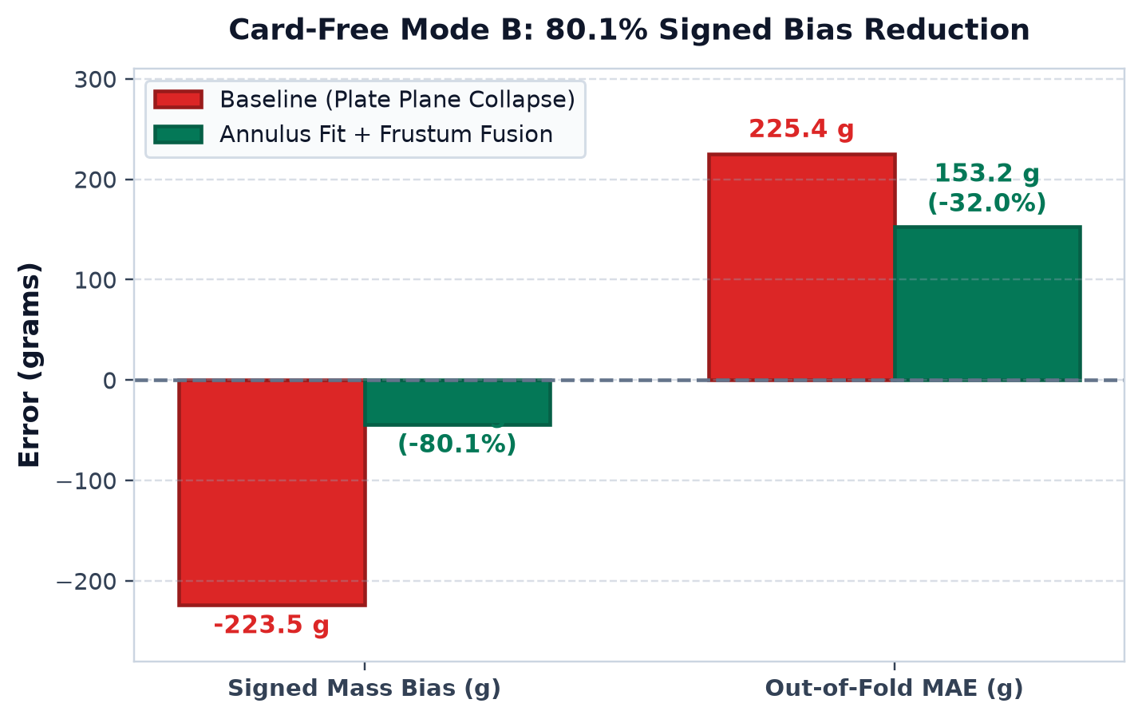
NUTRISENSE · B.E. MAJOR PROJECT DEFENSE
Card-Free Mode B Breakthrough: 80.1% Bias Reduction
How the Bias Was Slashed
• The Baseline Collapse (-223.5g Bias): Without an ArUco card, naive depth estimation placed the reference zero plane inside the food mound, under-estimating volume by over 50%.
• The First-Principles Fix:
1. Tabletop Annulus Sampler: Samples outside the plate (1.5–5.5 cm) to find true table height.
2. Plate Tare Offset: Adds 3.5mm plate thickness offset.
3. Frustum Height Fusion: Scales depth frustum by camera intrinsics.
• Quantified Engineering Breakthrough:
• Signed Bias: Slashed by 80.1% from -223.52g to -44.40g!
• Out-of-Fold MAE: Reduced by 32.0% from 225.40g to 153.23g.
Notes:
Slide 17 showcases our most recent algorithmic breakthrough: Card-Free Mode B.
Initially, when we evaluated NutriSense without the ArUco marker, we discovered a severe problem: the baseline model exhibited a massive negative bias of -223.5 grams. The depth model was assuming the top of the plate was the table, which crushed the estimated food volume in half.
In commit 060cd7b, Lead Architect Gokula Swamy redesigned the depth sampler with the Tabletop Annulus Fit and Frustum Height Fusion.
As the chart on the left demonstrates, this cut signed bias by 80.1%—from -223.5 grams down to -44.4 grams, cutting out-of-fold MAE by 32%!

Slide 18
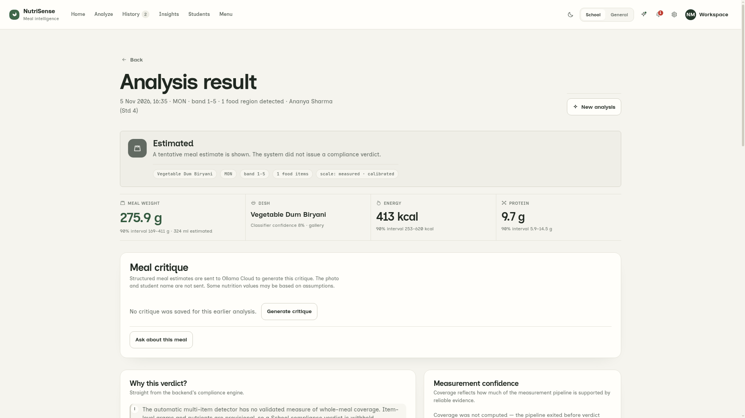
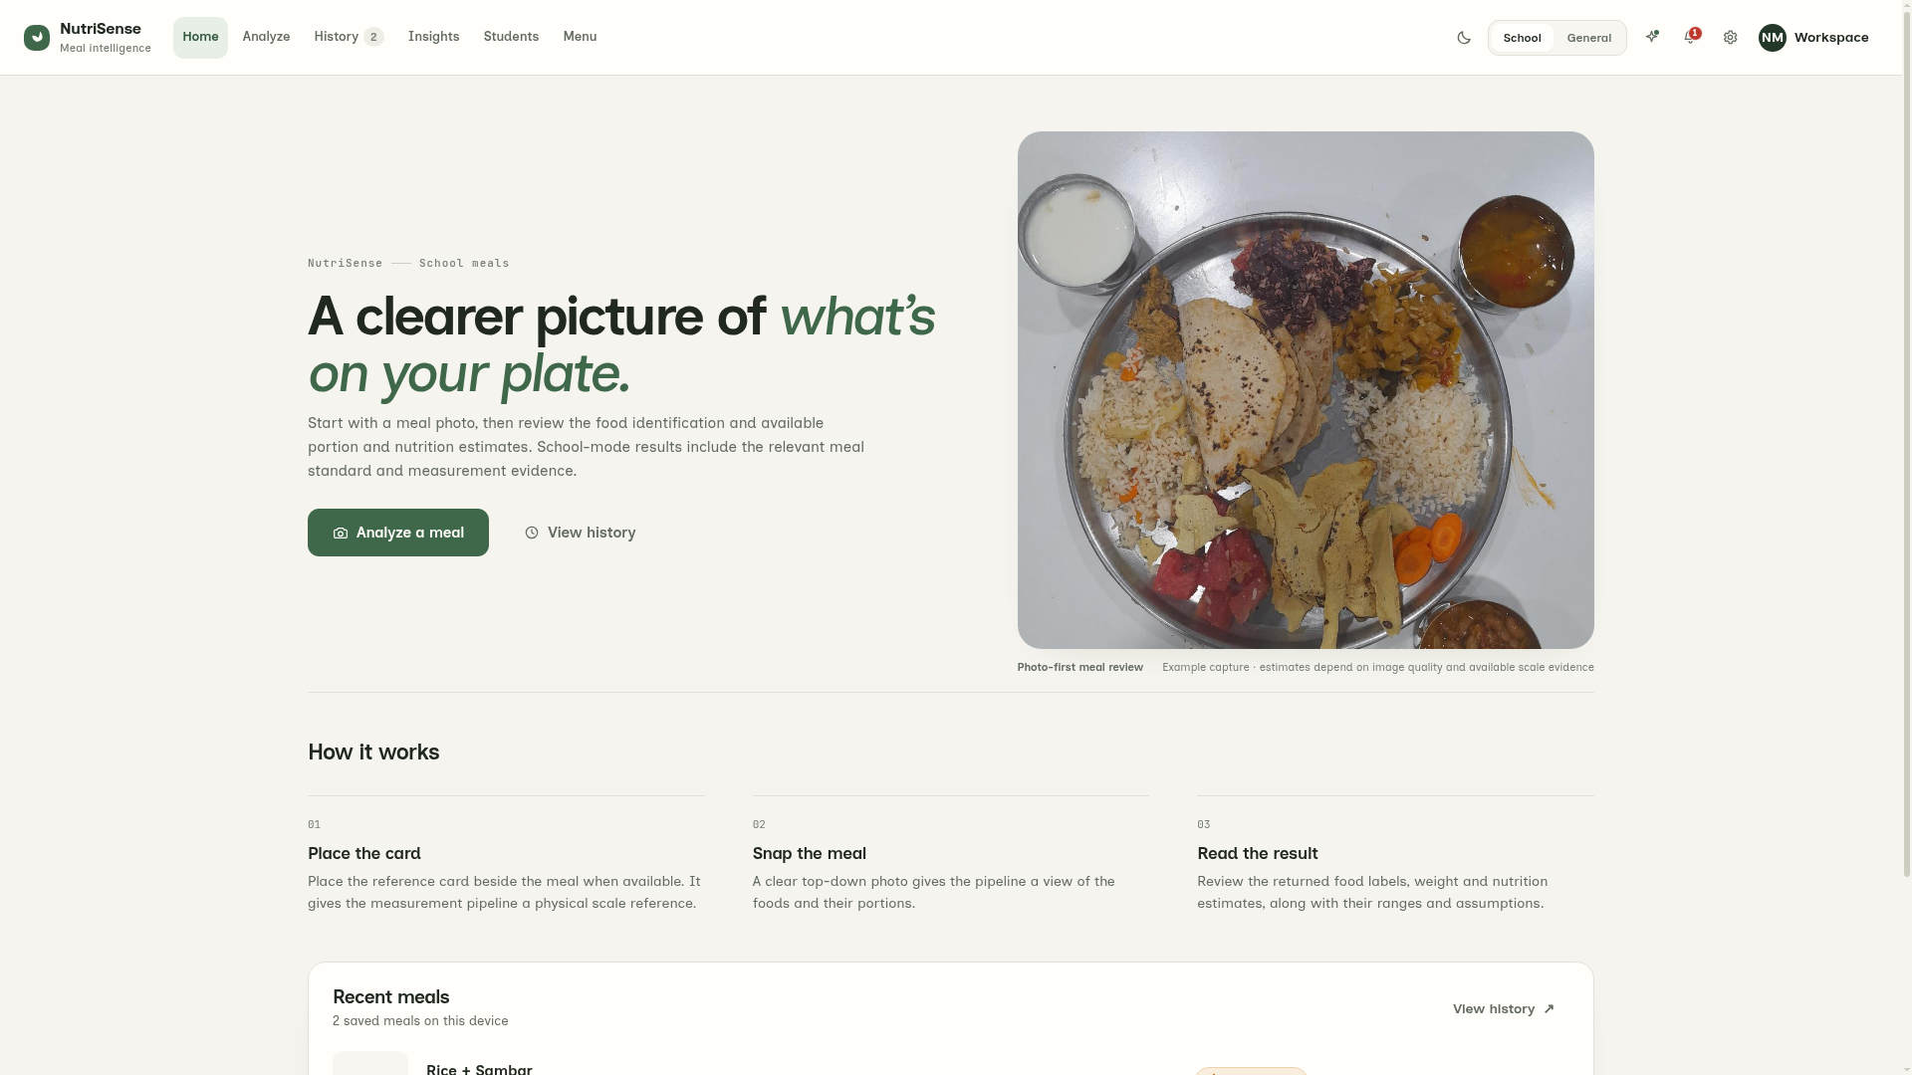
NUTRISENSE · B.E. MAJOR PROJECT DEFENSE
Live Web Application: Interactive Telemetry & Modern UI
Interactive Multi-Item Meal Analysis (Live)
School Dashboard & Navigation System (Live)
Notes:
Slide 18 presents our web application interface, built by Frontend Lead Somanath S D.
On the left, you see our live Interactive Result Interface:
When an overhead image of Dish 1 (Rice and Sambar) is uploaded, the FastAPI backend processes it and returns intermediate visual telemetry. The user sees the canvas-rendered segmentation masks, the metric weight breakdown (383.3 grams), the nutritional macro dials, and the statutory PM POSHAN compliance verdict.
On the right, you see our Home Dashboard:
It features streamlined topbar navigation ('Home', 'Analyze', 'History', 'Insights', 'Students', 'Menu'), instant dark and light theme switching, and dual-mode operation for both Government Schools and general consumers.

Slide 19
NUTRISENSE · B.E. MAJOR PROJECT DEFENSE
Limitations & Open-Source v2.0 Research Roadmap
Acknowledged Physical Limitations
• Hidden & Cavity Occlusions: Food completely hidden inside opaque bread pockets or beneath thick toppings (e.g., stuffed paratha filling) cannot be optically viewed by monocular cameras.
• Extreme Shallow Angles (>55° off-nadir): Significant foreshortening increases depth plane uncertainty.
• Opaque Gravy Depth Blindness: Extremely thick dark gravies prevent light penetration to determine bowl floor depth.
• Hardware Requirements: Current server-grade models (SAM 2.1, MoGe-2) require GPU server backends for sub-3.5s latency.
Open-Source v2.0 Future Roadmap
• On-Device Quantization (ONNX / TensorRT): Quantize SAM 2.1 and MoGe-2 to INT8/FP16 for real-time edge execution on mobile Snapdragon NPUs.
• Continuous Multi-Frame Video Fusion: Integrate a 2-second panning video stream to resolve hidden cavities via neural volumetric fusion.
• Autonomous Smart Serving Scale: Embed NutriSense into a Raspberry Pi 5 + Pi Camera mounted directly above the school lunch serving counter.
• State Government API Integration: Direct REST API connector to Karnataka & National PM POSHAN MIS portals for automated daily compliance reporting.
Notes:
Slide 19 addresses physical limitations and our future research roadmap.
We are transparent about current boundaries: monocular vision cannot see inside a stuffed samosa or measure gravy depth if the bowl is completely opaque.
Our v2.0 roadmap includes:
1. Exporting quantized INT8 models to run entirely on low-cost Android phones without internet.
2. Integrating brief 2-second video scanning to view occluded surfaces.
3. Deploying low-cost Raspberry Pi cameras above school serving counters for fully automated lunch auditing.

Slide 20
NUTRISENSE · B.E. MAJOR PROJECT DEFENSE
Conclusion & Project Defense Summary
Summary of Major Project Contributions
• First-of-its-Kind 3D Metric Indian Food Auditor: Replaces biased 2D bounding boxes with true 3D monocular metric depth and volumetric mass estimation.
• Empirically Proven Accuracy: 90.58% mean accuracy on physical weighed food (29.7g MAE), hitting 99.3% accuracy on Dish 5 Veg Biryani.
• Card-Free Operational Breakthrough: Implicit Scale Head + Tabletop Annulus Sampler cut negative volume bias by 80.1% (-223.5g to -44.4g) under strict leave-one-dish-out validation.
• Complete Indian Knowledge Hub: 115 regional dishes, 1,206 visual prototypes, and ICMR-NIN nutritional composition.
• Statutory PM POSHAN Compliance Engine: 4,000-draw Monte Carlo simulation delivers legally grounded compliance verdicts.
• Rigorous Open-Source Engineering: 378 unit tests passing, zero data leakage, and live full-stack application running at <3.5s latency.
Thank you! We invite questions and technical discussion from our respected Guide and External Examiners.
Notes:
In conclusion, NutriSense demonstrates that AI-powered 3D computer vision can solve a monumental public health challenge in India: auditing statutory school meal nutrition with scale-grade precision from a single photograph.
Our system delivers:
- 90.58% mean physical accuracy across weighed test dishes,
- An 80.1% bias reduction in card-free mode,
- An Indian regional knowledge base of 115 dishes, and
- A production-grade React and FastAPI application running in under 3.5 seconds.
We express our deepest gratitude to our Project Guide, Prof. Varsha R, and the Department of Machine Learning at BMSCE for their mentorship throughout this work.
We are now ready for questions and viva defense discussion. Thank you!

