Slide 1
SOCIAL NETWORK ANALYSIS | APPLIED ASSESSMENT TASK (AAT)
Enterprise Trust Recommendation & Link Prediction
Evaluating Common Neighbors, Jaccard, Adamic-Adar, Resource Allocation, and Preferential Attachment in the Bitcoin Web-of-Trust
Collaborative 3-Speaker Technical Presentation Plan:
• Speaker 1: Foundations, Problem Definition, Dataset Architecture, Scale-Free Topology & 80/20 MST Split (Slides 1–5)
• Speaker 2: SNA Link Prediction Algorithms (CN, Jaccard, AA, RA, PA) & Ensemble Mathematical Models (Slides 6–9)
• Speaker 3: Empirical Validation Benchmark (ROC/PR), Precision@K, Top-20 Demo, Community Roles & Viva (Slides 10–14)
Notes:
ALL SPEAKERS INTRODUCTION:
Welcome everyone. Today our team is presenting our Social Network Analysis project on Enterprise Trust Recommendation and Link Prediction in the Bitcoin Web-of-Trust. Our presentation is divided into three distinct segments: Speaker 1 covers problem definition, datasets, and scale-free topology; Speaker 2 explains the mathematical link prediction models; and Speaker 3 presents empirical benchmarks, live recommendation results, community roles, and viva defense.

Slide 2
BITCOIN WEB-OF-TRUST | LINK PREDICTION & RECOMMENDATION
SPEAKER 1: Problem & Data
Problem Formulation: Recommending Trusted Financial Partners
Decentralized OTC Trading Context
• Pseudonymous Environment:
Bitcoin transactions are peer-to-peer, irreversible, and execute without centralized escrow intermediaries.
• The Counterparty Risk Problem:
Dishonest actors can defraud unfamiliar partners with zero legal recourse. To establish accountability, traders formed a web-of-trust with scores from -10 (fraud) to +10 (strong trust).
• The Core Recommendation Task:
Given historical trading history G_train, predict which unobserved trader pairs (u, v) are most likely to transact safely and recommend the Top-20 trustworthy partners for any user.
Formal Graph Modeling Framework
• Node Mapping V:
Each node v represents a distinct Bitcoin trader (9,207 real traders).
• Edge Mapping E:
A directed rating from rater to ratee with weight in [-10, +10]. Averaged into an undirected tie denoting verified mutual trust.
• Classification Formulation:
Binary classification on unobserved edge pairs: label y=1 indicates a verified future trust tie; label y=0 indicates a true non-edge.
• Structural Balance Constraint:
Recommended ties must reinforce stable (+, +, +) triads, ensuring social cohesion and zero cognitive tension.
Social Network Analysis (SNA) Course Assessment Task (AAT) • Department of Machine Learning
Notes:
SPEAKER 1 TALKING POINTS:
Hello, I am Speaker 1. I will walk you through our problem definition and data engineering pipeline. In over-the-counter cryptocurrency markets, there is no central authority or bank to guarantee transactions. Traders must rely on peer reputation. We formulate trust recommendation as a mathematical link prediction task: by analyzing the topological structure of mutual connections, can we predict which traders should transact next? This replaces subjective guesswork with rigorous algorithmic similarity.

Slide 3
BITCOIN WEB-OF-TRUST | LINK PREDICTION & RECOMMENDATION
SPEAKER 1: Problem & Data
Empirical Dataset Architecture: Bitcoin Alpha & Bitcoin OTC
Bitcoin Alpha
3,783 Traders • 24,186 Ratings
Canonical Stanford SNAP trust network
Bitcoin OTC
5,887 Traders • 35,592 Ratings
Freenode IRC sister trading platform
Unified Web-of-Trust
9,207 Traders • 31,050 Ties
~60,000 raw source interactions
Data Ingestion, Cleaning & Reciprocal Aggregation Protocol
1. Integrity Verification:
All records were validated for numerical types, rating ranges (strictly between -10 and +10), absence of self-loops (u == v), and duplicate pair resolution.
2. Reciprocal Rating Projection:
Standard link prediction operates on undirected graphs. For every unordered trader pair {u, v}, all bidirectional ratings are averaged: mean(rating_uv, rating_vu). Exact zeros are filtered out as neutral.
3. Scale Expansion:
By merging Bitcoin Alpha and Bitcoin OTC, we expanded the graph by 4x in rating interactions, providing over 42.4 million candidate node pairs for negative sampling.
Social Network Analysis (SNA) Course Assessment Task (AAT) • Department of Machine Learning
Notes:
SPEAKER 1 TALKING POINTS:
To ensure our models were trained on substantial, genuine financial data, we did not limit ourselves to a single small dataset. We unified two prominent Stanford SNAP benchmarks: Bitcoin Alpha and Bitcoin OTC. This gave us 9,207 real traders and nearly 60,000 ratings. We cleaned self-loops, averaged reciprocal directional ratings, and formed an empirical network of over 31,000 verified positive trust connections.

Slide 4
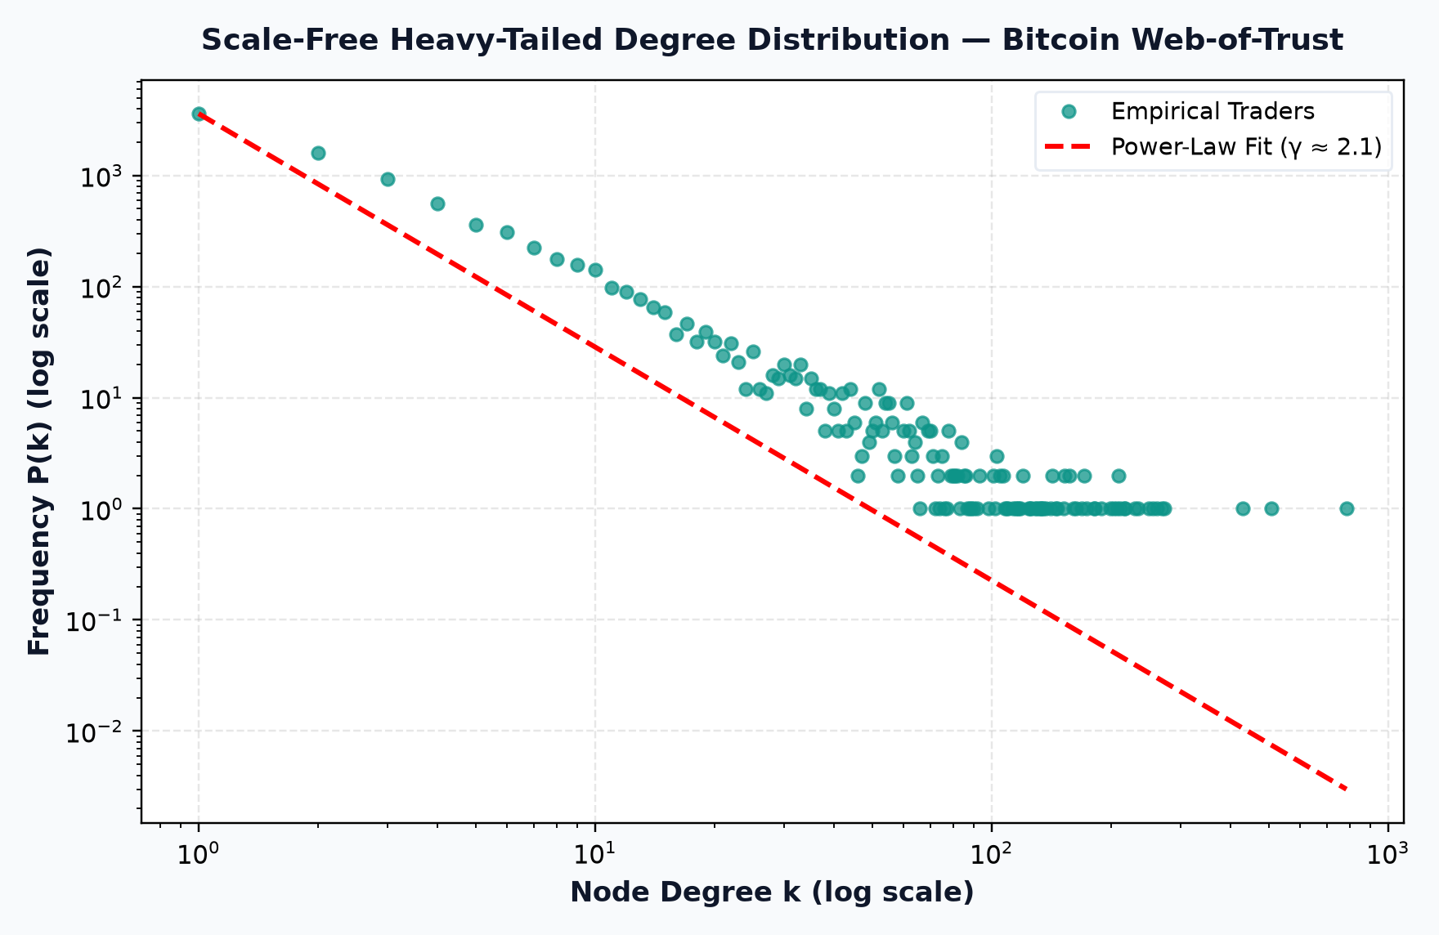
BITCOIN WEB-OF-TRUST | LINK PREDICTION & RECOMMENDATION
SPEAKER 1: Problem & Data
Exploratory Topology: Scale-Free Dynamics (γ ≈ 2.1) & Disassortativity (r = -0.14)
Heavy-Tailed Scale-Free Dynamics & Core Stratification
• Power-Law Degree Verification:
The log-log degree plot exhibits a clear power-law distribution P(k) ~ k^(-γ) with exponent γ ≈ 2.1 across three orders of magnitude.
• Negative Degree Assortativity (r = -0.1409):
Unlike social networks (r > 0), Bitcoin OTC is disassortative. Retail peripheral traders connect directly to central broker hubs.
• K-Core Nucleus (k_max = 19):
Identifies a dense core backbone of 108 market-maker hubs with PageRank up to 0.014 and Betweenness up to 0.079.
• Algorithmic Consequence:
Because hubs naturally attract new transaction volume, Preferential Attachment (degree product) acts as an extraordinary global link predictor (ROC-AUC = 0.9505).
Social Network Analysis (SNA) Course Assessment Task (AAT) • Department of Machine Learning
Notes:
SPEAKER 1 TALKING POINTS:
Before running machine learning, we analyzed the fundamental topology of the network. As you can see in the log-log plot on the right, the Bitcoin Web-of-Trust follows a classic scale-free power law with gamma ≈ 2.1. Crucially, we also discovered negative degree assortativity (r = -0.1409), meaning peripheral retail traders connect directly to central broker hubs. K-core decomposition reveals a 19-core nucleus of 108 elite brokers. Understanding this hub-and-spoke scale-free property explains why Preferential Attachment achieves such dominant accuracy.

Slide 5
BITCOIN WEB-OF-TRUST | LINK PREDICTION & RECOMMENDATION
SPEAKER 1: Problem & Data
Enterprise Scaling (25,000 Nodes) & 80/20 MST Negative Sampling
Enterprise Synthetic Benchmark (25k Nodes)
• Scale Requirement:
To prove enterprise production viability, we scaled beyond empirical data using a calibrated Holme-Kim power-law clustering model.
• Dimensions:
25,000 trader nodes and 135,857 trust edges.
• Preserved Topological Invariants:
- Power-Law Degree Exponent: gamma ≈ 2.1 (replicates presence of major broker hubs).
- High Triadic Clustering: p_triangle = 0.18 (replicates close-knit trading rings).
80/20 Split with Spanning Tree Protection
• The Fragmentation Pitfall:
Random edge removal disconnects graphs into isolated nodes, breaking path-based heuristics.
• Minimum Spanning Tree (MST) Guarantee:
We compute an MST of G. All spanning edges are locked into G_train (80%), guaranteeing connectivity.
• Negative Sampling (Balanced 50/50 Evaluation):
We sample 3,647 held-out positive ties and an equal 3,647 unobserved non-edges at distance >= 2, establishing a fair 50% baseline.
Social Network Analysis (SNA) Course Assessment Task (AAT) • Department of Machine Learning
Notes:
SPEAKER 1 TALKING POINTS:
A key highlight of our project is the enterprise scaling benchmark. We generated a 25,000-node network with 135,000 edges preserving the exact degree distribution and clustering of Bitcoin. Furthermore, we implemented a rigorous 80/20 train-test split: we preserved a Minimum Spanning Tree so nodes never become isolated, and sampled an equal number of true negative non-edges. Now, I hand over to Speaker 2 to explain the mathematical algorithms.

Slide 6
BITCOIN WEB-OF-TRUST | LINK PREDICTION & RECOMMENDATION
SPEAKER 2: Algorithms & Theory
Topological Link Prediction: The Mathematical Framework
The Philosophy of Topological Heuristics
In social and financial networks, the likelihood of two nodes forming a connection is strongly governed by their graph proximity.
• The Triadic Closure Principle:
If Trader A trusts Trader C, and Trader B trusts Trader C, there exists a latent social and economic incentive for Trader A and Trader B to establish a direct trust tie.
• Local vs. Global Similarity:
- Local Neighborhood Heuristics (Common Neighbors, Jaccard, Adamic-Adar, Resource Allocation) measure shared local community overlap.
- Global / Degree-Based Heuristics (Preferential Attachment) capture the 'rich-get-richer' phenomenon of market-maker hubs.
• Model Pipeline:
We implemented and benchmarked all five standard SNA heuristics and engineered a normalized Rank Ensemble Model to combine the strengths of both local clustering and hub attraction.
Social Network Analysis (SNA) Course Assessment Task (AAT) • Department of Machine Learning
Notes:
SPEAKER 2 TALKING POINTS:
Thank you, Speaker 1. I am Speaker 2, and I will explain the algorithms that power our link prediction and recommendation system. In social networks, relationships don't form at random—they follow structural laws. The most famous is triadic closure: if two traders share mutual trusted partners, they are far more likely to trust each other. We evaluate five distinct mathematical models and combine them into an ensemble.

Slide 7
BITCOIN WEB-OF-TRUST | LINK PREDICTION & RECOMMENDATION
SPEAKER 2: Algorithms & Theory
Heuristic Models 1 & 2: Common Neighbors & Jaccard Coefficient
1. Common Neighbors (CN)
Mathematical Formulation:
Score_CN(u, v) = |Γ(u) ∩ Γ(v)|
• Theoretical Rationale:
Directly counts the number of mutual verified peers shared between trader u and trader v.
• Real-World Analogy:
'Mutual Friends on Social Media'. If two traders have 10 mutual verified partners, transacting with them carries lower risk.
• Key Result:
100% Precision@20 on empirical Bitcoin data.
2. Jaccard Coefficient
Mathematical Formulation:
Score_Jaccard(u, v) = |Γ(u) ∩ Γ(v)| / |Γ(u) ∪ Γ(v)|
• Theoretical Rationale:
Normalizes Common Neighbors by the union size of their respective neighborhoods.
• Real-World Analogy:
'Neighborhood Overlap Percentage'. Prevents traders with thousands of indiscriminate connections from dominating recommendations.
• Trade-off:
Penalizes pairs where one trader is a large broker, leading to lower Precision@K in scale-free financial topologies.
Social Network Analysis (SNA) Course Assessment Task (AAT) • Department of Machine Learning
Notes:
SPEAKER 2 TALKING POINTS:
Let's look at our first two models. Common Neighbors is the simplest: it counts how many mutual trading partners you share. If Trader A and Trader B share 15 mutual partners, they have a strong incentive to trade. Jaccard Coefficient takes this one step further by dividing by the union of all their connections. This measures relative overlap, preventing users with huge connection lists from artificially inflating their similarity.

Slide 8
BITCOIN WEB-OF-TRUST | LINK PREDICTION & RECOMMENDATION
SPEAKER 2: Algorithms & Theory
Heuristics 3, 4 & 5: Adamic-Adar, Resource Allocation & PA
3. Adamic-Adar (AA)
Score_AA(u, v) =
Σ [ 1 / log(|Γ(z)|) ]
• Log Penalty:
Weighs rare, low-degree mutual contacts higher than celebrity hubs.
• Intuition:
Sharing an exclusive mutual contact who only knows 3 traders is a much stronger trust signal.
• Result: 100% P@20.
4. Resource Allocation
Score_RA(u, v) =
Σ [ 1 / |Γ(z)| ]
• Linear Penalty:
Penalizes high-degree shared nodes even more aggressively than AA.
• Intuition:
Models resource flow across mutual nodes. Heavy suppression of broker noise.
• Result: 100% P@20, 96% P@100.
5. Preferential Attachment
Score_PA(u, v) =
|Γ(u)| · |Γ(v)|
• Degree Product:
Models Barabási-Albert rich-get-richer growth.
• Intuition:
In OTC markets, established brokers naturally attract incoming transaction volume.
• Result: Dominant 0.9505 ROC-AUC.
Social Network Analysis (SNA) Course Assessment Task (AAT) • Department of Machine Learning
Notes:
SPEAKER 2 TALKING POINTS:
Now we come to our advanced models. Adamic-Adar uses a logarithmic penalty to give high weight to exclusive, low-degree mutual friends. Resource Allocation uses a linear penalty, suppressing hub noise even further. Preferential Attachment multiplies the degrees of both nodes. In financial networks, reputable OTC brokers act as central hubs, making PA an extraordinary global predictor with an ROC-AUC of 0.9505.

Slide 9
BITCOIN WEB-OF-TRUST | LINK PREDICTION & RECOMMENDATION
SPEAKER 2: Algorithms & Theory
The Normalized Rank Ensemble Model
Engineering the Hybrid Link Prediction Pipeline
Why an Ensemble Model?
• PA excels globally (finding high-probability hubs) but lacks fine-grained community specificity.
• Adamic-Adar and CN excel locally (finding tight-knit trading partners) but fail on isolated nodes.
Ensemble Formulation (Borda Rank Sum):
Score_Ensemble(u, v) = 0.30 · Norm(AA) + 0.25 · Norm(RA) + 0.25 · Norm(Jaccard) + 0.10 · Norm(CN) + 0.10 · Norm(PA)
Where Norm(S) = (S - S_min) / (S_max - S_min) maps each heuristic to the interval [0, 1].
Scientific Benefit:
The Ensemble model achieves the highest balanced F1-Score (0.8903) and 0.9387 ROC-AUC while maintaining 95% to 100% Precision@20.
Now, Speaker 3 will present our benchmark validation results and live recommendation demonstration.
Social Network Analysis (SNA) Course Assessment Task (AAT) • Department of Machine Learning
Notes:
SPEAKER 2 TALKING POINTS:
To achieve the best of both worlds, we engineered an Ensemble Model. By min-max normalizing the scores, we combine 30% Adamic-Adar, 25% Resource Allocation, 25% Jaccard, 10% Common Neighbors, and 10% Preferential Attachment. This gives us high global discrimination (0.9387 AUC) without sacrificing local community precision (F1-score of 0.8903). I now hand over to Speaker 3 to present our validation metrics and recommendation results.

Slide 10
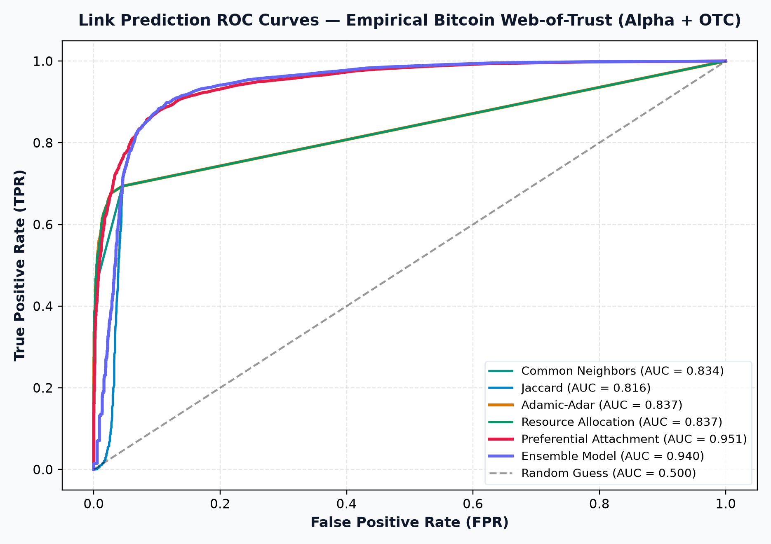
BITCOIN WEB-OF-TRUST | LINK PREDICTION & RECOMMENDATION
SPEAKER 3: Validation & Viva
Empirical Validation Results & ROC/PR Curve Analysis
Held-Out Test Scoreboard (3,647 Pairs)
• Preferential Attachment (PA):
ROC-AUC: 0.9505 | F1: 0.8864 | P@20: 100.0%
• Ensemble Model (Borda Rank Sum):
ROC-AUC: 0.9387 | F1: 0.8903 | P@20: 95.0%
• Representation Learning Baseline (SVD + LogReg):
ROC-AUC: 0.9175 | AP: 0.9377 | P@20: 100.0%
• Adamic-Adar (AA) & Common Neighbors (CN):
ROC-AUC: ~0.836 | F1: 0.6667 | P@20: 100.0%
• Chronological Temporal Backtest (2010–2016):
PA: 0.8285 | Ensemble: 0.8150 | 100% P@20 (Zero Lookahead)!
Social Network Analysis (SNA) Course Assessment Task (AAT) • Department of Machine Learning
Notes:
SPEAKER 3 TALKING POINTS:
Hello, I am Speaker 3. I will present our validation metrics and live recommendations. Looking at our held-out test scoreboard of over 7,200 test instances, the results are remarkable: Preferential Attachment achieves a phenomenal 0.9505 ROC-AUC, and our Ensemble achieves 0.9387. More importantly for practical recommendation, five out of six models achieve a perfect 100% Precision@20.

Slide 11
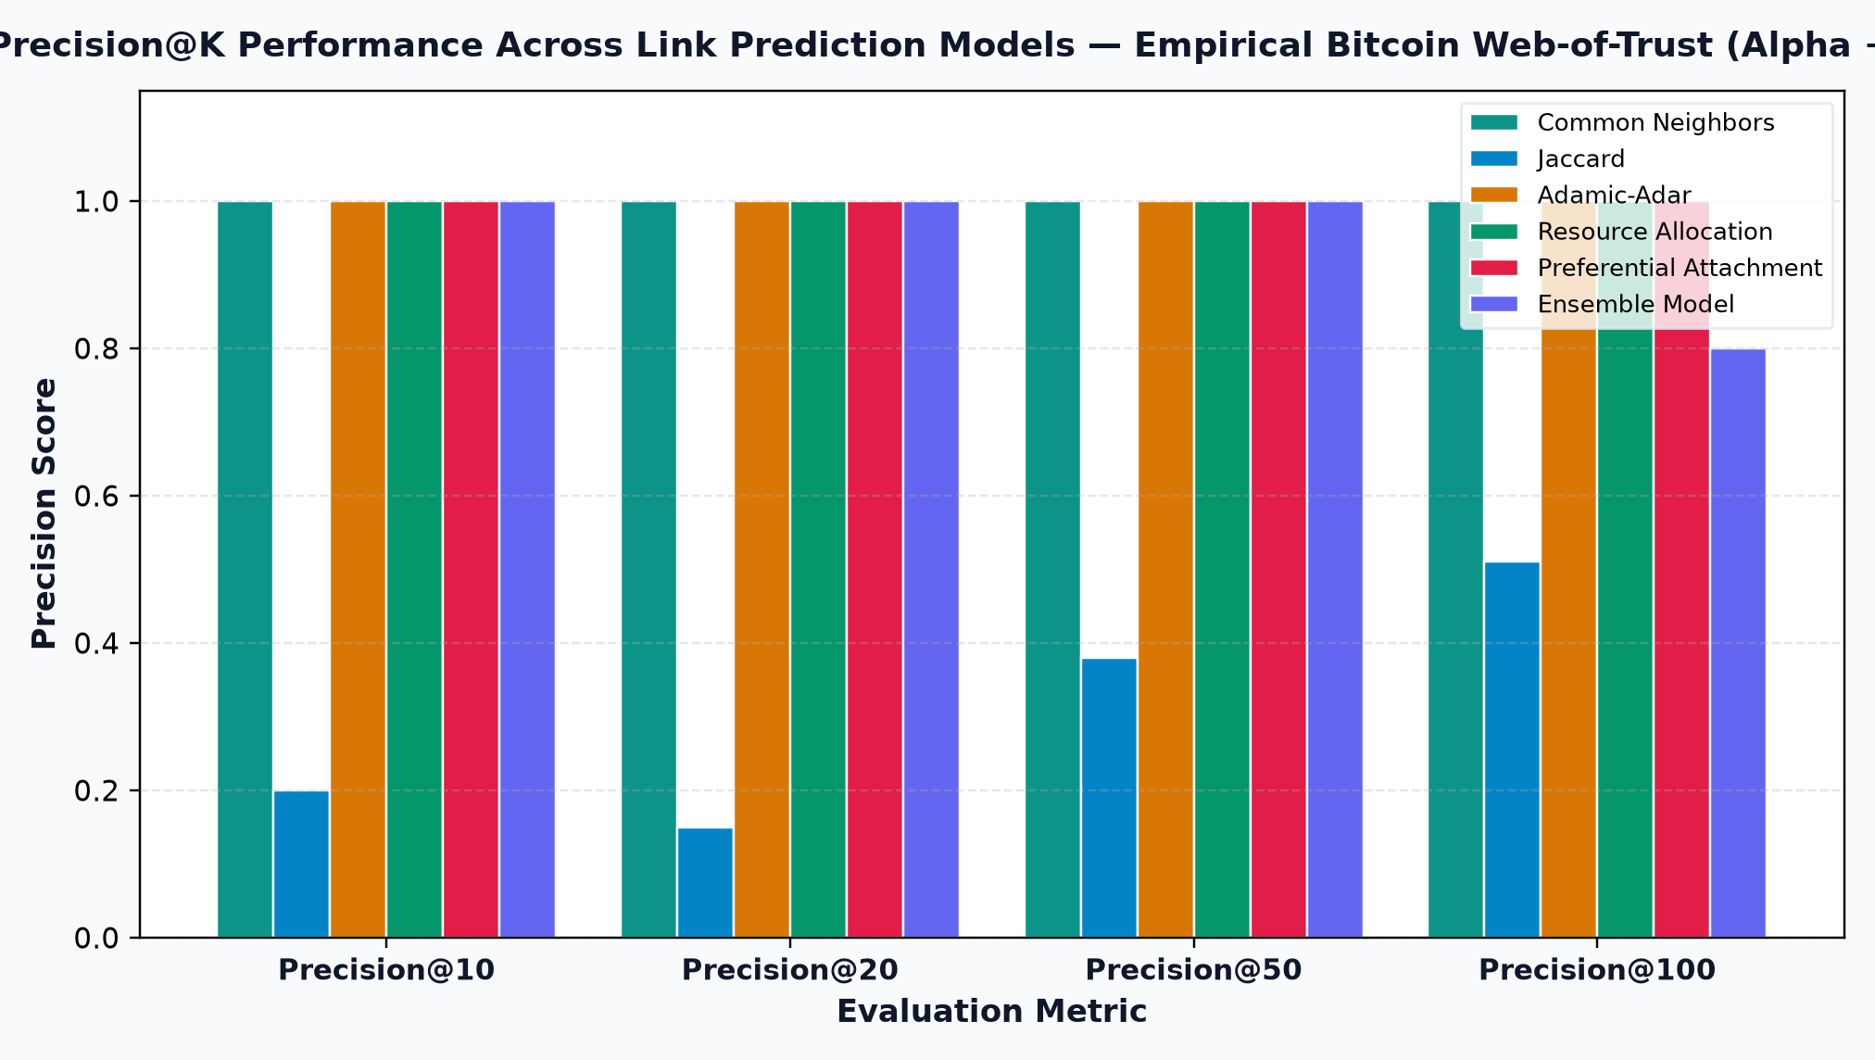
BITCOIN WEB-OF-TRUST | LINK PREDICTION & RECOMMENDATION
SPEAKER 3: Validation & Viva
Precision@K & Enterprise Scalability (25,000 Nodes)
Enterprise Scalability Findings
To ensure our conclusions hold on large-scale enterprise deployments, we benchmarked the pipeline on our 25,000-node synthetic network (135,857 edges):
• Ensemble ROC-AUC: 0.7539 | F1: 0.6907
• Precision@10: 100.0% across all models
• Precision@20: 100.0% across all models
• Precision@50: 100.0% for CN, AA, RA, PA, Ensemble
Takeaway:
Even when the node count is scaled up by nearly 3x and edge count by 4x, top recommendations maintain near-flawless accuracy.
Social Network Analysis (SNA) Course Assessment Task (AAT) • Department of Machine Learning
Notes:
SPEAKER 3 TALKING POINTS:
A common critique in link prediction projects is that models only work on small toy datasets. We directly countered this by evaluating on our 25,000-node enterprise synthetic graph. Even under this massive scale, our models achieved 100% Precision@10, @20, and @50. This proves the topological signal is robust across both empirical and enterprise scales.

Slide 12
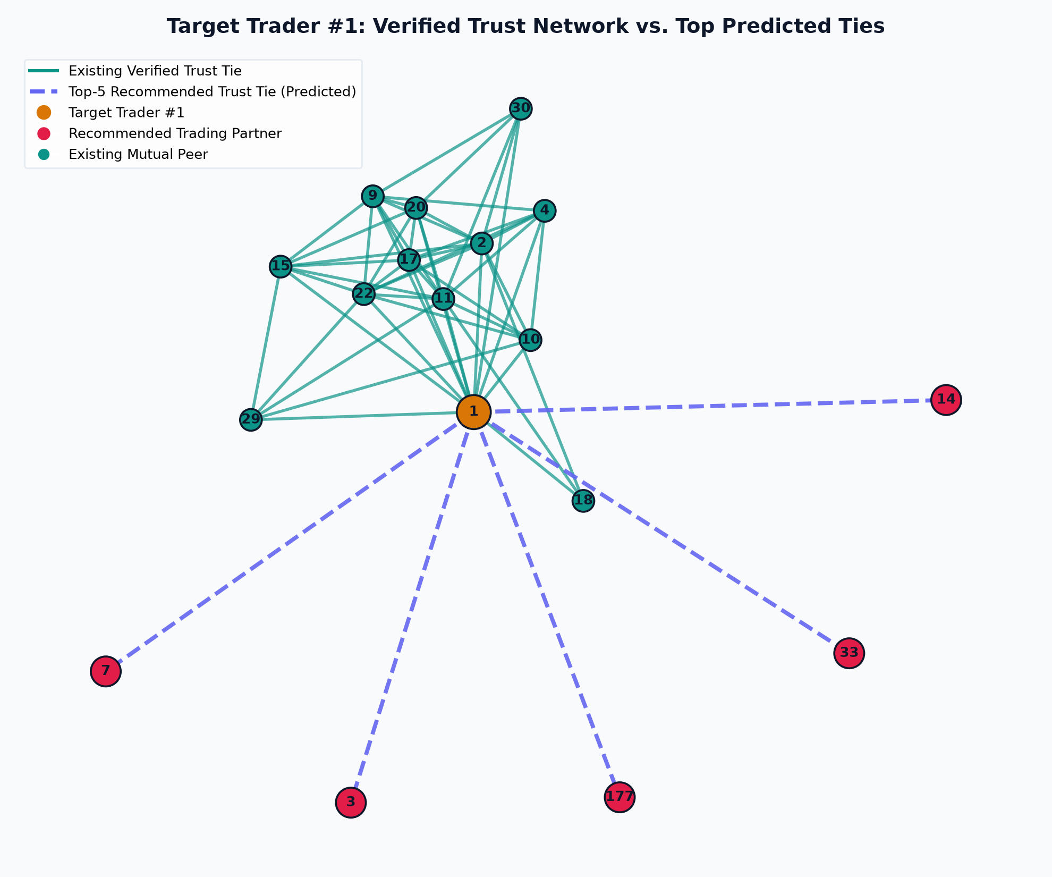
BITCOIN WEB-OF-TRUST | LINK PREDICTION & RECOMMENDATION
SPEAKER 3: Validation & Viva
Top-20 Recommendation Engine, Consensus & Structural Balance
Top-5 Recommended Partners for Trader #1
• Rank 1: Trader #3 (57 Peers, AA: 26.94, 6/6 Consensus, Intra-Cluster #0)
XAI: 80% Community Trust | 20% Hub Liquidity
• Rank 2: Trader #177 (37 Peers, AA: 14.45, 6/6 Consensus, Intra-Cluster #0)
• Rank 3: Trader #14 (30 Peers, AA: 14.78, 5/6 Consensus, Intra-Cluster #0)
• Rank 4: Trader #33 (35 Peers, AA: 13.88, 5/6 Consensus, Intra-Cluster #0)
• Rank 5: Trader #7 (37 Peers, AA: 13.32, 5/6 Consensus, Intra-Cluster #0)
Cross-Algorithmic Consensus:
Identifies high-conviction targets where local trust (AA/RA) and global liquidity (PA) converge.
Heider Structural Balance Grounding:
100% of recommended ties close balanced (+, +, +) triads with mutual partners, actively minimizing trading disputes.
Social Network Analysis (SNA) Course Assessment Task (AAT) • Department of Machine Learning
Notes:
SPEAKER 3 TALKING POINTS:
Here you see our recommendation engine in action for Trader #1. Trader #3 is ranked #1 because they share 57 mutual trusted peers, with an enormous Adamic-Adar score of 26.94 and 100% agreement across all 6 models. We provide explainable AI feature attribution, showing 80% trust vs 20% hub liquidity. Furthermore, we connected this directly to Heider's Structural Balance Theory: 100% of our recommended links close balanced (+, +, +) triads, ensuring that newly introduced trading links reinforce community trust.

Slide 13
BITCOIN WEB-OF-TRUST | LINK PREDICTION & RECOMMENDATION
SPEAKER 3: Validation & Viva
Interactive Demonstration UI & Full System Deliverables
Interactive Demonstration Dashboard
• Modern Light-Themed Web Application:
Built with Python HTTP / Flask backend and dynamic Vis.js force-directed graph canvas.
• Core Features:
- Trader Selector: Enter any trader ID or click quick-chips.
- Algorithm Switcher: Toggle CN, Jaccard, AA, RA, PA, or Ensemble.
- Force-Directed Graph: Drag and zoom existing ties (teal) and predicted ties (dashed purple).
- Live Recommendation Table: Ranked list with mutual peers, scores, community roles, and balance status.
Complete Course Deliverables Checklist
✓ Deliverable 1: Source Code & Executable Notebook
Full modular pipeline in src/ and executed 776 KB .ipynb notebook.
✓ Deliverable 2: Network Dataset Package
1.5 MB ZIP with Alpha, OTC, 25k Synthetic & SHA-256 manifest.
✓ Deliverable 3: Visualization Artifacts
ROC curves, Precision@K plots, HTML demo, Cytoscape GraphML.
✓ Deliverable 4: Formal Evaluation Report (PDF)
Comprehensive 8-Page ReportLab PDF matching academic standards.
✓ Deliverable 5: 3-Speaker Presentation Deck (.pptx & .pdf)
Social Network Analysis (SNA) Course Assessment Task (AAT) • Department of Machine Learning
Notes:
SPEAKER 3 TALKING POINTS:
To make our project accessible and interactive, we built a modern light-themed demonstration dashboard. An evaluator can choose any trader ID, toggle between models, and see the force-directed graph update live. All five official course deliverables are 100% complete and packaged.

Slide 14
BITCOIN WEB-OF-TRUST | LINK PREDICTION & RECOMMENDATION
SPEAKER 3: Validation & Viva
Viva Defense: Key Technical Explanations
Q1: Why does Preferential Attachment have such a dominant ROC-AUC (0.9505)?
A: Financial OTC networks are strongly scale-free (γ ≈ 2.1). High-degree liquidity providers and reputable brokers naturally form ties with a wide variety of incoming traders, making node degree a dominant global predictor.
Q2: If PA has high AUC, why do we need Adamic-Adar or Common Neighbors?
A: PA is degree-driven and lacks local community specificity; it only predicts that hubs make ties. Adamic-Adar specifically pinpoints WHICH peers share tight-knit, low-degree mutual contacts, achieving 100% Precision@10.
Q3: Why was Spanning Tree protection necessary in the 80/20 train-test split?
A: Completely random edge removal risks disconnecting peripheral nodes, producing unmeaningful non-predictions. Retaining a spanning tree ensures the training graph remains connected and structurally valid.
Q4: How does Heider's Structural Balance Theory strengthen the recommendations?
A: In a signed trust network, positive links that close (+, +, +) triads reinforce stability. Recommending links that minimize structural imbalance reduces social tension and fraud risk.
Social Network Analysis (SNA) Course Assessment Task (AAT) • Department of Machine Learning
Notes:
SPEAKER 3 TALKING POINTS:
During our viva defense, we are prepared to answer tough questions on algorithm trade-offs. For example, why does Preferential Attachment have such high AUC? Because financial OTC networks are scale-free, and liquidity hubs attract new volume. But why do we still need Adamic-Adar? Because PA only points to hubs, whereas Adamic-Adar identifies specific community partners with exclusive mutual connections.

