Slide 1
SOCIAL NETWORK ANALYSIS | COURSE PROJECT
Structural Balance
in the Bitcoin Alpha
Trust Network
85.64%
of observed closed triads
are structurally balanced
Compared with 76.94% under a fixed-topology sign shuffle
Positive and negative trust relationships in a signed social network
Submitted by: ____________________ USN: ______________
Submitted to: Course Instructor | Social Network Analysis
SNA COURSE PROJECT | STRUCTURAL BALANCE
01
Notes:
Introduce the study question: do trust and distrust ties form balanced triads more often than the same graph would under random reassignment of its signs? State that the headline is based on an undirected projection of the directed ratings. Source: Stanford SNAP Bitcoin Alpha dataset, https://snap.stanford.edu/data/soc-sign-bitcoinalpha.html

Slide 2
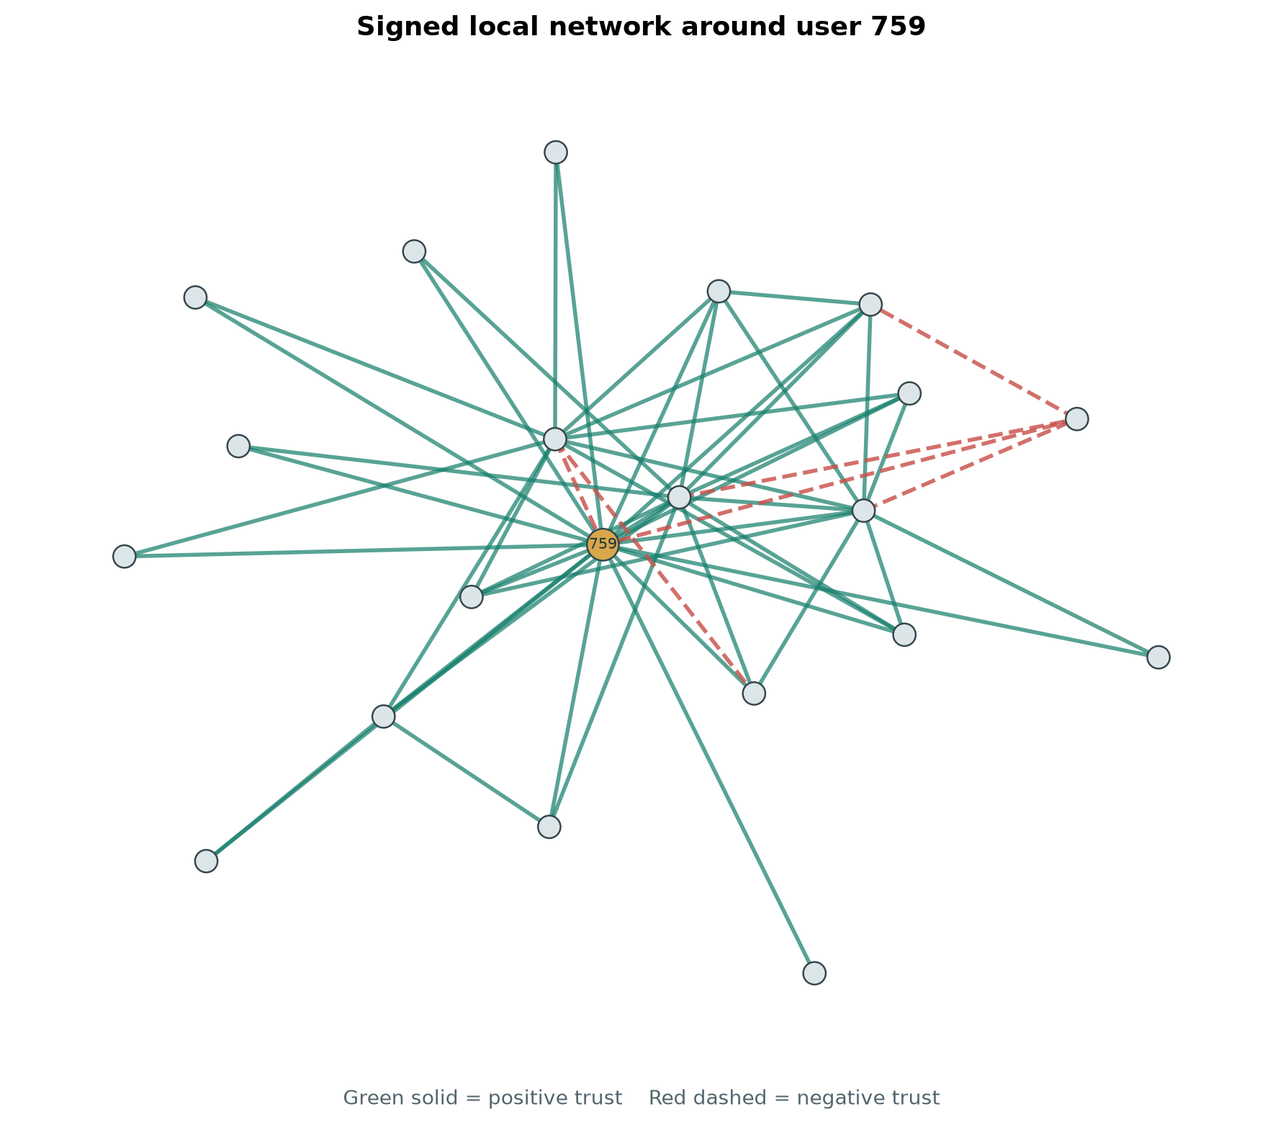
BITCOIN ALPHA TRUST NETWORK
Users rate trust from -10 to +10
3,783
24,186
user nodes
directed ratings
Each rating is a signed relationship from the rater to the ratee. Positive values express trust; negative values express distrust.
One local neighborhood. Green lines are positive, red dashed lines are negative.
SNA COURSE PROJECT | STRUCTURAL BALANCE
02
Notes:
The original SNAP records are directed ratings with source, target, rating, and timestamp. The local image is an ego network around user ID 759, selected for a readable neighborhood display; the identifier is anonymous and has no inferred real-world identity. Dataset source and citation: Kumar et al. (2016), https://snap.stanford.edu/data/soc-sign-bitcoinalpha.html

Slide 3
BITCOIN ALPHA TRUST NETWORK
Structural balance needs an undirected signed graph
To evaluate balance, reciprocal ratings are averaged for each unordered user pair.
01
02
03
24,186
14,124
14,081
directed ratings
unordered pairs
non-neutral signed ties
43 zero-mean pairs are excluded as neutral. The projection can hide disagreement between reciprocal ratings.
12,769 positive ties 1,312 negative ties
SNA COURSE PROJECT | STRUCTURAL BALANCE
03
Notes:
Explain the projection choice. Classical structural balance is evaluated on undirected signed ties, so ratings between user pairs are averaged. A positive mean gives sign +1; a negative mean gives sign -1; exact zero is neutral and excluded from the signed graph. The graph keeps all 3,783 source users, including those who become isolated. This is a modeling assumption and one of the study limitations.

Slide 4
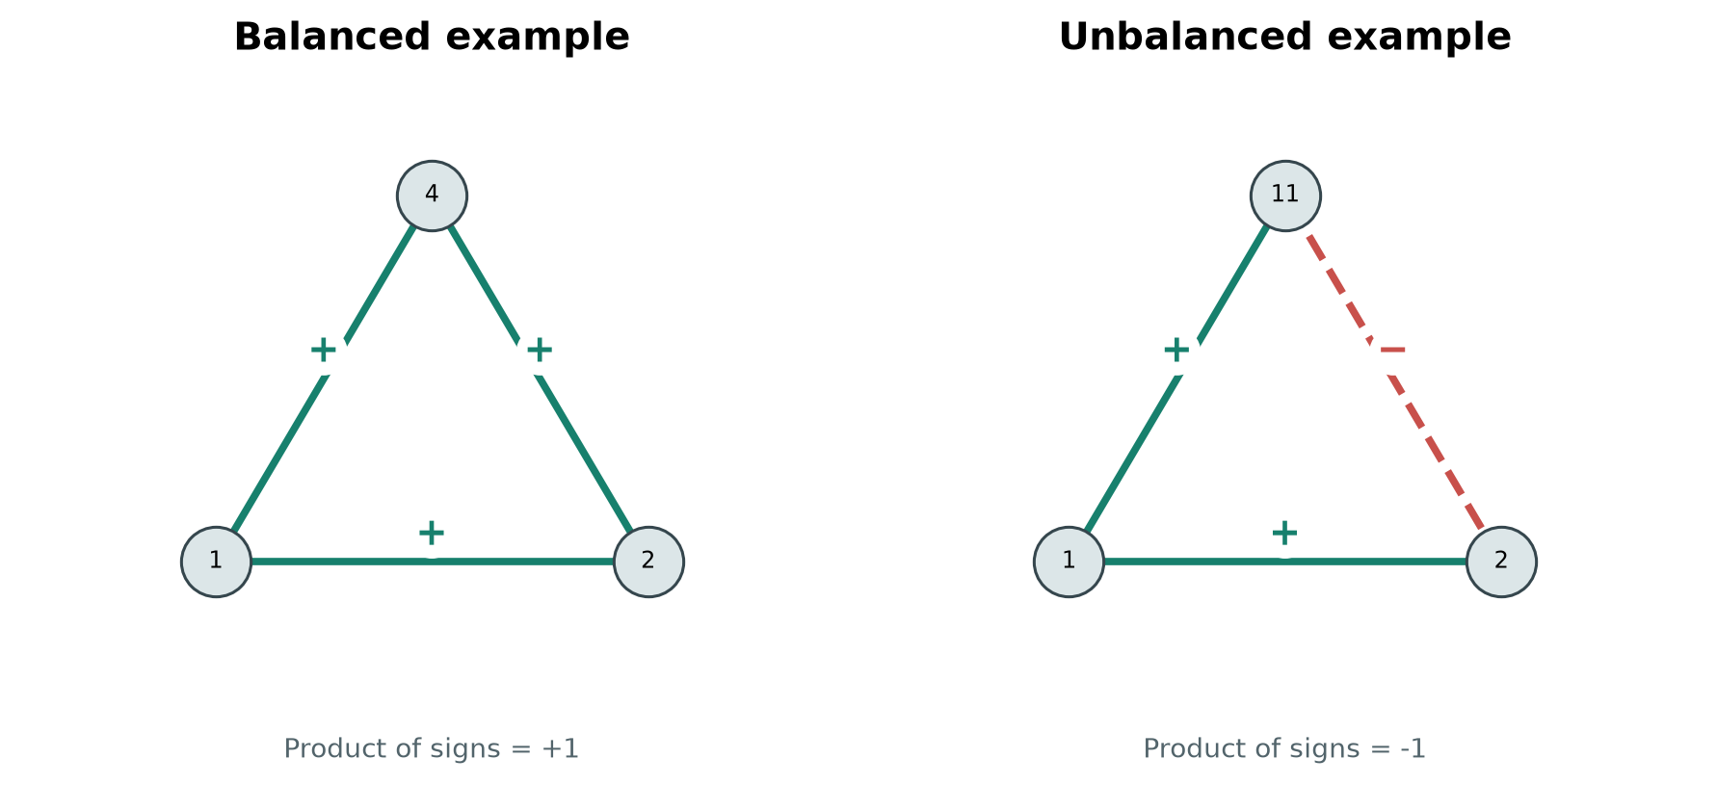
BITCOIN ALPHA TRUST NETWORK
A triad is balanced when its sign product is positive
For each closed triad, multiply the three edge signs.
Product +1: balanced
Product -1: unbalanced
SNA COURSE PROJECT | STRUCTURAL BALANCE
04
Notes:
The left example is all positive. The right example has two positive ties and one negative tie. Both have a positive product and are balanced. An odd number of negative edges gives a negative product and an unbalanced triad. The pictured triads are examples from the observed network. Structural balance is the positive/negative relationship topic in Unit 2 of the course syllabus.

Slide 5
BITCOIN ALPHA TRUST NETWORK
Positive trust dominates the projected ties
90.68%
of non-neutral ties
are positive
14,081
signed ties in the projection
The graph is sparse: density 0.00197. Its largest component contains 99.71% of users.
SNA COURSE PROJECT | STRUCTURAL BALANCE
05
Notes:
The chart is an editable PowerPoint chart. It shows 12,769 positive ties and 1,312 negative ties, a 90.68% positive share. Density is 0.001968. There are 8 connected components; the largest has 3,772 of 3,783 users (99.71%). Source: analysis of the SNAP dataset, https://snap.stanford.edu/data/soc-sign-bitcoinalpha.html

Slide 6
BITCOIN ALPHA TRUST NETWORK
Observed balance exceeds the sign-shuffle range
OBSERVED
85.64%
Null mean
76.94%
95% null interval
75.36%-78.52%
1,000 sign permutations
Plus-one p = 0.001
SNA COURSE PROJECT | STRUCTURAL BALANCE
06
Notes:
The editable column chart shows the distribution of 1,000 null fractions. Each permutation shuffles the observed edge signs over the same fixed graph, preserving the total counts of positive and negative ties. The observed fraction is 85.6438%, compared with a null mean of 76.9424% and a 95% central interval of 75.3561%-78.5211%. No permutation reached the observation. The plus-one upper-tail permutation p-value is 0.001, the smallest reportable value at 1,000 permutations. This null does not preserve per-node sign tendencies, edge weights, or time order.

Slide 7
BITCOIN ALPHA TRUST NETWORK
The result describes local triads, not every relationship
18,565
3,112
balanced triads
unbalanced triads
The observed balance rate is 8.70 percentage points above the null mean. Under this null, signs are arranged into more balanced closed triads than random reassignment would produce.
Interpret with care
Averaging reciprocal ratings can hide disagreement. The null keeps overall sign counts, but not each user's sign pattern. The data are historical and do not describe current platform behavior.
SNA COURSE PROJECT | STRUCTURAL BALANCE
07
Notes:
Clarify that 85.64% applies only to closed triads in this projected network. It does not mean that most users are harmonious or that the graph has a global two-faction structure. There are 3,112 unbalanced observed triangles. Results depend on the directed-to-undirected averaging rule and on the null model. The data timestamps span 2010-2015.

Slide 8
BITCOIN ALPHA TRUST NETWORK
Conclusion and study scope
Conclusion
Bitcoin Alpha has 85.64% balanced closed triads, above the 76.94% mean under the fixed-topology sign shuffle.
Interpretation boundary
The 85.64% result describes closed triads in an undirected projection. The null preserves graph topology and total sign counts, but not each user's sign tendencies. The analysis does not establish causality or a global two-faction structure.
Data and citation
Kumar et al. (2016), Edge Weight Prediction in Weighted Signed Networks.
SNAP dataset: snap.stanford.edu/data/soc-sign-bitcoinalpha.html
SNA COURSE PROJECT | STRUCTURAL BALANCE
08
Notes:
The study finds 85.64% of observed closed triads are balanced versus a null mean of 76.94%; none of 1,000 sign shuffles reached the observed rate. The p-value tests an upper-tail null probability for the stated permutation setup; it is not a probability that structural balance theory is true. The analysis is limited by the directed-to-undirected averaging rule and by a null that preserves only global sign totals. Cite the SNAP data page and Kumar et al. (2016): https://snap.stanford.edu/data/soc-sign-bitcoinalpha.html

