Slide 1
Verified-Agent Badge
customer-side agent verification
UNCLONE Track 3 · Day 1

Slide 2
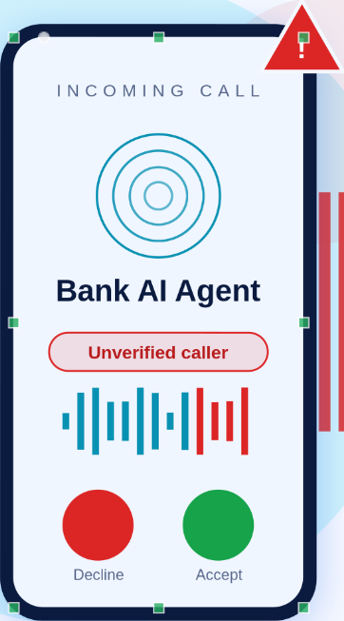
SLIDE 1
Problem
Who: a retail bank customer. Phone rings: “This is your bank's verification desk about a transaction of ₹86,499 on your card, above your limit.”
The moment someone tries to fool them: the “bank agent” on the line is an imposter — a live-cloned voice that sounds exactly like the real bank assistant, walking the customer into approving the payment or reading an OTP.
Why now: voice AI makes convincing real-time clones cheap; caller ID is spoofable, “the bank never asks for X” advice fails when the caller sounds like the bank. The customer has no way to verify who is speaking.
Stakes: one approval on a high-value/suspicious transaction = money gone, and the customer did everything “right”.
Judge link: https://unclone-verified-agent.onrender.com

Slide 3
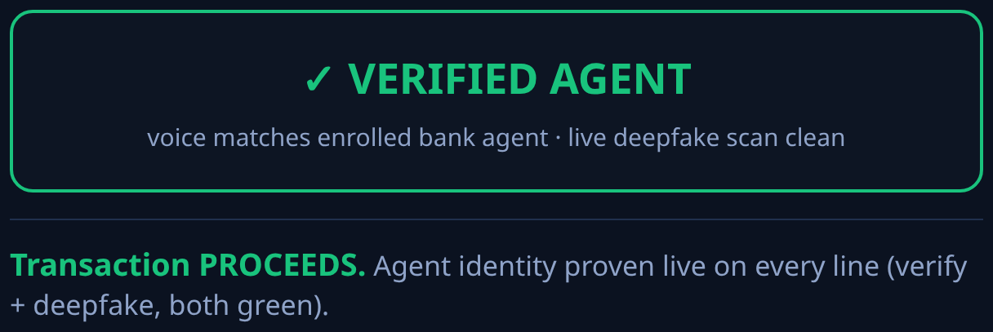
SLIDE 2
Solution
Verified-Agent Badge — the user side verifies the bank's agent. (Bank's own agent already authenticates us; nobody authenticates it.)
The customer's side runs an AI agent that checks every spoken turn of the call against the enrolled, known voice of the genuine bank assistant.
The badge drives the decision: green = conversation may proceed to the transaction step; red = transaction held, customer warned, call escalated.
Two scenarios, both live in the prototype: Call 1 above-limit (genuine agent → PROCEEDS), Call 2 suspicious (imposter hijack → HELD).
Zero customer effort: verification happens automatically on their side of the line.
Judge link: https://unclone-verified-agent.onrender.com

Slide 4
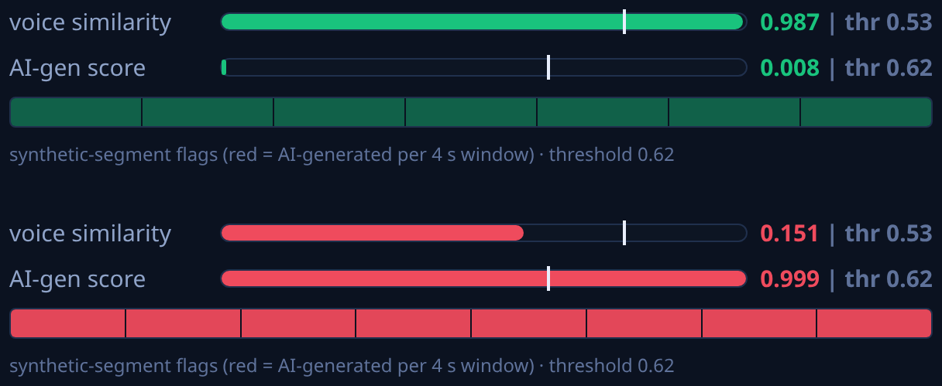
SLIDE 3
DetectifAI (tools disclosed here per rules 5.2)
Both APIs, one call: DetectifAI POST /v1/speakers/verify with detect_deepfake=true → speaker verification (matches the caller against enrolled bank_agent_1) and deepfake detection (is this speech AI-generated?) per turn.
Where it sits: middle of the call flow — browser call screen → FastAPI backend → DetectifAI → badge verdict → transaction decision. Taken out of the product, the badge has nothing to stand on and the product stops existing.
The decision it drives: match + genuine → approve (PROCEEDS); no_match or synthetic → block (transaction held, warn customer).
Live results from the prototype today: genuine voice → match, similarity 0.987 (thr 0.53), deepfake real 0.008 (thr 0.62); attacker TTS → no_match, 0.151, deepfake synthetic 0.999, per-4s synthetic segments flagged.
Tools used: DetectifAI (verify + deepfake detection) · FastAPI/Python · edge-tts (team-generated attacker voice) · ffmpeg · Render · GitHub · built with an AI coding assistant (Codebuff/Claude Code).
Judge link: https://unclone-verified-agent.onrender.com

Slide 5
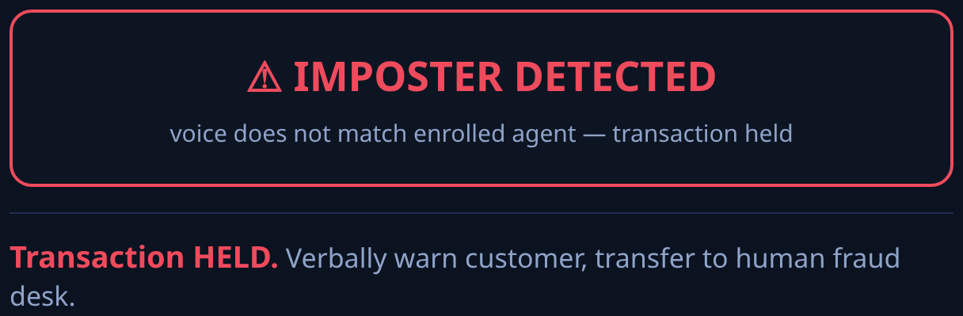
SLIDE 4
Impact
Who it protects: every customer on an outbound bank/NBFC/insurer verification call — the exact fraud moment DetectifAI itself was founded on.
What changes: the imposter call ends before the customer speaks a single secret; the genuine call gets a visible trust signal instead of anxiety.
Measured on the working prototype: ~2.5 s end-to-end per spoken turn; both decisions demonstrated live (approve 0.987 vs hold on 0.999-synthetic clone); no hardware, no customer onboarding beyond voice enrollment (15–60 s).
False-alarm posture: red never locks the customer out — it steps up to an alternate verified channel (in-app confirmation), so friction is bounded.
Judge link: https://unclone-verified-agent.onrender.com

Slide 6
SLIDE 5
Scale (incl. Day 2 plan)
Day 2 plan (nine hours, judge-gap driven):
1. Streaming deepfake check — feed the live call's audio continuously (DetectifAI's segment scoring already visualised in the UI) instead of per turn; deeper use of the API.
2. Verified-badge handshake — extend to agent-to-agent: any voice agent presents/enrolls its voice; a protocol-level “verified agent” attestation both directions.
3. Phone channel path — bridge the same check to PSTN/WhatsApp-audio calls (audio in → same API → same badge).
Scale: per-turn check costs 50+50 credits and ~2.5 s today — cheap enough to run on every suspicious transaction; enrollment reuses banks' existing voice-consent flows; the badge client is one API wrapper any call surface can embed.
Demo link (no login): https://unclone-verified-agent.onrender.com
Judge link: https://unclone-verified-agent.onrender.com

