Slide 1
LionDApp
A Seeker-native community layer for the Solana dApp ecosystem
Discover needs. Find builders. Explore 1,000+ official Store dApps.
Clock In Hackathon 2026 · Solo project · Native Android / Kotlin
01

Slide 2
PROBLEM
The missing layer between users and builders
Seeker users have ideas, but discovery is fragmented.
Need signal
community demand
Real product needs disappear in chat groups and social feeds.
→
Store context
Existing dApps are hard to compare in a community-first workflow.
builder action
Builder access
A focused, wallet-verified loop
Builders lack a clear, structured view of what Seeker users want next.
LIONDAPP · CLOCK IN 2026 · 02

Slide 3
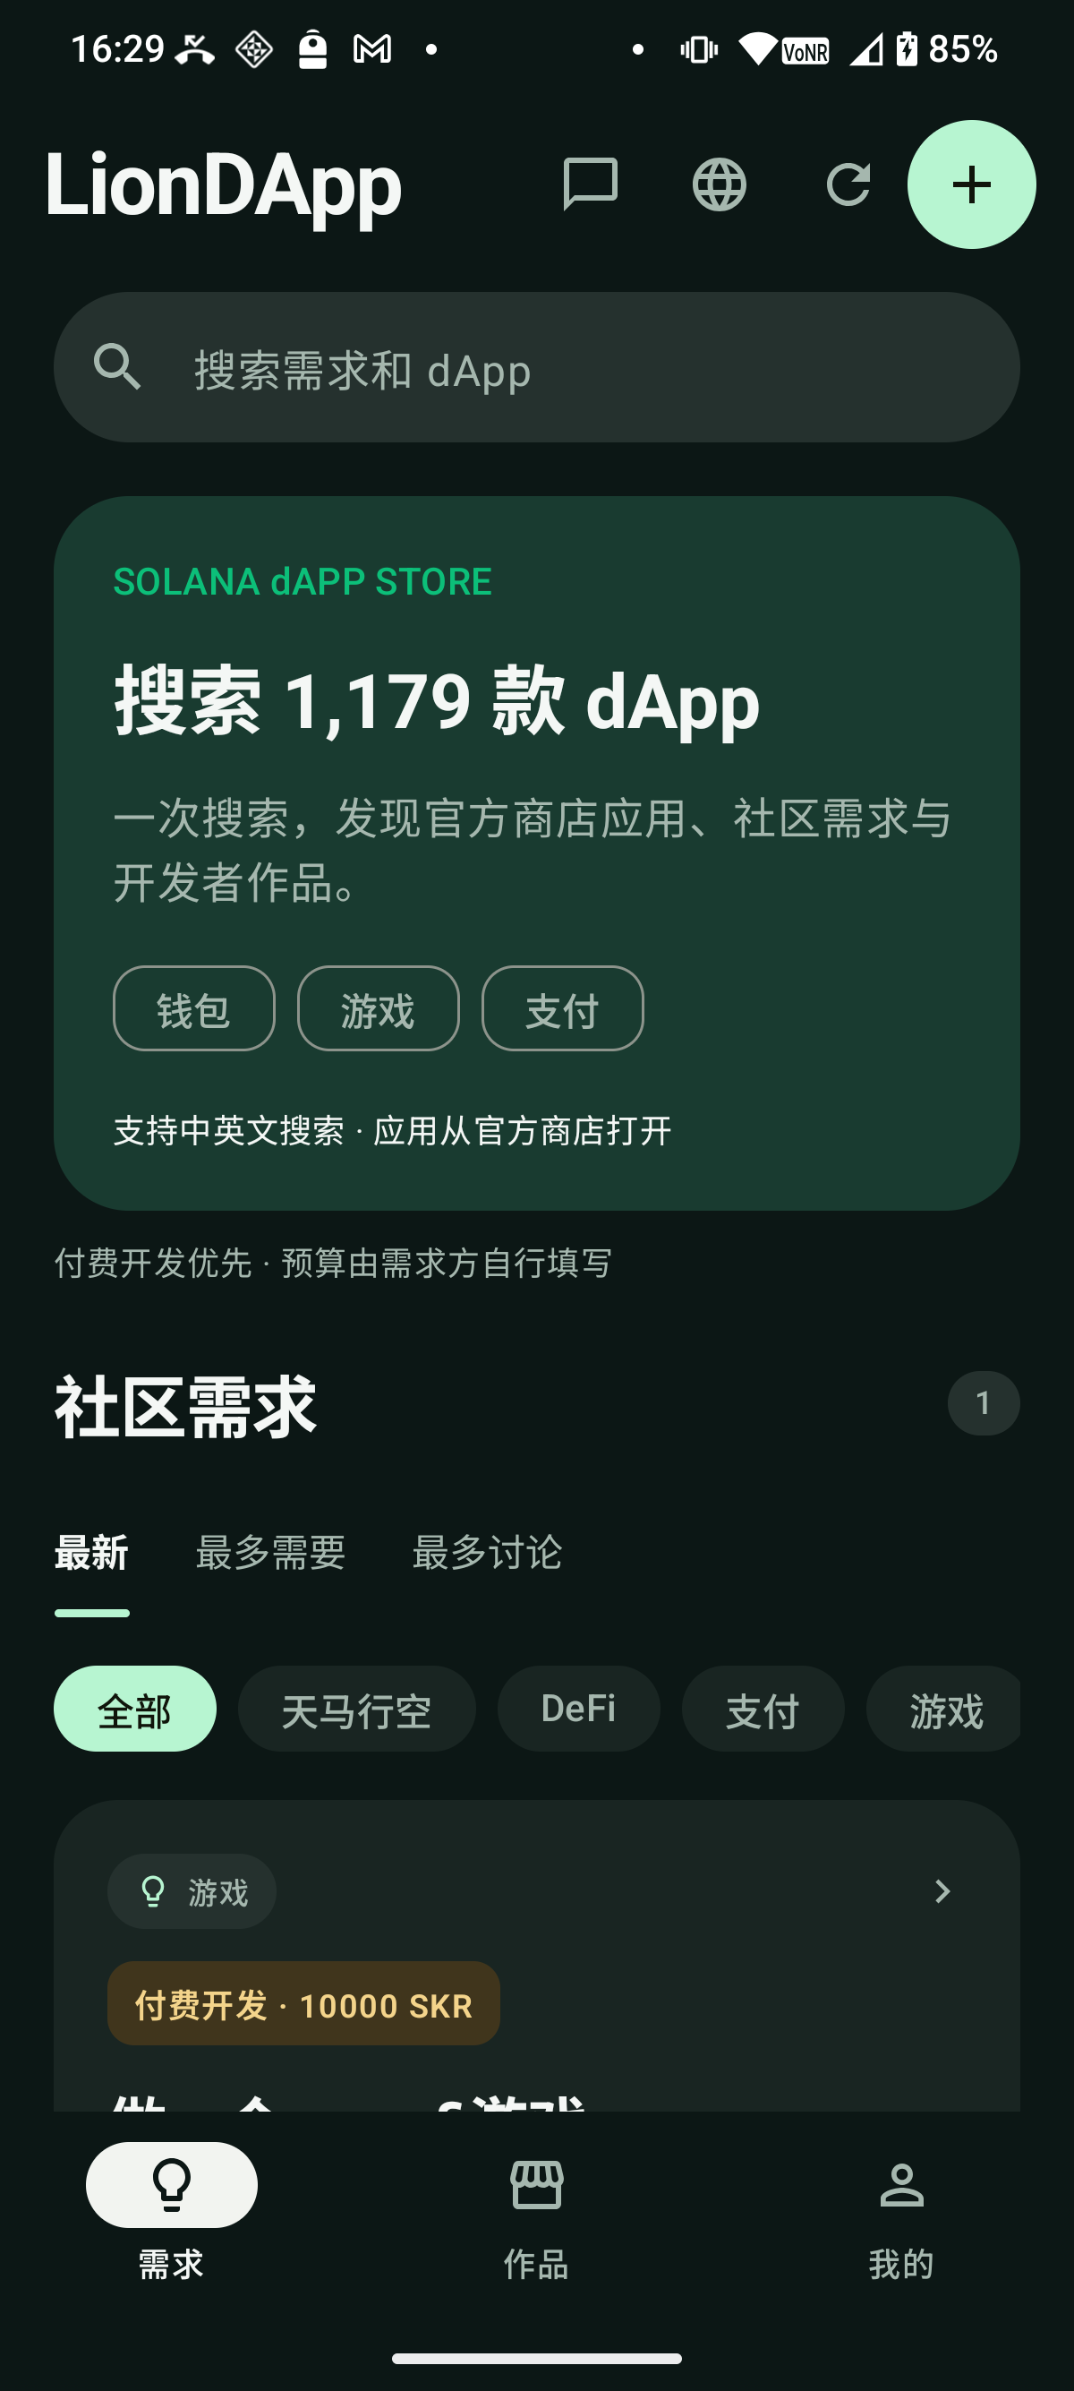
PRODUCT
One place to discover, request and build
1 Discover
Browse needs, works and an official Solana dApp Store catalog with bilingual detail.
2 Request
Publish structured needs or wild ideas with resilient drafts and moderation.
3 Connect
Open a private conversation with a developer; paid-development labels are optional and never escrowed.
4 Show work
Public profiles surface a user’s published needs and developer works.
LIONDAPP · CLOCK IN 2026 · 03

Slide 4
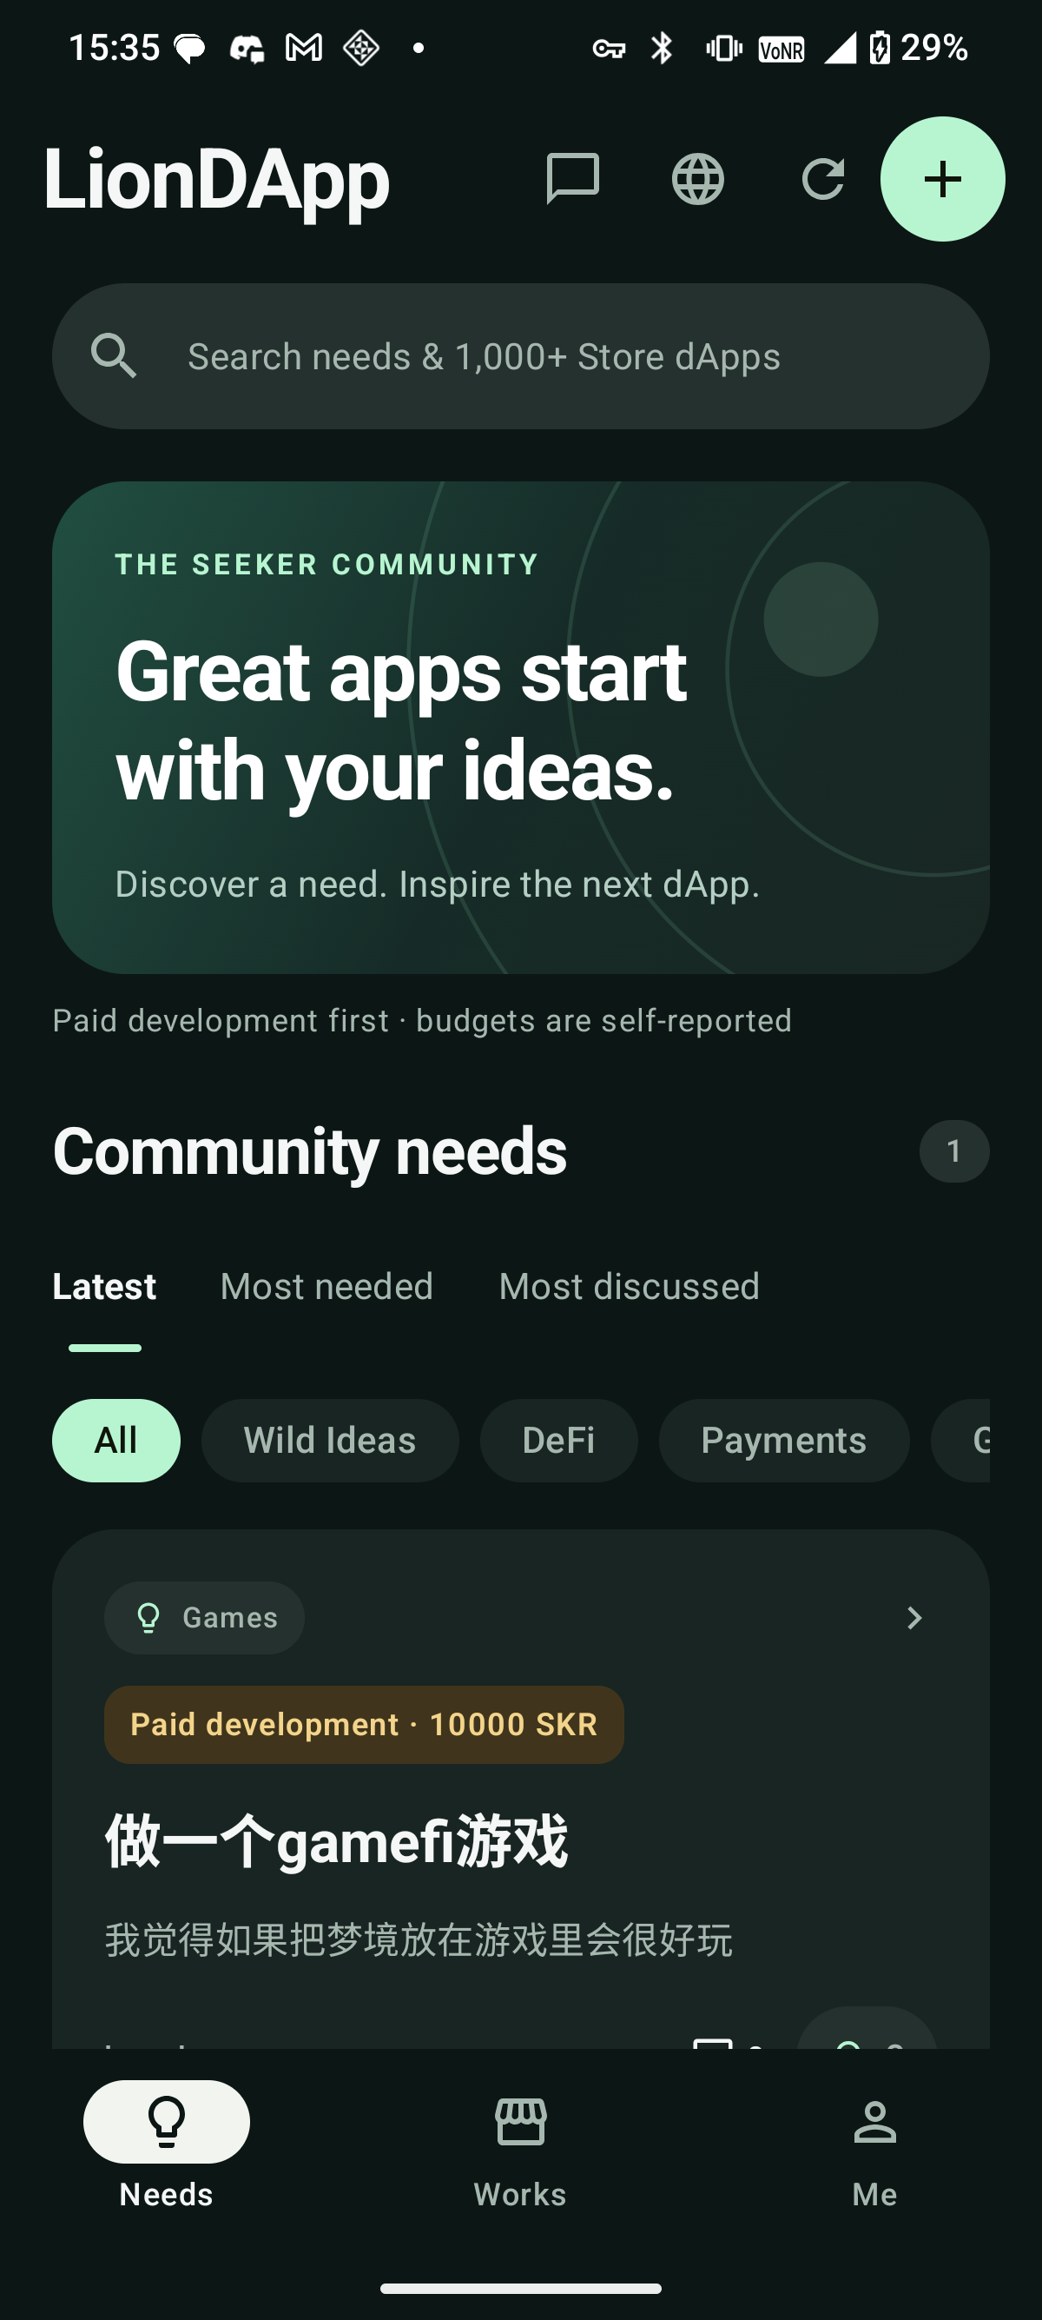
MOBILE
Built for Solana Mobile Seeker
Seed Vault identity
Mobile Wallet Adapter + SIWS, with server-side `.skr` ownership verification.
Seeker-first UX
Native Kotlin + Jetpack Compose, dark surfaces, large touch targets and offline-safe drafts.
Official ecosystem links
LionDApp links to official Store listings and never hosts APKs or custody assets.
Release evidence
Signed package `top.oneion.liondapp`, version 1.0.0, verified on physical Seeker.
LIONDAPP · CLOCK IN 2026 · 04

Slide 5
SAFETY
Trust is a product feature
Every public text surface passes server-side policy checks before it is written or approved.
Moderation
Rules plus Workers AI screening for needs, works, comments and replies; reports and blocks remain available.
1,441
Persistence
Cloudflare D1 stores product data; R2 stores approved media; scheduled private snapshots support recovery.
active Store catalog apps
1,440 translated · budget capped locally
Boundaries
No escrow, no user-to-user payments, no APK hosting. Optional project tips stay disabled until owner and eligibility checks pass.
LIONDAPP · CLOCK IN 2026 · 05

Slide 6
EVIDENCE
What is working today
Production services
Website, API and independent admin console are deployed on `1ion.top` hostnames.
NEXT GATE
Release APK
Upload → sign → mint → review
APK SHA-256: `9584ee4e…e57d739`; signer fingerprint recorded separately.
Verification
Then attach the final deck, demo, repository and direct APK link to Clock In.
86 Node tests + 6 Python tests passed; release APK cold-started on Seeker.
Honest status
Publisher KYC is owner-confirmed. Store upload, Release NFT and review are still pending portal actions.
LIONDAPP · CLOCK IN 2026 · 06

Slide 7
ROADMAP
The next release loop
Now
Finish evidence capture, resolve the last catalog translation retry, and publish a clean public repository.
LionDApp turns community intent into an actionable signal for the Solana Mobile ecosystem.
Submit
Upload the signed APK and metadata to Solana dApp Store; owner completes wallet signatures and fees.
Demo
Record a three-minute Seeker walkthrough: discover → request → chat → official Store catalog.
Repository, APK and demo links will be inserted after owner authentication and upload.
Scale
Use feedback to improve discovery ranking, translation quality and builder conversion.
LIONDAPP · CLOCK IN 2026 · 07

