Slide 1
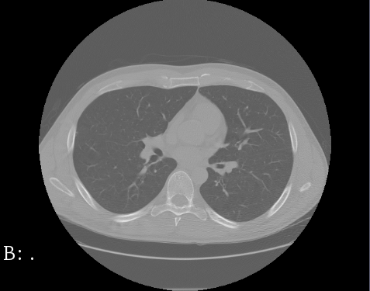
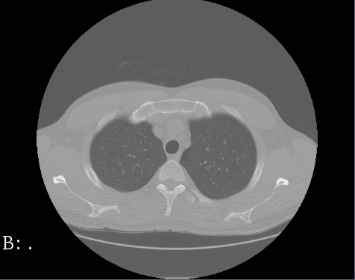
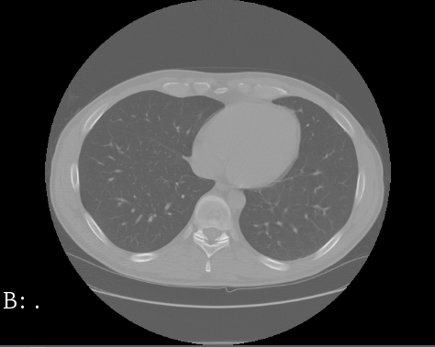
DeepMedic and U-Net neuronal network architectures
for lung segmentation in CT scans
Lionel Rajaona
Rajat Balbotra
Daniel Allen
Steffen Bleher

Slide 2
Outline
Lung segmentation and LUNA16 dataset
CNN architectures
DeepMedic
U-Net
Process and problems
Results
Conclusion

Slide 3
1. Lung segmentation and LUNA16 dataset

Slide 4
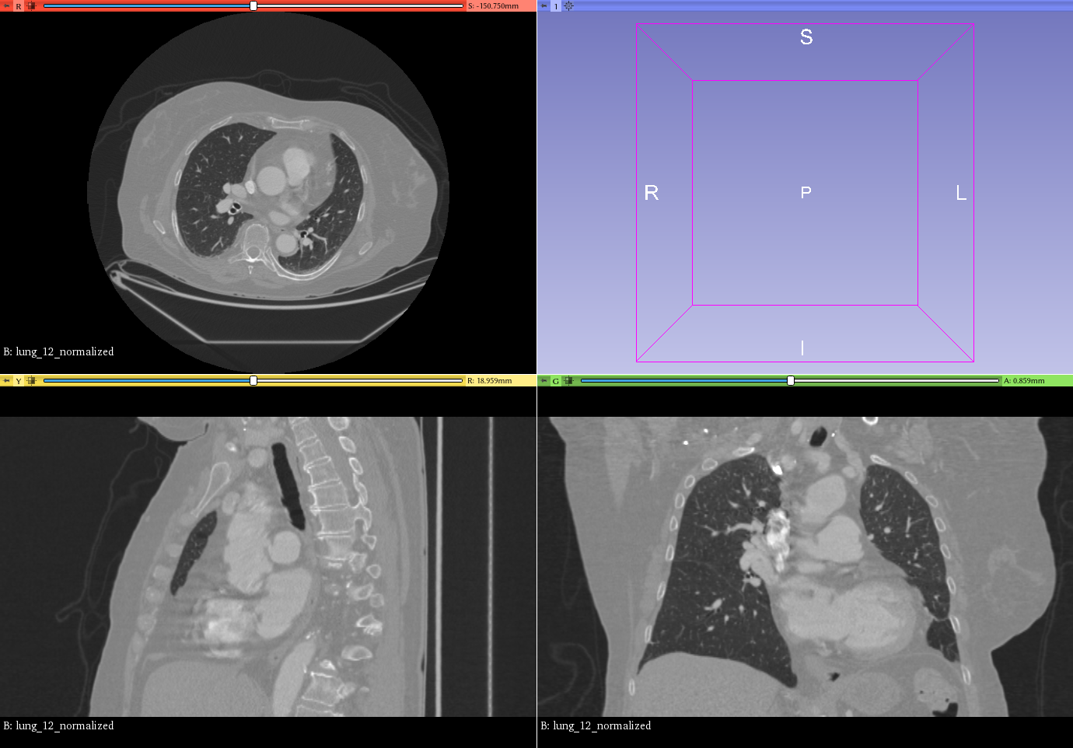
1. Lung segmentation and LUNA16 dataset
Medical Image Computation (MIC)
Image Segmentation
Computed Tomography (CT) slices
Notes:
A lot of image data in medical application, ml can help to deal with this data → MIC

Slide 5
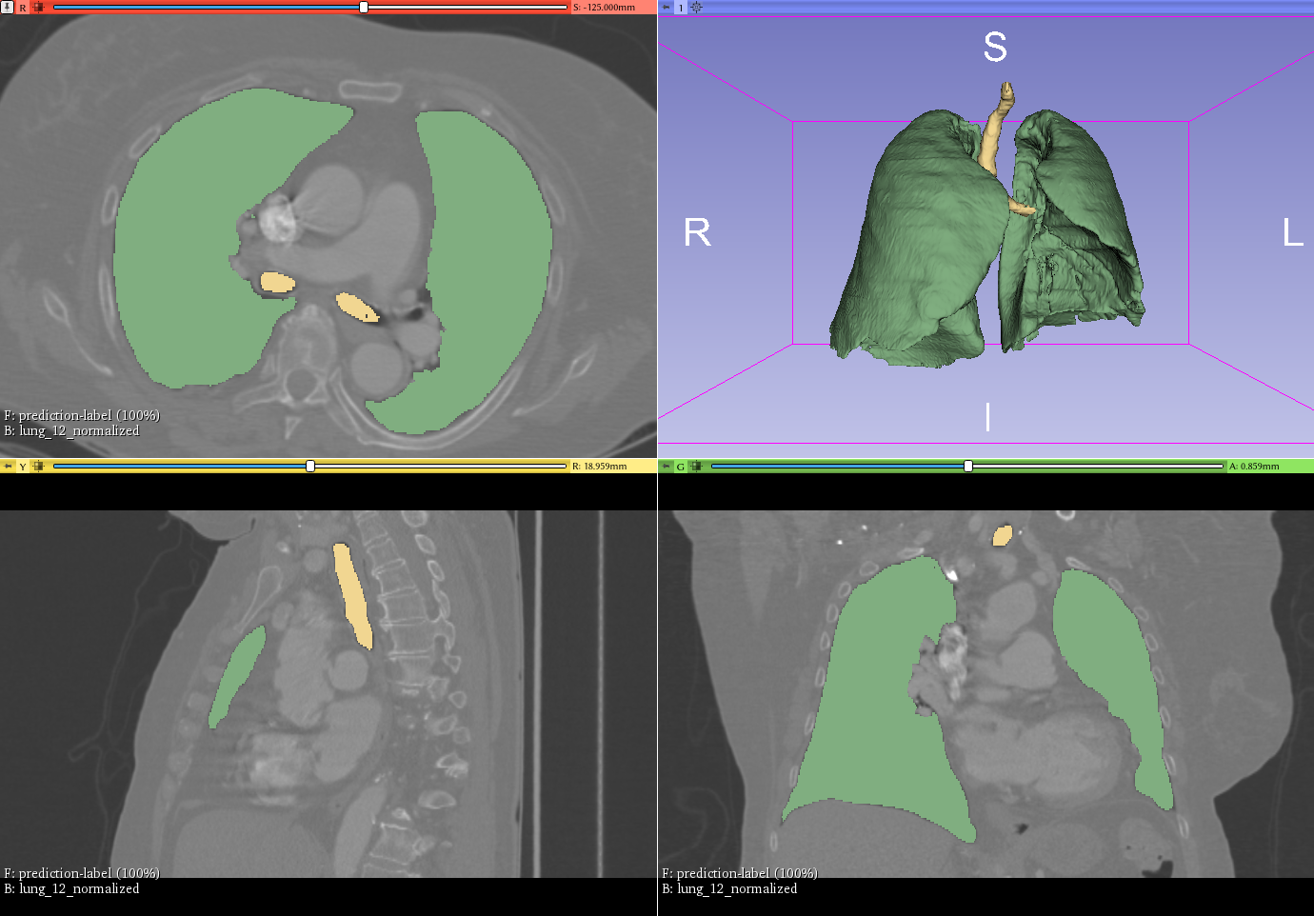
1. Lung segmentation and LUNA16 dataset
Medical Image Computation (MIC)
Image Segmentation
Computed Tomography (CT) slices
Extract a 3D structure of the lung
First step for cancer detection, …
Notes:
A lot of image data in medical application, ml can help to deal with this data → MIC

Slide 6
1. Lung segmentation and LUNA16 dataset
Dataset description
Notes:
A lot of image data in medical application, ml can help to deal with this data → MIC

Slide 7
2. Convolutional neural network architectures

Slide 8
2. CNN architectures – DeepMedic
3D convolutional neural network
Initially designed for brain tumors

Slide 9
2. CNN architectures – U-Net
text

Slide 10
3. Process and problems

Slide 11
3. Process and problems
Preprocessing
Training and Validation
↯ Issues with huge dataset
↯ Recognition of different labels

Slide 12
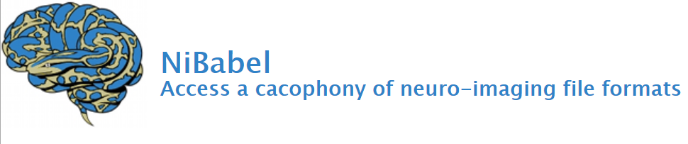
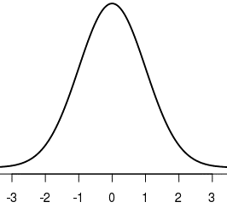
3. Process and problems
Preprocessing
Data type conversions (mhd/raw → nii.gz)
Manual check of dataset
Normalization: μ = 0 and σ = 1 (ITK library)

Slide 13




3. Process and problems
Training
Setup
U-net -> implementation
DeepMedic -> open-source code

Slide 14
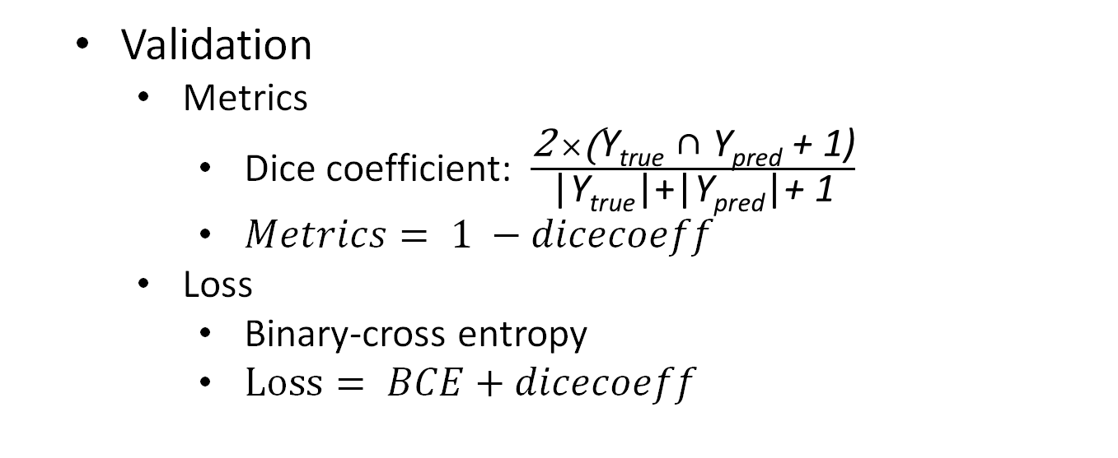
3. Process and problems
Validation
Metrics
Dice coefficient: $\frac{\text{2} ×\text{(}\text{Y}\text{true}\text{ ∩ }\text{Y}\text{pred}\text{ + 1)}}{\text{|}\text{Y}\text{true}\text{|+}\text{|}\text{Y}\text{pred}\text{|}\text{+ 1}}$
$Metrics= 1 −dicecoeff$
Loss
Binary-cross entropy
$Loss= BCE+dicecoeff$
Notes:
Smooth factor 1: stands for backpropagation
Num:
Denom: cardinality

Slide 15
3. Process and problems
↯ Issues with huge dataset
Providing images as a matrix with size [512, 512, number of slices]
Generation of dataset in real-time and feeding it right away to the training process Keras DataGenerator

Slide 16
3. Process and problems
↯ Issues with huge dataset
Providing images as a matrix with size [512, 512, number of slices]
↯ RAM problem
→ just loading reference to image data

Slide 17
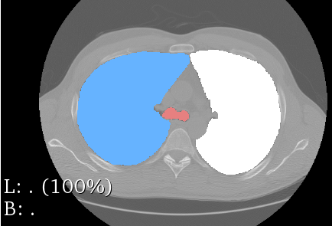
3. Process and problems
↯ Recognition of different labels
Network architectures not suitable for recognizing positional information
➔

Slide 18
4. Evaluation

Slide 19
4. Evaluation
Training process
graphs

Slide 20
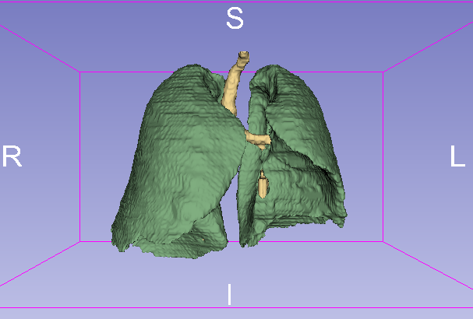
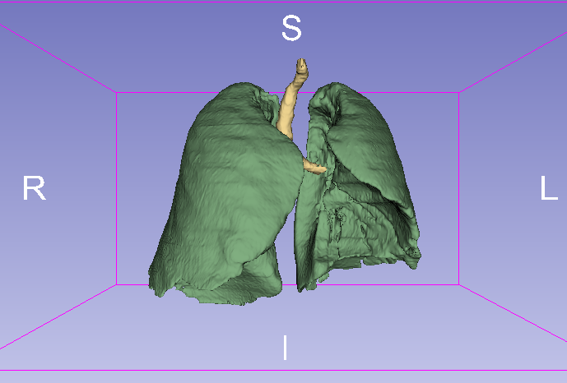
4. Evaluation
Prediction with DeepMedic
original
prediction

Slide 21
4. Evaluation
Prediction with U-net
original
prediction

Slide 22
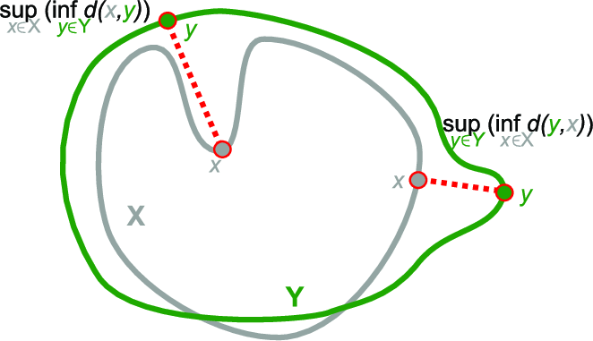
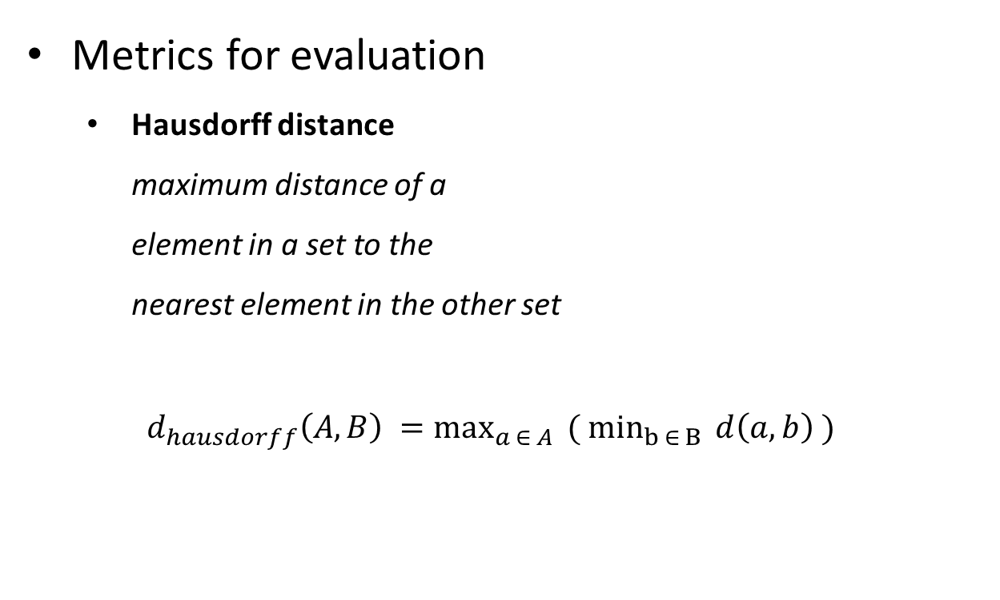
4. Evaluation
Metrics for evaluation
Hausdorff distance maximum distance of a element in a set to the nearest element in the other set
$d_{hausdorff}\left(A,B\right) =\max_{a ∈ A}{ ( \min_{b ∈ B}{d\left(a,b\right) )}}$

Slide 23

4. Evaluation
Metrics for evaluation
Mean distance average over distances of all elements in one set to the nearest element in the other set
$d_{mean}\left(A,B\right) =\underset{}{\frac{1}{|A|} \sum_{a ∈A}{ \min_{b ∈ B}{d\left(a,b\right) }}}{}$

Slide 24
4. Evaluation
Comparison in the two metrics
graph for the 20 pictures
→ Superior architecture for the task:

Slide 25
5. Conclusion

Slide 26
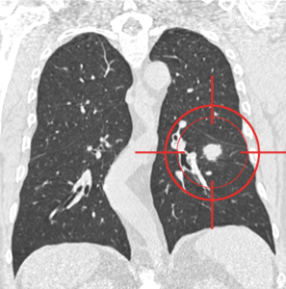
5. Conclusion
Biggest Issues for Data Analytics with Images:
Allocation of computational resources
data preparation
Next step:
Cancer detection by identifying ill nodules
Notes:
Detect ay abnormality in the lung, anithing which could warn a tumor

Slide 27
Thanks for the attention
Questions?

