Slide 1
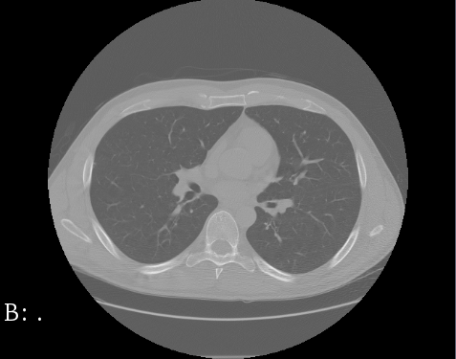
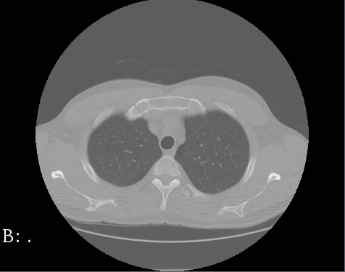
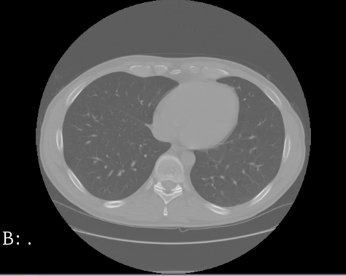
DeepMedic and U-Net neuronal network architectures
for lung segmentation in CT scans
Lionel Rajaona
Rajat Balbotra
Daniel Allen
Steffen Bleher

Slide 2
Outline
Lung segmentation and LUNA16 dataset
CNN architectures
DeepMedic
U-Net
Process and problems
Results
Conclusion

Slide 3
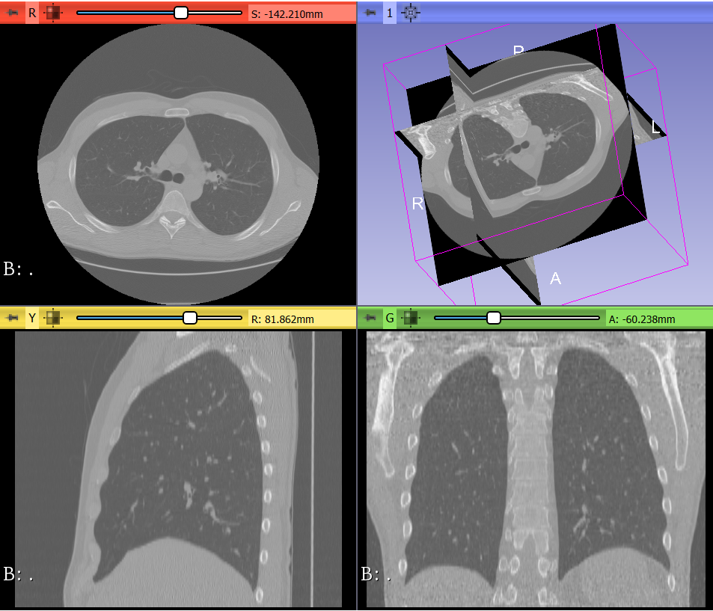
1. Lung segmentation and LUNA16 dataset
Medical Image Computation (MIC)
Image Segmentation
Computed Tomography (CT) slices
Notes:
A lot of image data in medical application, ml can help to deal with this data → MIC

Slide 4
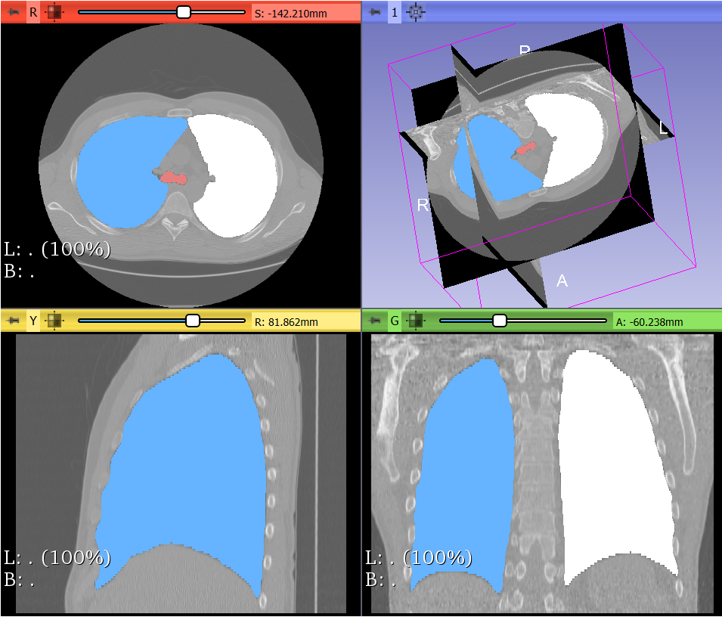
1. Lung segmentation and LUNA16 dataset
Medical Image Computation (MIC)
Image Segmentation
Computed Tomography (CT) slices
Extract a 3D structure of the lung
First step for cancer detection, …
Notes:
A lot of image data in medical application, ml can help to deal with this data → MIC

Slide 5
2. CNN architectures – DeepMedic
text

Slide 6
2. CNN architectures – U-Net
text

