Slide 1

Angular School
Lesson 9. RxJS

Slide 2

LESSON PLAN
Introduction
Overview
Features
Creating an Observable
Error handling
Comparison with problems
Functional programming with array methods
Buffers
Merging of observables
Hot and cold observable
Connectable observables
Observables in Angular2

Slide 3
OVERVIEW
RxJS one of the ReactiveX implementations
The observer pattern
The iterator pattern
Functional programming
Usage ReactiveX
Frontend
Backend
Usage RxJS
UI events
API events
…

Slide 4
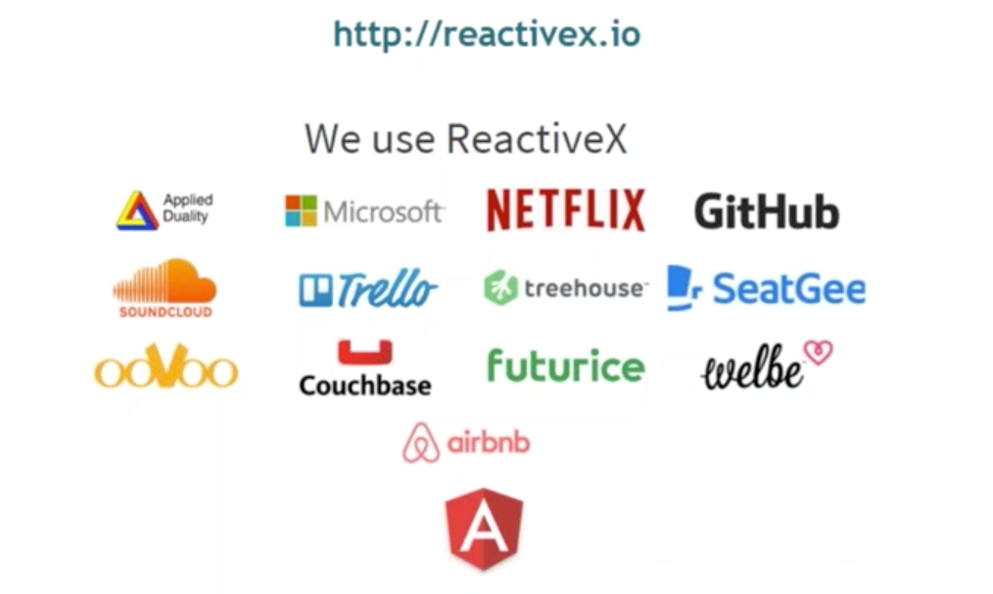
POPULARITY

Slide 5
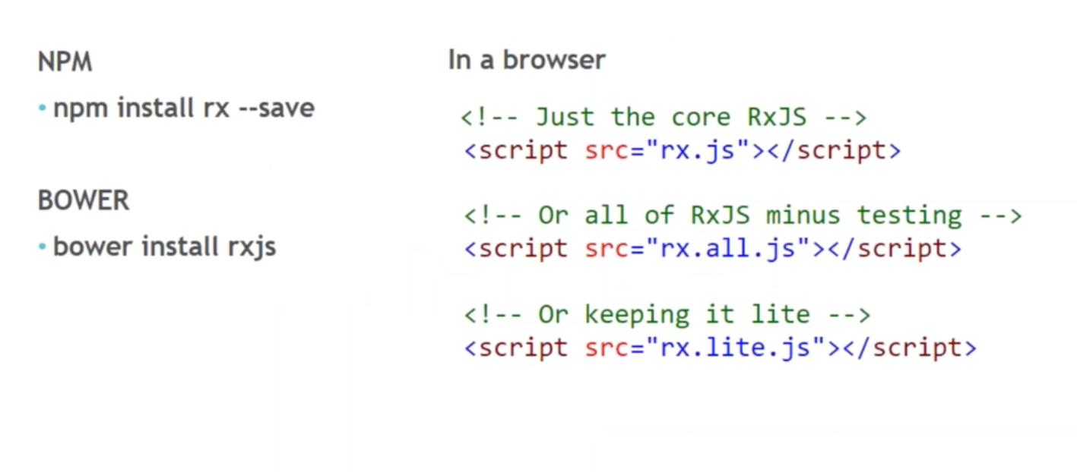
SETUP

Slide 6
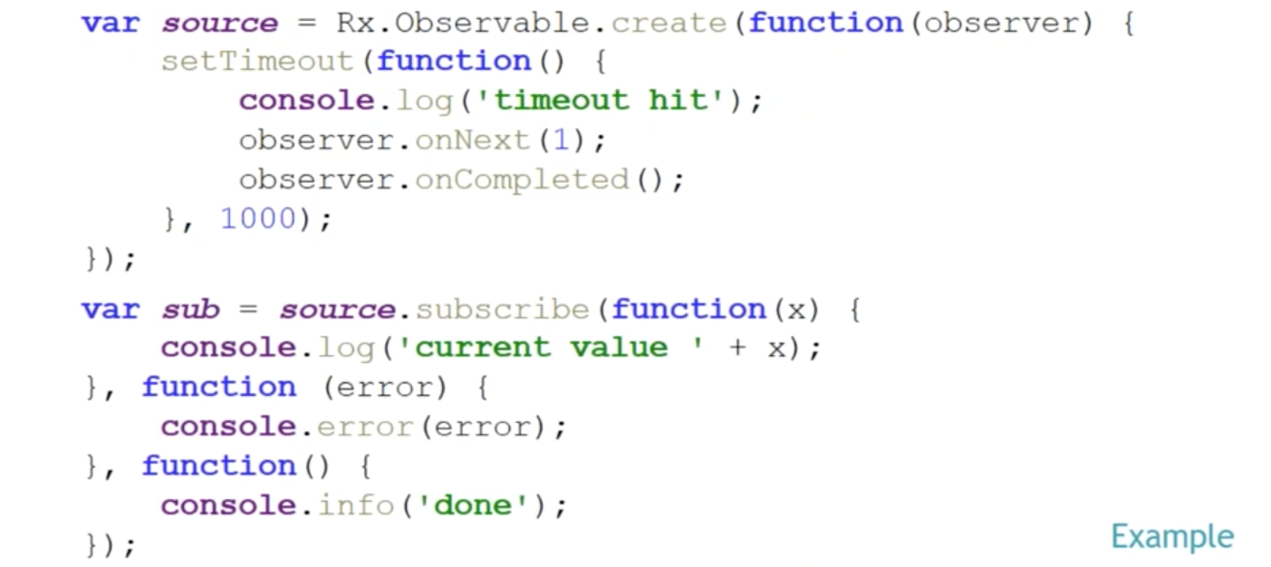
CREATING OBSERVABLE

Slide 7
WAYS OF CREATING AN OBSERVABLE
create(subscribe_detail)
fromArray()
throw(error_msg)
return(value)
range(start, count)
empty()
generate(initial_state, condition, iterate,selector)
never()
fromEvent(dom_element, event_name)
fromCallback(func)
fromPromise(promise)
from(iterable)

Slide 8
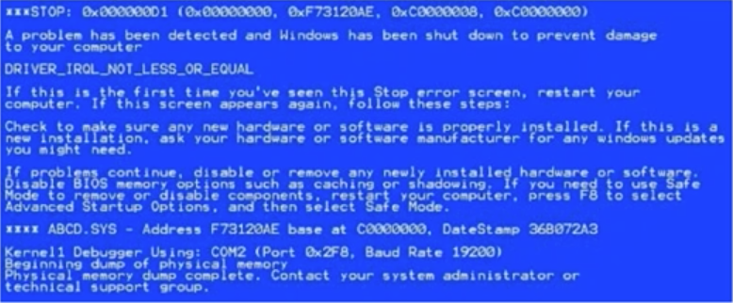
ERROR HANDLING
catch()
onErrorResumeNext()
retry(n)
retryWhen()

Slide 9
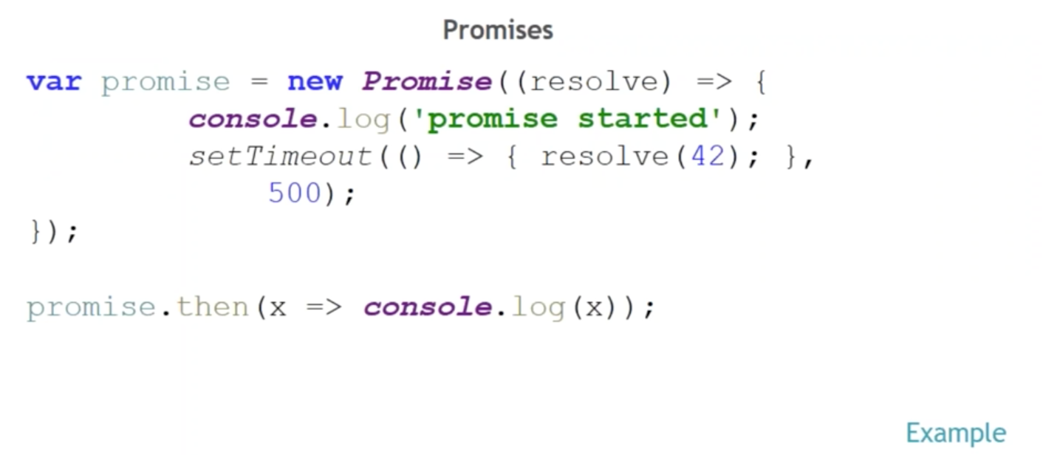
OBSERVABLES VS. PROMISES

Slide 10
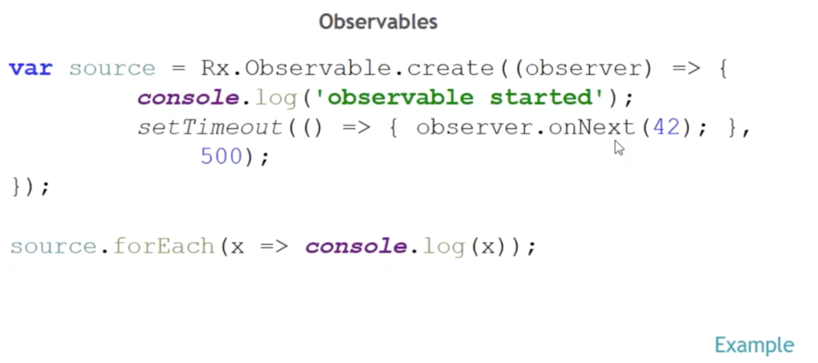
OBSERVABLES VS. PROMISES

Slide 11
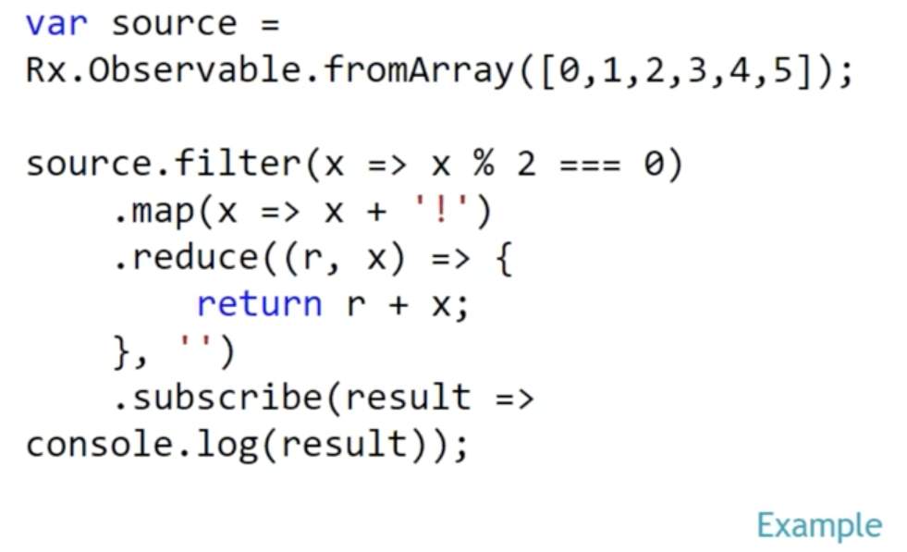
FUNCTIONAL PROGRAMMING
filter()
reduce()
map()
concatAll()
zip()

Slide 12
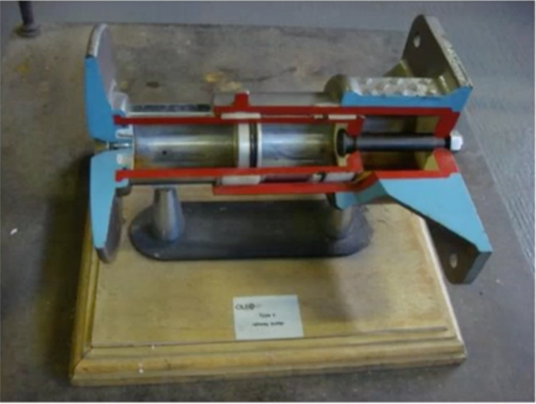
BUFFERS
buffer()
bufferWithCount()
bufferWithTime()
bufferWithTimeOrCount()

Slide 13

MERGE
merge
mergeAll
mergeDelayError

Slide 14
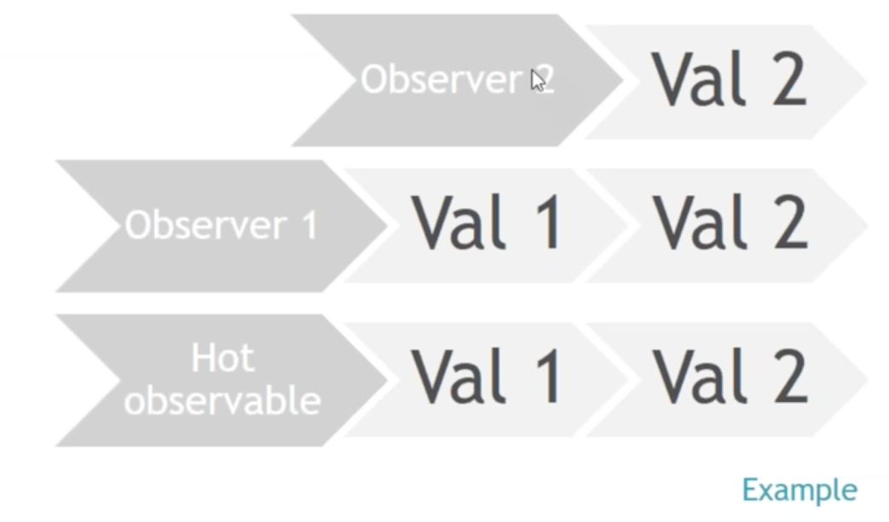
HOT & COLD OBSERVABLES
publish
refCount

Slide 15

CONNECTABLE OBSERVABLES

Slide 16
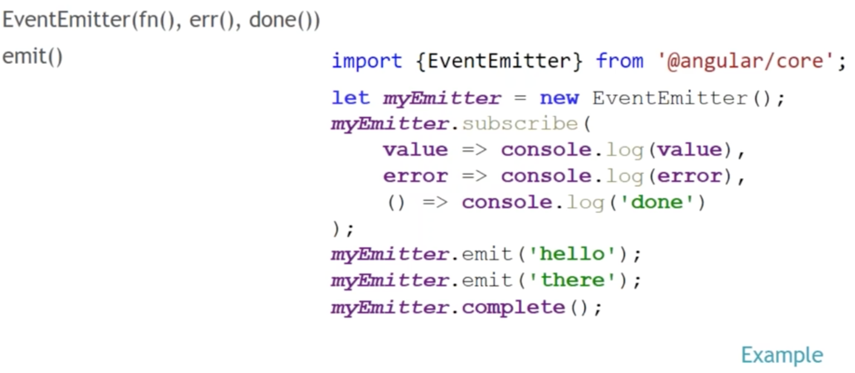
REACTIVE PROGRAMMING IN ANGULAR

Slide 17
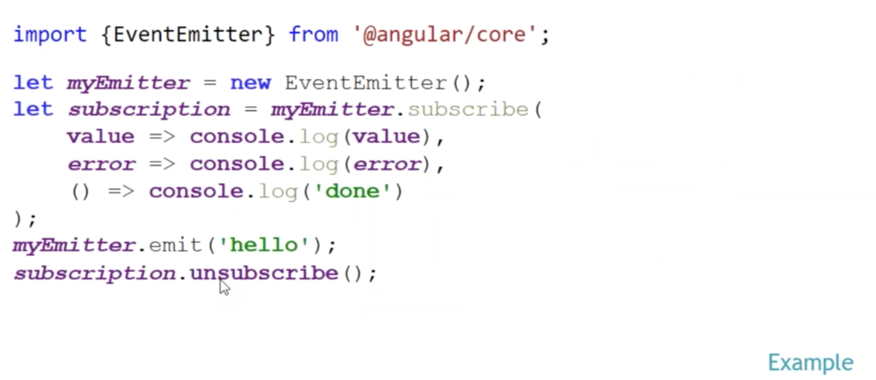
REACTIVE PROGRAMMING IN ANGULAR

Slide 18
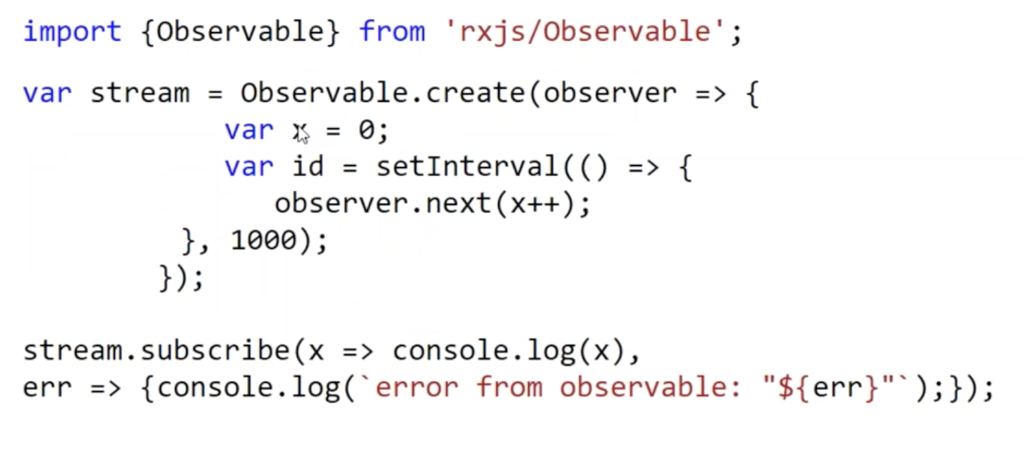
REACTIVE PROGRAMMING IN ANGULAR

Slide 19
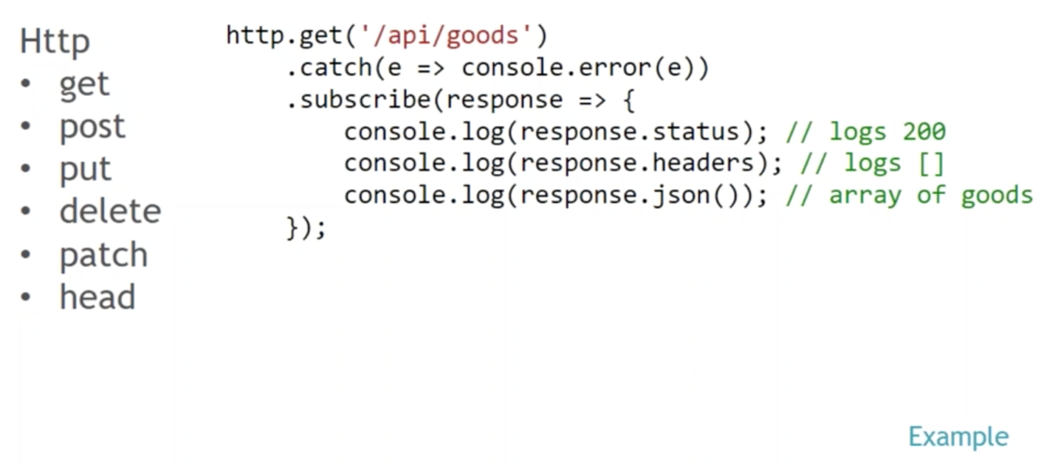
REACTIVE PROGRAMMING IN ANGULAR

Slide 20
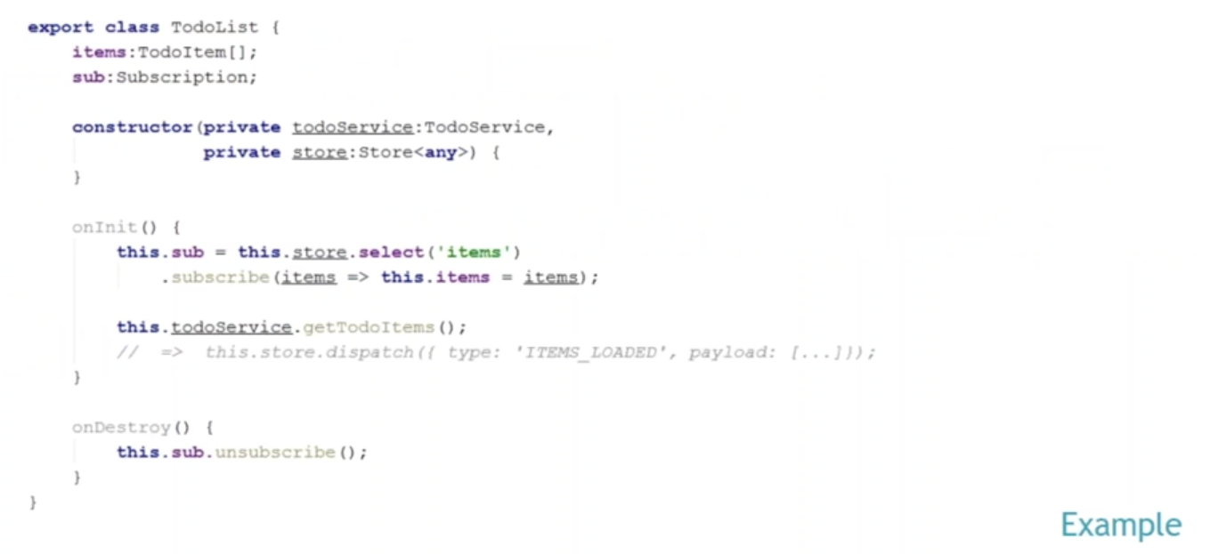
REACTIVE PROGRAMMING IN ANGULAR

Slide 21
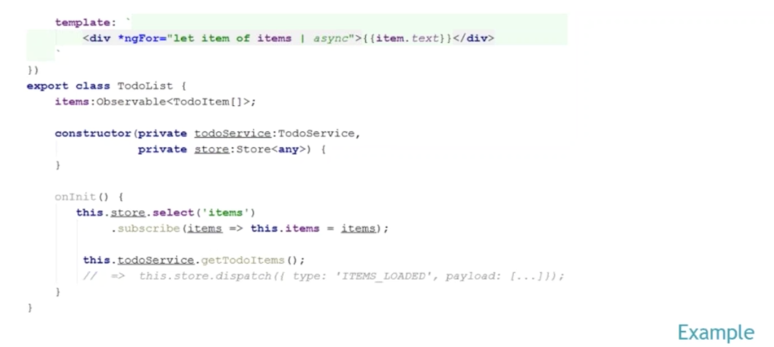
REACTIVE PROGRAMMING IN ANGULAR

Slide 22
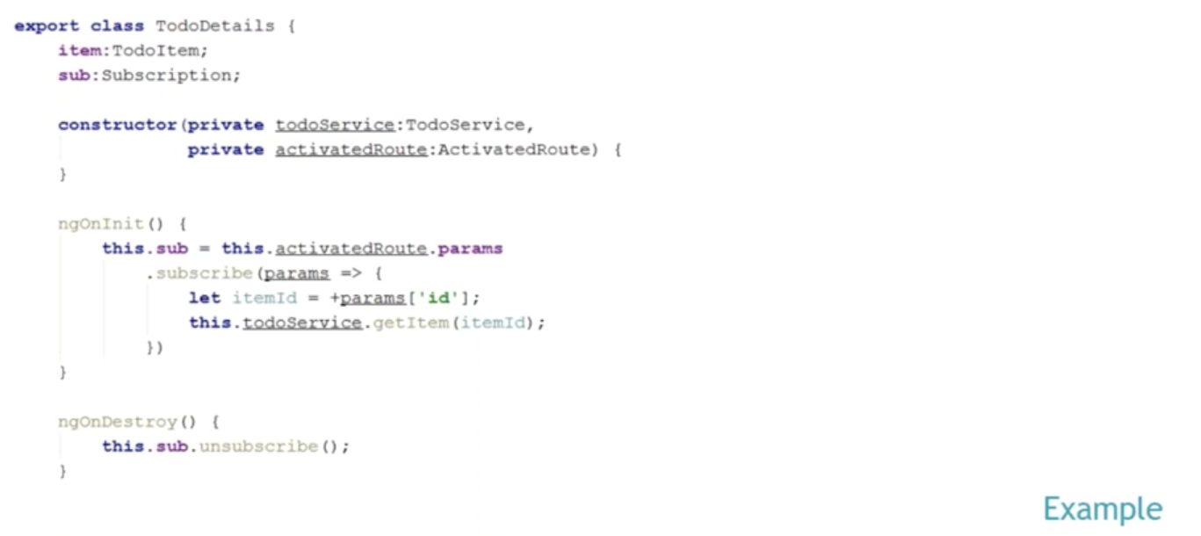
REACTIVE PROGRAMMING IN ANGULAR

Slide 23
Angular School
Thanks!

