Slide 1

Angular School
Lesson 7. Dependency Injection & Modules

Slide 2

LESSON PLAN
Dependency injection
Overview
Configuration
Hierarchy
Services in Angular 4

Slide 3
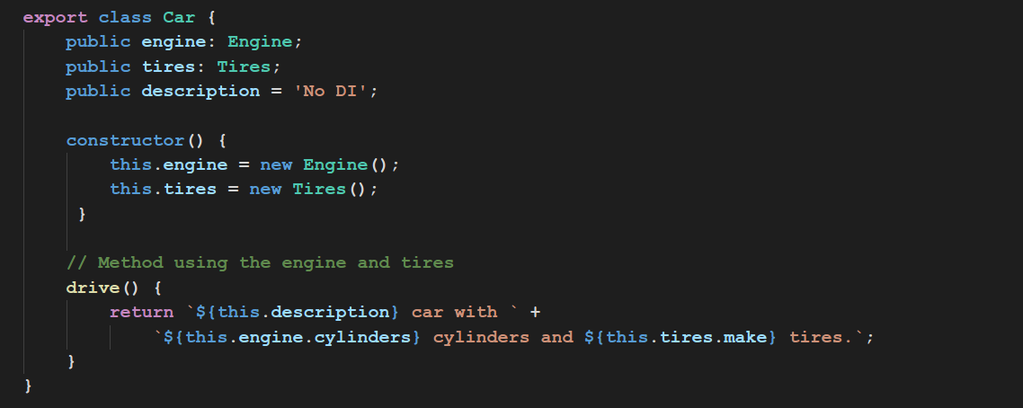
WHY WE NEED DI?

Slide 4
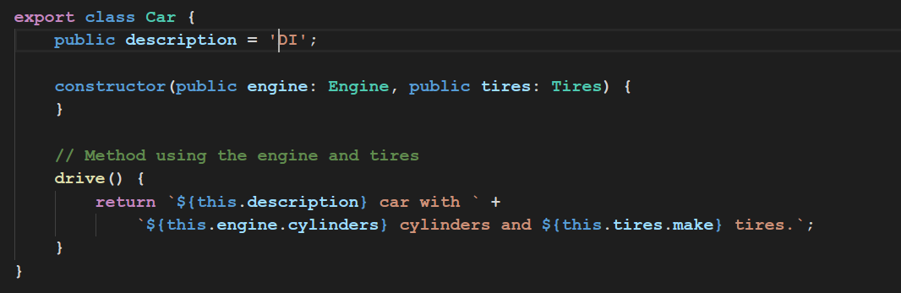
WHY WE NEED DI?

Slide 5
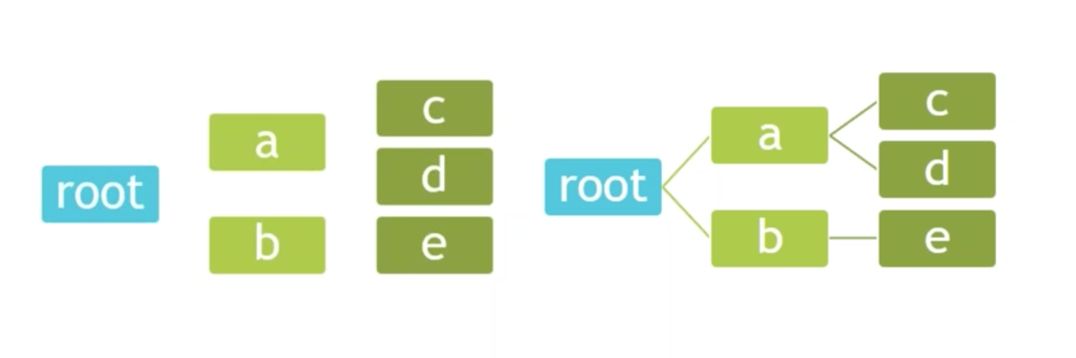
WHY WE NEED DI?

Slide 6
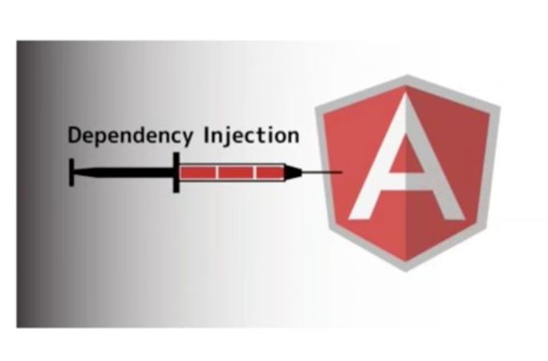
DEPENDENCY INJECTION OVERVIEW
Token
Provider
Injector
Dependency

Slide 7
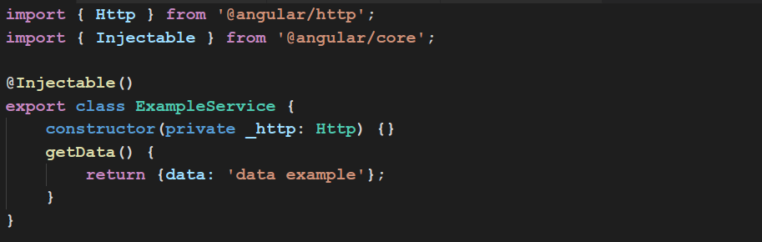
EASY TO DEVELOP

Slide 8
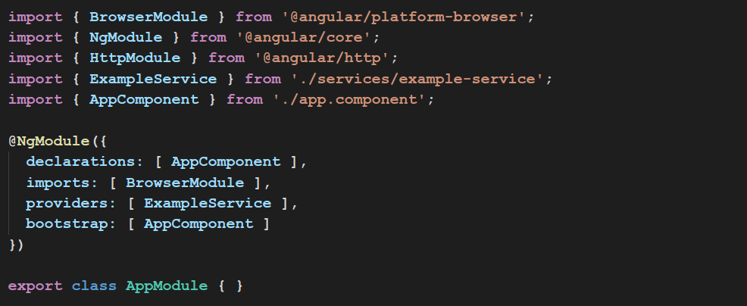
PROVIDERS

Slide 9
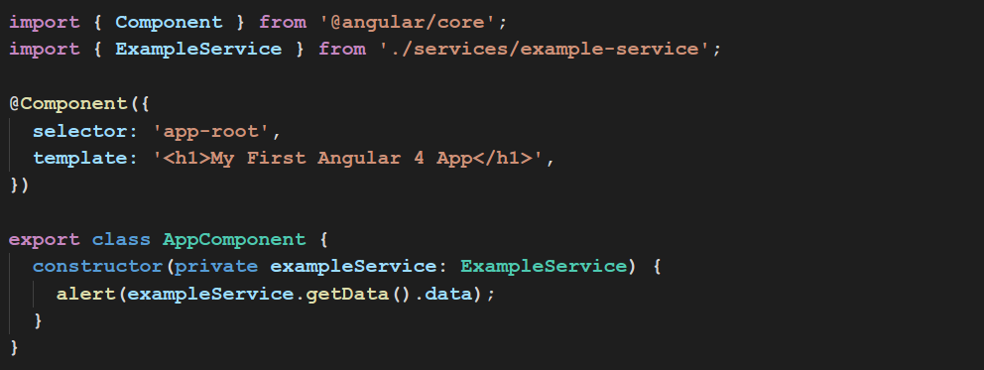
PROVIDERS

Slide 10
SERVICES
Provide streams (data models)
Provide operations with data
Helpers

Slide 11

NAMING CONVENTION
data.service.ts
some-data.service.ts

Slide 12
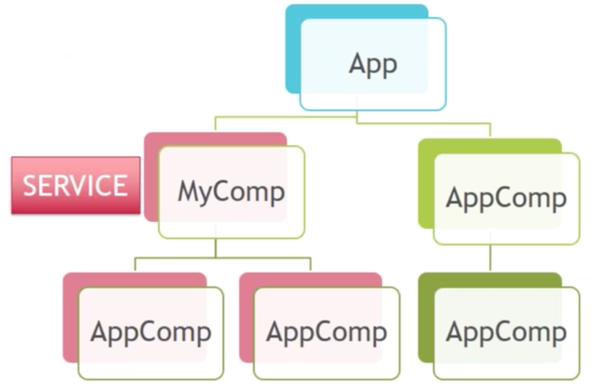
SERVICES

Slide 13
DI CONFIGURATION
Inject a (singleton) instance of a class
Call any function and inject the return value of that function
Inject a value
Create an alias

Slide 14
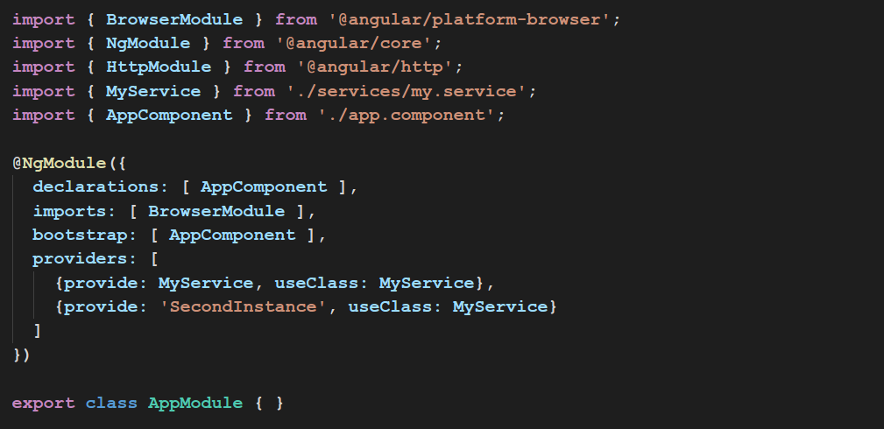
DI CONFIGURATION

Slide 15
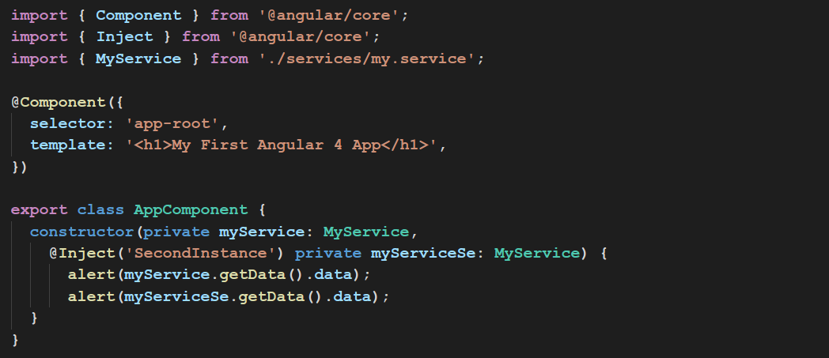
DI CONFIGURATION

Slide 16
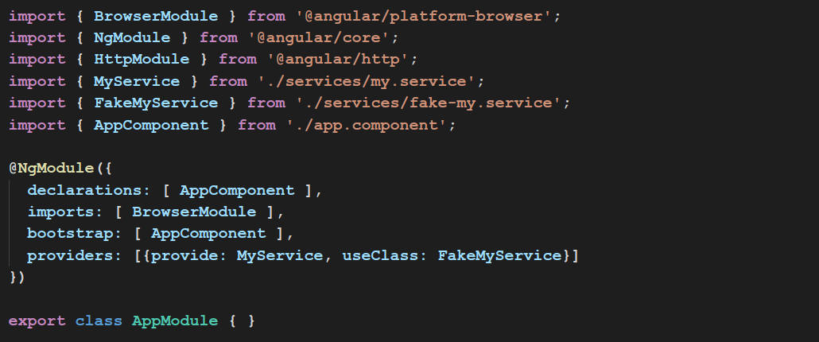
DI CONFIGURATION

Slide 17
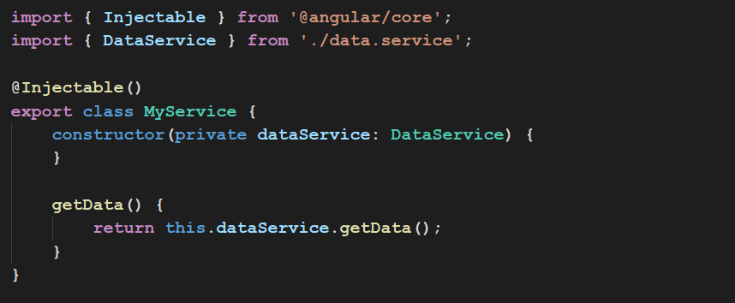
DI CONFIGURATION

Slide 18
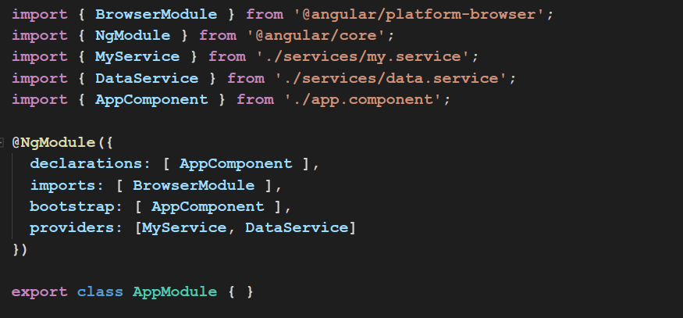
DI CONFIGURATION

Slide 19
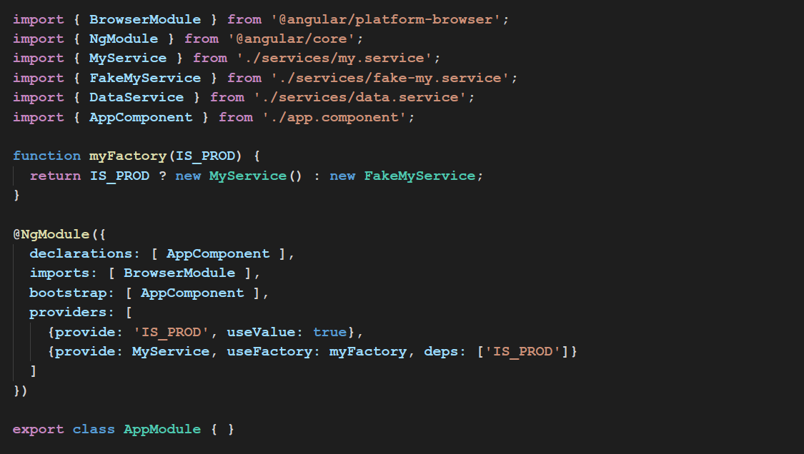
USEVALUE & USEFACTORY

Slide 20
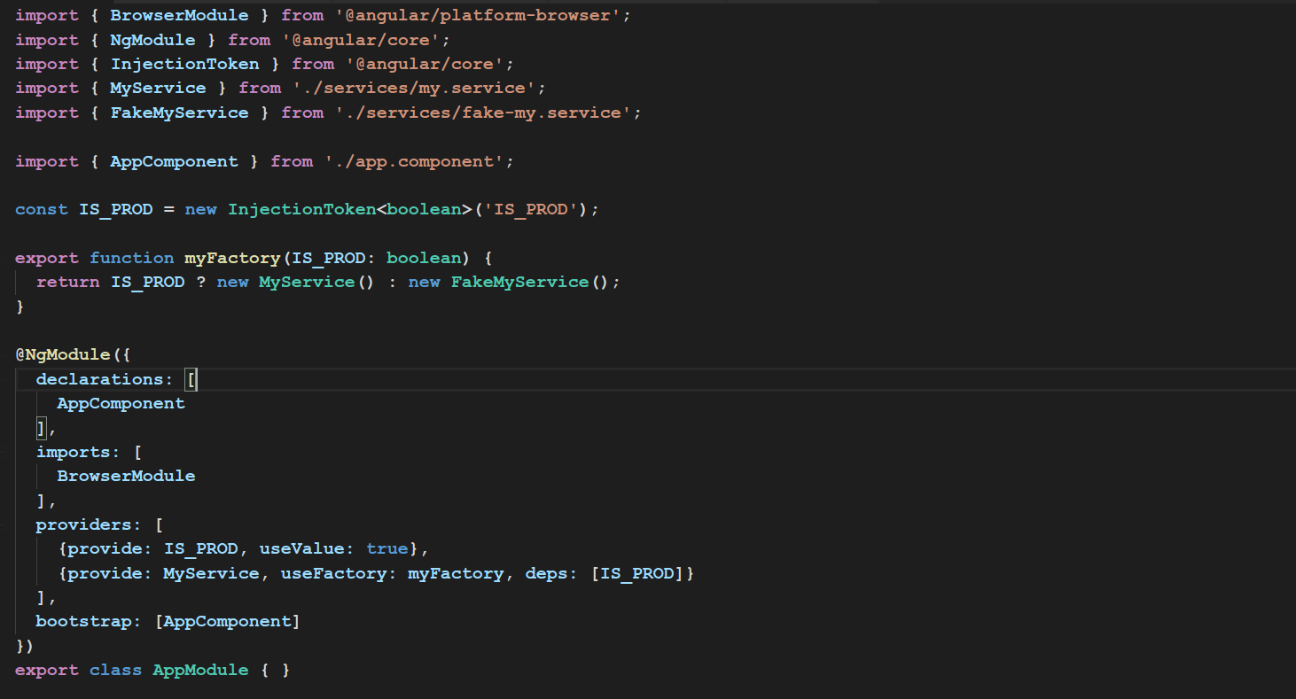
INJECTION TOKEN

Slide 21
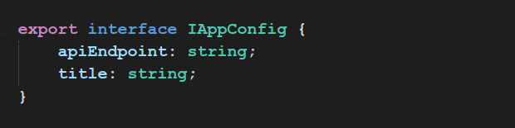
INJECTION TOKEN
app-config-interface.ts

Slide 22
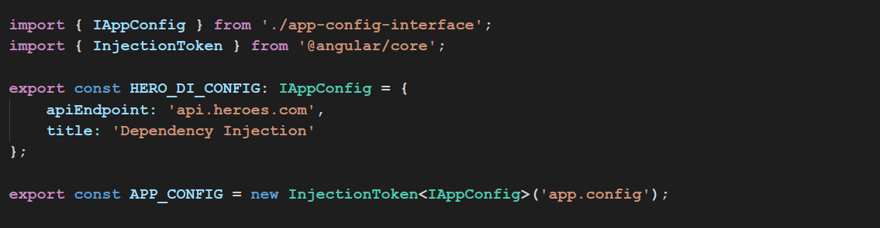
INJECTION TOKEN
app-config.ts

Slide 23
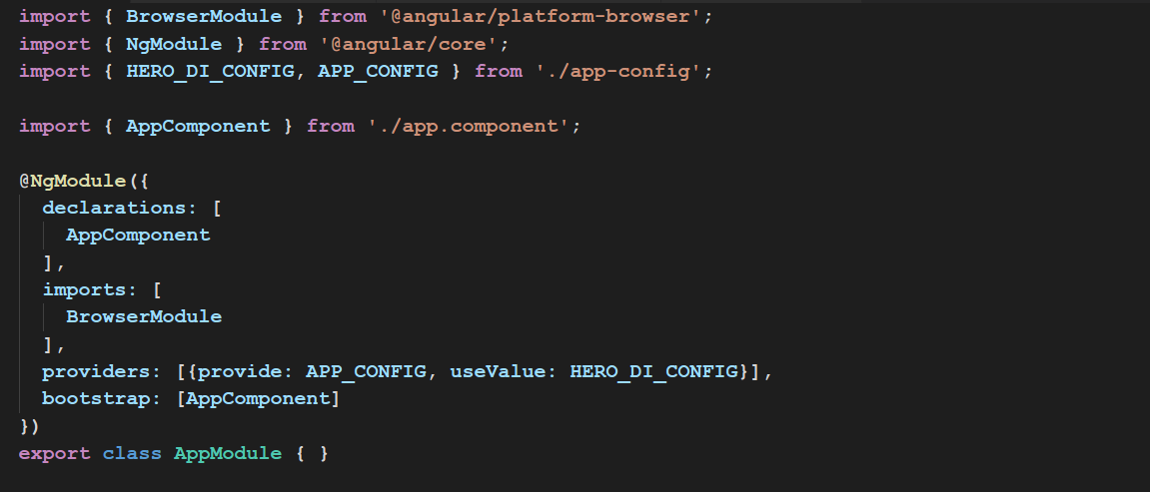
INJECTION TOKEN

Slide 24
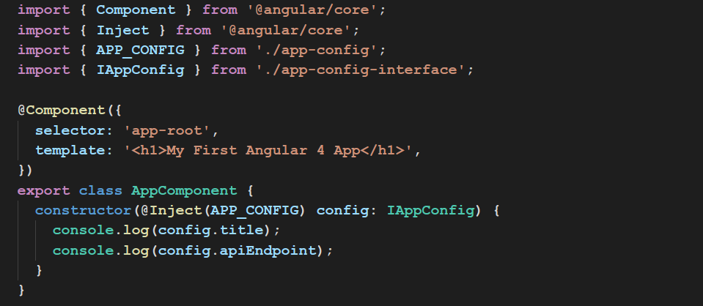
INJECTION TOKEN

Slide 25
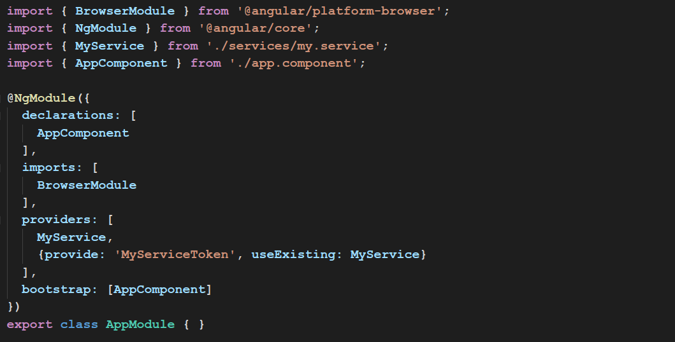
USEEXISTING

Slide 26
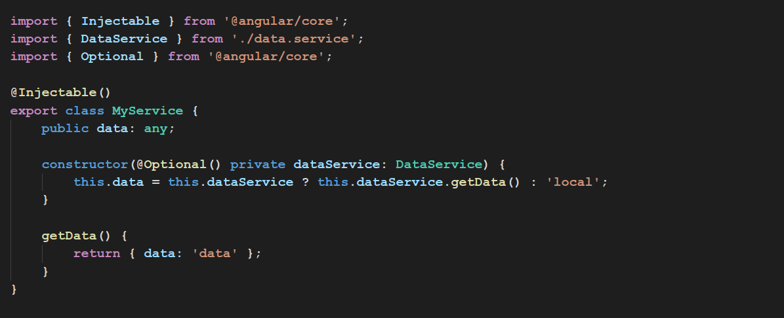
OPTIONAL DEPENDENCIES

Slide 27
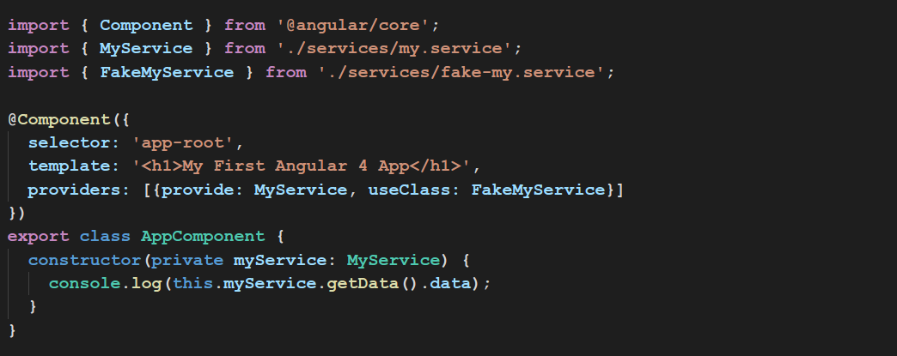
NOT ROOT DEPENDENCY

Slide 28
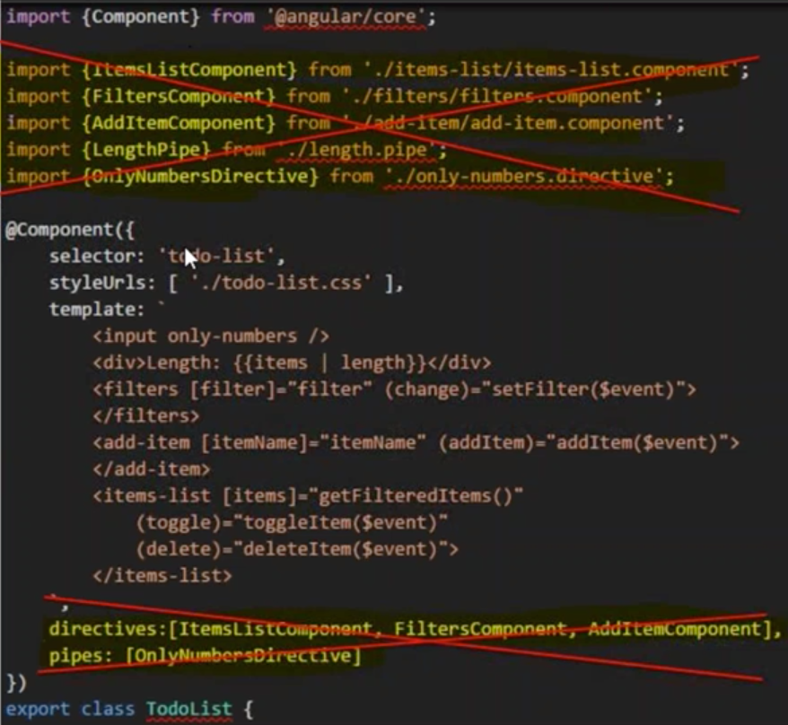
MODULES

Slide 29
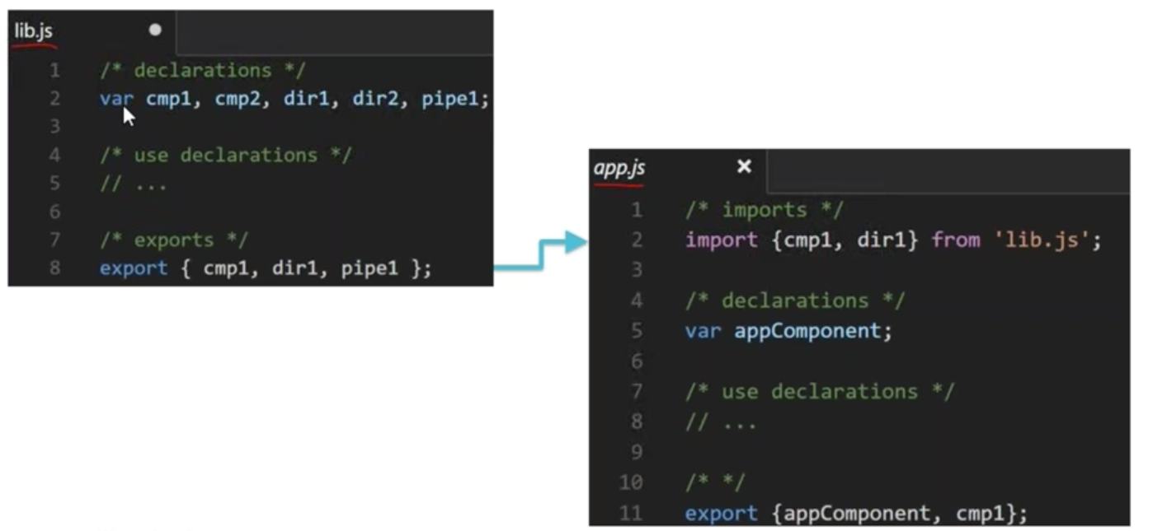
ES6 MODULES

Slide 30
NGMODULE
Angular modules help organize an application into cohesive blocks of functionality
An Angular Module is a class adorned with @NgModule decorator function. @NgModule takes a metadata object that tells Angular how to compile and run module code. It identifies the module’s own components, directives and pipes, making some of them public so external components can use them. It may add service providers to application dependency injectors.

Slide 31
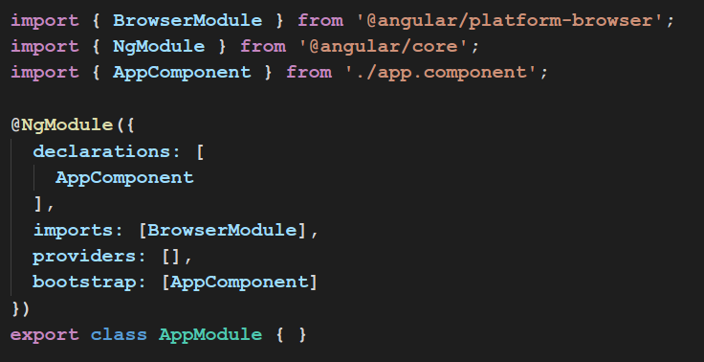
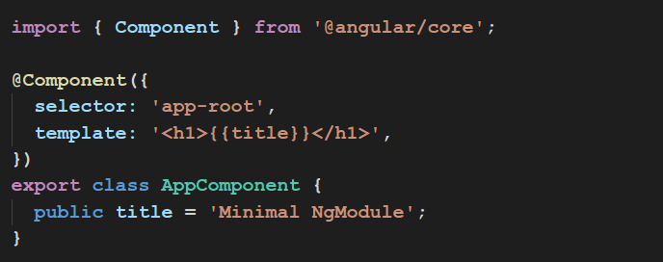
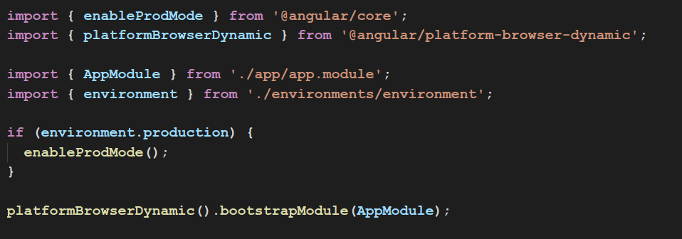
@NGMODULE

Slide 32
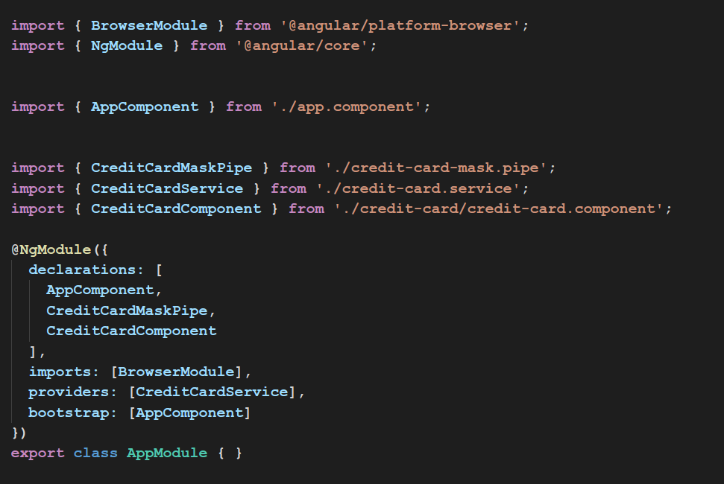
WHY MODULE
credit-card.component
credit-card.pipe
credit-card.service
app.component
app.module

Slide 33
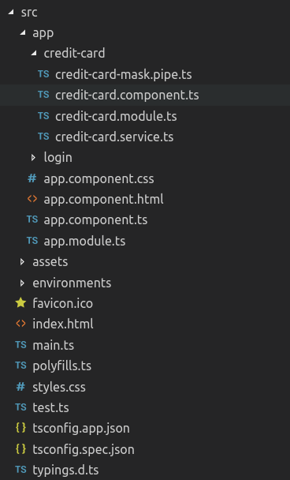
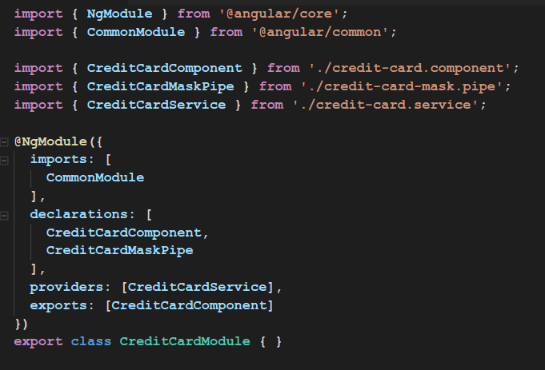
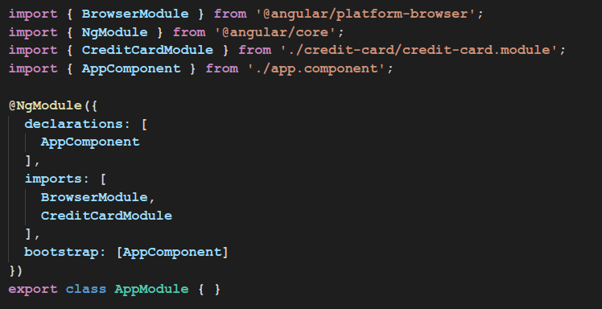
CREATING A FEATURE MODULE
credit-card.module
app.module

Slide 34
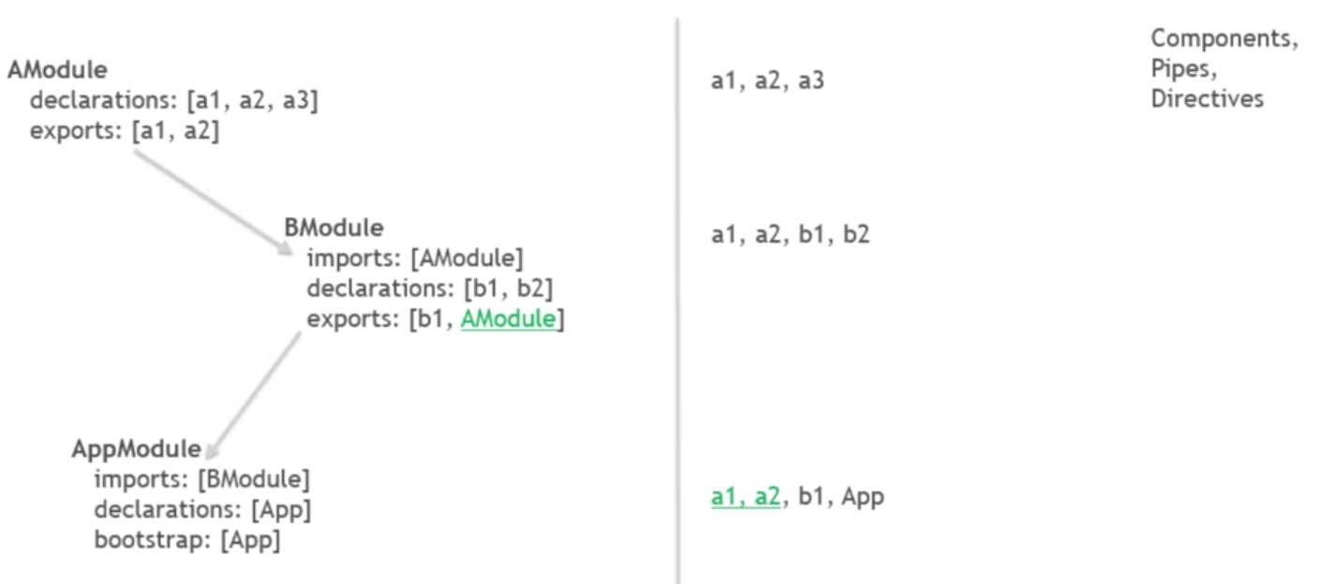
DECLARATIONS, EXPORTS, IMPORTS

Slide 35
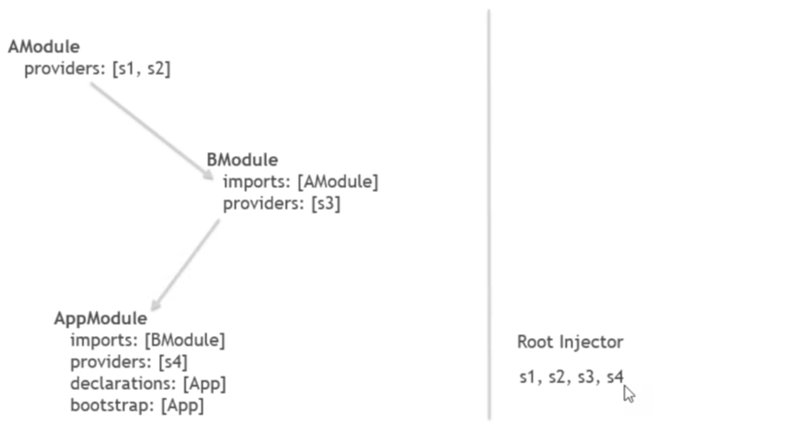
PROVIDERS

Slide 36
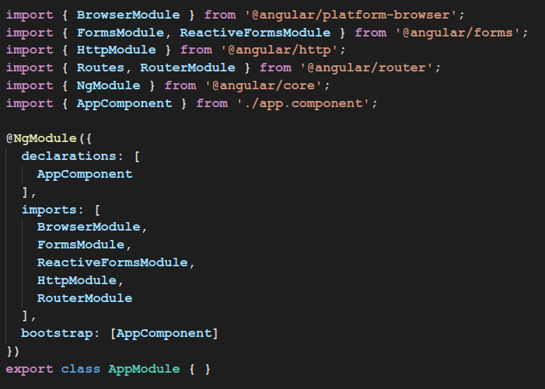
BUILT IN MODULES

Slide 37
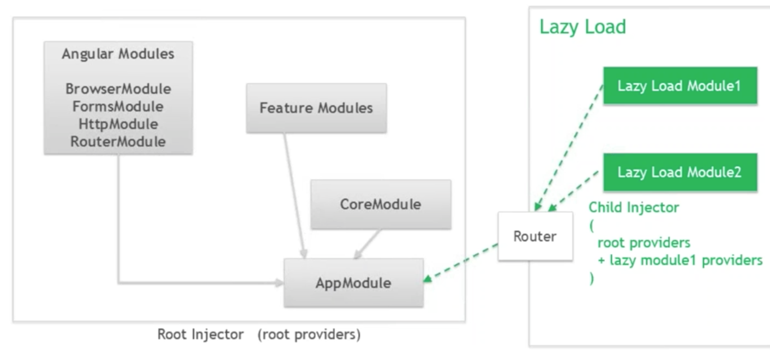
ARCHITECTURE WITH LAZY LOADING

Slide 38
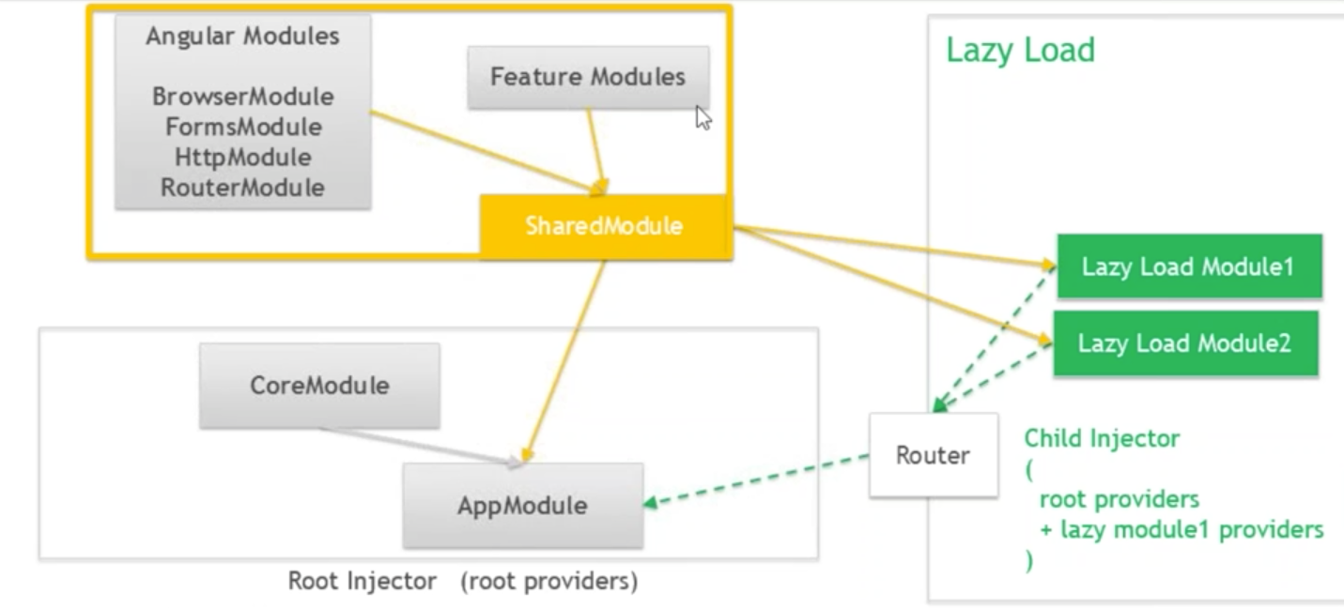
ARCHITECTURE WITH LAZY LOADING

Slide 39
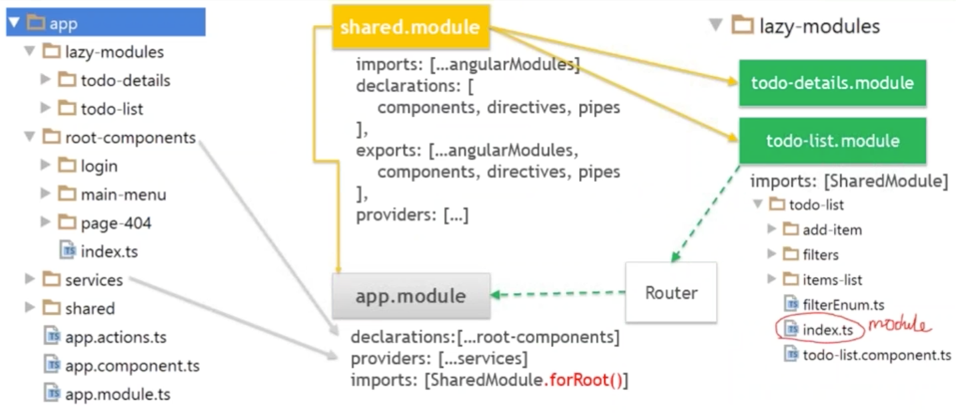
MODULE ARCHITECTURE EXAMPLES

Slide 40
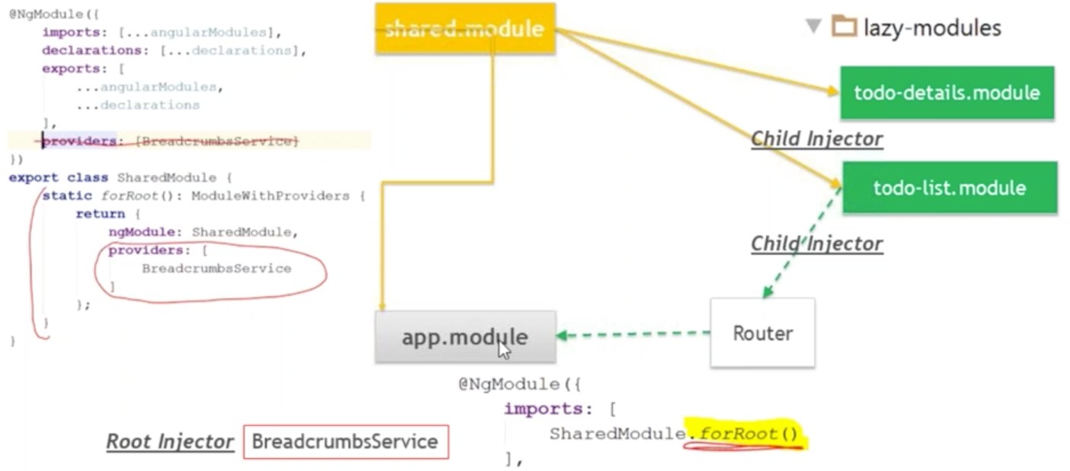
LAZY MODULE PROVIDERS PROBLEMS

