Slide 1


Projecting match Results in Dota 2
Capstone Project: non-technical Presentation

Slide 2

Presentation Roadmap
Problem Statement
What are we looking at?
Business Value
How does this impact me?
Methodology
What did we do?
The Models
Findings
Future Work
What did we use?
What did we find out?
How can we improve?
Business Recommendations
What should you implement?
Notes:
Hello, my name is John Dean, and I am here today to talk to you about predicting match outcomes in the video game Dota 2. Developed by Valve software, this game has cultivated a massive community of competitive players, professional organizations, analysts, as well as a thriving gambling community.

Slide 3

Problem Statement
Expanding market for gambling an analytics
Difficult to analyze
Notes:
As the game has grown, so has the appetite for advanced tools for predicting match outcomes and analyzing what factors lead to a team winning or losing. The problem is that Dota is one of the most complex games out there, which makes simple projections hard to nail down.

Slide 4
Business value
More insight => Better decision making
Planning Ahead
Notes:
In our case, the problem we are attempting to solve is how to most effectively predict match outcomes using information available prior to the match start. This allows for better decision making for teams in the draft phase of games, as well as for bettors to make more informed decisions with their money.

Slide 5
Methodology – the data
Public matches pulled from the OpenDota API
25,000 matches used in building the model
Weighted and evaluated
Trained on 75% of set, tested on 25%

Slide 6
Methodology - The models
Logistic Regression Model
Random Forest Classifier
GridsearchCV

Slide 7
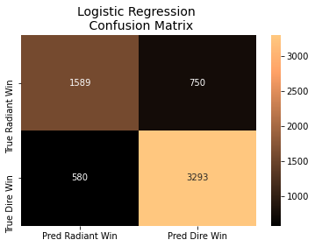
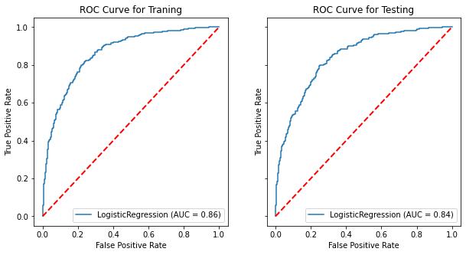
Findings – Logistic Regression
Notes:
These are the results for our logistic regression model. As you can see, it performed fairly well, scoring 84% overall. It did perform better in predicting Dire wins rather than Radiant wins, which we believe is due to a small imbalance in the sample sizes.

Slide 8
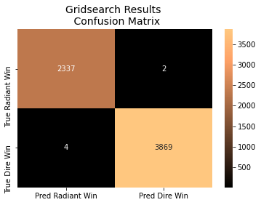
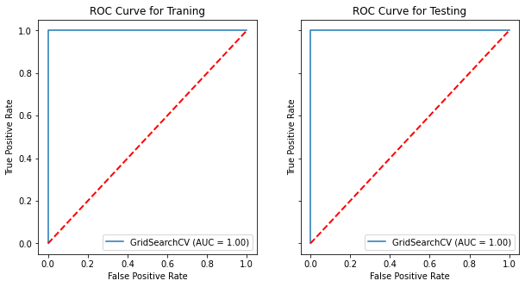
Findings – Random Forest Classifier
Notes:
These are the results for our tuned Random Forest classifier. While the first model performed very well, this model was near perfect. As you can see, from about 6,000 matches, it predicted the wrong result in only 6 cases.

Slide 9
Business Recommendations
Automated system to respond to meta trends in real time
Updating every 3 days to ensure all fresh data

Slide 10
Future Work
Alternative Classification methods
More Data
More Compute

Slide 11
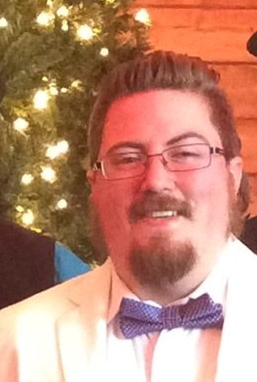
Thank You!

