Slide 1
Module 1 - Final Project
Non-Technical Presentation
John Casey Dean

Slide 2

Problem Statement
Enter Film Industry
High Risk – High Reward
Notes:
The film industry is big business. There are hundreds of films releasing each year, which makes entering the business hard to navigate. How do you decide which films to make? Are you trying to take risks to find that next generation defining film, or are you looking for a stream of steady successes? How do you identify those films? In this presentation, I will provide some answers that give us a solid foundational understanding of the film industry that we can make decisions from.

Slide 3
Business Value
Reduce Risk
Define Direction
Opportunity to Outperform Expectations
Notes:
If we can define which films carry the greatest risks, we can then define what kinds of films to target for production. In doing so, we can also seek opportunities to maximize our return on investment, rather than just minimizing any losses.

Slide 4
Methodology
Data
Identify high-risk Factors
Identify low-risk groups that have high performance
Notes:
We began by using data pulled primarily from the numbers movie database, and supplemented it with data pulled from IMDB. This allowed us to combine financial data from the numbers, and combine it with information such as film genres from imdb.
Once our data was put in place, we explored several variables to try and find relationships between those variables, and the rate of success for films. For the purposes of this exercise, we defined a success as any film that generated a profit.
This allowed us to define low risk groups of films, that we then further explored to try and identify film categories that carried low risk, but tended to outperform other categories.

Slide 5
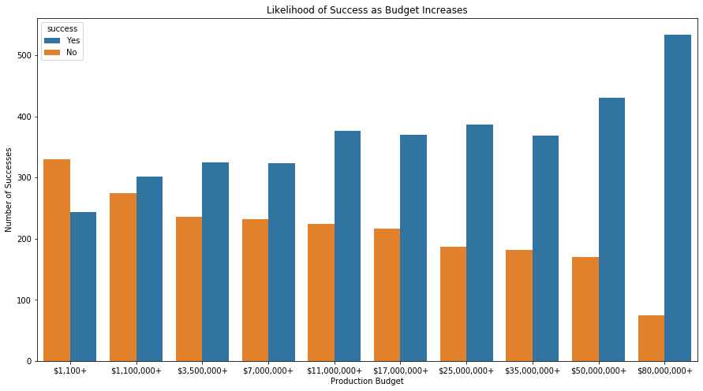
Findings - Budget
Notes:
This slide shows us the distribution of films that made or lost money based on their budgets. As you can see, there is a strong correlation between an increase in budget and the rate of success. In general, films that had budgets smaller than $50,000,000 had a less than 70% chance of generating a profit. For this reason, our recommendation is to plan to spend at least this much on each film produced.

Slide 6
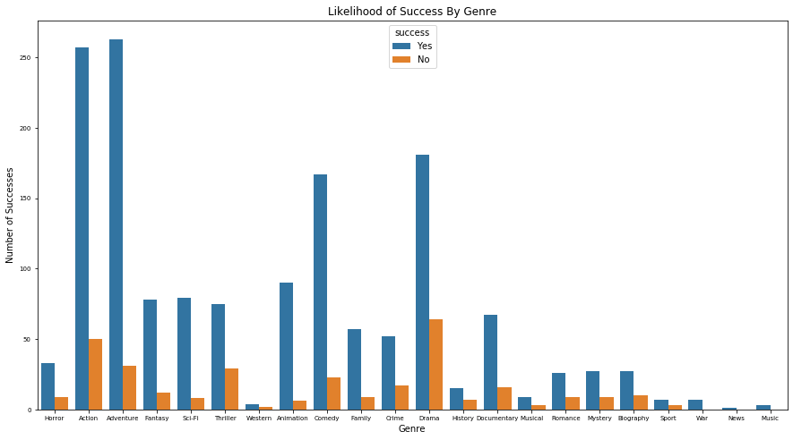
Findings - Genre
Notes:
Once finding a minimum budget for viability, we proceeded to explore variables within only the films that had a budget of at least $50,000,000. Within those variables, we had some interesting finds. This chart shows the rate of success for each genre of film within this subset of data.
Notice that, while all genres have more successes than failures, there are several genres that show both higher representation and higher rates of success. Action and Adventure are the two that stand out most, but Comedy, Animation, Sci-Fi, and Fantasy films all show higher success rates relative to their peers in other genres.
Among all genres with significant representation, Animated films show the highest rate of success.

Slide 7
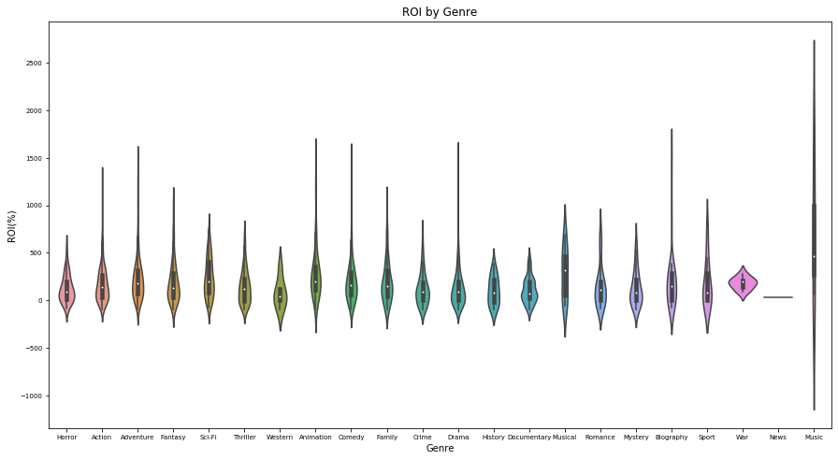
Findings - Genre
Notes:
Moving on, this chart shows us the distribution of what we can expect for a return on investment across the same films from the last slide. A quick glance tells us that all genres have similar floors, and the median for all genres is positive. Animation has a higher median ROI than any other high-success genre.
Certain genres show higher potential to outperform expectations, such as Action, Adventure, Fantasy, Animation, and Comedy. Sci-Fi is particularly interesting, because its peak is not as high as other high-success genres, but more likely to make a higher return on each film.

Slide 8
Business Recommendations
Plan to invest at least $50-80 million in each film
Focus on a mix of high-success genres
Notes:
To sum all of our findings, we recommend a minimum budget of $50-80 million per film, and focusing in high success genres, including Action, Adventure, Sci-Fi, fantasy, Comedy, and Animation.

Slide 9
Future Work
Combinations of genres
Release schedules
More Data
Notes:
Given more time and resources, we could bring further recommendations. With more time, we would love to explore the impacts of different combinations of genres in a film, as well as the impacts of release timings, maturity ratings in combination with our other variables.
The biggest thing we could use to generate more findings is to gather more financial data. Data such as genres, cast, and release dates are all easily available. For this project, we started with basic name and genre data for over 140,000 films. For financial data, however, we only had data on about 6,000 films. With financial support, we could get access to potentially millions of financial data points. Opusdata, for example, provides a dataset that gives weekly revenues broken down by country for over 21000 films. This would allow us to find information such as which types of films are seeing growth in their revenues, as well as which are declining. Which films see longer windows for generating revenue, and many more potential questions we could answer.

Slide 10
Thank You

