Slide 1


Sentiment Analysis
Module 4 Final Project: non-technical Presentation

Slide 2

Presentation Roadmap
Problem Statement
What are we looking at?
Business Value
How does this impact me?
Methodology
What did we do?
The Models
Findings
Future Work
What did we use?
What did we find out?
How can we improve?
Business Recommendations
What should you implement?
Notes:
Hello, my name is John Dean, and today I’m going to talk with you about Sentiment Analysis.

Slide 3

Problem Statement
Rapidly growing volume of text data
Difficult to analyze
Notes:
As the internet and social media become ever present in our lives, the amount of text data we interact with is growing at a rate that is honestly difficult to wrap our heads around. There are over 500 million tweets every day. Yelp hosts nearly 200 million reviews. The amount of text data available to us is simply staggering. With that in mind, it’s imperative that we find ways to take this wealth of data and turn it into actionable insights to solve the problems we encounter every day.

Slide 4
Business value
More insight => Better decision making
Planning Ahead
Notes:
In our case, the problem we are attempting to solve is how to conduct effective sentiment analysis. Knowing how your company and its products are being viewed by the public is key to developing a successful plan for product releases, feature updates, social media presence, and other decisions that encompass every aspect of your business.

Slide 5
Methodology – the data
Tweets from data.world
9000 tweets, labeled
Weighted and evaluated
Trained on 75% of set, tested on 25%

Slide 6
Methodology - The models
Naïve Bayesian Multinomial Classifier

Slide 7
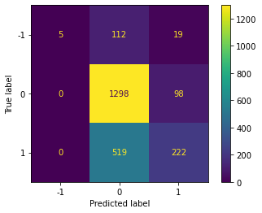
Findings
Notes:
Here are the results of our model. If you look in the lower right corner, you can see that our model did not perform particularly well. We believe this is mostly a problem of probability thresholds and will be working to correct that in the future.

Slide 8
Business Recommendations
Automated system to respond in real time to customer feedback
Positive feedback receives a positive response
Negative feedback receives a support offer and apology

Slide 9
Future Work
Alternative Classification methods
More Data
More Compute

Slide 10

Thank You!

