Slide 1
Smart Energy
Consumption Analytics
System
Data Mining Course — Final Project
👤 Author
👩‍🏫 Instructor
📅 Date
🔬 Method
Omar Abdulaal
Mariam Labib
May 2026
CRISP-DM

Slide 2
Problem & Motivation
Why does household energy analytics matter?
⚠ The Problem
✓ Our Approach
› Monthly bills give no insight into WHEN consumption peaks
› No visibility into which appliances drive high-usage hours
› Energy efficiency requires data — not guesses
› Manual inspection of 2M+ rows is impractical
› Turn raw meter readings into actionable insights
› Identify peak hours and behavioral usage segments
› Predict short-term consumption with regression
› Classify high-usage periods for smart alerts
› Deliver findings through an interactive dashboard

Slide 3
Dataset Overview
Individual Household Electric Power Consumption — UCI / Kaggle
📊 1,048,575
🔢 9 columns
⏱ 1 / minute
📅 Dec 2006–Dec 2008
Raw Rows
Raw Features
Sampling Rate
Date Range
Feature Description
Known Limitations
Global_active_power
kW Total household active power
› Missing values: ~0.39% encoded as '?'
› Date and Time stored separately
› No weather or occupancy data
› Single household — not generalizable
› No tariff / pricing information
Global_reactive_power
kW Reactive power
Voltage
V Supply voltage
Global_intensity
A Current intensity
Sub_metering_1
Wh Kitchen appliances
Sub_metering_2
Wh Laundry appliances
Sub_metering_3
Wh Water heater / AC

Slide 4
Methodology: CRISP-DM
Six-phase iterative data mining framework
01
02
03
04
05
06
Business Understanding
Data Understanding
Data Preparation
Modelling
Evaluation
Deployment
Define objectives, research questions, success criteria
→
Explore distributions, missing values, initial patterns
→
Clean, resample hourly, engineer 22 features
→
Clustering, regression, classification models
→
MAE, RMSE, R², silhouette, accuracy
→
Streamlit dashboard 5 interactive sections
→
Deliverables
01_Business Understanding.ipynb
02_Data Understanding.ipynb
03_Data Preparation.ipynb
04_Modelling .ipynb
05_Evaluation .ipynb
06_Deployment + Dashboard

Slide 5
Data Preparation
1,048,575 raw minutes → 17,477 clean hourly rows · 22 features · 0 missing values
› Combine Date + Time → single datetime index
› Cast all columns numeric, treat '?' as NaN
› Remove exact duplicate timestamps
› Time-based linear interpolation for gaps
› Engineer: hour, day_of_week, month, is_weekend
› Engineer: sub_metering_total_wh, active_energy_wh, unmetered_energy_wh
› Resample minutes → hourly (mean power, sum energy)
› Create high_consumption label (top quartile = 1)
› Add lag_1, lag_2, lag_24 features
› Add rolling_3_mean, rolling_24_mean features
💡 Why hourly? Minute-level data is large and noisy. Hourly aggregation reduces noise, speeds up model training, and makes daily usage cycles visually clear without losing predictive signal.

Slide 6
Modelling Techniques
Three data mining categories applied to hourly household consumption data
🔵 Clustering
🟢 Regression
🟡 Classification
K-Means | DBSCAN
Linear | Ridge | Poly Ridge
Logistic Reg. | Random Forest
Group similar hourly consumption behavior into segments
Predict hourly global active power from time + lag features
Label each hour as high vs normal consumption
› K-Means tested for k = 2 – 5
› Best k selected by silhouette score
› DBSCAN detects dense regions + noise
› PCA 2D projection for visualization
› 3 clusters: Low Weekday, Low Weekend, Peak
› Chronological 80 / 20 split (no shuffle)
› Lag features prevent target leakage
› Polynomial degree = 2 captures non-linearity
› Best: Polynomial Ridge R² = 0.633
› Target: top quartile of power = 1
› Stratified 80 / 20 split
› 12 behavior features
› RF feature importance extracted
› Best: Logistic Regression 99.77%

Slide 7
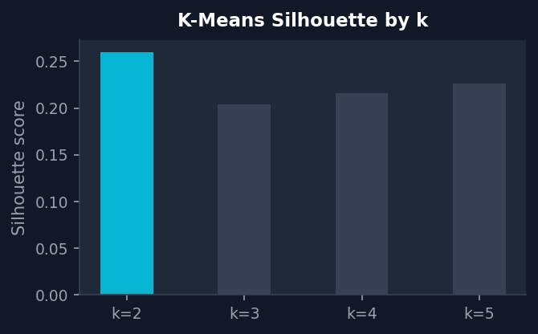
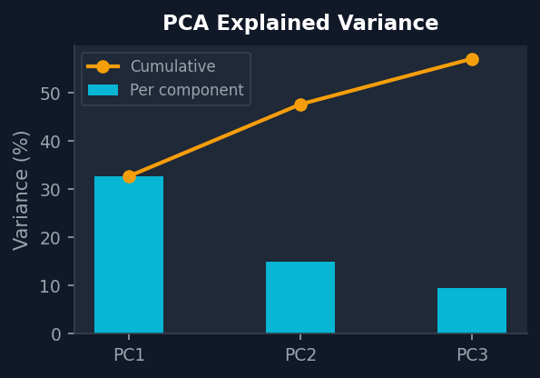
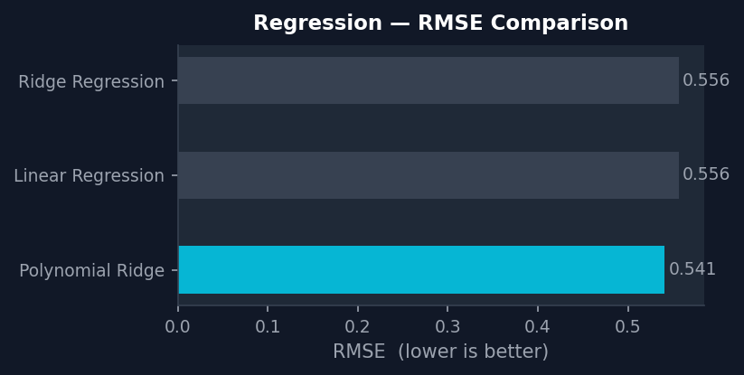
Evaluation Results
Full-dataset results from 17,477 hourly rows
Classification — Full Dataset
★ Logistic Regression
Acc 99.77% P/R 1.00 / 1.00
Random Forest
Acc 99.57% P/R 0.99 / 0.99
PCA Feature Variance

Slide 8
Interactive Dashboard
Streamlit · 5 sections · Tech Blue theme · Deployed to Streamlit Community Cloud
📈 Overview
🔵 Clustering
📉 Regression
🎯 Classification
💡 Business Insights
Time-series, hourly profile, energy share pie, weekday vs weekend
Silhouette table, cluster profile, PCA scatter + heatmap
RMSE comparison + Actual vs Predicted time-series plot
Accuracy table, classification report, RF feature importance
Peak hour, consumption share, PCA + recommendations
📷 Dashboard Screenshot — Insert here
[ Paste a screenshot of your running Streamlit dashboard ]

Slide 9
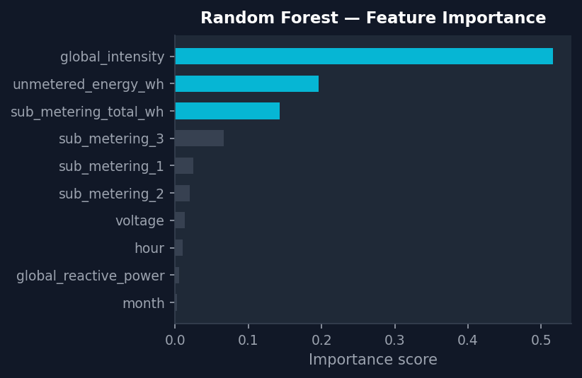
Business Insights
Actionable findings from the dashboard and model outputs
⏰ 20:00 – 21:00
⚡ 1.106 kW
📈 6.560 kW
🔥 25%
Peak Consumption Hour
Average Active Power
Peak Active Power
High Consumption Share
✅ Recommendations
› Shift laundry and dishwashers away from 19:00–22:00 peak
› Sub-metering shows which appliance (kitchen / laundry / HVAC) drives load — target the highest first
› Use the RF classifier as a simple household consumption alert
› Cluster 2 (Peak Usage, 2.59 kW avg) peaks mid-afternoon — high usage is not only an evening event
› Weekend usage is structurally different — separate optimization strategies apply

Slide 10
Limitations & Future Work
⚠ Limitations
🚀 Future Work
› Single household — not directly generalizable
› No weather, occupancy, or tariff data
› Baseline models — not production forecasters
› High accuracy reflects feature-label correlation
› Local CSV may not cover full public dataset range
› Add weather and temperature features
› Incorporate tariff / pricing data for cost analysis
› Apply LSTM or Prophet for time-series forecasting
› Expand to multi-household comparison datasets
› Real-time smart meter integration and alerts
› Association rule mining for appliance co-usage

Slide 11
Conclusion
✓ Complete CRISP-DM cycle
Delivered across 6 ordered notebooks from business understanding to deployment
✓ All 3 mining categories
Clustering, regression, and classification implemented and evaluated on real data
✓ Polynomial Ridge regression
Explains 63.3% of hourly power variation using lag + time features (R² = 0.633)
✓ Classification accuracy
Logistic Regression identifies high-consumption hours at 99.77% accuracy
✓ Interactive dashboard
5 sections turn model outputs into actionable household energy recommendations
💡 Key Insight:
Peak electricity usage concentrates in 20:00–21:00 evening hours. Shifting heavy appliances (laundry, dishwasher) out of this window is the most impactful behavioral change available to the household.

