Slide 1


Integrated Accounting
Management and Document
Centralization System
Presented by:
Supervisor:
Dr. Natali Levi-Soskin
Lior Esterkin
Matan Ben Hamo
Notes:
דגשים למצגת: הבעיה: איסוף מסמכים מפוזר ולא מסודר תלות גבוהה בלקוחות - בהקשר של מסמכים עומס עבודה ידני על צוות המשרד קושי במעקב אחרי סטטוס לקוחות עומס בתקופות דיווח סיכום: פיזור מסמכים בערוצים שונים עומס עבודה ידני וחוזר על עצמו קושי במעקב ובקרה אחר סטטוס לקוחות ומסמכים טעויות אנוש, כפילויות ומסמכים לא תקינים חוסר יעילות בתקופות עומס וחוסר שקיפות מול הלקוח

Slide 2
Motivation
Why does document in collection accounting offices becomes a critical bottleneck?
"When critical documentation is scattered across informal channels like WhatsApp, it leads to a significant increase in cognitive load and a higher probability of human error."
Schaupp, M., & Cleary, P. (2023). Information overload research in accounting: a systematic review of the literature. Journal of Management Control, 34(3), 271-309. /

Slide 3

The Client
Accounting Office: Levi Unger Slilat, CPAs
Levi Unger Slilat is a boutique accounting firm based in Haifa, Israel.
The firm provides accounting, tax, auditing, and business consulting services.

Slide 4




Working with a Real-World Client
Client Introduction
In-Depth Interview
Requirements Gathering
Partnered with an active accounting firm to examine and analyze their manual file collection workflows.
Conducted a structured session with the lead accountant to locate operational bottlenecks.
"Collecting documents manually from WhatsApp is our biggest bottleneck."
Translated actual operational pain points into core, actionable system specifications and features.
69% of accounting professionals spend too much time collecting client documents, while 79% waste time locating files and 58% report losing important client information.
Financial Cents. (2025). The State of Accounting Workflow & Automation Report.

Slide 5
The Core Problem
Accounting firms lack a centralized and controlled document submission process.
1
2
3
Scattered Submission
Manual Workload
Tracking Issues
Documents arrive from different channels and formats
Accountants manually sort, check, and follow up
Missing or duplicate files are hard to detect
4
Multiple WhatsApp Business Accounts
Client documents are split across separate conversations

Slide 6
Client Requirements: FR and NFR
Key functional and non-functional needs identified during the client interview
Functional Requirements
Non-Functional Requirements
Collect documents from WhatsApp, Gmail, and web upload
Secure separation between client data
Allow clients to upload documents through a web portal
Mobile-friendly interface
Extract document data
Fast dashboard loading
Notify accountants about completed or late submissions
High availability during business hours
Allow accountants to verify each processed document
Encryption, backups, and audit logging

Slide 7



Existing Solutions & Gaps
Existing solutions and the gap our system addresses
Hashavshevet
Morning
Dext
Powerful but too complex for everyday clients to use.
Handles invoicing but misses external expenses.
No unified workspace and does not work in Hebrew.

Slide 8
Our Solution
A web-based platform connecting clients and accountants in one unified workspace
Centralized document collection
Accountants access a centralized dashboard for document review and tracking
Automatic data extraction for reports and client-document matching
Key Capabilities
Client Web Portal
Accountant Dashboard
Collection from Email & WhatsApp
OCR Data Extraction
Duplicate & Missing Detection
Submission Notifications
Notes:
מה הרעיון של

Slide 9
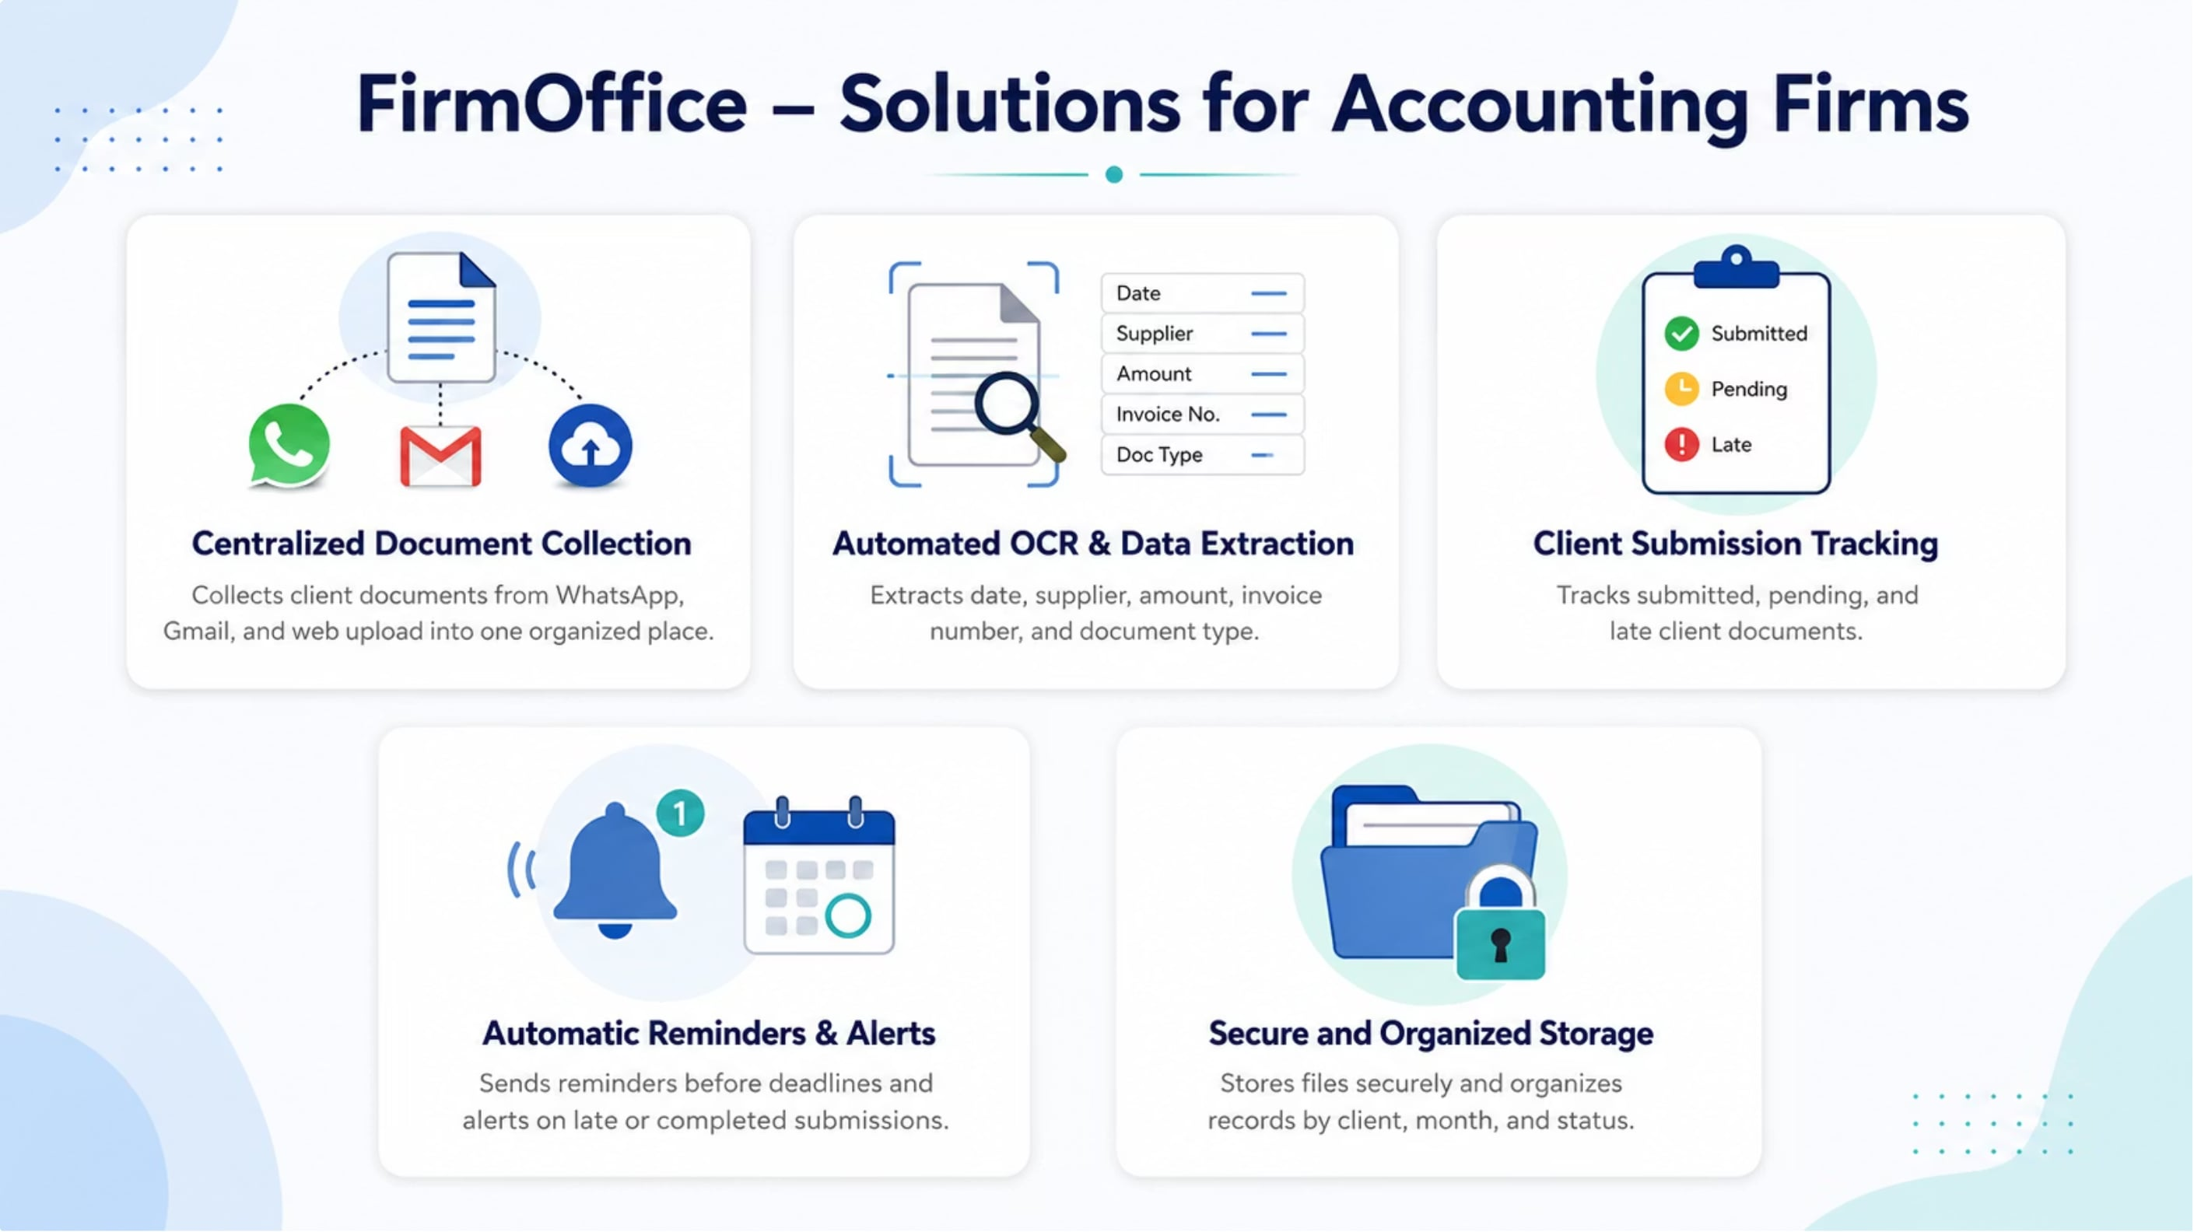
FirmOffice System
Notes:
מה הרעיון של השקופית?

Slide 10




Systems Main Components
OCR for Extracting data from the documents
Making information accessible to accountants
With Google cloud vision API
Firestore stores structured system data
Cloud Storage securely stores the original uploaded files
Retrieves incoming emails and attachments from the firm clients
Extracts financial documents sent by clients via email
With Gmail API
Gmail API
Receives documents sent by clients through a central WhatsApp Business account
Sends the documents into the system
Using WhatsApp Webhook
Webhook

Slide 11
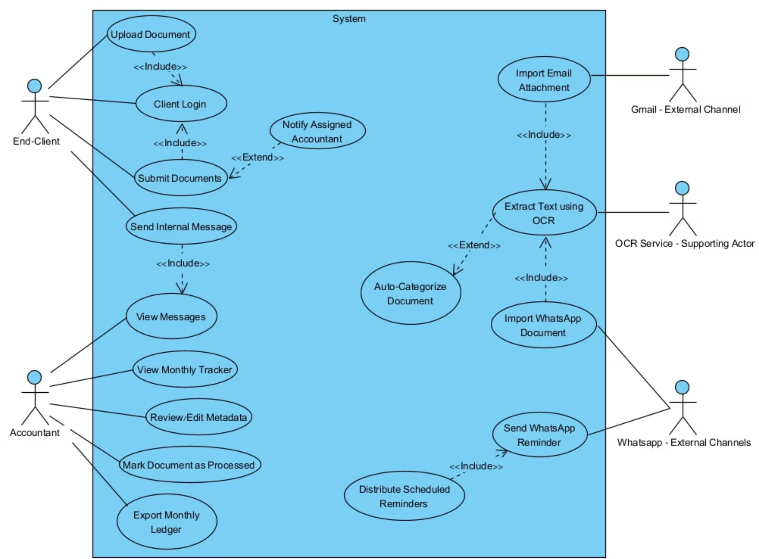
Use Case Diagram

Slide 12
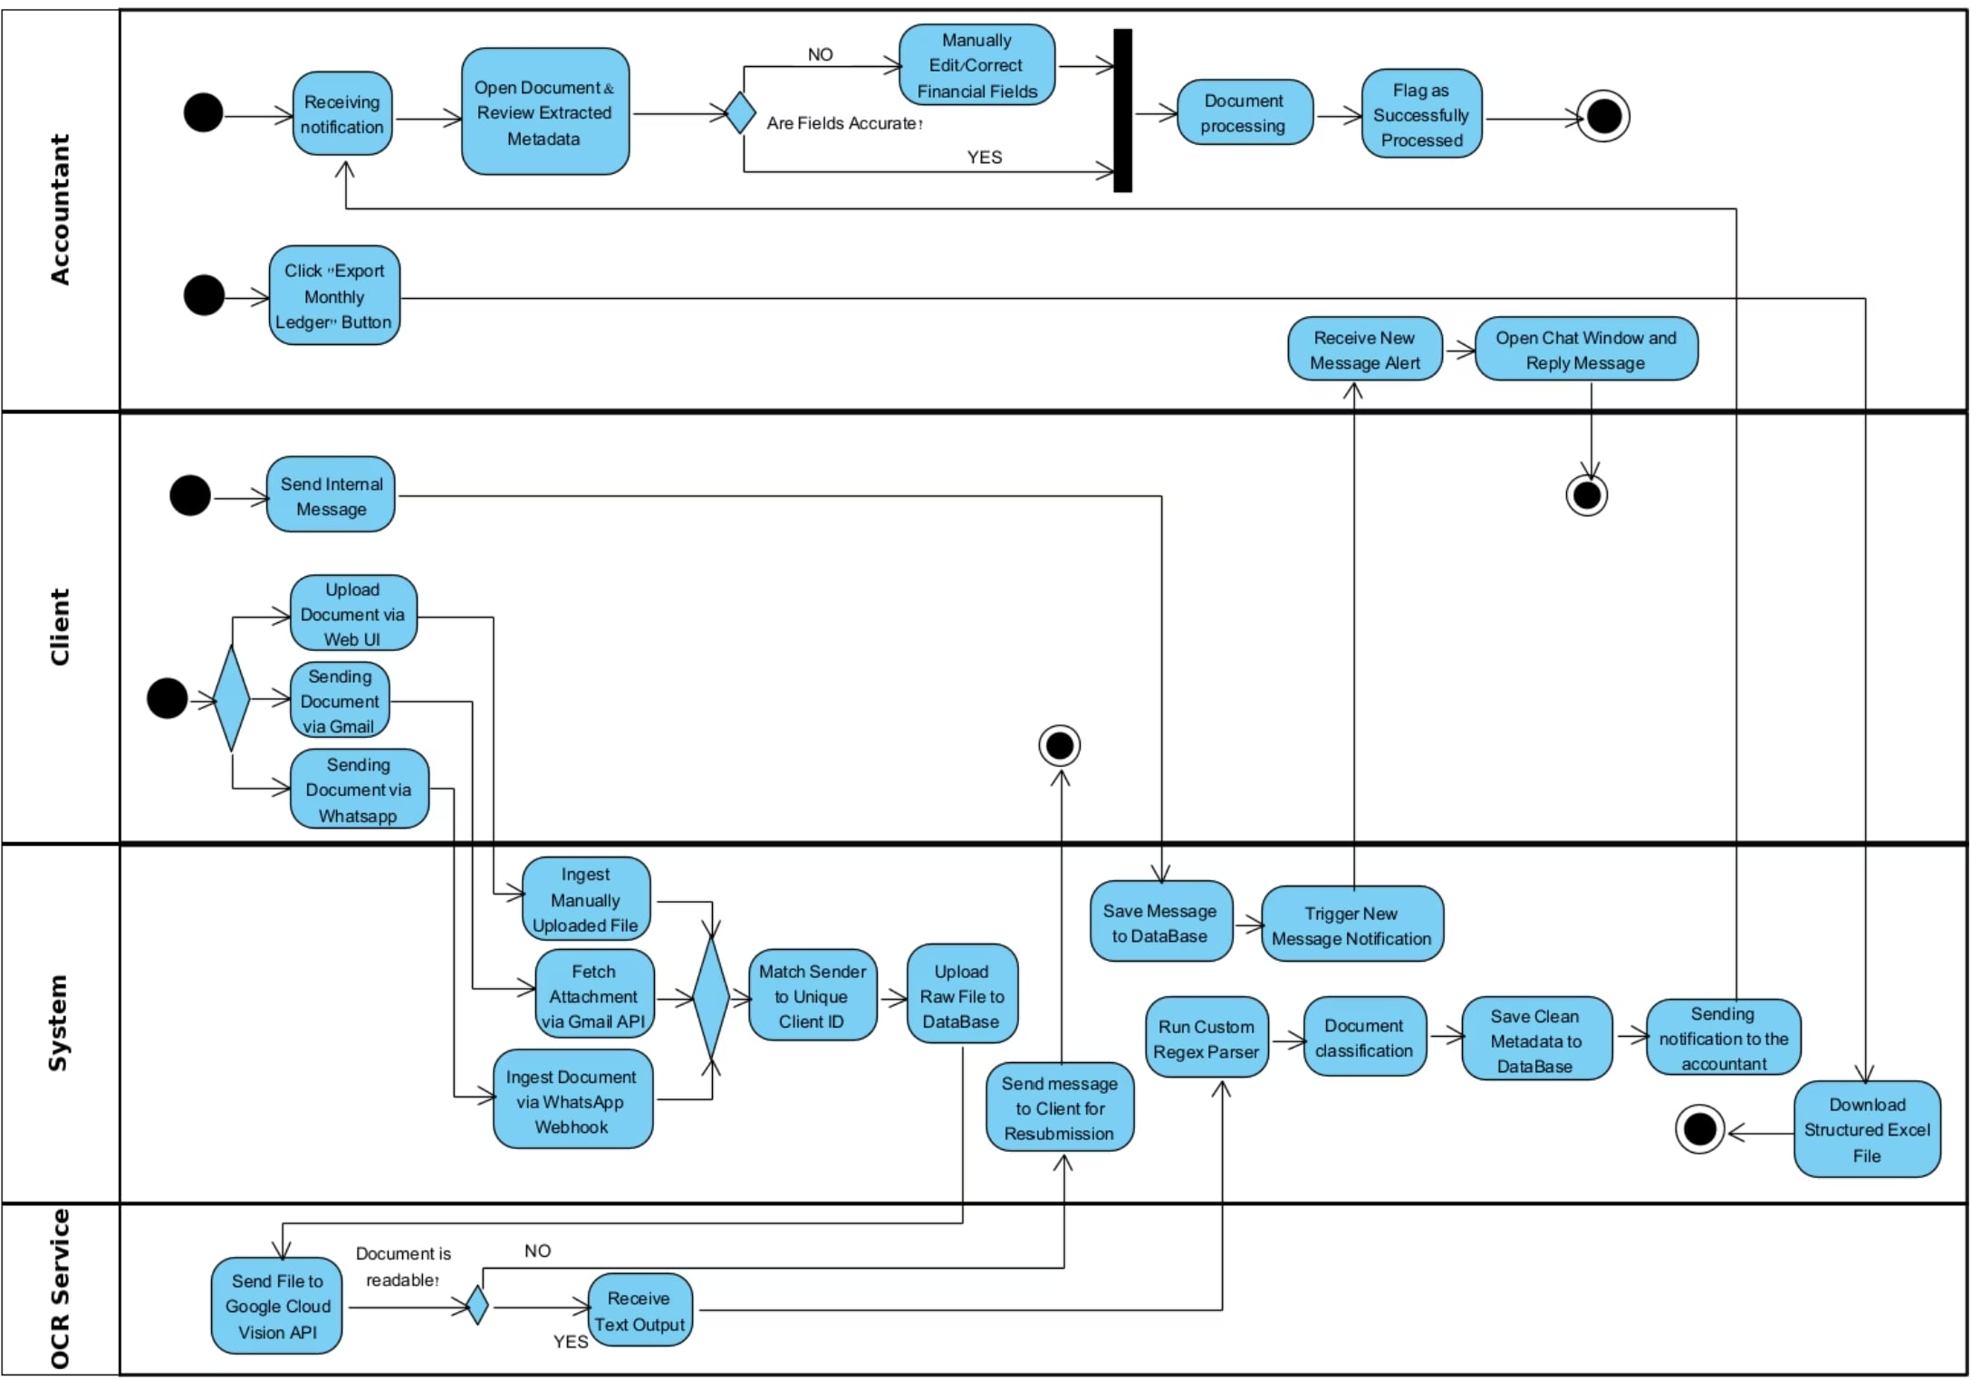
Activity Diagram

Slide 13
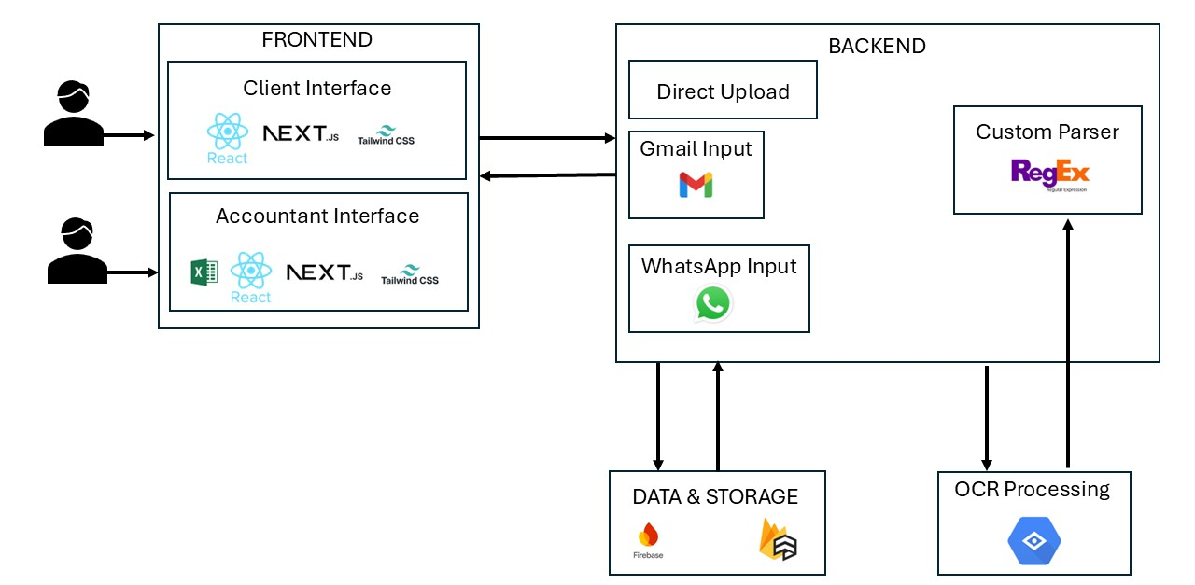
System Architecture

Slide 14






Core Algorithm
📥 Stage 1 — Login & Client Validation: User submits credentials · System verifies client in database
❌ Client not found → Error Notification — Stop
📤 Stage 2 — Upload & Validate Document
Checks: format · size · readability · duplicate detection
❌ Invalid or duplicate → Error Notification — Stop
☁️ Stage 3 — Store & Register
Upload to Cloud Storage · Record in Firebase · Status: Pending OCR
🤖 Stage 4 — OCR & Data Extraction
Extracts: Supplier · Date · Amount · VAT · Doc Number
⚠️ OCR fails → Manual Review Queue
✔️ Stage 5 — Validate & Save Data
Quality checks on fields · Save to Firebase · Update status
⚠️ Fails → Requires Manual Review
🧾 Stage 6 — Accountant Review
Dashboard notification · Reviews document & extracted data
Final status: Approved · Rejected · Correction Required

Slide 15
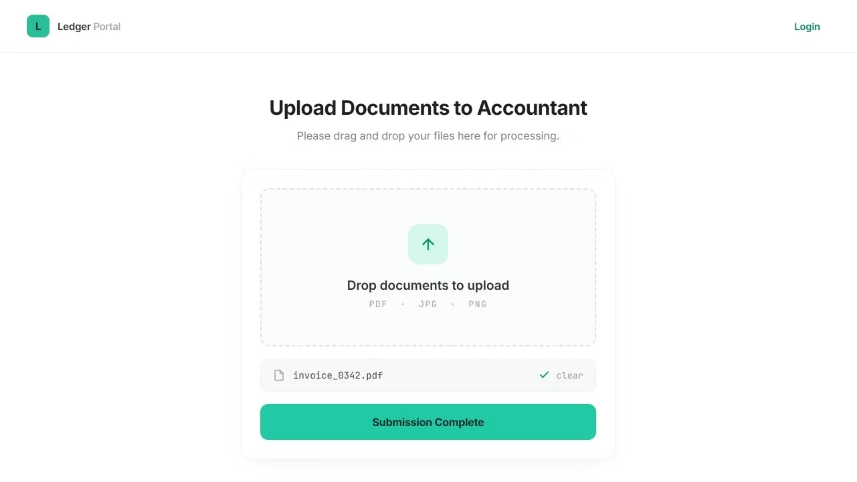
User interface

Slide 16
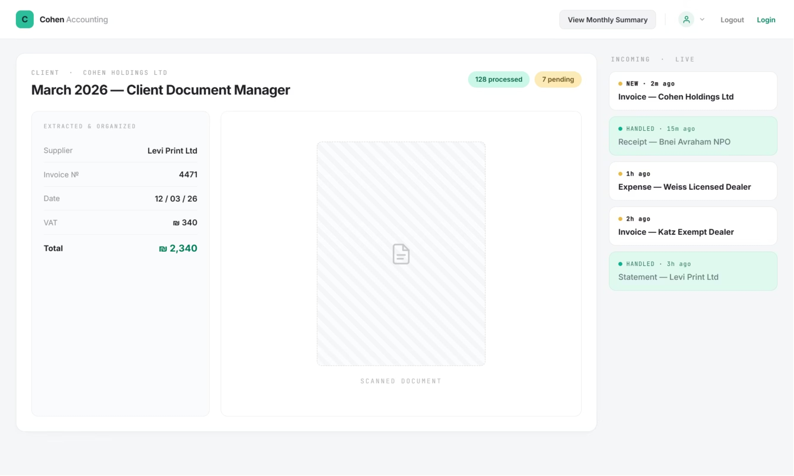
Accountant interface

Slide 17
Security & Data Protection
1
2
3
Passwordless Login
Private Cloud Storage
Secure HTTPS Channels
No passwords are saved in our database. Users log in securely with single-use codes sent straight to WhatsApp.
Files are stored in private cloud storage. Access is limited using secure, temporary, and expiring links.
All communication and data transfers are encrypted in transit using standard, built-in SSL protocols.

Slide 18
Testing & Evaluation
Test Case
What Is Tested
Pass Condition
Document Ingestion
WhatsApp file upload
File successfully received
OCR Processing
Text extraction accuracy
Legible text correctly converted
Data Classification
Document type identification
Correctly labeled as invoice
System Integration
API data transfer
Data reaches accounting database
User Interface
Dashboard metrics display
Real-time updates visible
Security
User token authentication
Unauthorized access blocked

Slide 19
Key Performance Indicators - KPIs
Metric
Target
OCR Accuracy
≥ 85% accuracy in extracting key document fields after accountant verification.
Manual Documents Entry Reduction
≥ 60% reduction
Document Processing Time
≤ 30 seconds from document upload to dashboard availability.
Document Submission Completion Rate
≥ 80% of clients complete monthly submission before the deadline.

Slide 20
Thank You!
Questions?

