Slide 1
Context Assignment
TEAM LIOR

Slide 2
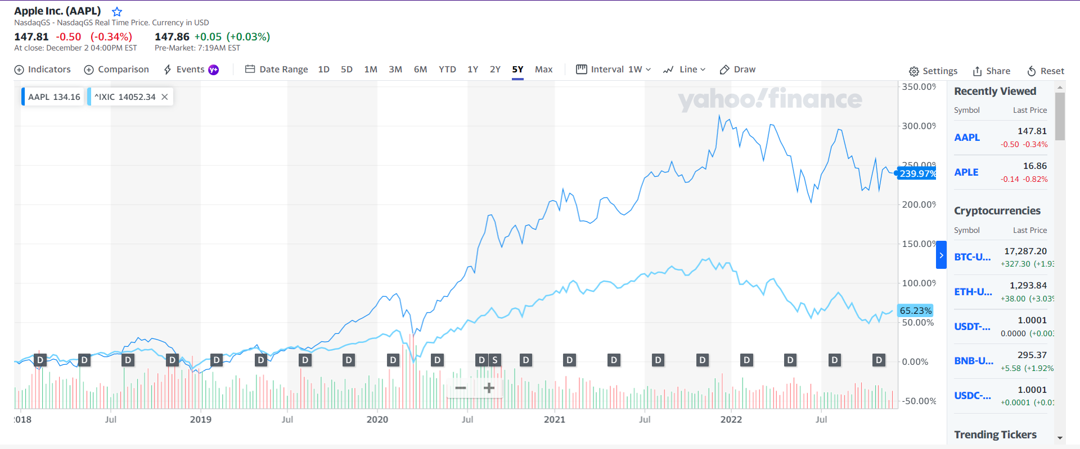
APPLE is leading the technological industry NASDAQ

Slide 3
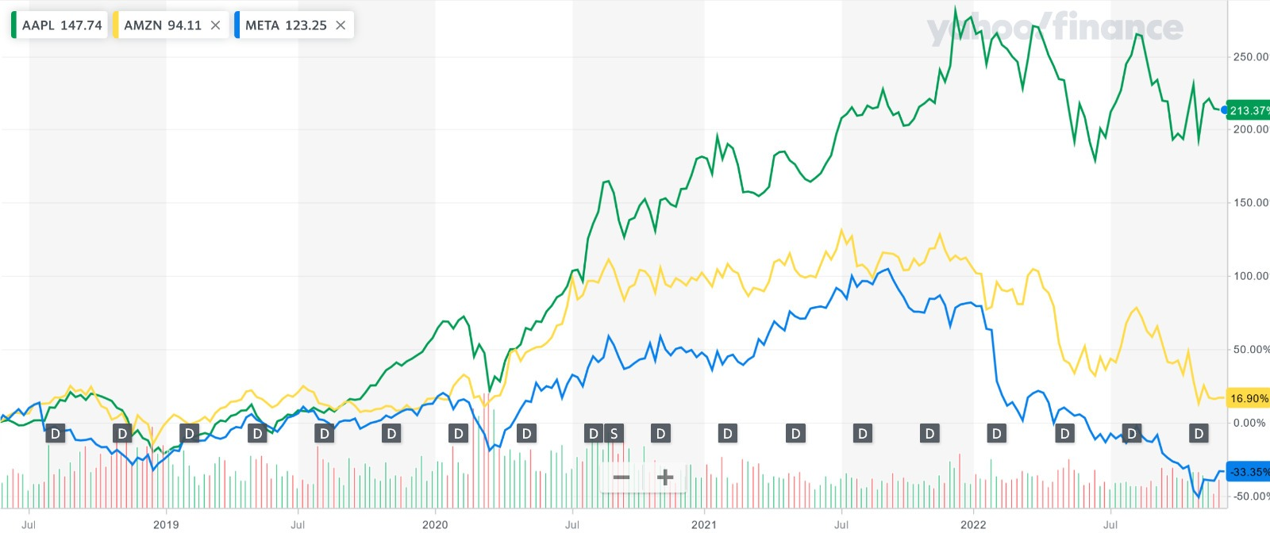
APPLE is the best & safest investment
World economic crisis
16.5%
COVID 19
43%
63%

Slide 4
TEAM LIOR
Lior Gabriel 316539675
Adi Malach 318531969
Najat Abu Rkeek 322327305
Amit leiba 316379403
Nadav Cohen 314964164
Eden Forman 204359350

