Slide 1
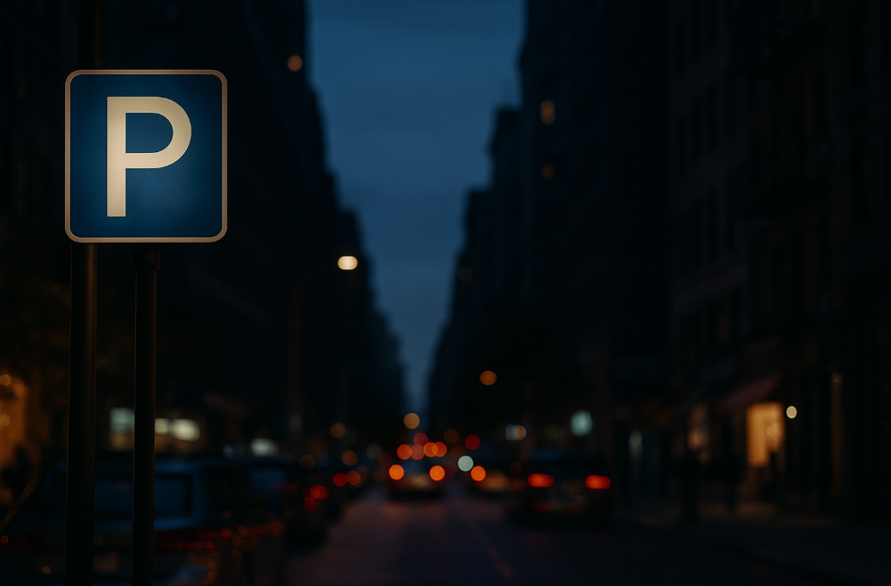
PARKSCOPE
WazePark Assist
​
By Lior Yanwo, Kiril Litvin, Stas Shubaev

Slide 2
MOTIVATING USE CASE
Detecting empty parking spaces by finding curb segments where no car is present (focusing on what is missing in the scene).
Helps drivers find real-time available parking spots.
Reduces unnecessary circling around the area.
Improves navigation with more accurate routing decisions.
Enhances user experience with timely parking suggestions.
PARKING SPOT AVAILABLE IN 200m

Slide 3
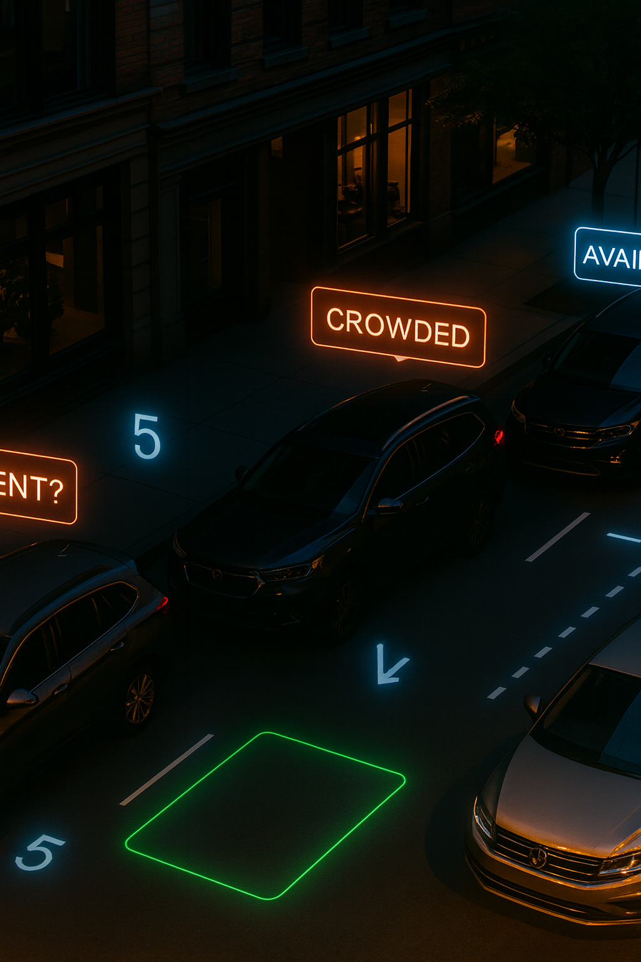
PROJECT TASK DESCRIPTION
PROBLEM TYPE:
INPUT:
OUTPUT:
A single street-level image containing parked vehicles
Bounding boxes of potential empty parking spaces.
Computer Vision — Object Detection
NOVELTY:
Diffusion-model inpainting for realistic car removal.
Synthetic generation of curb/sidewalk segments for parking-spot labeling.
YOLO fine-tuning on inpainted data.
Seeing if the model works the same on real photos and on inpainted ones.

Slide 4
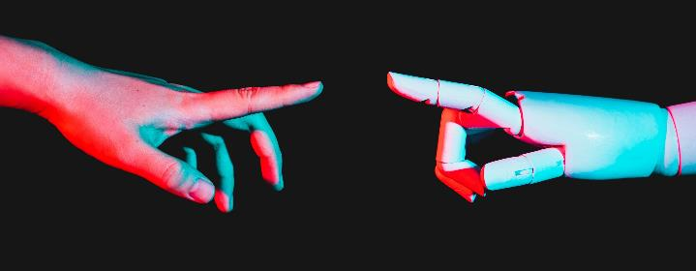
MODELS & METHODS
1. DATASET PREPARATION (PREPROCESSING)
• Images are sourced from public street datasets (KITTI).
• YOLO/DETR detects parked cars in each image.
• A diffusion based inpainting model is applied to the car regions to reconstruct the street/sidewalk surface realistically.
• The inpainted curb segment (the area left empty after inpainting) are manually labeled as empty parking spots.
2. PARKING-SPOT DETECTOR (MAIN MODEL):
• Fine-tuned YOLO detects empty parking spaces directly (bounding-box output).
• Input: street image, --> Output: parking-spot bounding boxes.
• The model is trained on inpainted images where cars were removed using diffusion based inpainting.

Slide 5
DATA SPECIFICATION
DATA SOURCES:
• Public street-image dataset (KITTI).
DATA TYPES:
Raw street images containing parked vehicles.
Car detections from YOLO/DETR (bounding boxes).
Inpainting images generated by applying a diffusion based inpainting model to the car regions reconstructing the street/sidewalk surface realistically.
Augmented images derived from KITTI (crop, brightness, contrast, blur).
Final labeled data: masked images + manually labeled parking-spot bounding boxes.
DATA SIZE:
Small real-image set for initial training and evaluation.
Augmented + inpainting dataset used for expanding the training set.

Slide 6
METRICS & KPIS
METRICS:
PRECISION
MAP (MEAN AVERAGE PRECISION)
RECALL
Out of all predicted parking spots, how many were correct.
Main metric for evaluating object detectors. Measures how accurately the model localizes and identifies empty parking spots
Out of all true empty parking spots in the image, how many did the model detect.
EVALUATION SCOPE:
• Compare detection quality before/after fine-tuning. • Test performance on different lighting conditions (augmentation). • Validate on real images from KITTI like dataset.
SERVICES / FUTURE USE:
• Could integrate with systems like Waze to highlight streets with free parking. • Can sum bounding boxes across multiple frames to estimate street-level parking availability.

Slide 7
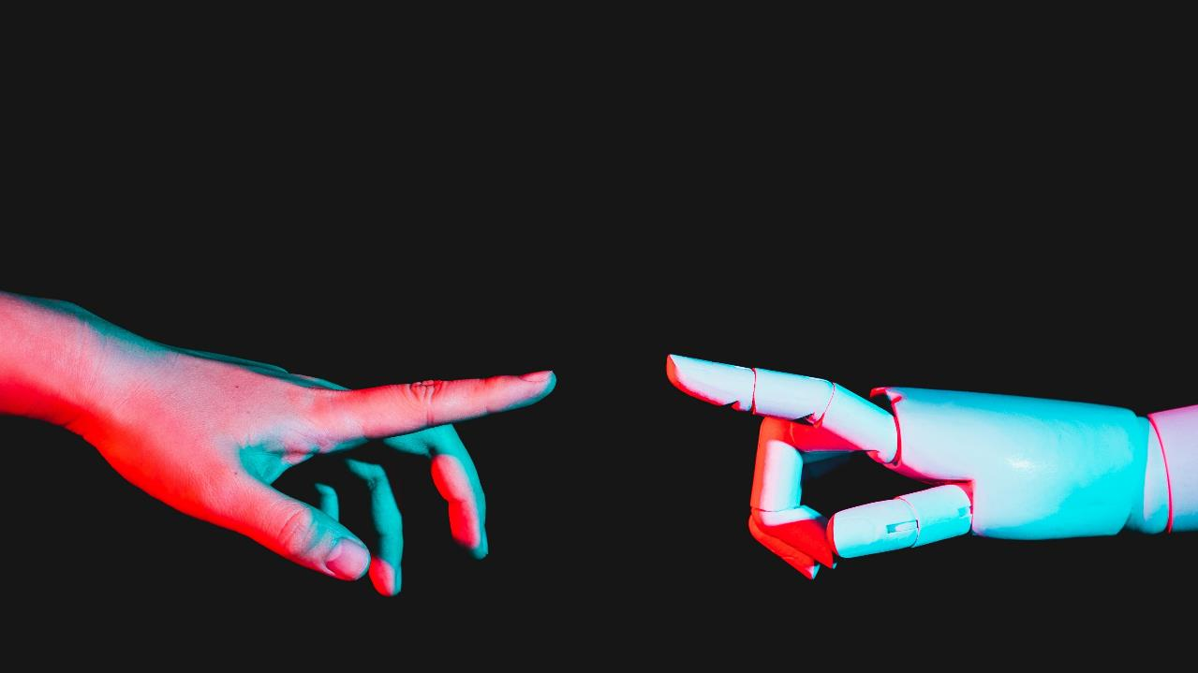
THANK U GOODBYE

