Slide 1

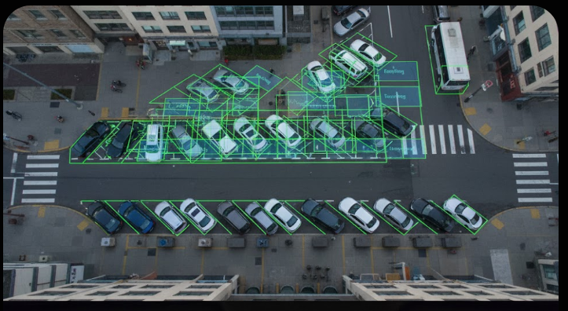
ParkScope Empty Parking Space Detection
By Lior Yanwo, Kiril Litvin, Stas Shubaev

Slide 2
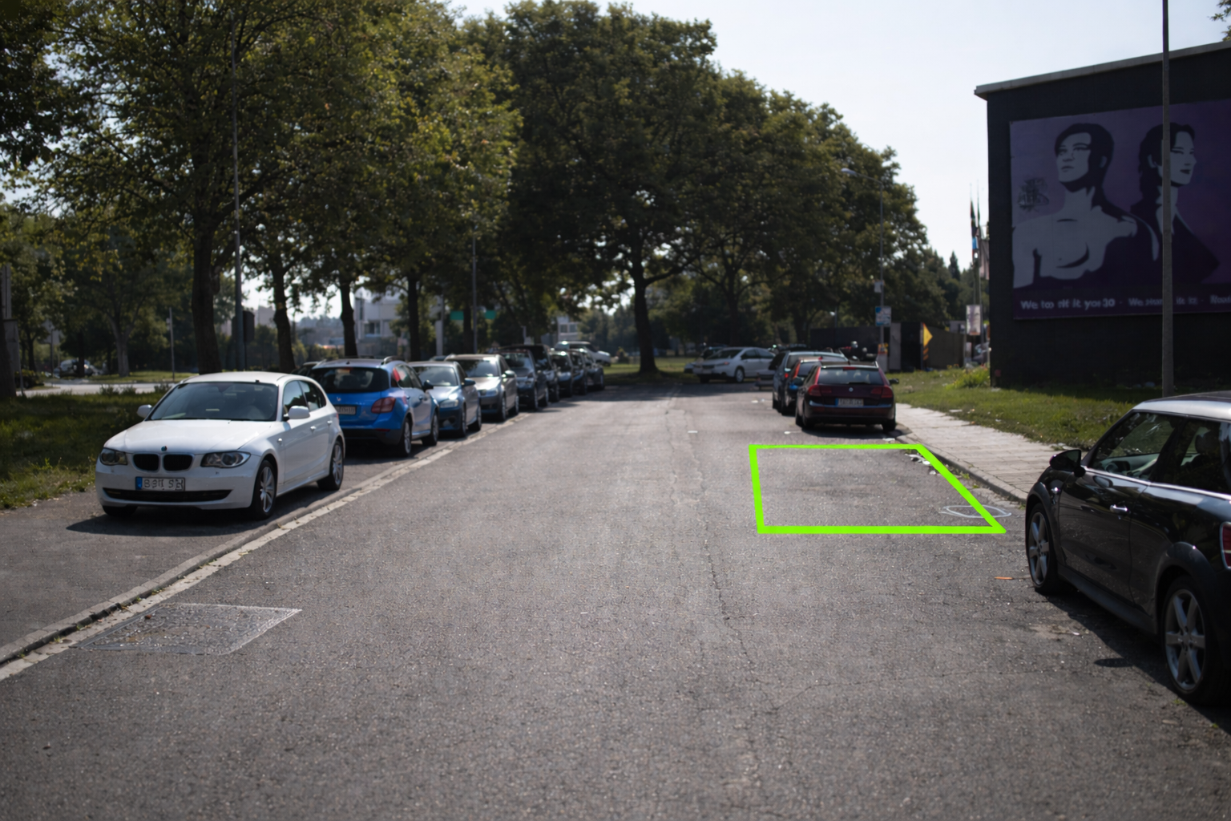
ParkScope – Interim Project Review
Motivation: We propose a vision-based ADAS system for real-time detection of empty curbside parking spaces in urban environments.
Task Definition: Input: Real-time street-level camera image. Output: Numbers of empty street parking slots.
What Changed Since Week 5:
Shifted from parking “difficulty scoring” to empty-space detection is a main and only output
Removed unnecessary models such as ResNet and ViT to simplify the pipeline.
Project Novelty:
Parking spaces are inferred without manual labels.
The system combining vehicle detection, removal, and ROI(Region Of Interest) -based on the logic of parking rules.

Slide 3
Previous Work
Paper | Task | Method | Relation to Our Project
Parking Slot Detection (2021) | Parking slot detection | CNN with labeled slots | Requires expensive annotations
Object Removal via Inpainting (2022) | Object removal | Diffusion-based inpainting | Inspiration for Stage 3
Urban Scene Understanding (2020) | Scene parsing | Semantic segmentation | Not focused on parking availability
Key Gap Identified: Existing methods depend on explicit annotations or static assumptions. Our approach targets curbside parking detection under real driving conditions.

Slide 4
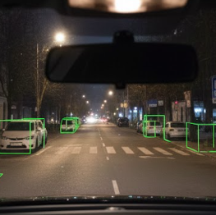
Baseline Solution and Results
Pipeline Overview:
Vehicle Detection (YOLOv8)
Synthetic Data Generation
Automated Labeling
Model Fine-Tuning (YOLO8)
Real-Time Inference & Counting
Loading Images from KITTI
Deep Augmentation Layer
Qualitative Results:
Work well ✔
Not working well
❌
The model learns to "see" a parking spot as an object, instead of just measuring gaps between cars.
Inpainting Artifact Overfitting Data Augmentation Layer
Overcoming road differences by using HSV and Perspective augmentations to ensure the model works on any street.
Ultra-Fast: Runs at ~3.2ms (300+ FPS) on YOLO11N, making it perfect for real-time use on a driving vehicle.

Slide 5
Project Plan Next Steps and Timeline
Task | Due Date | Expected Outcome
Model Transition to YOLO11 | Week 9 | Improved accuracy and SOTA real-time performance.
Integrated Augmentation Layer | Week 10 | Overcoming Inpainting artifacts and domain sensitivity.
Local Field Validation | Week 11 | Testing model robustness on various Israeli urban scenes.
Comprehensive Metrics Analysis | Week 12 | Finalizing IoU, mAP and Latency benchmarks.
Final presentation | Week 13 | Full end-to-end demo and project analysis.

Slide 6

Thank U Goodbye

