Slide 1
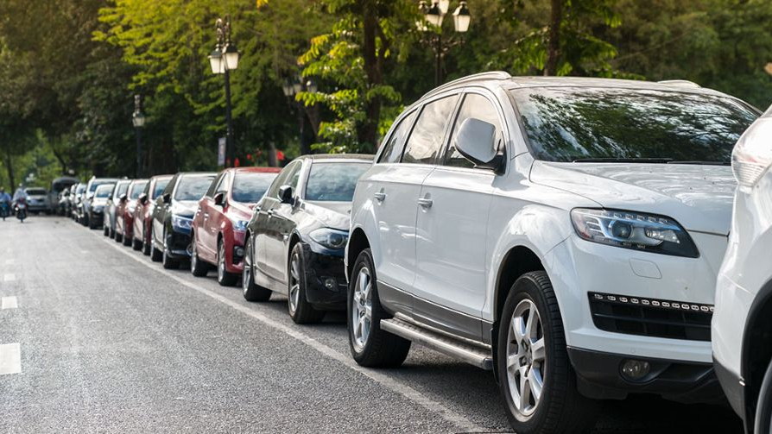




REVIEW AND REFINE PROJECT DEFINITION
Motivation
ParkScope
Urban detection hindered by data scarcity, specifically the lack of "available" (empty) parking spot samples.
Definition
GenAI-Enhanced Street Parking Detection
A high-precision detection system utilizing YOLO11 for real-time urban monitoring.
Core Models
YOLO11n (Nano) for inference & Stable Diffusion for synthetic data generation.
PRESENTERS
Kiril Litvin
•
Lior Yanwo
•
Stas Shubayev
Primary Metrics
Precision, Recall, and mAP@0.5.
CONFIDENTIAL PROJECT OVERVIEW

Slide 2



PROJECT OVERVIEW
Achievements & Novelty
ParkScope // 2026
Key Achievements
Project Novelty
mAP@0.5: 0.878 Successfully trained a model ensuring high reliability for urban deployment.
Applied a New Solution Approach by integrating a generative data pipeline directly into the training workflow.
GenAI Inpainting Created a balanced dataset by removing vehicles from real images to solve data scarcity.
Precision: 0.911 Achieved class-specific excellence for "Available" spots, critical for user trust.
Bridges gap between biased data & real needs
GenAI-driven synthetic augmentation
Closed-loop training optimization
Status: Ready for Real-World Testing

Slide 3

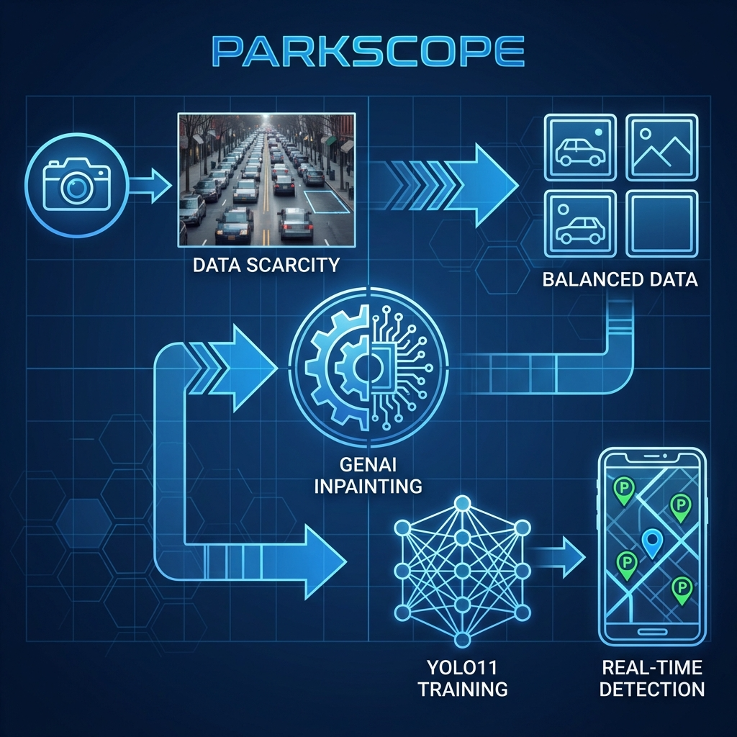


SLIDE 3
METHODOLOGY
Review Methodology
5-Stage Pipeline
1
Data Scarcity ID
2
GenAI Inpainting
3
Balanced Data Creation
4
YOLO11 Fine-Tuning
5
Real-Time Detection
QUALITY FOCUS
70%
Data Preparation
of Total Effort
Ensured critical class balance between "Occupied" and "Available".
RTX 2080 Ti
RTX 4070
Kiril: CUDA 12.1
Lior: CUDA 12.1
Batch 8, Workers 4
Batch 16, Workers 8
100 Epochs
100 Epochs
The dataset we used to create this hybrid model:
Link here

Slide 4
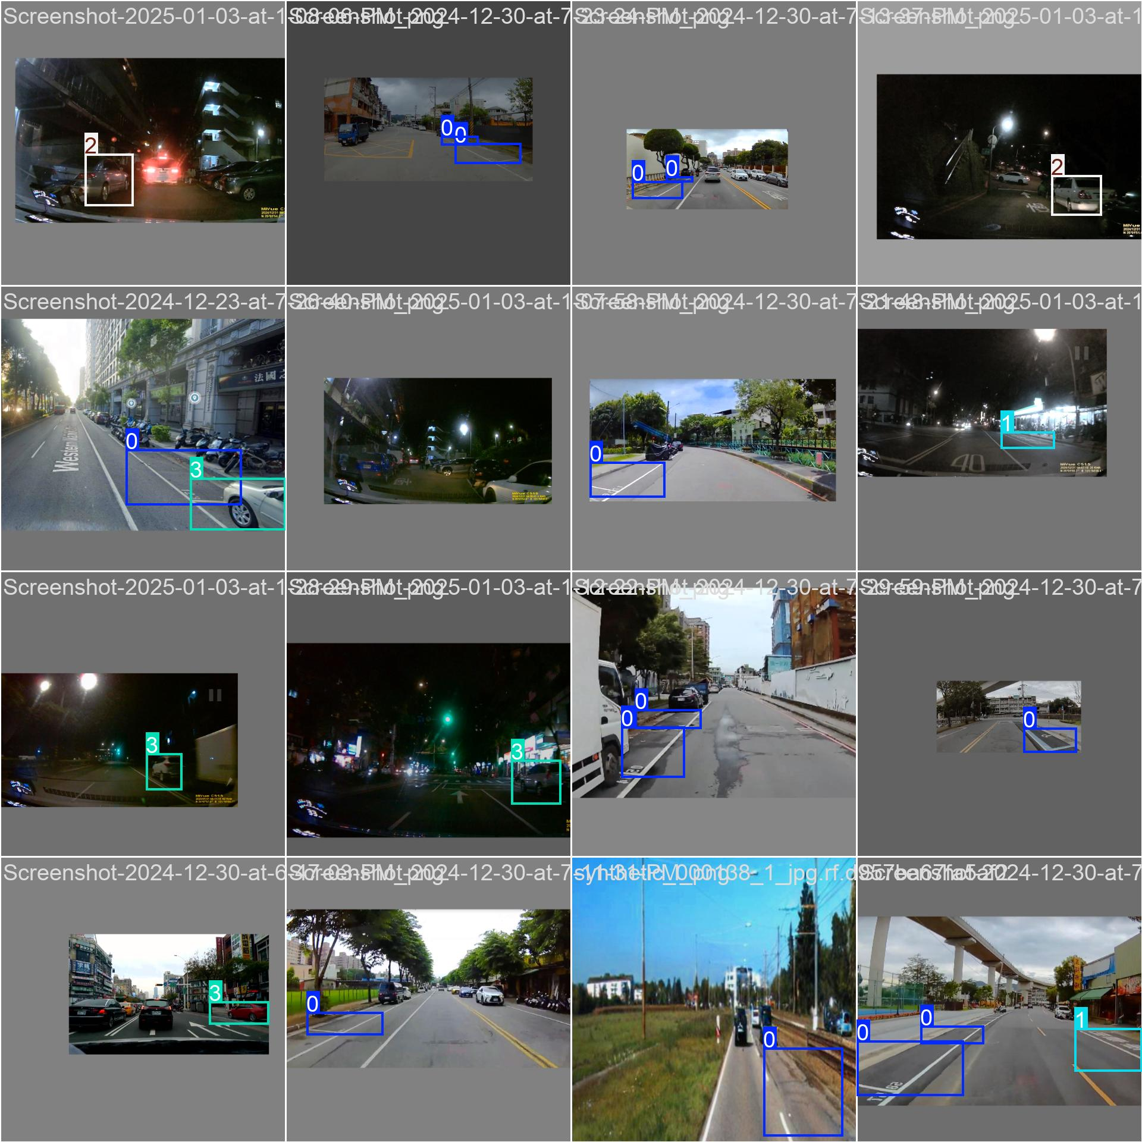
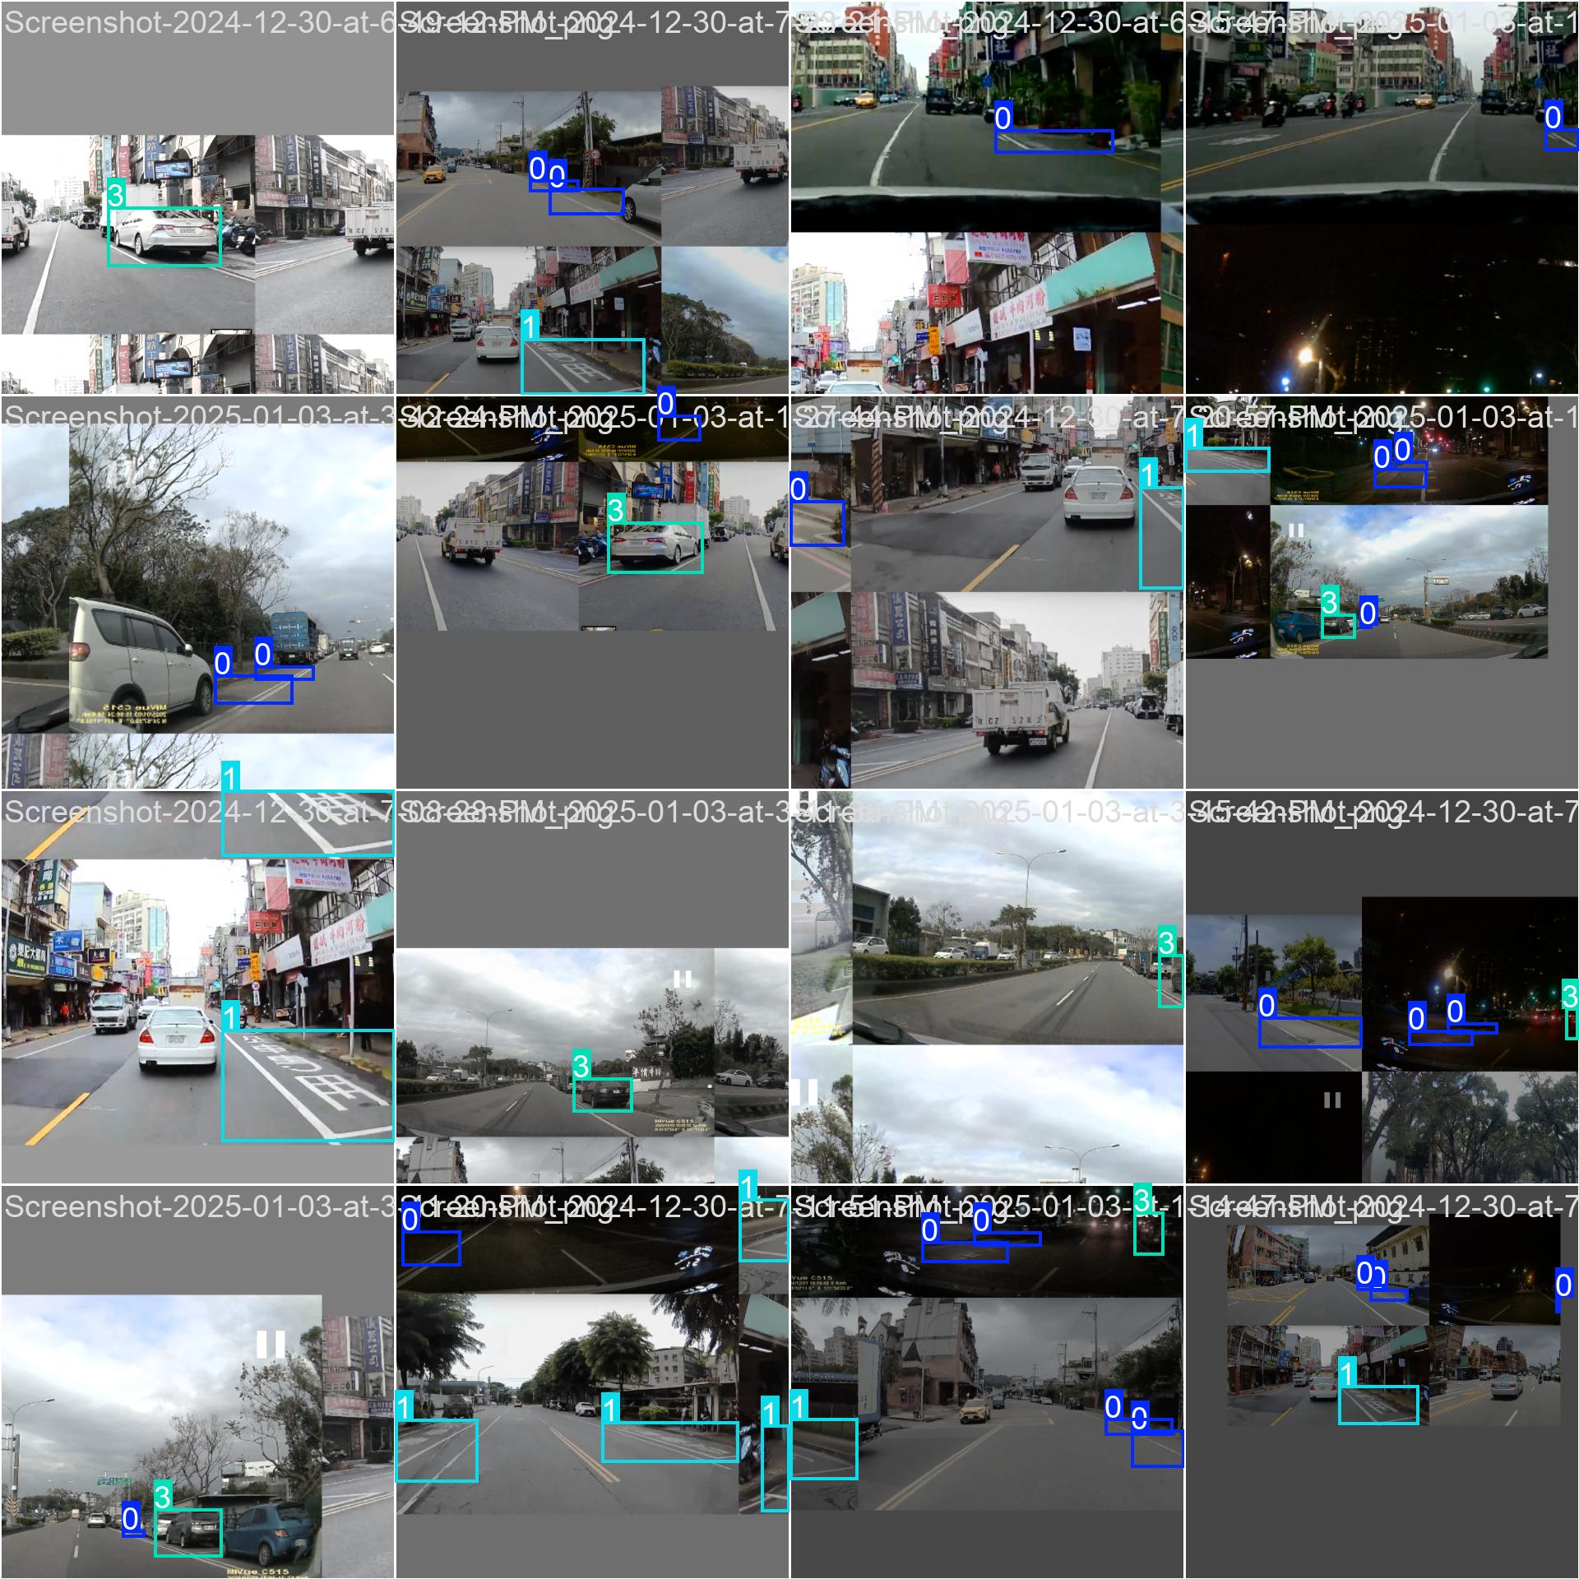
Runs

Slide 5

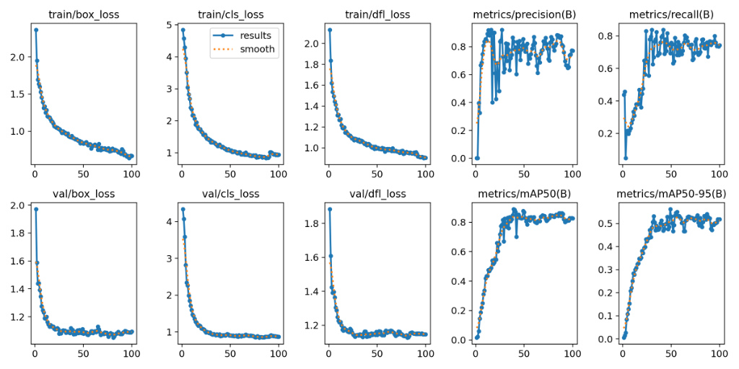




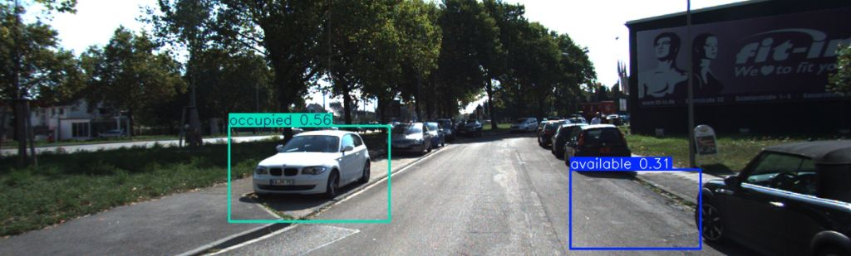

SLIDE 4
RESULTS (I)
Training Performance & Key Metrics
Model Evaluation
Training Logs (100 Epochs)
METRICS
OVERALL MAP@0.5
"AVAILABLE" CLASS
0.878
0.911
mAP@0.5
High reliability suitable for urban deployment.
Critical metric for user trust in the app.
ANALYSIS
Convergence
Consistent drop in box & classification loss over 100 epochs.
Stabilization Metrics peak and stabilize around Epoch 50.
Detection Example (Inference)

Slide 6
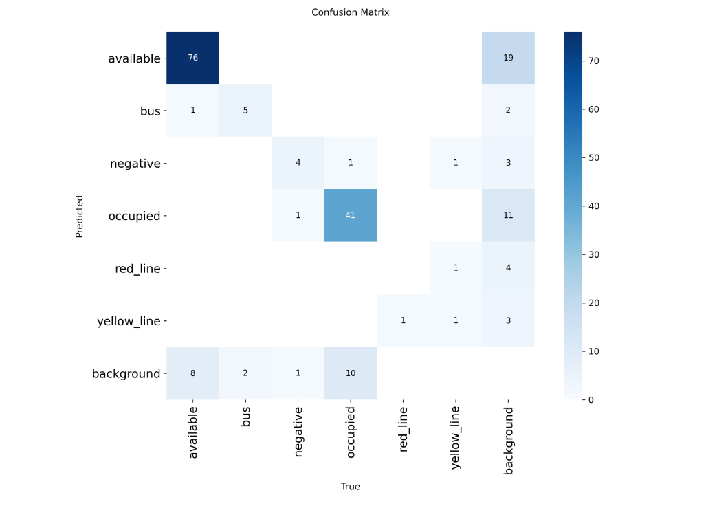
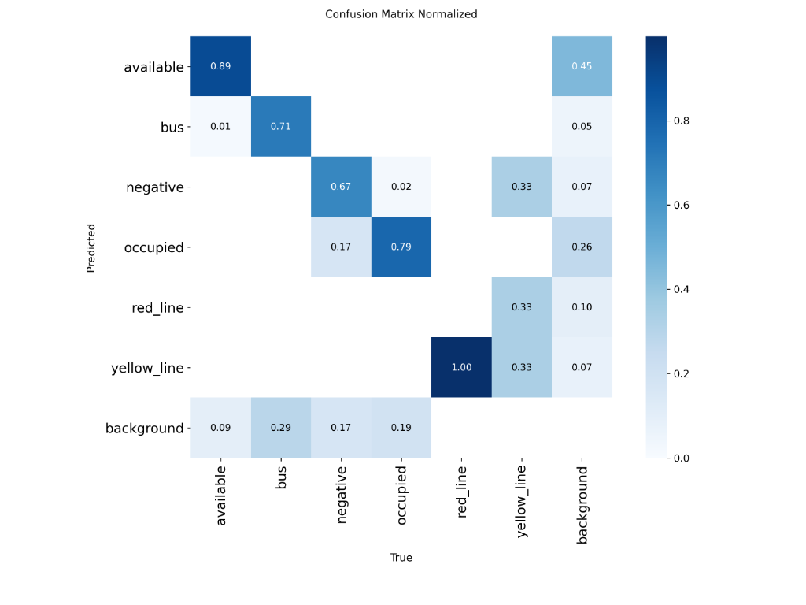


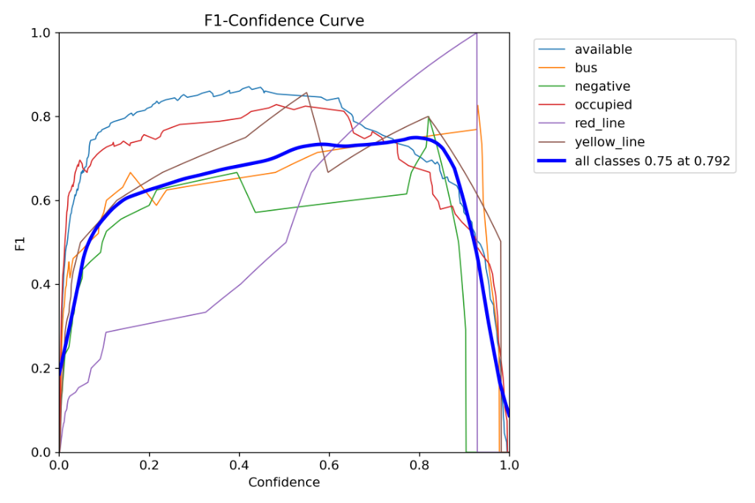
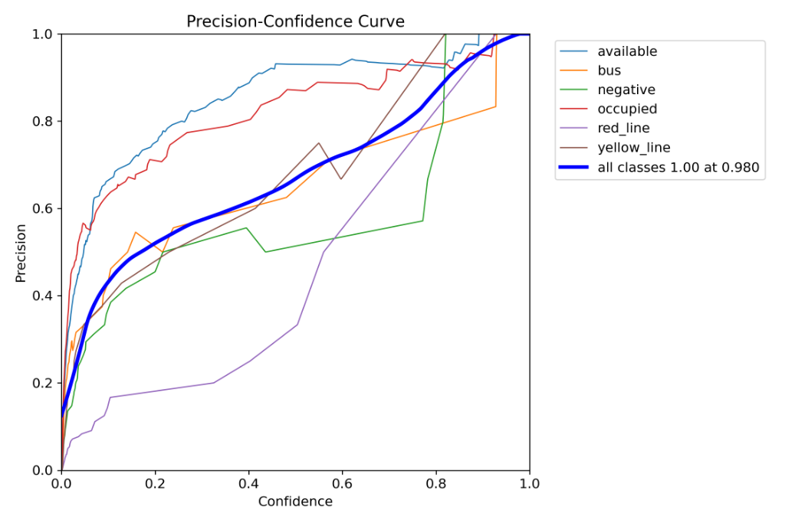
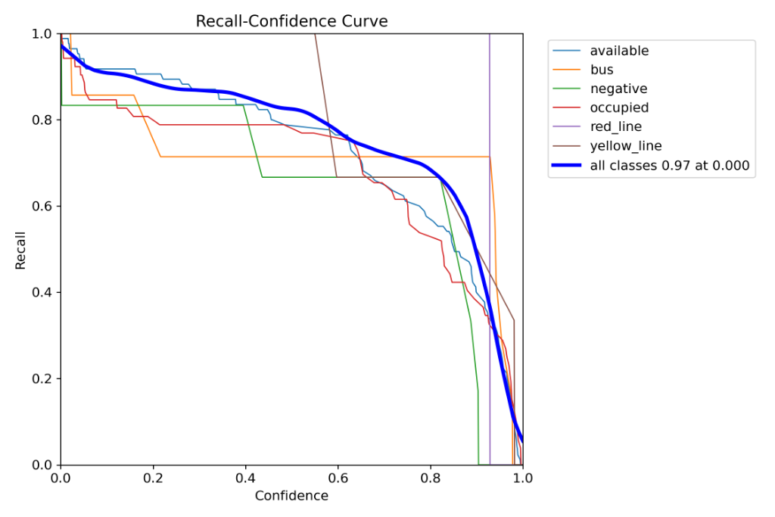
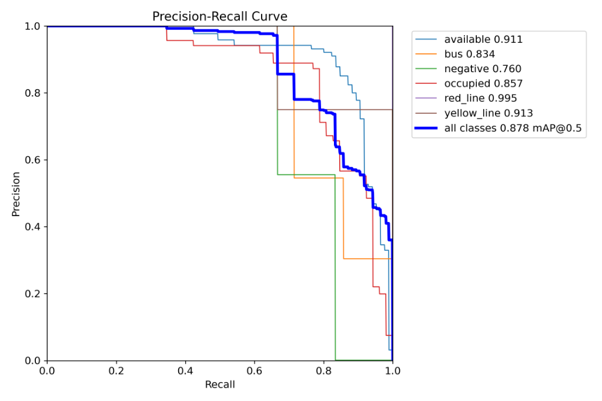

SLIDE 5
EVALUATION & RELIABILITY
Results (II): Confusions & Threshold Behavior
Available Spots
89%
True Positive Rate (76/85)
Occupied Spots
79%
True Positive Rate (41/52)
Confusion Matrix (Raw Counts)
Confusion Matrix (Normalized)
Observation
Detailed metrics confirm model robustness across varied confidence thresholds.
F1 vs Confidence
Precision vs Confidence
Recall vs Confidence
Precision-Recall (mAP)

Slide 7





SLIDE 6
FINAL THOUGHTS
Conclusion
Project Outcome
The project successfully met its goals by delivering a robust, real-time detection model capable of identifying parking availability with high precision.
Key Lesson
GenAI-driven data augmentation is a powerful tool for overcoming class imbalance in computer vision tasks where real-world data collection is difficult.
Future Exploration
Deployment on edge hardware (Jetson Nano/RPi)
Expand dataset (Night-time & Weather)
PARKSCOPE PRESENTATION // 2026

