Slide 1
High Accuracy Measurement over Multiple Dimensions
Yinda Zhang

Slide 2
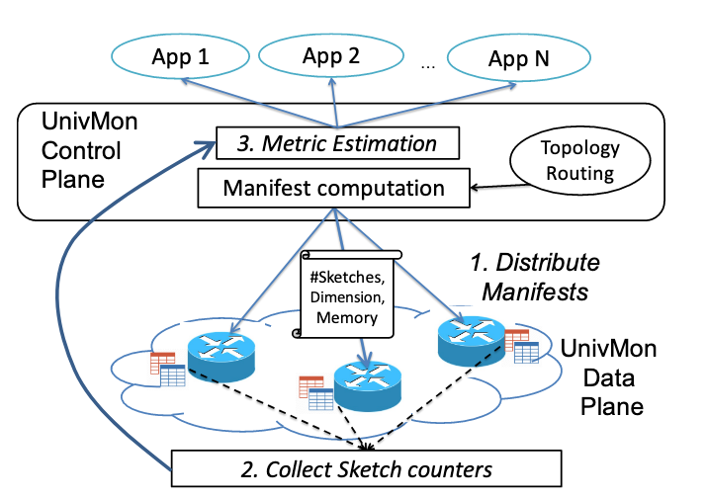
Large scale Deployment
Multiple Dimensions
Multiple Sketches

Slide 3
Multiple Dimensions
IP: 5-tuples, src/dst, prefix
Limitation
Memory overhead
Low accuracy/throughput
Sketch for SrcIP
133.97.100.14
208.53.159.69
Sketch for DstIP
Src: 133.97.100.14
Dst: 208.53.159.69
Compute dimensions
...
133.97.100.***
Sketch for IP prefix

Slide 4
Multiple Sketches
Space (Multiple measurement nodes)
Why need aggregation?
Multi-path
Not know path
Time (One sketch per 10s)
Sum up results

Slide 5
Space
4
5
6
7
2
3
8
9
1
10

Slide 6
Limitations
Complex aggregation rule
different rules for different dimensions
Count-Min & Count sketch are not aggregation friendly
mainly designed for single point measurement
Error ∝ sum size of traffic pass each sketch

Slide 7
1.2 Our solution
Min-granularity aggregation

Slide 8
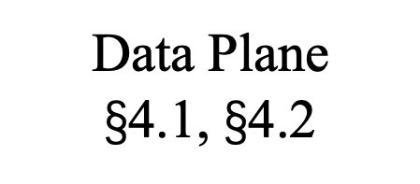
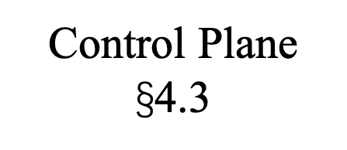
Applications
Dimensions Requirements
Aggregation Result
Topology information
Control Plane $\text{§}$4.3
Aggregation
Sketches Collection
Measurement on min-granularity dimension
Data Plane
$\text{§}$4.1, $\text{§}$4.2

Slide 9
1.2 Our solution
Count/CM Sketch
Aggregation-Friendly Algorithm

Slide 10
Aggregation-friendly
Subset sum estimation
Variance sum minimization

Slide 11
Subset-Sum Estimation
If we have known the exact size of all traffic, we can directly calculate the optimal choice to achieve variance sum minimization
God’s perspective? -- unrealistic
Computation based on overall data? – low throughput

Slide 12
Our solution
Fit in sketch-based data structure
Minimize variance sum locally

Slide 13
3 Overview

Slide 14
Applications
Dimensions Requirements
Aggregation Result
Topology information
Control Plane $\text{§}$4.3
Aggregation
Sketches Collection
Measurement on min-granularity dimension
Data Plane
$\text{§}$4.1, $\text{§}$4.2

Slide 15




4.1 Basic Version
$${(e}_{1},w_{1})$$
$$h_{1}$$
 | $$e_{2}, w_{2}$$
$$h_{2}$$
 |  |  | $$e_{9}, w_{9}$$
$$h_{3}$$
 |  |  |  |  |  | $$e_{7}, w_{7}$$

Slide 16
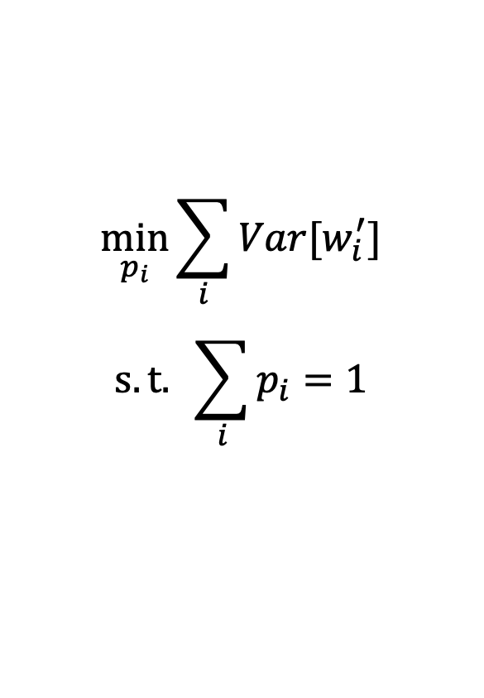







Minimize variance sum locally
$${(e}_{1},w_{1})$$
$$h_{1}$$
$$\min_{p_{i}}{\sum_{i}{Var[w_{i}^{′}]}}$$
$$s.t. \sum_{i}{p_{i}}=1$$
$$e_{2}, w_{2}$$
$$p_{1}$$
$$p_{2}$$
$$e_{1}, w_{1}/p_{1}$$
$$e_{2}, w_{2}/p_{2}$$

Slide 17
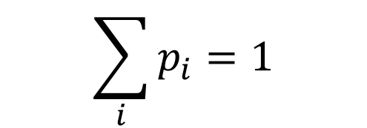
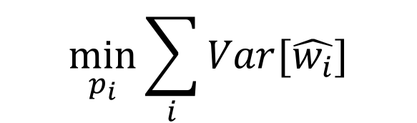

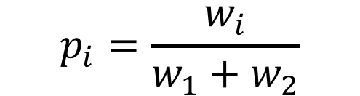
Minimize variance sum locally
$$\min_{p_{i}}{\sum_{i}{Var[\hat{w_{i}}]}}$$
$$p_{i}=\frac{w_{i}}{w_{1}+w_{2}}$$
$$\sum_{i}{p_{i}}=1$$
$$w^{′}=w_{1}+w_{2}$$

Slide 18





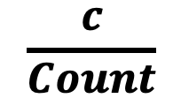


Basic Version
$$e_{i}$$
$$h_{1}$$
$$\frac{c}{Count}$$
$$+c$$
ID | Count
$$h_{2}$$
$$+c$$
 |  | ID | Count
$$h_{3}$$
$$+c$$
 |  |  |  |  |  | ID | Count

Slide 19
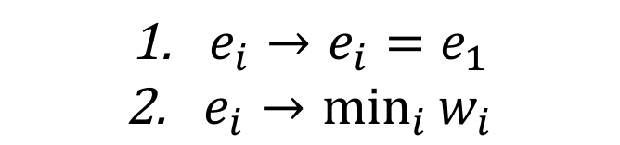
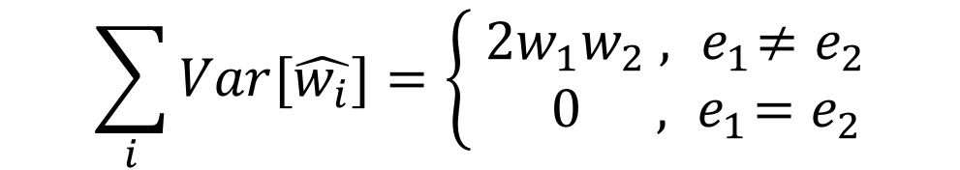
4.2 Optimization
$$\sum_{i}{Var[\hat{w_{i}}]}=\left\{\begin{aligned} 2w_{1}w_{2} , { e}_{1}≠e_{2} \\ 0 , { e}_{1}=e_{2}\end{aligned}\right.$$
${e_{i}→e}_{i}=e_{1}$
$\underset{i}{e_{i}→min}{w_{i}}$

Slide 20
4.3 Aggregation
Aggregation on space
Aggregation on time&dimension

Slide 21

Aggregation on Space
Different dimensions have different rules!
Now we only need to focus on min-granularity
Min-granularity $≤$ (srcIP, dstIP)
First work?

Slide 22
$$1=2+3=\left(4+5\right)+(6+7)=8+9=10$$
4
5
6
7
2
3
8
9
1
10
Notes:
mean/median
Packet loss
Recovery information

Slide 23
Aggregation on Time&Traffic
GROUP BY dimensions of traffic
WHERE time in dimensions of time
SrcIP (0x) | DstIP (0x) | Time | Size
32 45 67 89 | 32 45 67 89 | [00:10, 00:20] | 1500
32 45 67 89 | 32 45 67 89 | [00:20, 00:30] | 32091
32 45 67 89 | 32 45 67 89 | [00:10, 00:20] | 1642
32 45 67 89 | 32 45 67 89 | [00:20, 00:30] | 2453
32 45 67 89 | 32 45 67 89 | [01:10, 01:20] | 541927
32 45 67 89 | 32 45 67 89 | [00:40, 00:50] | 201868
32 45 67 89 | 32 45 67 89 | [00:20, 00:30] | 524

Slide 24
4.4 Application
Estimation for Overall traffic
Estimation for Heavy traffic

Slide 25
Platforms
CPU
OVS
FPGA
P4

Slide 26
Backup Slides
How to define the “min-granularity dimension”

Slide 27
App1
App2
App3
Dimension 1
Dimension 2
Dimensions
of traffic
Thread 1
Thread 2
Result of min-granularity dimension
Topology information
Thread 1
Thread 2
Thread 3
Dimensions
of sketch

Slide 28
Compression
$$\frac{C_{1}}{{C_{1}+C}_{2}}e_{i}/\frac{C_{2}}{{C_{1}+C}_{2}}e_{2}$$
$$e_{1}$$ | $$C_{1}$$
$$+$$
$$e_{2}$$ | $$C_{2}$$
$$=$$
??? | $${C_{1}+C}_{2}$$

Slide 29
Global Part
ID | Count
Local Part
Count
Count

