Slide 1
High Accuracy Measurement over Multiple Dimensions
Yinda Zhang

Slide 2
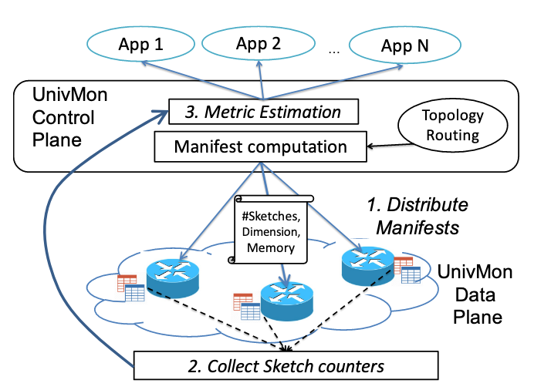
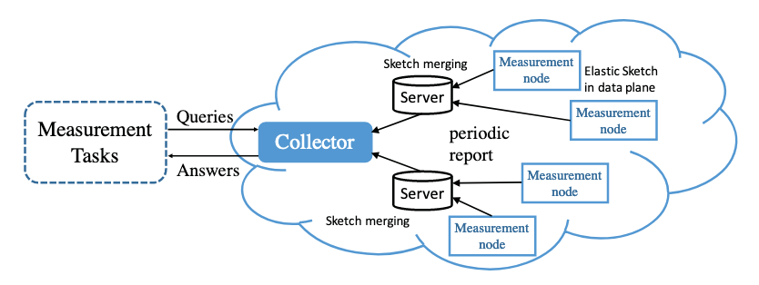
Background

Slide 3
Dimensions
[flowID, sketchID]
[(srcIP, dstIP), (switchID, timeID)]

Slide 4
flowID
srcIP
dstIP
(srcIP, dstIP)
IP prefix (Hierarchy Heavy Hitter)

Slide 5
sketchID
switchID
multiple paths per flow (network-wide heavy hitter)
timeID
long lasting flow

Slide 6
Other
Traffic from a given customer
Traffic was generated by a certain application

Slide 7
Prior Works
Sketch-based algorithms
Subset-sums algorithms

Slide 8
Sketch-based algorithms
Univmon, Elastic Sketch
Advantanges
Aggregating data
Measurement of the specific dimension
Limitation
One sketch per dimensions
Simply get the sum of the result will lead to large errors
Dimensions decided in advance

Slide 9







$$e_{i}$$
$$h_{1}$$
$$+c$$
$$h_{2}$$
$$+c$$
$$h_{3}$$
$$+c$$

Slide 10









$$S_{1}$$
$$S_{2}$$
$$e_{i}$$
$$e_{i}$$
$$h_{1}$$
$$+$$
$$h_{1}$$
$$S_{1}+S_{2}$$
$$e_{i}$$
$$h_{1}$$

Slide 11

$$e_{1}$$
$$e_{2}$$
$${e_{1}+e}_{2}$$

Slide 12
Subset-sums algorithms
Priority Sampling, Threshold Sampling
Advantanges
Measurement over multiple dimension
Limitation
Pre-aggregated data
The ID and the accurate frequency of flow should be known in advance
Unrealistic with small memory and high throughput

Slide 13
Proposed Solution
Break down the procedure of prior subset-sums algorithms
Achieve local optimum per packet insertions
Apply it to sketch-based data structure

Slide 14


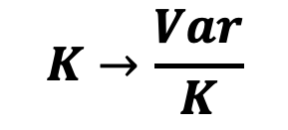
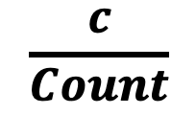
Our solution
$$K→\frac{Var}{K}$$
$$e_{i}$$
$$h_{1}$$
$$\frac{c}{Count}$$
$$+c$$
ID | Count
$$h_{2}$$
$$+c$$
 |  | ID | Count
$$h_{3}$$
$$+c$$
 |  |  |  |  |  | ID | Count

Slide 15
Threshold Sampling
Threshold: $τ$
$$\underset{}{p_{i}=min}{(1, \frac{w_{i}}{τ })},w_{i}^{′}=\frac{w_{i}}{p_{i}}$$
$$∑p_{i}=k$$
Optimal Poisson sampling scheme

Slide 16
Optimality
$${e_{1}, w}_{1}$$
ID | Count
$${e_{2}, w}_{2}$$
$$\min_{}{∑var\left(w_{i}\right)}\underset{⇔}{}\min_{}{∑p_{i}E\left({\hat{w_{i}}}^{2}\right)}\underset{⇔}{}\min_{}{∑\frac{w_{i}^{2}}{p_{i}}}$$
$$∑p_{i}=1$$

Slide 17
Global Part
ID | Count
Local Part
Count
Count

Slide 18
Compression
$$\frac{C_{1}}{{C_{1}+C}_{2}}e_{i}/\frac{C_{2}}{{C_{1}+C}_{2}}e_{2}$$
$$e_{1}$$ | $$C_{1}$$
$$+$$
$$e_{2}$$ | $$C_{2}$$
$$=$$
??? | $${C_{1}+C}_{2}$$

Slide 19
Topology
$$1=2=\left(3+4\right)=5=6$$
3
4
2
5
6
1

Slide 20
Tasks
Frequency Estimation
Heavy Hitter
Heavy change

Slide 21
Platforms
CPU
OVS
FPGA
P4

