Slide 1
High Accuracy Measurement over Multiple Dimensions
Yinda Zhang

Slide 2
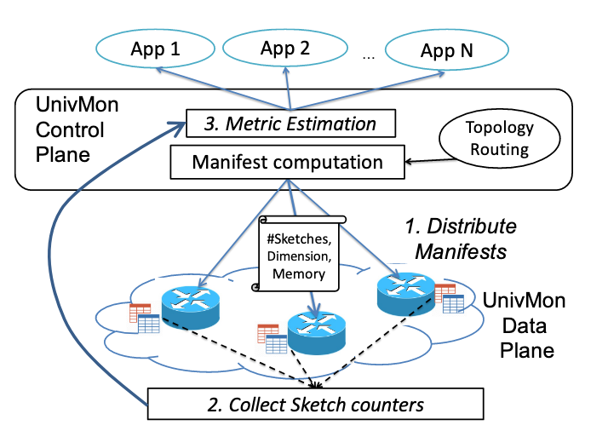
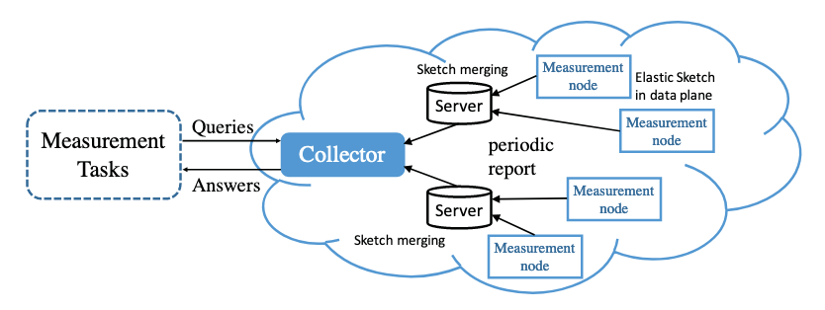
1.1 Background and Motivation

Slide 3
Dimensions
Dimensions of traffic
Dimensions of sketch

Slide 4
Dimensions of traffic
IP 5-tuples
src/dst IP
IP prefix
application

Slide 5
Dimensions of traffic
Sketch for SrcIP
133.97.100.14
208.53.159.69
Sketch for DstIP
Src: 133.97.100.14
Dst: 208.53.159.69
Compute dimensions
...
Application ID 137
Sketch for Application

Slide 6
Limitations
Every possible dimensions
Memory overhead
Low accuracy/throughput

Slide 7
Dimensions of sketch
Location (Multi-path/not know the path)
Time (One sketch per 10s)

Slide 8
Topology
4
5
6
7
2
3
8
9
1
10

Slide 9
Dimensions of sketch
Directly sum up the result in each sketch

Slide 10
Limitations
Count-Min & Count sketch are not aggregation friendly
mainly designed for single dimension
Error ∝ sum size of traffic pass each sketch
Query in a wide range (do not know the exact range)

Slide 11
1.2 Our solution
Min-granularity

Slide 12
1.2 Our solution
Min-granularity
Min-granularity dimension already contains enough information

Slide 13
1.2 Our solution
 | Prior Algorithms | Our solution
D of traffic | Measure separately | Aggregate Min-granularity
D of sketch | Aggregate Min-granularity | Aggregate Min-granularity

Slide 14
1.2 Our solution
 | Prior Algorithms | Our solution
D of traffic | Measure separately | Aggregate Min-granularity
D of sketch | Aggregate Min-granularity | Aggregate Min-granularity
Count/CM Sketch
Aggregation-Friendly Algorithm

Slide 15
Aggregation-friendly
Subset sum estimation
Variance sum minimization

Slide 16
Subset-Sum Estimation
If we have known the exact size of all traffic, we can directly calculate the optimal choice to achieve variance sum minimization

Slide 17
Subset-Sum Estimation
If we have known the exact size of all traffic, we can directly calculate the optimal choice to achieve variance sum minimization
God’s perspective? -- unrealistic
Computation based on overall data? – low throughput

Slide 18
Our solution
Fit in sketch-based data structure
Minimize variance sum locally

Slide 19
3 Overview

Slide 20
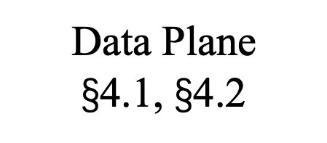
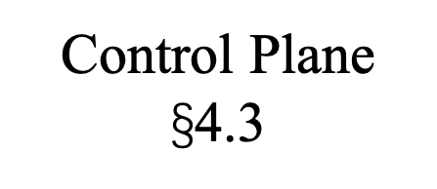
Applications
Dimensions Requirements
Aggregation Result
Topology information
Control Plane $\text{§}$4.3
Aggregation
Sketches Collection
Measurement on min-granularity dimension
Data Plane
$\text{§}$4.1, $\text{§}$4.2

Slide 21




4.1 Basic Version
$${(e}_{i},w_{i})$$
$$h_{1}$$
$$h_{2}$$
$$h_{3}$$

Slide 22
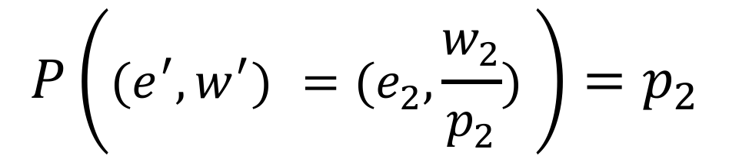





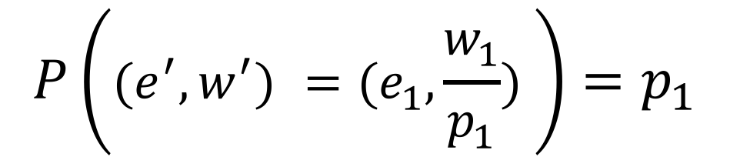
Minimize variance sum locally
$$P\left({(e}^{′},w^{′}) =(e_{1},\frac{w_{1}}{p_{1}}) \right)=p_{1}$$
$${{(e}_{1}, w}_{1})$$
$${{(e}_{2}, w}_{2})$$
$$p_{1}$$
$$p_{2}$$
$$P\left({(e}^{′},w^{′}) =(e_{2},\frac{w_{2}}{p_{2}}) \right)=p_{2}$$
$${(e}^{′},w^{′})$$

Slide 23
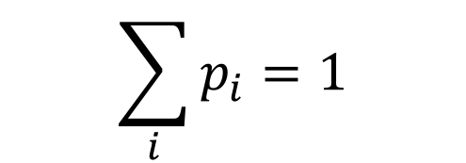
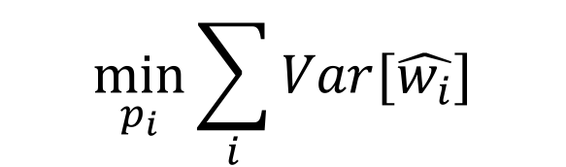

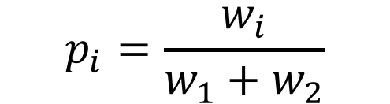
Minimize variance sum locally
$$\min_{p_{i}}{\sum_{i}{Var[\hat{w_{i}}]}}$$
$$p_{i}=\frac{w_{i}}{w_{1}+w_{2}}$$
$$\sum_{i}{p_{i}}=1$$
$$w^{′}=w_{1}+w_{2}$$

Slide 24





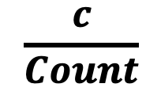


Basic Version
$$e_{i}$$
$$h_{1}$$
$$\frac{c}{Count}$$
$$+c$$
ID | Count
$$h_{2}$$
$$+c$$
 |  | ID | Count
$$h_{3}$$
$$+c$$
 |  |  |  |  |  | ID | Count

Slide 25
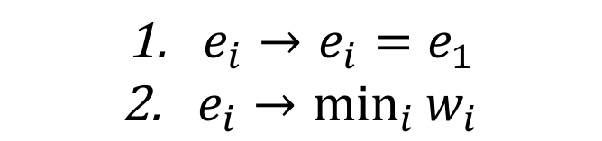
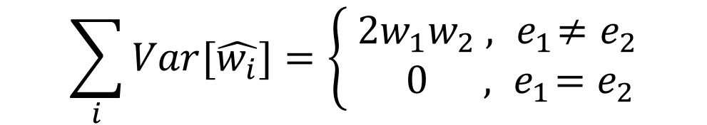
4.2 Optimization
$$\sum_{i}{Var[\hat{w_{i}}]}=\left\{\begin{aligned} 2w_{1}w_{2} , { e}_{1}≠e_{2} \\ 0 , { e}_{1}=e_{2}\end{aligned}\right.$$
${e_{i}→e}_{i}=e_{1}$
$\underset{i}{e_{i}→min}{w_{i}}$

Slide 26
4.3 Aggregation
Different query method/error bound?

Slide 27
Topology
$$1=2+3=\left(4+5\right)+(6+7)=8+9=10$$
4
5
6
7
2
3
8
9
1
10
Notes:
mean/median
Packet loss
Recovery information

Slide 28
App1
App2
App3
Dimension 1
Dimension 2
Dimensions
of traffic
Thread 1
Thread 2
Result of min-granularity dimension
Topology information
Thread 1
Thread 2
Thread 3
Dimensions
of sketch

Slide 29
Platforms
CPU
OVS
FPGA
P4

Slide 30
Tasks
Estimation for Overall traffic
Estimation for Heavy traffic

Slide 31
Question
How to define the “min-granularity dimension”
How to assign measurement nodes

Slide 32
Compression
$$\frac{C_{1}}{{C_{1}+C}_{2}}e_{i}/\frac{C_{2}}{{C_{1}+C}_{2}}e_{2}$$
$$e_{1}$$ | $$C_{1}$$
$$+$$
$$e_{2}$$ | $$C_{2}$$
$$=$$
??? | $${C_{1}+C}_{2}$$

Slide 33
Global Part
ID | Count
Local Part
Count
Count

