Slide 1
High Accuracy Measurement over Multiple Dimensions
Yinda Zhang

Slide 2
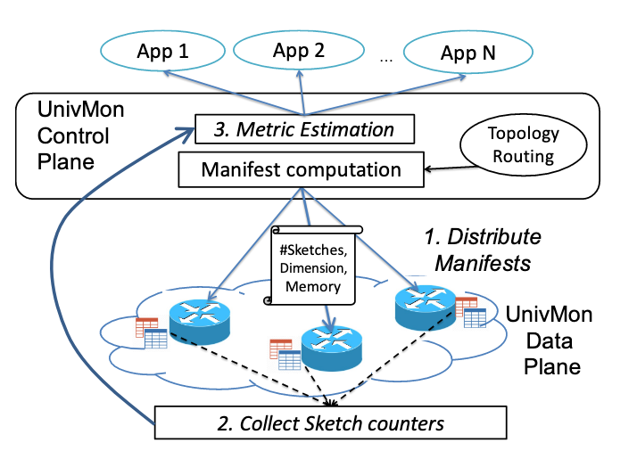
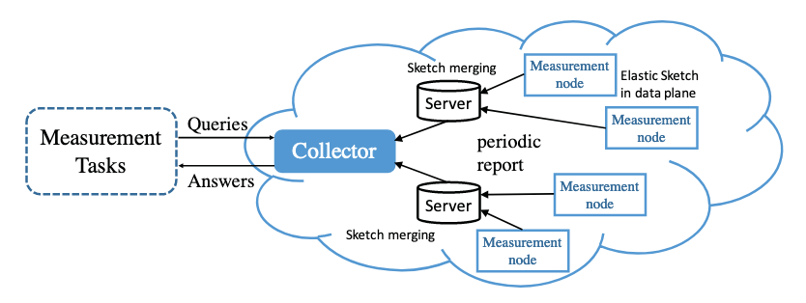
1.1 Background and Motivation
Notes:
Network measurement provides important support for the upper network services, such as flow scheduling, load balancing, and anomaly detection. Due to the challenges of high throughput and limited resources in network measurement, the sketch-based algorithm, which can achieve high accuracy under such constraints, is widely accepted and used on many different tasks.

Slide 3
Dimensions
Dimensions of traffic
Dimensions of sketch
Notes:
Because of the diversity of applications, they often need different dimensions of measurement. However, prior sketch-based algorithms fail to keep their superiority when they measure over multiple dimensions. In this paper, we divide the dimensions into two categories and introduce them separately.

Slide 4
Dimensions of traffic
IP 5-tuples
src/dst IP
IP prefix
application
Notes:
The first kind of dimensions are Dimensions of traffic. For SYN-flood or DDoS detection, the dimension of traffic may be the destination IP address. For finding heavy hitter flows, the dimension of traffic may be the IP 5-tuples. For finding hierarchical heavy hitters, the dimension of traffic may be the IP prefix. Different applications often need different dimensions of traffic.

Slide 5
Dimensions of traffic
Sketch for SrcIP
133.97.100.14
208.53.159.69
Sketch for DstIP
Src: 133.97.100.14
Dst: 208.53.159.69
Compute dimensions
...
Application ID 137
Sketch for Application
Notes:
Prior sketch-based algorithms often build one sketch for each dimension.

Slide 6
Limitations
Memory overhead
Low accuracy/throughput
Every possible dimensions
Notes:
In such a way, we may need more memory, and the throughput may also decrease because each packet has to pass multiple sketches. This problem will be more serious when we cannot know the dimensions needed by applications in advance, because we have to measure all possible dimensions needed.

Slide 7
Dimensions of sketch
Location (Multi-path/not know the path)
Time (One sketch per 10s)

Slide 8
Topology
4
5
6
7
2
3
8
9
1
10

Slide 9
Dimensions of sketch
Directly sum up the result in each sketch

Slide 10
Limitations
Count-Min & Count sketch are not aggregation friendly
mainly designed for single dimension
Error ∝ sum size of traffic pass each sketch
Query in a wide range (do not know the exact range)

Slide 11
1.2 Our solution
Min-granularity

Slide 12
1.2 Our solution
Min-granularity
Min-granularity dimension already contains enough information

Slide 13
1.2 Our solution
 | Prior Algorithms | Our solution
D of traffic | Measure separately | Aggregate Min-granularity
D of sketch | Aggregate Min-granularity | Aggregate Min-granularity

Slide 14
1.2 Our solution
 | Prior Algorithms | Our solution
D of traffic | Measure separately | Aggregate Min-granularity
D of sketch | Aggregate Min-granularity | Aggregate Min-granularity
Count/CM Sketch
Aggregation-Friendly Algorithm

Slide 15
Aggregation-friendly
Subset sum estimation
Variance sum minimization

Slide 16
Subset-Sum Estimation
If we have known the exact size of all traffic, we can directly calculate the optimal choice to achieve variance sum minimization

Slide 17
Subset-Sum Estimation
If we have known the exact size of all traffic, we can directly calculate the optimal choice to achieve variance sum minimization
God’s perspective? -- unrealistic
Computation based on overall data? – low throughput

Slide 18
Our solution
Fit in sketch-based data structure
Minimize variance sum locally

Slide 19
3 Overview

Slide 20
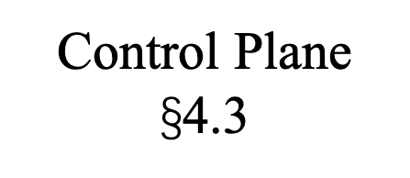
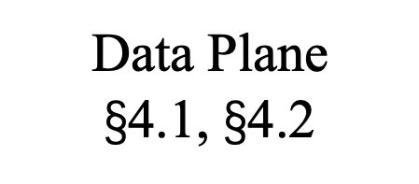
Applications
Dimensions Requirements
Aggregation Result
Topology information
Control Plane $\text{§}$4.3
Aggregation
Sketches Collection
Measurement on min-granularity dimension
Data Plane
$\text{§}$4.1, $\text{§}$4.2

Slide 21




4.1 Basic Version
$${(e}_{1},w_{1})$$
$$h_{1}$$
 | $$e_{2}, w_{2}$$
$$h_{2}$$
 |  |  | $$e_{9}, w_{9}$$
$$h_{3}$$
 |  |  |  |  |  | $$e_{7}, w_{7}$$

Slide 22





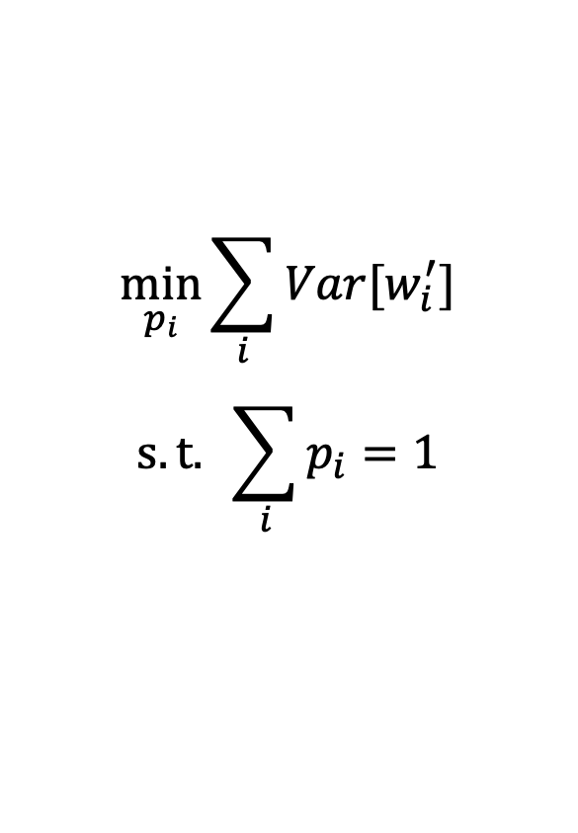


Minimize variance sum locally
$${(e}_{1},w_{1})$$
$$h_{1}$$
$$\min_{p_{i}}{\sum_{i}{Var[w_{i}^{′}]}}$$
$$s.t. \sum_{i}{p_{i}}=1$$
$$e_{2}, w_{2}$$
$$p_{1}$$
$$p_{2}$$
$$e_{1}, w_{1}/p_{1}$$
$$e_{2}, w_{2}/p_{2}$$

Slide 23
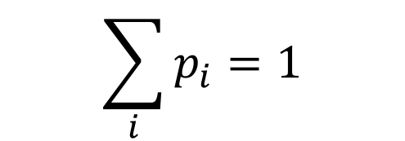
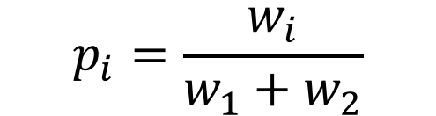

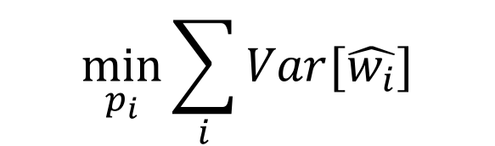
Minimize variance sum locally
$$\min_{p_{i}}{\sum_{i}{Var[\hat{w_{i}}]}}$$
$$p_{i}=\frac{w_{i}}{w_{1}+w_{2}}$$
$$\sum_{i}{p_{i}}=1$$
$$w^{′}=w_{1}+w_{2}$$

Slide 24






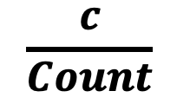

Basic Version
$$e_{i}$$
$$h_{1}$$
$$\frac{c}{Count}$$
$$+c$$
ID | Count
$$h_{2}$$
$$+c$$
 |  | ID | Count
$$h_{3}$$
$$+c$$
 |  |  |  |  |  | ID | Count

Slide 25
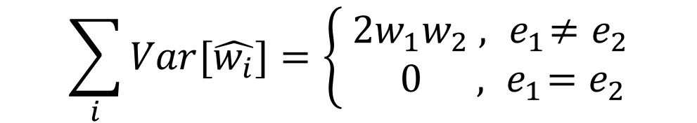
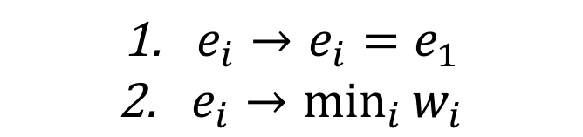
4.2 Optimization
$$\sum_{i}{Var[\hat{w_{i}}]}=\left\{\begin{aligned} 2w_{1}w_{2} , { e}_{1}≠e_{2} \\ 0 , { e}_{1}=e_{2}\end{aligned}\right.$$
${e_{i}→e}_{i}=e_{1}$
$\underset{i}{e_{i}→min}{w_{i}}$

Slide 26
4.3 Aggregation
Aggregation on space
Aggregation on time&traffic

Slide 27

Aggregation on Space
Different dimensions of traffic have different rules!
Now we only need to focus on min-granularity
Min-granularity $≤$ (srcIP, dstIP)
First work?

Slide 28
$$1=2+3=\left(4+5\right)+(6+7)=8+9=10$$
4
5
6
7
2
3
8
9
1
10
Notes:
mean/median
Packet loss
Recovery information

Slide 29
Aggregation on Time&Traffic
GROUP BY dimensions of traffic
WHERE time in dimensions of time
SrcIP (0x) | DstIP (0x) | Time | Size
32 45 67 89 | 32 45 67 89 | [00:10, 00:20] | 1500
32 45 67 89 | 32 45 67 89 | [00:20, 00:30] | 32091
32 45 67 89 | 32 45 67 89 | [00:10, 00:20] | 1642
32 45 67 89 | 32 45 67 89 | [00:20, 00:30] | 2453
32 45 67 89 | 32 45 67 89 | [01:10, 01:20] | 541927
32 45 67 89 | 32 45 67 89 | [00:40, 00:50] | 201868
32 45 67 89 | 32 45 67 89 | [00:20, 00:30] | 524

Slide 30
4.4 Application
Estimation for Overall traffic
Estimation for Heavy traffic

Slide 31
Platforms
CPU
OVS
FPGA
P4

Slide 32
Backup Slides
How to define the “min-granularity dimension”

Slide 33
App1
App2
App3
Dimension 1
Dimension 2
Dimensions
of traffic
Thread 1
Thread 2
Result of min-granularity dimension
Topology information
Thread 1
Thread 2
Thread 3
Dimensions
of sketch

Slide 34
Compression
$$\frac{C_{1}}{{C_{1}+C}_{2}}e_{i}/\frac{C_{2}}{{C_{1}+C}_{2}}e_{2}$$
$$e_{1}$$ | $$C_{1}$$
$$+$$
$$e_{2}$$ | $$C_{2}$$
$$=$$
??? | $${C_{1}+C}_{2}$$

Slide 35
Global Part
ID | Count
Local Part
Count
Count

