Slide 1
PROJECT ON ORIYA
CHARACTERS
RECOGNITION.
GUIDED BY:
MRS.SIPRA SAHOO
ASSISSTANT PROFESSOR,
DEPARTMENT OF CSE.
SUBMITTED BY:
LIPSA MISHRA
RAJASHREE PADHI

Slide 2
TALK FLOW:
INTRODUCTION
LITERATURE SURVEY
PROBLEM STATEMENT
OBJECTIVE AND MOTIVATION
PROPOSED WORK
DESIGN AND IMPLEMENTATION
EXPERIMENTAL RESULTS
CONCLUSION
FUTURE WORK
REFERENCES

Slide 3
INTRODUCTION:
Handwritten character recognition is one of the most challenging and burning topic in the field of image processing and pattern recognition.
Compared to English like Roman script, one of the major stumbling blocks in Optical Character Recognition (OCR) of handwritten odia script is the large number of complex shaped character classes of odia alphabets Recognition.
There exists some work on recognition of handwritten odia alphanumeric characters but to the best of our knowledge no work is published on combined recognition of odia handwritten basic and compound characters .
. The problem statement is that till date no score of Oriya alphabets has been given.

Slide 4
INTRODUCTION Continued…:
To recognize the characters we need a predefined score to match the score of the alphabet to be recognized.
To generate the score we need to take different images of an alphabet and scan the images.
Using the image fusion method to recognize the unknown characters, the character to be recognized is matched with each known character pattern and a recognition score is generated.
The character pattern that corresponds to the highest score so generated is accepted as the recognized character.
. This score is compared with the known scores of character pattern to choose the closely related patterns.

Slide 5
LITERATURE SURVEY:
SL.NO. | AUTHOR’S NAME | JOURNAL/ CONFERENCE | YEAR | FINDINGS | LIMITATIONS
1. | Debananda padhi, ”A Survey on Morphological Approach for Extracting Single Character from Odia Handwritten Text”. | International Journal of Emerging trends in Engineering and Development | 2012 | To represent the process of extracting the individual characters from Odia handwritten text the compound characters (Juktakhyra) which are having more than one modifiers and joint characters to form a single characters. | Here, with the values, neural network can be used to get a good end result. But the problem of well defined data sets lies in carefully chosen algorithm attributes. Attributes are important and can have a crucial impact on the end results.

Slide 6
LITERATURE SURVEY(Continued….)
2. | T.Som and Sumit Saha,”Handwritten Character recognition using fuzzy membership function”. | International journal of emerging technology in sciences and engineering. | 2011 | Unknown Characters is converted to an image matrix and compared with each standard matrix and thereby recognized There may be few mismatches if there is completely different styles of handwritten characters. | There may be few mis-matches if there is completely different style of handwritten character due to different race and region.

Slide 7
LITERATURE SURVEY(Continued….)
3. | A S Ramteke and G S Katkar. “Recognition of offline modi script”. | International Journal of Emerging Technologies in Sciences and Engineering. | 2012 | Some structural similarities of standard characters and handwritten characters are verified using measured structure similarity approach. | Before any extraction and recognition part,the pre-processing of the images has to be done,which has taken as a constraint in this thesis.

Slide 8
LITERATURE SURVEY(Continued….)
4. | N Tripathy and U Pal,Handwriitten segmentation of unconstrained odia text. | Computer vision and pattern recognition unit,Indian Statistical Institute. | 20 | It is proposed that a water reservoir concept based scheme for segmentation of unconstraint Oriya handwritten text into individual characters. | Segmentation of characters from Handwritten words is difficult as the characters are mostly connected through words.

Slide 9
LITERATURE SURVEY(Continued….)
5. | Debabarata Senapati, Sasmita Rout, Mamta Nayak, “A novel approach to textline and word segmentation on Odia printed documents” | International Journal of Emerging Trends in engineering And Development | 2012 | This paper has proposed a robust method for segmentation of individual text lines of Odia printed document image file.The segmented textline is an input for the segmentation method which produces segmented words .

Slide 10
PROBLEM STATEMENT :
Several efforts have been made for recognition of different types of languages like English , Hindi , Devnagari script, Marathi.
But still there are no developments for Odia characters as there are many number of alphabets with similar features.
It is difficult to design an appropriate algorithm to recognize the odia alphabets.
We need to develop a method that is required for generating the recognition score of each odia character.
After generation of the recognition score we will be able to appropriately recognize the Odia alphabets.
Less human interaction.

Slide 11
OBJECTIVE AND MOTIVATION:
To develop a Robust Odia off-line character Recognition algorithm which can be adaptable in the situations of high dimensional spaces and similarly to the characters.
To create a read engine which will have negligible human intervention and easy reading techniques.
To design an efficient algorithm to recognize the known individual characters.
Till date no pre defined score has yet been generated for odia characters. So, efforts are put to generate recognition scores for known characters.
To directly recognise the names and details of a person writing in odia and applying for various identification proofs without much human intervention.

Slide 12
PROPOSED WORK:
CHARACTER SET CH
PATTERN MATRIX(MP[X][Y])
INPUT IMAGE (5 COPIES)
FUSED IMAGE(MASTER PATTERN)
TEST IMAGE
RECOGNITION SCORE

Slide 13
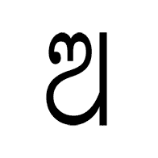
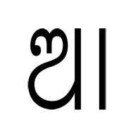
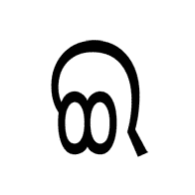
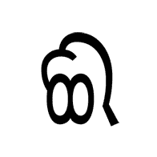


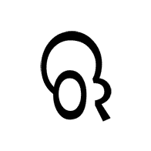

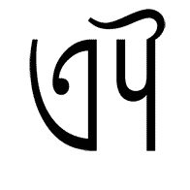
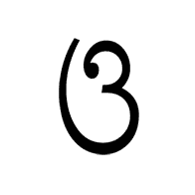
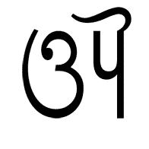
CHARACTER SET(CH):

Slide 14
DESIGN AND IMPLEMENTATION :
PROCEDURE:
An unknown character is taken into consideration and five images of the same character are copied.
These images are then converted into ( .jpg ) file.
Each image is converted from rbg to gray scale image.
Similarly, all the five images of a single character are converted into gray scale.
After conversion, the images are formed into matrices.

Slide 15
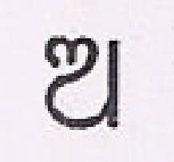
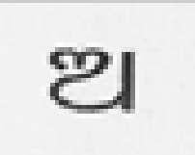
INPUT IMAGES:
INPUT IMAGE:
// A1= IMREAD(A1.jpg’);
5 COPIES OF INPUT IMAGE:
// B1=rgb2gray(A1);
RGB SCALE IMAGE
GRAY SCALE IMAGE

Slide 16
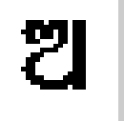
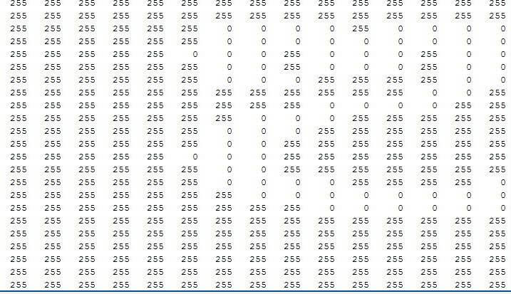
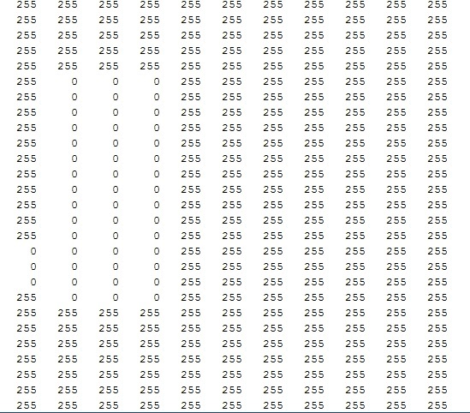
GENERATION OF FUSED IMAGE:
These matrices are fused to generate the score for recognition with the code:
B=S1+S2+S3+S4+S5;
Check the size of the matrix whether size>225 or not. If greater than 255,we need to keep the same size.
// if(S1(i , j) > 255 )
// S1(i , j)=255;
// else
// S1(I , j)=0;

Slide 17

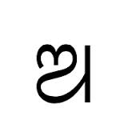
GENERATION OF RECOGNITION SCORE :
The test image is taken from 5 different sources. The sources are kalinga font, Lohitoriya font, Baraha pad,scanned image from an article and an image from a magazine.
The image to be tested is taken and then, the minimum of the two i.e,
the test image and fused image is found out.
// min_test(i,j)=min(B11(i,j),B(i,j));//Minimum of B11 and B1.
The above process is carried out with all the five sources.
Then , the recognition score is calculated with the below algorithm:
// k= k+(min(s(i,j),B(i,j))*S(I,j));
// rec-score=k/t;

Slide 18
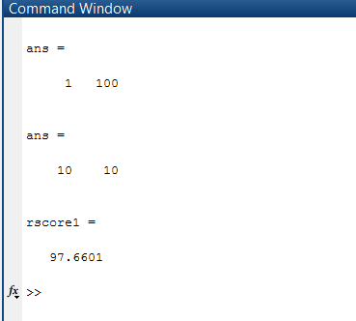
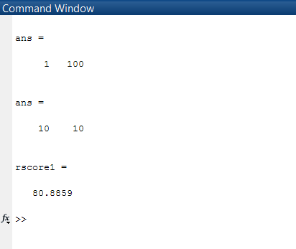
OUTPUT SCREENS:
Images with recognition score :

Slide 19

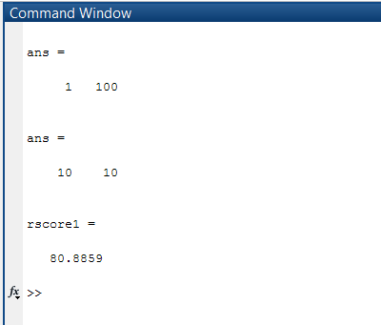
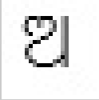
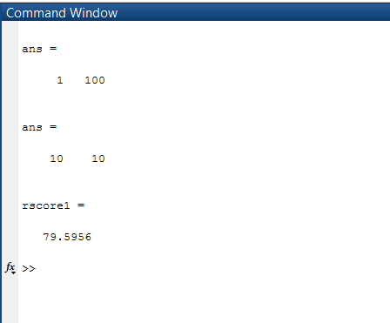
OUTPUT SCREENS(CONTINUED……..)
Images with recognition score

Slide 20
CONCLUSION:
The project approaches towards better character recognition algorithm for odia script. This can help to make an improved man-machine interface with the help of a native language.
But, the odia script is very challenging due to the presence of a large number of characters and the similarity between them with no score yet generated.
Thus, in this project, different classification, pre-processing, segmentation methods and pattern recognition techniques have been used for odia character recognition.
An attempt is made to generate the recognition scores which will help in appropriate recognition of characters.

Slide 21
FUTURE WORK:
This project can also be extended to recognise the unknown characters.
Further, the algorithm and the project can be extended to include modified and compound characters.
Rather than concentrating on a single character , it can also be designed to identify the sentences.
It can be designed to directly recognise the names and details of a person writing in odia and applying for various identification proofs without much human intervention.
Removing the constraints present in the project by applying fuzzy membership function.

Slide 22
REFERENCES:
[1] Chakraborty, R., Sil, J., Handwritten Character Recognition Sys-tem Using Image-Fusion and Fuzzy Logic," First International Con-ference on Pattern Recognition and Machine Intelligence”, pp. 20-22,Dec 2005.
[2] Som,T.,Saha,S., Handwritten Character Recognition Using Fuzzy Membership Function, “IJTSE International Journal of Emerging Technologies in Sciences and Engineering”,vol.5,no.2,pp.11-15.Dec
2011.
[3]Ramteke.,S.,A. ,Katkar.,S.G., Recognition of off-line modi script, “IJREISS International Journal of Research in Engineering, IT and Social
Sciences”,vol.2,issue 11,pp.102-103,Nov 2012.

Slide 23
REFERENCES contd…….
[4] Tripathy, N., Pal, U., “Handwriting Segmentation of Unconstrained Oriya Text”, Computer Vision and Pattern Recognition Unit, vol. 31, pp.755-769, Dec 2006.
[5] Wlodzislaw, D., “Uncertainty of Data, Fuzzy Membership Functions and Multi-layer Perceptron's”, IEEE Transaction on Neural Network, vol.3, pp. 1-12, Dec 2004.
[6] Padhi, D., Senapati, D., Rout, S., “Morphological Approach for Extracting Single Character from Odia Handwritten Text”, International Journal of Emerging Trends in Engineering and Development, vol.2, pp.138-147, March 2012.

Slide 24

