Slide 1

Content Sphere Hub
A Full-Fledged Content Management System using MERN Stack

Slide 2

Introduction
Content Sphere Hub is a robust and modern content management system (CMS) built using the MERN stack (MongoDB, Express.js, React.js, and Node.js). It allows users and administrators to seamlessly create, manage, and monitor content. The platform emphasizes usability, performance, and extensibility, catering to blogs, tech news platforms, and community-driven content portals.

Slide 3
Project Objectives
The objectives of the Content Sphere Hub project are multi-faceted: To build a fully functional CMS that enables both users and admins to interact with digital content seamlessly. Provide a secure and scalable backend with Node.js and Express. Implement role-based access where users can only manage their content and admins can moderate all content. Enable dynamic routing and responsive design with React.js, ensuring compatibility with mobile and desktop devices. Facilitate content uploads including rich text and media (images, links) with an intuitive interface. Introduce backend services for analytics, dashboard statistics, comment management, and notification handling. Ensure that the system architecture is extensible for features like real-time chat, collaborative editing, and version control in future releases.

Slide 4

Technology Stack
The technology stack used in Content Sphere Hub is the MERN Stack: MongoDB: Stores user data, posts, categories, comments, and notifications in a NoSQL schema format allowing flexible document structure. Express.js: Serves as the backend framework handling API routing, middleware authentication with JWT, and CRUD operations. React.js: Powers the frontend UI with reusable components, stateful pages using hooks and context, and responsive layouts using Tailwind CSS. Node.js: Executes the backend server, manages environment configurations, and integrates with third-party libraries like Multer for media uploads. These technologies together offer a unified JavaScript ecosystem from frontend to backend, reducing cognitive load and increasing development speed.

Slide 5

Features Overview
Key Features of Content Sphere Hub include: 1. User Authentication: Secure registration and login using JWT with hashed passwords stored in MongoDB. 2. Post Management: Create, Read, Update, Delete posts with title, category, and rich text editor powered by a WYSIWYG input field. 3. Media Uploads: Upload and manage images with backend support via Multer and cloud/local file system. 4. Admin Panel: Admins can manage categories, moderate content, view system-wide analytics, and manage user roles. 5. Comment System: Users can comment on posts, and authors/admins can reply or delete comments. 6. Notification System: In-app notifications alert users about new interactions. 7. Dashboard Analytics: Display of content counts, user activity logs, and post performance metrics. 8. Responsive Design: Layout adapts to mobile, tablet, and desktop views using TailwindCSS and Flex/Grid models.

Slide 6

User Roles
There are two main roles in the system:
User: Can register, log in, create/view/edit/delete posts, comment, and view analytics.
Admin: Full access to all user and content management functionalities.

Slide 7

Home Page
The home page serves as the main entry point of the CMS. It displays recent posts, a navigation bar, and user account options.
Key Components:
Navbar with links: Home, Login, Register, Create Post, Dashboard (for admin)
Post Feed: Recent or featured posts dynamically fetched via API
Optional Search & Filter section for categories or keywords
Conditional rendering: Based on user authentication state
Technical:
React functional components with state hooks
Redux or Context API for auth state
Axios for data fetching from backend

Slide 8
Login Page
Login Page provides access control for authenticated users.
Key Features:
Email and Password input with frontend validation
Authenticated via JWT tokens
Errors for wrong credentials
Redirects after successful login
Technical:
React + Tailwind form UI
POST /api/auth/login
Stores JWT in localStorage
Updates user state via Redux/Context

Slide 9
Register Page
Register Page enables new users to join the platform.
Key Features:
Input Fields: Full Name, Email, Password
Frontend Validation using Regex or Yup
Backend check for duplicate users
Optional auto-login on register
Technical:
POST /api/auth/register
Password hashed with bcrypt
JWT returned and stored
Form handled via hooks or Formik

Slide 10
Post Page
Post Page is the core component for content creation and viewing.
Key Functionalities:
Create/Edit/Delete post with WYSIWYG editor
Image uploads handled via multer
Comments and Replies section
Real-time post view and analytics
Technical:
React Router dynamic routes (/post/:id)
CRUD via /api/posts
Protected routes using JWT middleware
Rich text editor like React Quill
MongoDB for structured post and comment storage

Slide 11
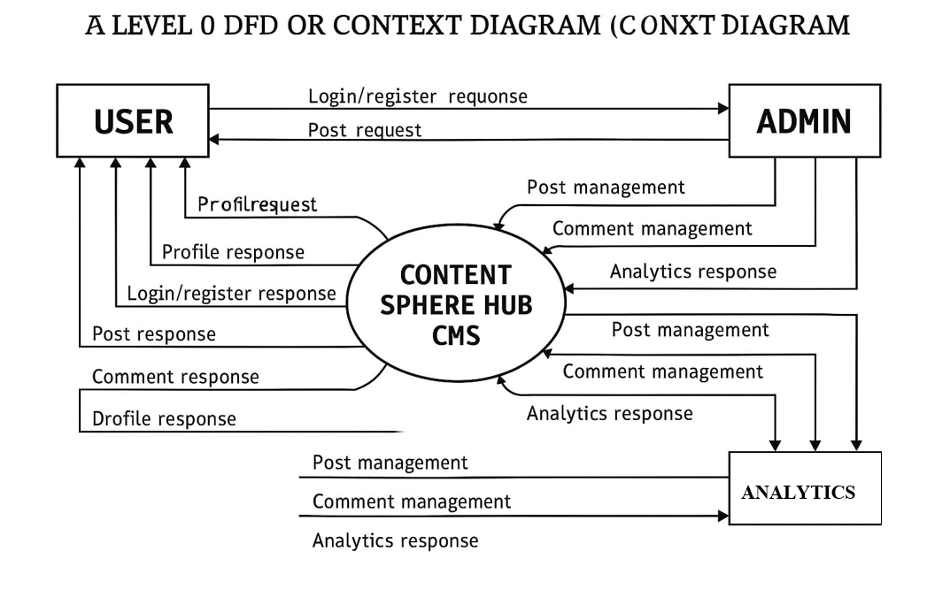
DFD Level 0

Slide 12
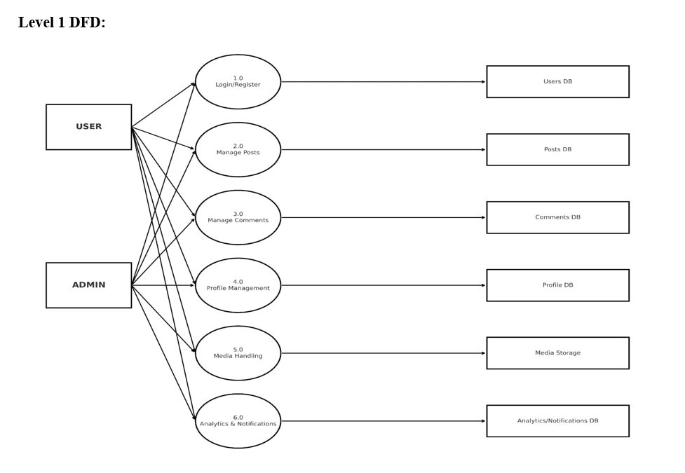
DFD Level 1

Slide 13
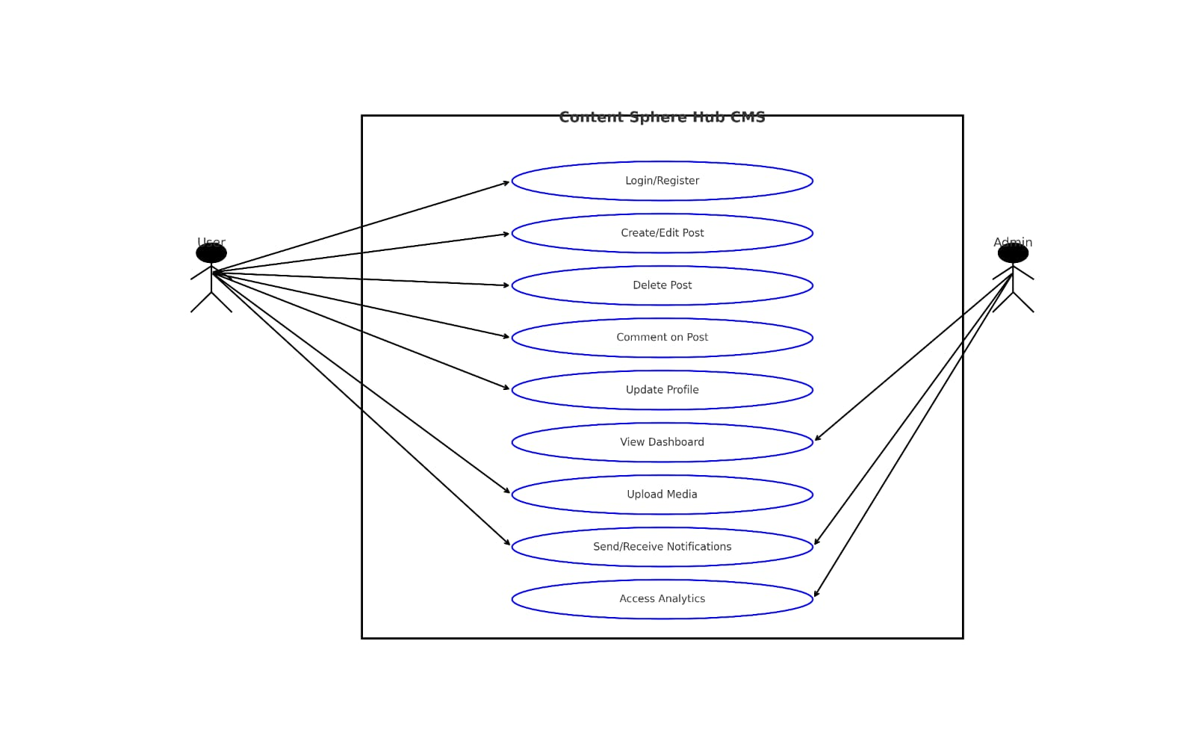
Use Case Diagram

Slide 14
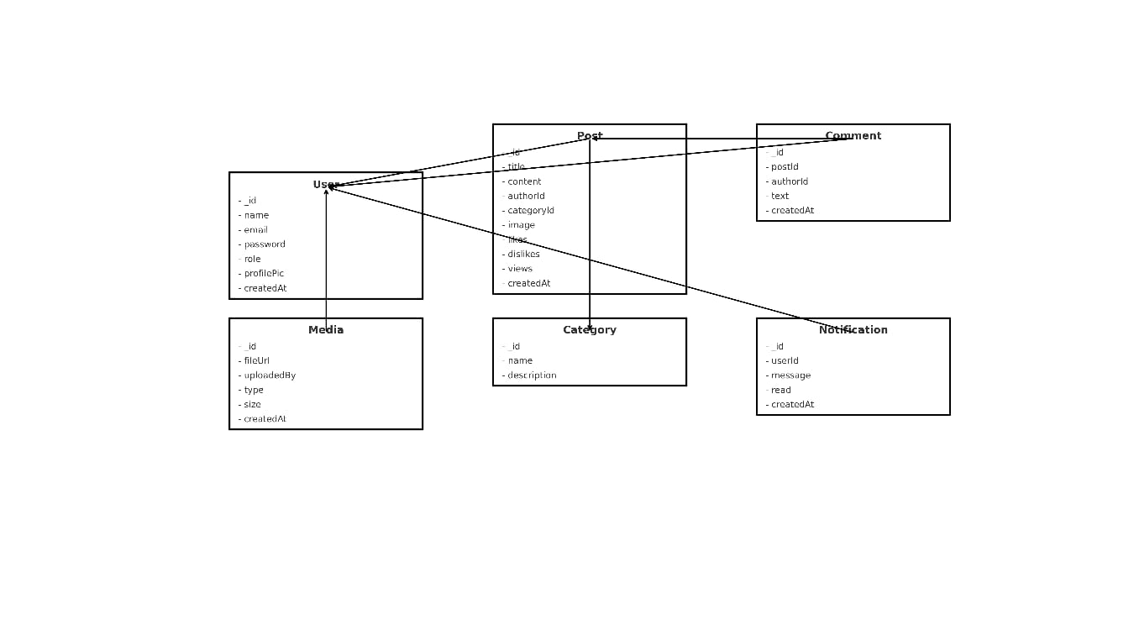
ER Diagram

Slide 15
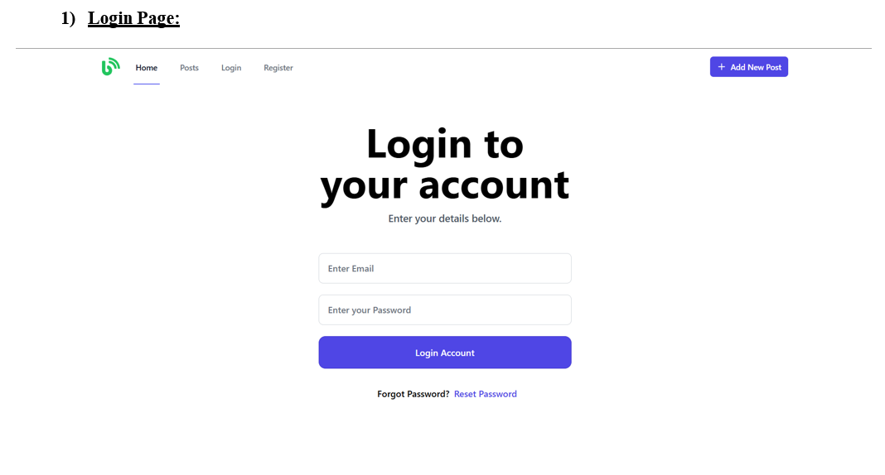
Login Page

Slide 16
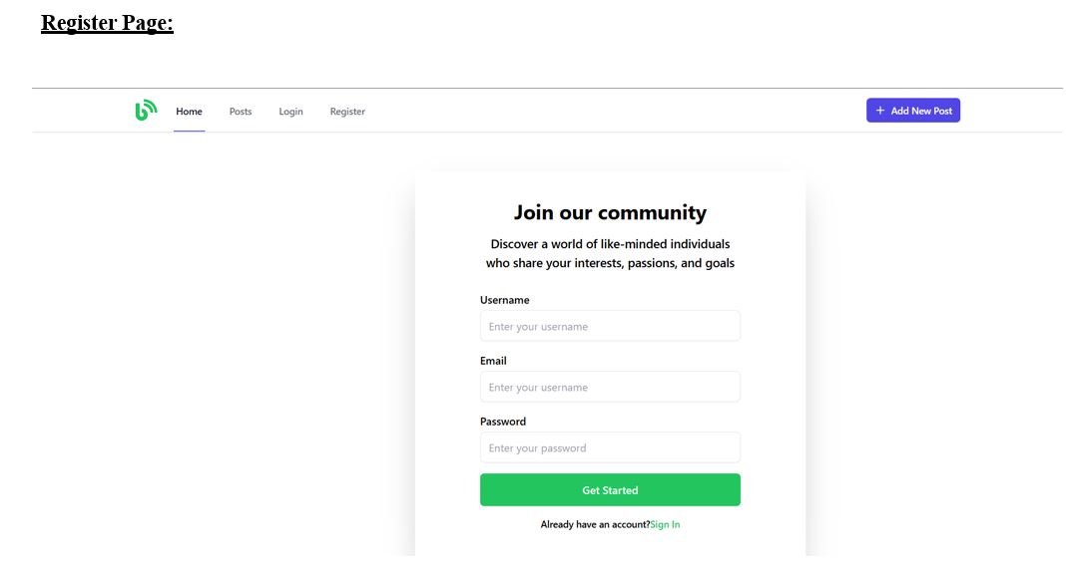
Register Page

Slide 17
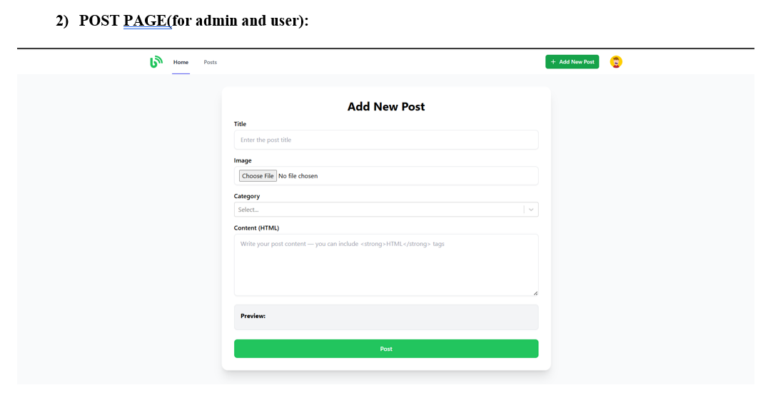
Post Page

Slide 18
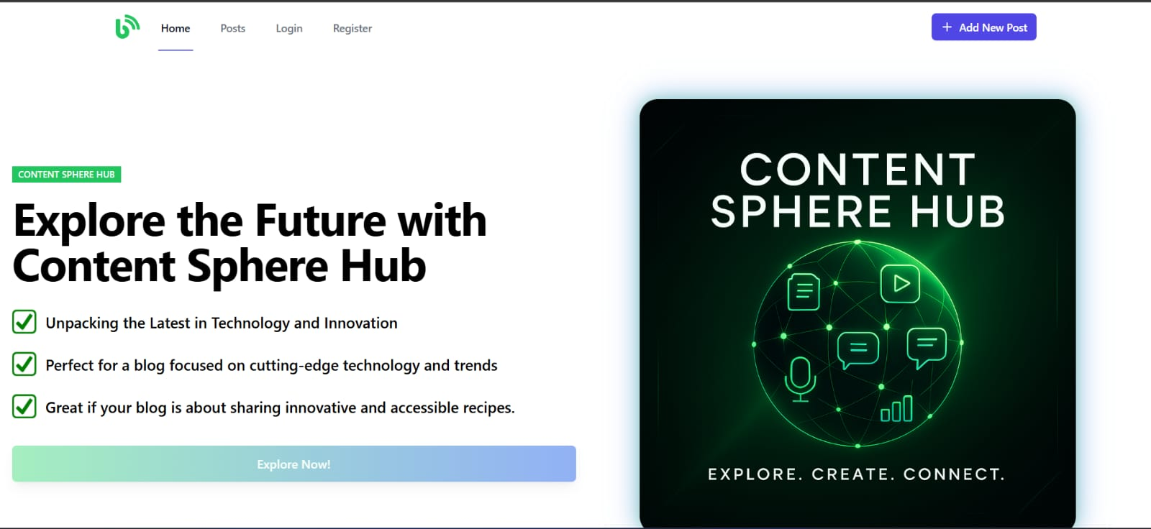
Homepage UI

