Slide 1
H1B Labor Condition Application Certification

Slide 2
Problem and Client
Predicting Labor Condition Application (LCA) success
Pre-requisite for final H1B visa application
Prospective Clients
Foreign nationals hoping to secure a job
Domestic companies hoping to sponsor a foreign born employee
Dataset
US Department of Labor LCA petitions from 2011-2016
N ~ 3 Million
FCC Area API
Census block populations
Census Population Estimates API
County Populations

Slide 3
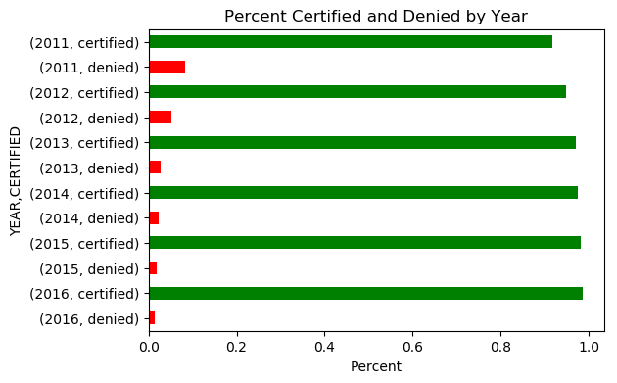
Certified and Denied Applications
Certified
n = 2,818,282
Denied
n = 94,346
Percent certified increased ever year
96.8% Certified in total

Slide 4
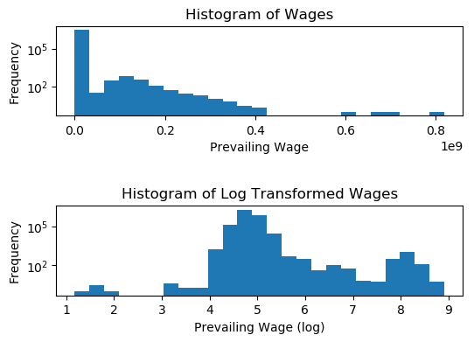
Certified and Denied Applications
Prevailing Wage (non-zero)
mean = $141,144
median = $65,000

Slide 5
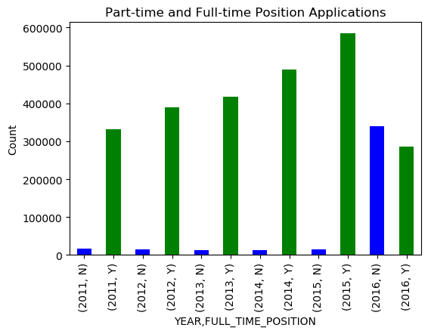
Part-time and Full-time Positions
Full-time applications far outnumber part-time…
…Until 2016

Slide 6
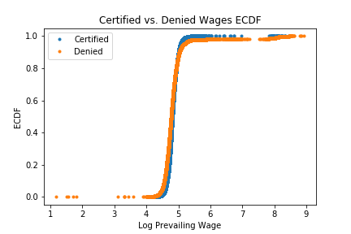
Wages for Certified and Denied Applications
Mean Wages
Certified - $72,553 (n=2,818,282)
Denied – $2160,933 (n=94265)
Mean wage between certified and denied not equal
p ≈ 0

Slide 7
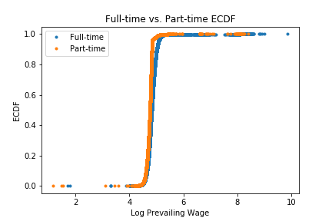
Wages for Full- and Part-time Jobs
Mean Wages
Full-time – $155,125 (n = 2,501,021)
Part-time – $68,549 (n = 411,528)
Mean wage between full-time and part-time positions not equal
p ≈ 0

Slide 8
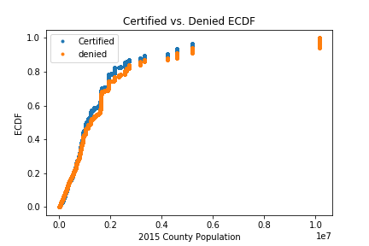
County Population
Mean Population
Certified – 1,720,650 (n = 2,721,739)
Denied – 85,107 (n = 85,107)
Mean county population for certified and denied not equal
p ≈ 0

Slide 9
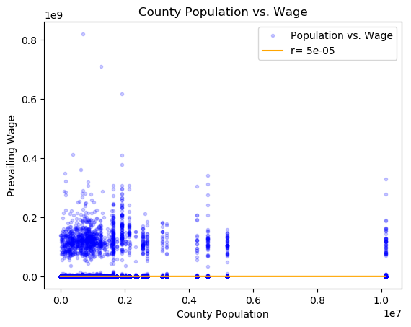
County Population vs. Wage Correlation
Essentially no correlation between county population and wage

Slide 10
Classification Analysis
SGD Classifier
Hyperparameters: alpha, loss, penalty, max_iter
Features
FULL_TIME_POSITION, PREVAILING_WAGE, SOC_NAME, lon, lat, block_fis, block_pop_2015, county_fips, county_pop, state_code
Reduced the number of features as I proceeded through cross-validation
Cross-validation
Five-fold
Other Parameters
Kernel Approximation
Imputation
Intercept Fit

Slide 11
Classification Analysis
SGD Classifier
Hyperparameters: alpha, loss, penalty, max_iter
Features
Full-time Position, Prevailing Wage, SOC_NAME, Latitude, Longitude, Census Block FIPS Code, Census Block Population, County FIPS code, County Population, Sate FIPS Code
Reduced the number of features as I proceeded through cross-validation
Standardized all features
Cross-validation
Five-fold
Subset of random 10,000 records
Hyper Parameters
Alpha
Loss Function
Number of Epochs
Penalty
Kernel Approximation
Intercept Fit
Class Weights

Slide 12
Results of Full Models
Features | Alpha, Loss, Max_Iter, Penalty | Kernel | Fit Intercept | Accuracy | Precision (certified; denied; weighted) | Recall (certified; denied; weighted) | F1 Score(certified; denied; weighted)
FULL_TIME_POSITION, PREVAILING_WAGE, SOC_NAME, lon, lat, county_fips, county_pop, state_code | 1 Hinge 5 L2 | NA | TRUE | 0.96967 | 0.97; 1.00; 0.97 | 1.00; 0.00; 0.97 | 0.98; 0.00; 0.95
FULL_TIME_POSITION, PREVAILING_WAGE, SOC_NAME, lon, lat, county_fips, county_pop, state_code | 1 Perceptron 100 L1 | NA | TRUE | 0.96965 | 0.97; 0.00; 0.94 | 1.00; 0.00; 0.97 | 0.98; 0.00; 0.95
FULL_TIME_POSITION, PREVAILING_WAGE, SOC_NAME, lon, lat, county_fips, county_pop, state_code | 0.01 Hinge 5 L2 | RBFSampler | TRUE | 0.96965 | 0.97; 0.00; 0.94 | 1.00; 0.00; 0.97 | 0.98; 0.00; 0.95
FULL_TIME_POSITION, PREVAILING_WAGE, SOC_NAME, lon, lat, county_fips, county_pop, state_code | 0.01 Hinge 5 L2 | Nystroem | TRUE | 0.96965 | 0.97; 0.00; 0.94 | 1.00; 0.00; 0.97 | 0.98; 0.00; 0.95
FULL_TIME_POSITION, PREVAILING_WAGE, SOC_NAME, lon, lat, county_fips, county_pop, state_code | 1 Hinge 5 L2 | NA | FALSE | 0.63599 | 0.99; 0.06; 0.96 | 0.63; 0.69; 0.64 | 0.77; 0.10; 0.75
FULL_TIME_POSITION, PREVAILING_WAGE, SOC_NAME, lon, lat | 0.1 Hinge 10 L1 | NA | TRUE | 0.96965 | 0.97; 0.00; 0.94 | 1.00; 0.00; 0.97 | 0.98; 0.00; 0.95

Slide 13
Most Accurate Model
Features
Full-time Position, Prevailing Wage, SOC_NAME, Latitude, Longitude, County FIPS Code, County Population , State Code
Excluded Census Block FIPS and Population
Alpha – 1
Loss – hinge
Maximum iterations – 5
Penalty – L2
Intercept was fit
No balancing of class weights
96.97% accurate
Confusion Matrix
 | Certified | Denied
Certified | 676,348 | 0
Denied | 21,163 | 4

Slide 14
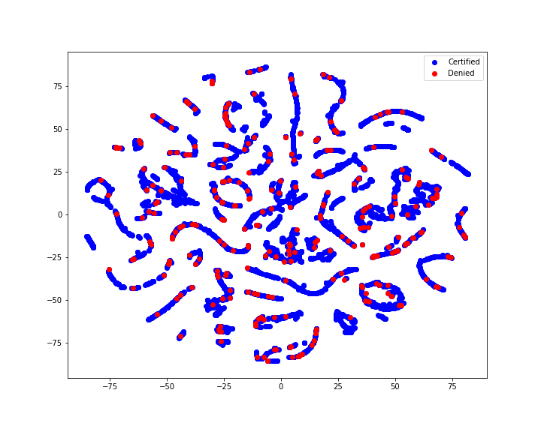
t-SNE Plot
Model very bad at predicting denied applications
Reduce data to two dimensions using t-SNE to visualize
Certified and Denied overlap almost completely

Slide 15
Conclusions
Model essentially as good as a coin flip
Model is 96.97% accurate
Over 97.68% of LCAs are certified
Bad at predicting denied applications
How are applications scored in real life?
Possible that I am missing information
Is there something missing that informs denied applications
Is completeness a factor?
Are the fields I’m missing NULL for my denied records?

Slide 16
Git Repository
All code for this project can be found here:
https://github.com/Liptoni/Springboard/tree/master/H1B_Capstone/python

