Slide 1
H1B Labor Condition Application Certification

Slide 2
Problem and Client
Predicting Labor Condition Application (LCA) success
Pre-requisite for final H1B visa application
Prospective Clients
Foreign nationals hoping to secure a job
Domestic companies hoping to sponsor a foreign born employee
Dataset
US Department of Labor LCA petitions from 2011-2016
N ~ 3 Million
FCC Area API
Census block populations
Census Population Estimates API
County Populations

Slide 3
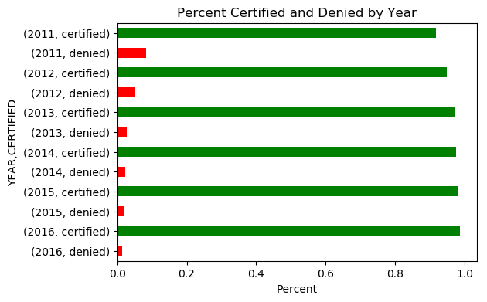
Certified and Denied Applications
Certified Applications
n = 2,818,282
Denied Applications
n = 94,346
Percent certified increased ever year

Slide 4
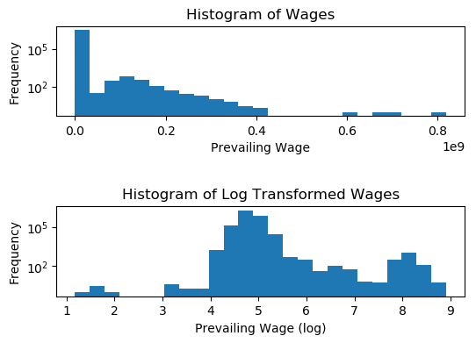
Certified and Denied Applications
Prevailing Wage (non-zero)
mean = $141,144
median = $65,000

Slide 5
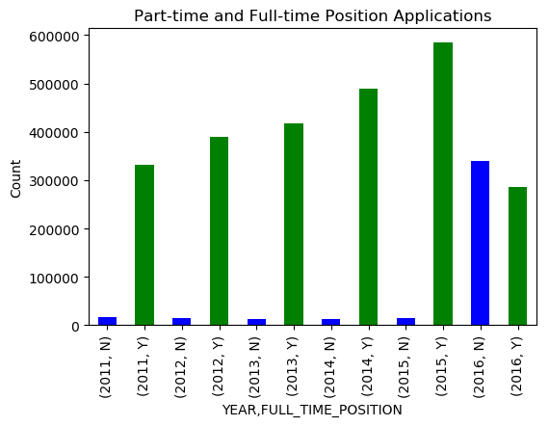
Part-time and Full-time Positions
Full-time applications far outnumber part-time…
…Until 2016

Slide 6
Preliminary Statistical Analysis
Mean wage between certified and denied not equal
p ≈ 0
Mean wage between full-time and part-time positions not equal
p ≈ 0
Mean county population for certified and denied not equal
p ≈ 0
All of these possibly skewed by very large dataset

Slide 7
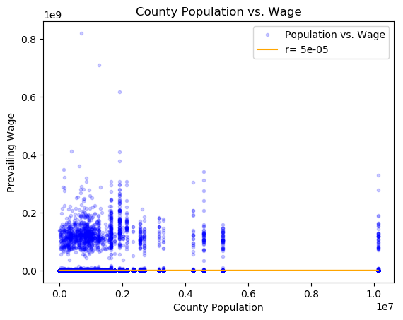
County Population vs. Wage Correlation
Essentially no correlation between county population and wage

Slide 8
Classification Analysis
SGD Classifier
Hyperparameters: alpha, loss, penalty, max_iter
Features
FULL_TIME_POSITION, PREVAILING_WAGE, SOC_NAME, lon, lat, block_fis, block_pop_2015, county_fips, county_pop, state_code
Reduced the number of features as I proceeded through cross-validation
Cross-validation
Five-fold
Other Parameters
Kernel Approximation
Imputation
Intercept Fit

Slide 9
Results of Full Models
Features | Alpha, Loss, Max_Iter, Penalty | Kernel | Fit Intercept | Accuracy | Precision (certified; denied; weighted) | Recall (certified; denied; weighted) | F1 Score(certified; denied; weighted)
FULL_TIME_POSITION, PREVAILING_WAGE, SOC_NAME, lon, lat, county_fips, county_pop, state_code | 1 Hinge 5 L2 | NA | TRUE | 0.96967 | 0.97; 1.00; 0.97 | 1.00; 0.00; 0.97 | 0.98; 0.00; 0.95
FULL_TIME_POSITION, PREVAILING_WAGE, SOC_NAME, lon, lat, county_fips, county_pop, state_code | 1 Perceptron 100 L1 | NA | TRUE | 0.96965 | 0.97; 0.00; 0.94 | 1.00; 0.00; 0.97 | 0.98; 0.00; 0.95
FULL_TIME_POSITION, PREVAILING_WAGE, SOC_NAME, lon, lat, county_fips, county_pop, state_code | 0.01 Hinge 5 L2 | RBFSampler | TRUE | 0.96965 | 0.97; 0.00; 0.94 | 1.00; 0.00; 0.97 | 0.98; 0.00; 0.95
FULL_TIME_POSITION, PREVAILING_WAGE, SOC_NAME, lon, lat, county_fips, county_pop, state_code | 0.01 Hinge 5 L2 | Nystroem | TRUE | 0.96965 | 0.97; 0.00; 0.94 | 1.00; 0.00; 0.97 | 0.98; 0.00; 0.95
FULL_TIME_POSITION, PREVAILING_WAGE, SOC_NAME, lon, lat, county_fips, county_pop, state_code | 1 Hinge 5 L2 | NA | FALSE | 0.63599 | 0.99; 0.06; 0.96 | 0.63; 0.69; 0.64 | 0.77; 0.10; 0.75
FULL_TIME_POSITION, PREVAILING_WAGE, SOC_NAME, lon, lat | 0.1 Hinge 10 L1 | NA | TRUE | 0.96965 | 0.97; 0.00; 0.94 | 1.00; 0.00; 0.97 | 0.98; 0.00; 0.95

Slide 10
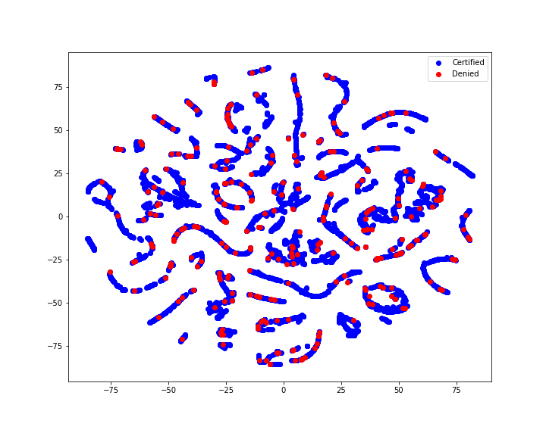
t-SNE Plot
Model very bad at predicting denied applications
Reduce data to two dimensions using t-SNE to visualize
Certified and Denied overlap almost completely

Slide 11
Conclusions
Model essentially as good as a coin flip
Bad at predicting denied applications
Over 97.68% of LCAs are certified
How are applications scored in real life?
Possible that I am missing information
Is there something missing that informs denied applications
Is completeness a factor?
Are the fields I’m missing NULL for my denied records?

Slide 12
Git Repository
All code for this project can be found here:
https://github.com/Liptoni/Springboard/tree/master/H1B_Capstone/python

