Slide 1
Classifying Photos Using Deep Learning Techniques

Slide 2
Problem and Client
Predicting the category of photographs
Landscape, people, plants, animals
200 images in each category
Stock Photography Site
Use to classify new images automatically
Individual Photographers
Use to tag photos, potentially too many to do by hand

Slide 3
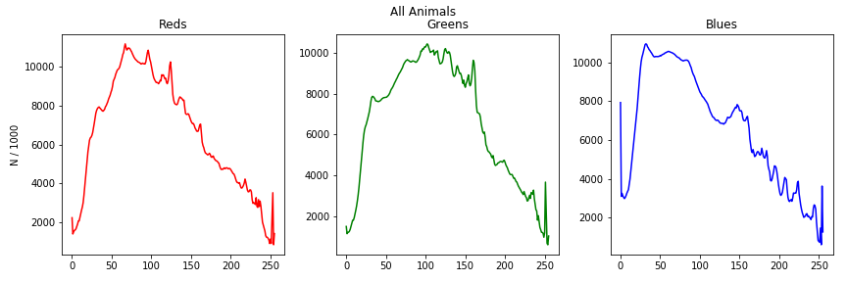
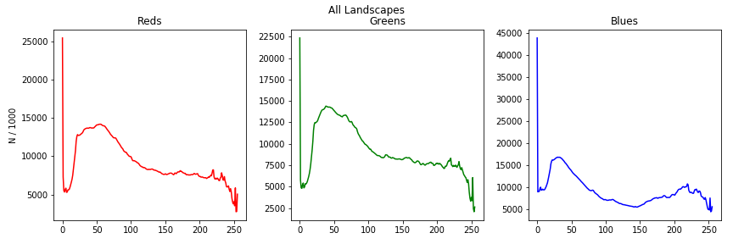
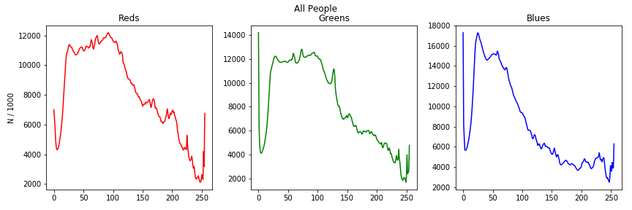
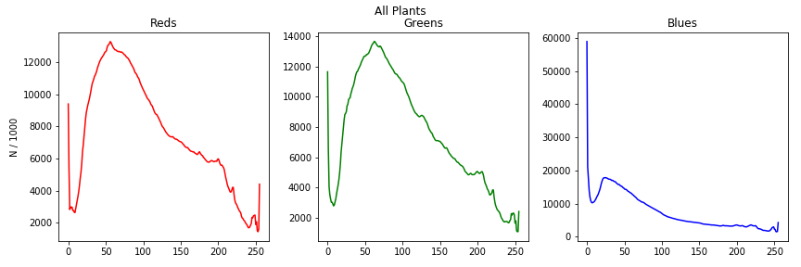
Color Channel Values
Frequency of color channel values for each category
X-axis represents less to more influence of a color

Slide 4
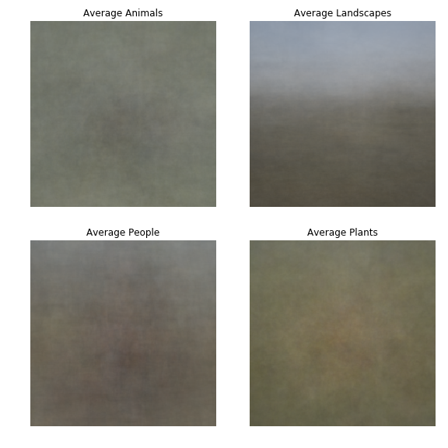
Average Images

Slide 5
Models Tested
Logistic Regression
Feed-forward Neural Net
2-layer
Sigmoid activation function
Simple CNN
2-layer
64 output channels, 7x7 Kernel, stride = 1, same padding
128 output channels, 5x5 kernel, stride = 1, same padding
ReLU activation
ResNet101
Transfer Learning
Re-train all parameters

Slide 6
Image Transformations
Crop
LogReg, FNN, CNN resize to 256, 224x224 center crop
ResNet RandomResizedCrop, 224x224
Random horizontal flip on training images
Normalized all images
Mean = [0.485, 0.456, 0.406]
Std. Dev = [0.229, 0.224, 0.225]

Slide 7
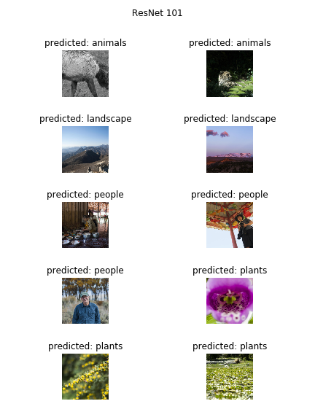
Model Performance
Logistic Regression
51.9% validation accuracy
7/10 final image accuracy
Feed-forward Neural Net
53.1% validation accuracy
6/10 final image accuracy
Simple CNN
62.5% validation accuracy
2/10 final image accuracy
ResNet101
98.1% validation accuracy
10/10 final image accuracy

Slide 8
Conclusions
Very impressive accuracy for ResNet model
Very few relative training images
Could adapt easily to stock photography.
Don’t need a ton of images to add more categories
Can adapt model to get top n-categories
Useful for applying more than one tag to a photo

Slide 9
Git Repository
All code for this project can be found here:
https://github.com/Liptoni/Springboard/tree/master/Photo_Classification_Capstone

