Slide 1
Angular: An Introduction
Objectives:
Getting started with Angular
History
Angular application structure

Slide 2

What is Angular?

Slide 3
Angular 101’s
Angular is a JavaScript framework, written in TypeScript, that simplifies the development of single-page web applications
It uses a Command-Line Interface to build applications programmatically
incorporates powerful databinding to m

Slide 4
Angular’s History

Slide 5
What is a SPA?

Slide 6
Understanding the CLI
Node, npm

Slide 7
Bundling
webpack

Slide 8
Get Started with Angular
CLI Comments to make first app
Cli commands for different elements

Slide 9
Application Architecture

Slide 10
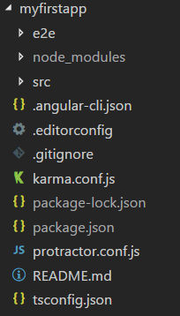
Application File Structure

