Slide 1
Argumentation Ethics

Slide 2
What is argumentation?

Slide 3
What is argumentation?
Interaction where two or more parties assert premises in support of two or more contradictory conclusions

Slide 4
What is argumentation?
Interaction where two or more parties assert premises in support of two or more contradictory conclusions
The goal of each party is to find the correct conclusion

Slide 5
What is argumentation?
Interaction where two or more parties assert premises in support of two or more contradictory conclusions
The goal of each party is to find the correct conclusion
A method of peaceful dispute resolution

Slide 6
What argumentation is not

Slide 7
What argumentation is not
Not about merely convincing others that you are correct.

Slide 8
What argumentation is not
Not about merely convincing others that you are correct.
It’s about a synthesis of oppossing theses and antitheses.

Slide 9
What argumentation is not
Not about merely convincing others that you are correct.
It’s about a synthesis of oppossing theses and antitheses.
Does not consist of free-floating propositions.

Slide 10
Normativity of argumentation

Slide 11
Normativity of argumentation
Certain norms are presupposed in the act of argumentation

Slide 12
Normativity of argumentation
Certain norms are presupposed in the act of argumentation
For example, one could not argue that argumentation is pointless

Slide 13
Normativity of argumentation
Certain norms are presupposed in the act of argumentation
For example, one could not argue that argumentation is pointless
Any norm that contradicts a normative presupposition of argumentation is dialectically false

Slide 14
“Argumentation ethics only applies to those currently arguing”

Slide 15
“Argumentation ethics only applies to body parts required to argue”

Slide 16
Other notes

Slide 17
Other notes
Each participant must be afforded exclusive control over their own body.

Slide 18
Other notes
Each participant must be afforded exclusive control over their own body.
These ethics are not derived from apodictic truths (i.e. we do not bridge the is/ought gap), but they are no less true.

Slide 19
Further Study

Slide 20
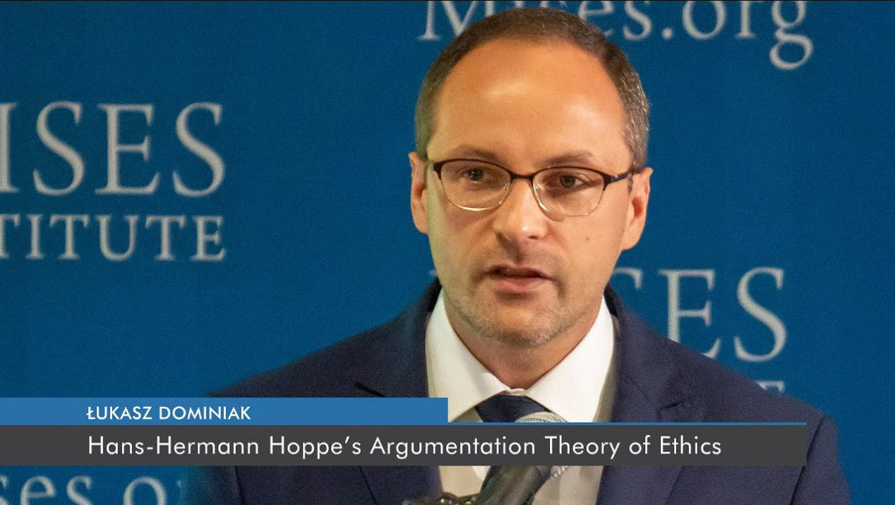
Łukasz Dominiak

Slide 21
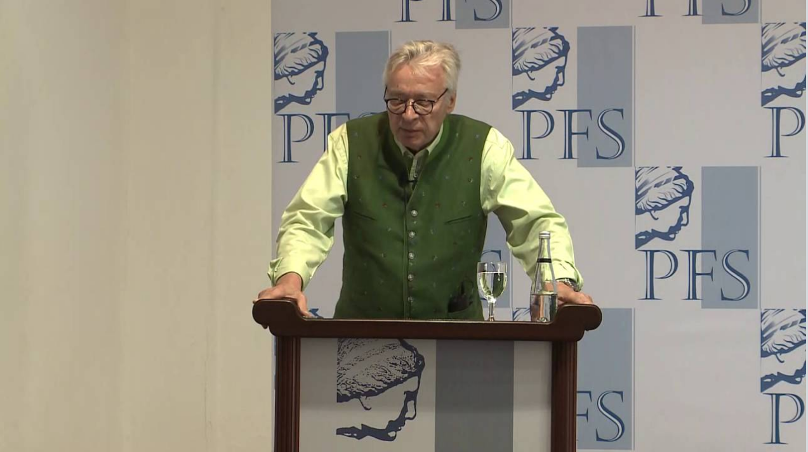
Hans-Hermann Hoppe

Slide 22
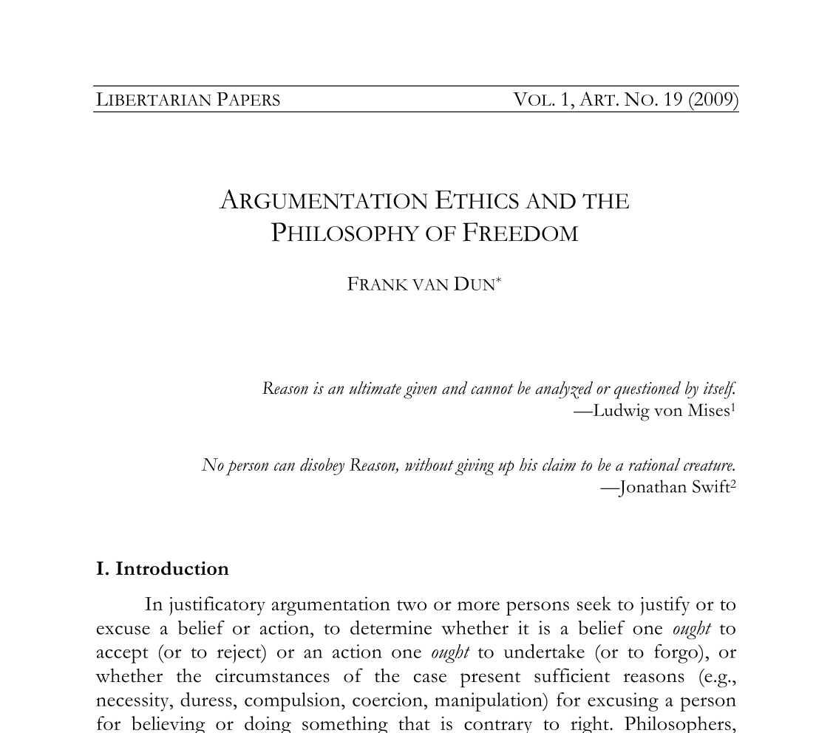

Slide 23
