Slide 1



ELATE: Elephant Flow-aware Learning-Accelerated
Traffic Engineering in Large-Scale LEO Constellation
He Ma, Yumei Wang†, Yu Liu, Linhui Wei
Affiliation: Beijing University of Posts and Telecommunications, China
Corresponding Author Email: ymwang@bupt.edu.cn
1–4 September, 2026 · Singapore
Notes:
Good afternoon everyone. My name is He Ma, from the Beijing University of Posts and Telecommunications. Today it is my pleasure to present our work titled "ELATE: Elephant Flow-aware Learning-Accelerated Traffic Engineering in Large-Scale LEO Constellation."

Slide 2

01
Introduction
02
Problem Formulation
CONTENTS
03
Proposed ELATE Method
ELATE
04
Simulation Results
05
Conclusion
2
Notes:
The talk has five parts: introduction, problem formulation, our proposed ELATE method, simulation results, and conclusion. Let's begin with the background and motivation.

Slide 3
01
Introduction
02
Problem Formulation
CONTENTS
03
Proposed ELATE Method
ELATE
04
Simulation Results
05
Conclusion
3
Notes:
First, the background and motivation of our work.

Slide 4
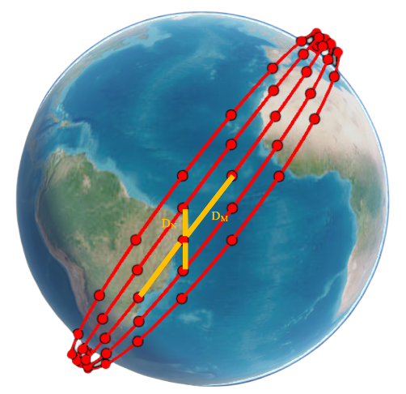
The Rise of Large-Scale LEO Constellations
Why LEO Mega-Constellations Matter
With the explosive growth of Internet traffic and bandwidth
demand, terrestrial infrastructure alone cannot keep up.
Low Earth Orbit mega-constellations — Starlink, Kuiper,
OneWeb — offer a promising solution with global coverage
and low latency.
Global Coverage
Ultra-Low Latency
Massive Scale
Reaches remote regions
unserved by terrestrial links
~550 km altitude enables
~10 ms one-way delay
1,584 Starlink satellites
(72 orbits × 22 sats)
Why Traffic Engineering?
Satellites orbit at ~27,000 km/h — the topology changes
continuously. Bursty, non-uniform traffic pushes existing
solvers to their limits, motivating a new TE approach.
1,584-satellite LEO constellation (D_N inter-orbit, D_M intra-orbit spacing)
4
Notes:
Internet traffic is growing explosively, and terrestrial infrastructure alone cannot keep up. LEO mega-constellations — Starlink, OneWeb — offer three key strengths. First, global coverage: they reach remote regions that terrestrial links simply cannot serve. Second, ultra-low latency: at about five-hundred-fifty-kilometer altitude, one-way delay is roughly ten milliseconds. Third, massive scale: Starlink Phase One consists of fifteen hundred and eighty-four satellites in seventy-two orbits of twenty-two, as illustrated on the right. However, these satellites orbit at twenty-seven thousand kilometers per hour, so the topology changes continuously. On top of that, the traffic is bursty and highly non-uniform. Together, these factors push existing TE solvers to their limits — and this is exactly what motivates the new approach we present.

Slide 5
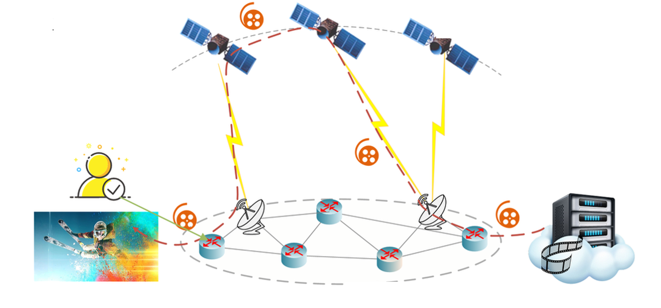
Why is Traffic Engineering Hard in LEO?
High-speed, regular satellite motion
Limited on-board compute resources
Random user distribution
Rich, diverse immersive services
Dynamic link-load variation
The bottleneck: satellites move at ~7.5 km/s over 1,584 nodes with bursty demand — the graph never stops changing.
Linear programming needs 34.76 s per traffic matrix — far too slow to scale, motivating a learning-accelerated approach.
5
Notes:
So, why is traffic engineering particularly hard in LEO? There are three main reasons. First, satellites are extremely dynamic, causing the network topology to change continuously and routing to be re-optimized very frequently. Second, the network is massive in scale — there are thousands of nodes and links with fluctuating demands, creating an enormous solution space. Third, a speed-quality dilemma — traditional linear programming produces good solutions, but it takes about thirty-five seconds for a single traffic matrix, which is far too slow for real-time operation. Existing heuristic methods either fail to scale, or they sacrifice congestion control. Therefore, we need a method that is both fast and high-quality.

Slide 6
01
Introduction
02
Problem Formulation
CONTENTS
03
Proposed ELATE Method
ELATE
04
Simulation Results
05
Conclusion
6
Notes:
Next, the problem formulation.

Slide 7
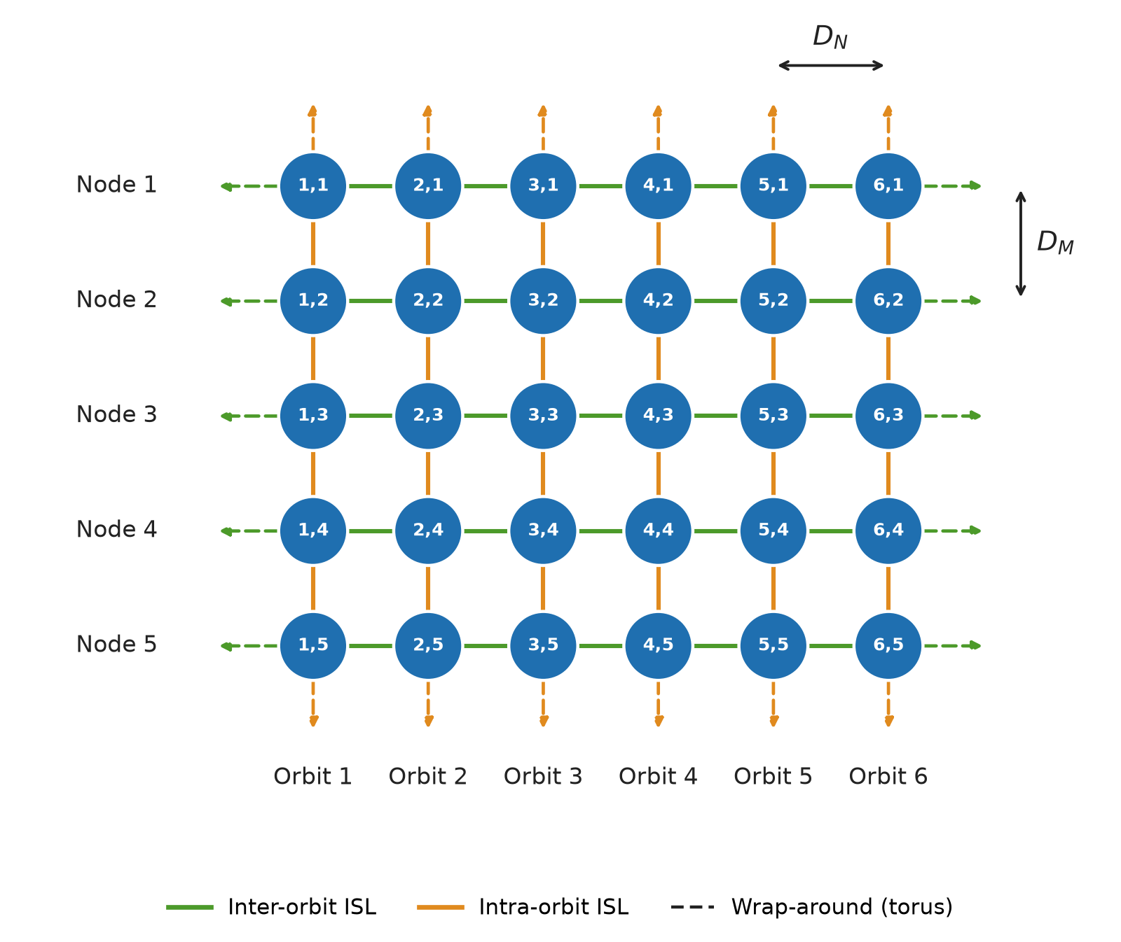
System Model & Objective
Graph Model G = (V, E)
V = satellites (nodes) · E = inter-satellite links
|V| = N × M = 72 × 22 = 1,584
+Grid topology: each satellite links 4 neighbors
— 2 intra-orbit + 2 inter-orbit, wrapping into a torus.
Relative topological positions stay invariant over
time — a property ELATE exploits later.
Objective — Minimize MLU (η)
η = max ratio of traffic load to link capacity
Decision variable x^{p}_{k} ∈ [0, 1]:
flow-splitting ratio for demand k on path p
Constraints:
• Load on each link ≤ η · capacity
• All demand fully allocated (flow conservation)
• Non-negativity: splitting ratios ≥ 0
+Grid topology: 2 intra-orbit + 2 inter-orbit ISLs per satellite; links wrap into a torus (D_{N}, D_{M} spacing)
7
Notes:
We model the constellation as a graph G, where vertices are satellites and edges are inter-satellite links. Under the Plus-Grid topology shown on the right, each satellite connects to four neighbors — two within the same orbit, two toward adjacent orbits — and the links wrap around at the boundaries, forming a torus of fifteen hundred and eighty-four nodes. Our objective is to minimize the Maximum Link Utilization, denoted eta — the highest load-to-capacity ratio across all links. The decision variables are flow-splitting ratios: for each demand, what fraction of traffic is placed on each candidate path. These are subject to capacity, demand-conservation, and non-negativity constraints.

Slide 8
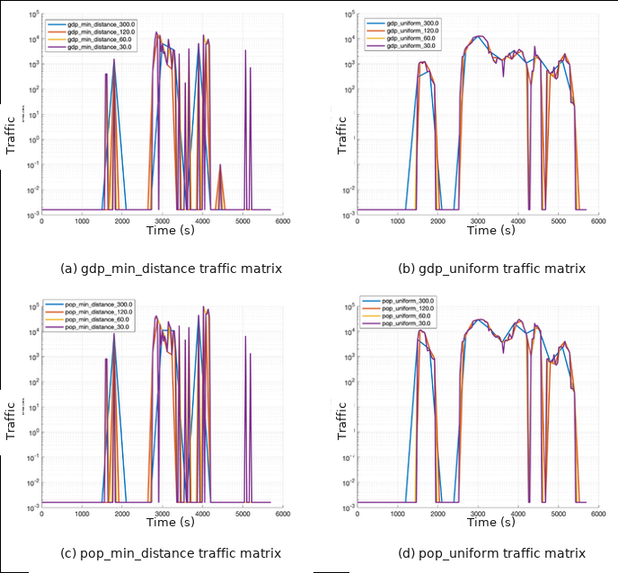
Key Insight: Heavy-Tailed Traffic
Elephant Flows
Few large flows that dominate congestion and
form bottlenecks — need sophisticated,
learning-based routing optimization.
Mice Flows
Many lightweight flows contributing only
marginally to bandwidth — safely handled
by static shortest-path routing.
ELATE Strategy: Decompose & Conquer
Offload mice flows to static shortest paths
→ drastically shrink the solution space,
then focus all computational effort on
optimizing the critical elephant flows only.
Measured traffic matrices: sparse, bursty spikes of several orders of magnitude
8
Notes:
Now let me highlight the key insight behind ELATE. In real networks, traffic is heavy-tailed. The figures on the right show measured traffic matrices over time: traffic is mostly near zero but occasionally spikes by orders of magnitude. In other words, a small number of elephant flows dominate congestion and form the bottlenecks — these need sophisticated, learning-based routing. The vast majority are mice flows, lightweight demands contributing only marginally. Our strategy is decompose and conquer: offload mice flows to shortest paths, drastically shrinking the solution space, then focus all computational effort on optimizing the critical elephant flows. This single decision is what makes ELATE so fast, as I will demonstrate later.

Slide 9
01
Introduction
02
Problem Formulation
CONTENTS
03
Proposed ELATE Method
ELATE
04
Simulation Results
05
Conclusion
9
Notes:
Now, let me introduce the design of ELATE.

Slide 10
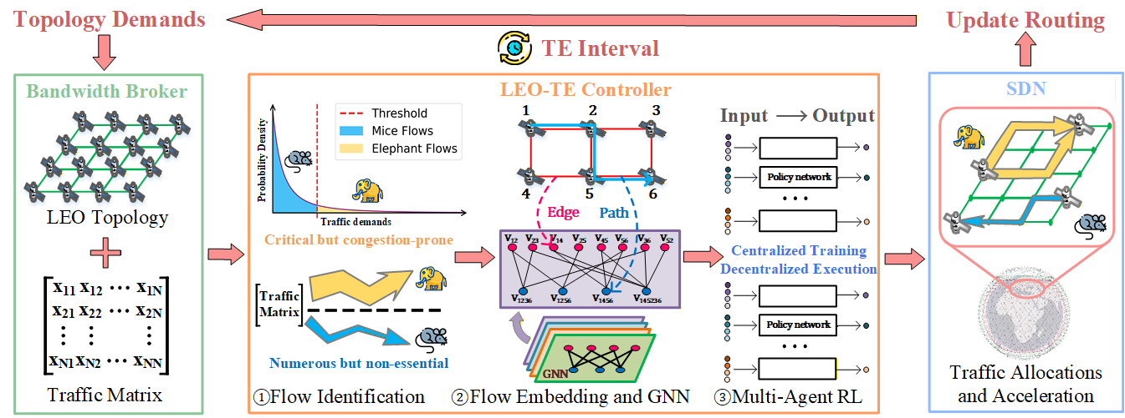
Three-Stage Processing Pipeline
① Flow Identification
② Flow Embedding + GNN
③ Multi-Agent RL
10
Notes:
ELATE is a three-stage pipeline. Stage one is flow identification, where we separate the elephant flows from the mice flows. Stage two is GNN embedding, where a graph neural network turns the network state into rich representations. And stage three is multi-agent reinforcement learning, which decides how to route the elephant flows. Let me explain each stage.

Slide 11
Stage 1: Elephant Flow Identification
λ-σ Thresholding Rule
Fast Path Instantiation
Algorithm 1: Elephant and Mice Flows Identification
Key: the LEO grid has translation invariance.
Pre-compute paths from a virtual origin to all
offsets and cache them in set Ω.
For any source-destination pair, apply a shift:
P_{k} = { (p + v_{i} ) mod (N, M) | p ∈ Ω }
Complexity: O(|V|) per flow
(vs. O(|V|²) for online all-pairs search)
1: Input: Traffic matrix F ∈ ℝ^{|V|×|V|}, hyperparameter λ
2: Output: Elephant flow matrix F^{(e)}, mice flow matrix F^{(m)}
3: Compute mean μ and standard deviation σ of F
4: Set the identification threshold τ ← μ + λσ
5: Initialize F^{(e)} ← 0^{|V|×|V|}, F^{(m)} ← 0^{|V|×|V|}
6: for i = 1 to |V| do
7: for j = 1 to |V| do
8: if F_{i,j} ≥ τ then
9: F^{(e)}_{i,j} ← F_{i,j}
10: else
11: F^{(m)}_{i,j} ← F_{i,j}
12: end if
13: end for
14: end for
11
Notes:
Stage one: elephant-flow identification. We apply a statistical threshold — tau equals mu plus lambda times sigma, where mu and sigma are the mean and standard deviation of the traffic matrix. Flows above the threshold are classified as elephants and receive learned routing; flows below are mice and take shortest paths. We found that lambda equals five works best — I will justify this with data shortly. We also exploit the LEO grid's translation invariance: pre-compute candidate paths once from a virtual origin and cache them, then simply shift for any source-destination pair. This reduces the path-generation complexity from quadratic to linear in the number of nodes.

Slide 12
Stage 2: GNN-Derived Flow Embedding
Time-Dependent Bipartite Graph
Link–Path Bipartite Graph
G_{t} = ( E_{t}, P_{t}, R_{t} )
E_{t} — active ISL (link) nodes
P_{t} — candidate path nodes
R_{t} — link–path inclusion edges
Aggregation operator A_{t} sums link
traffic along each path; A_{t}^{T} gathers the
congestion of all links on that path.
Links E_{t}
e₁
e₂
e₃
e₄
e₅
Paths P_{t}
p₁
p₂
p₃
p₄
Message passing over R_{t} couples interfering links and paths
Interleaved GNN + DNN layers (×L) → high-fidelity flow embeddings
GNN Layer
link ↔ path message passing
▶
DNN Layer
enforce Σ x_{k}^{p} = 1
▶
Flow Embeddings
state for routing policy
12
Notes:
Stage two: GNN embedding. We construct a time-dependent bipartite graph with two types of nodes: active links and candidate paths, connected by inclusion edges that record which links belong to which path. The aggregation operator A-t sums traffic along each path, and A-t-transpose gathers the congestion of every link on that path. This lets the graph capture both demand and supply information. We then interleave GNN layers and DNN layers. The GNN layers perform message passing between links and paths to capture their mutual interference — paths sharing a link compete for bandwidth. The DNN layers coordinate across flows and enforce that each flow's splitting ratios sum to one. This edge-centric design captures interference that ordinary node-based GNNs completely miss.

Slide 13
Stage 3: Multi-Agent RL for Routing
Agent Design
Centralized Training, Decentralized Execution
Each elephant flow k = one agent.
Observation — local state s_{k}^{t}:
candidate-path embeddings from the GNN.
Action — continuous split ratios:
a_{k} ~ π_{θ} ( · | s_{k}^{t} )
Policy — shared stochastic network θ.
Global reward: R = −η (min. max-link util.)
Environment
LEO topology & traffic matrix · one-step TE interval
state s_{k}^{t}
Shared policy network π_{θ} (parameter sharing)
Agent 1
Agent 2
· · ·
Agent K
action a_{k} (flow-split ratios)
Global reward R = −η (maximum link utilization)
Counterfactual advantage
TE is one-step (no future demands), so return = immediate reward.
N_{s} Monte-Carlo samples isolate each agent’s marginal contribution → unbiased gradients.
13
Notes:
Stage three: multi-agent reinforcement learning. We treat each elephant flow as an independent agent. Each agent observes its own local state — the embeddings of its candidate paths from the GNN — and outputs continuous flow-splitting ratios through a shared stochastic policy network. The global reward is the negative of maximum link utilization, so all agents cooperate to reduce congestion. A critical domain insight: traffic engineering is a one-step process — today's routing does not affect future demands, so the expected return equals the immediate global reward. We leverage this by using a counterfactual baseline estimated through Monte-Carlo sampling to isolate each agent's marginal contribution. This provides unbiased gradients and enables stable, end-to-end multi-agent policy training.

Slide 14
01
Introduction
02
Problem Formulation
CONTENTS
03
Proposed ELATE Method
ELATE
04
Simulation Results
05
Conclusion
14
Notes:
Next, the performance evaluation.

Slide 15
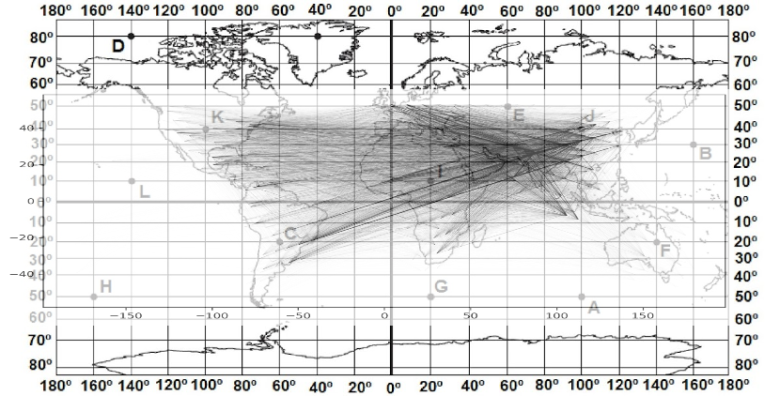
Simulation Environment & Settings
Constellation Model
Traffic Generation
Starlink Phase-I, Shell-I
1,584 satellites (72 orbits × 22)
+Grid inter-satellite links
Snapshot every 5 min from 2024-01-01 12:00 UTC
≈80 s translation period → temporal invariance
Python 3.10 · NVIDIA RTX 4090 GPU
Random gravity model (GDP / population)
Nearest-access: city → nearest satellite
+1 Mbps per sampled city pair
Base load: normalized Abilene (first 2 weeks)
100 GDP + 100 POP traffic matrices
Gravity-Model Demand (global cities)
Traffic-Matrix Statistics (Mbps)
Traffic
Min
Max
Mean μ
Std σ
gdp_random
0.0
1,160
11.59
29.25
pop_random
0.0
1,800
159.46
242.34
Max ≫ mean ⇒ strongly heavy-tailed traffic — motivating the elephant/mice split via τ = μ + 5σ (≈ 158 Mbps for GDP, ≈ 1,371 Mbps for POP).
15
Notes:
We evaluate on full Starlink Phase One — fifteen hundred and eighty-four satellites in seventy-two by twenty-two, Plus-Grid topology. For traffic, we use a random gravity model，We generate one hundred GDP and one hundred population traffic matrices. The statistics in the table reveal a heavy tail — under GDP traffic the mean is about twelve, but the maximum exceeds one thousand. This confirms that the elephant-mice split is well-motivated.

Slide 16
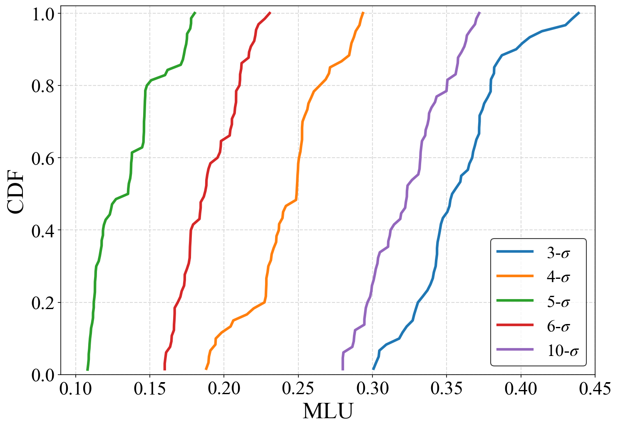
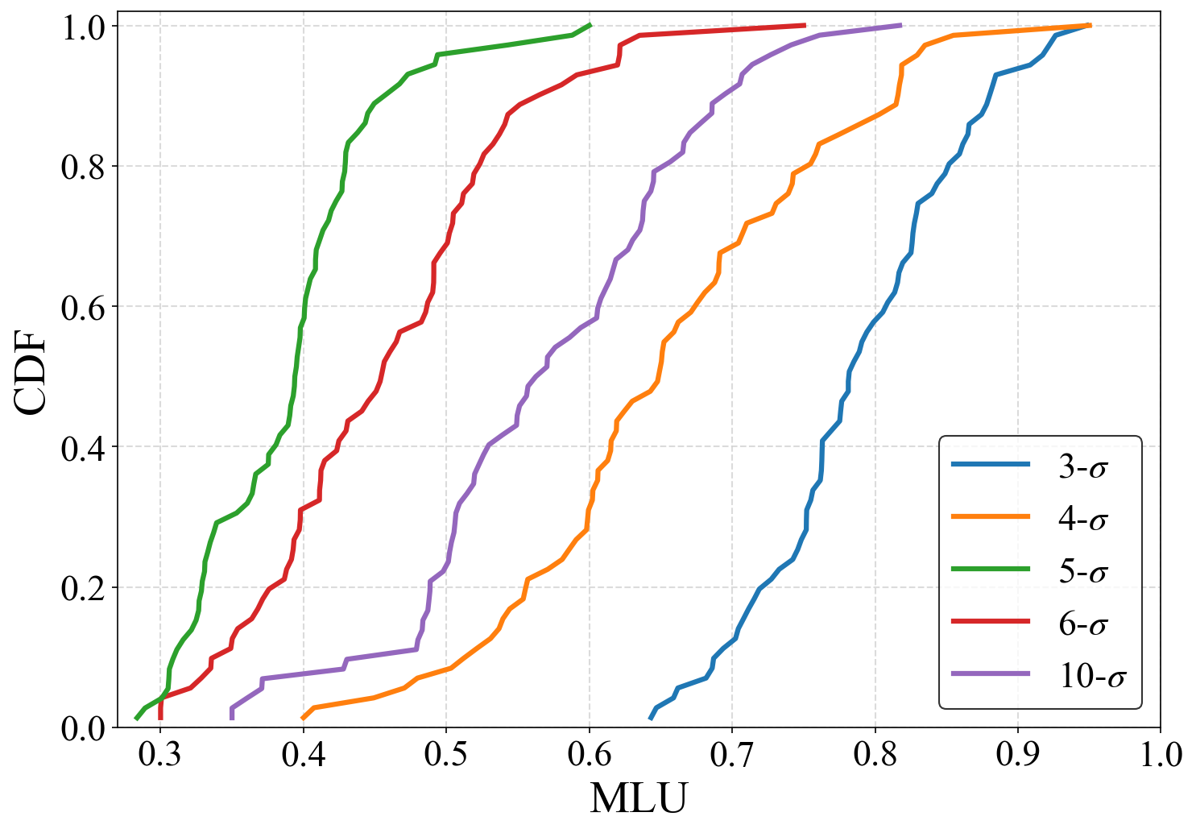
Threshold Sensitivity: Choosing λ
MLU CDF across λ-σ thresholds (3σ – 10σ)
GDP-based traffic
POP-based traffic
λ = 5σ (green) sits furthest left → lowest MLU. We adopt λ = 5 for all experiments.
16
Notes:
How do we set lambda? These CDF plots sweep the threshold from three-sigma to ten-sigma for both traffic types. In both GDP and population traffic, lambda equals five — the green curve — consistently sits furthest to the left, meaning the lowest MLU. Therefore we fix lambda at five in all experiments.

Slide 17
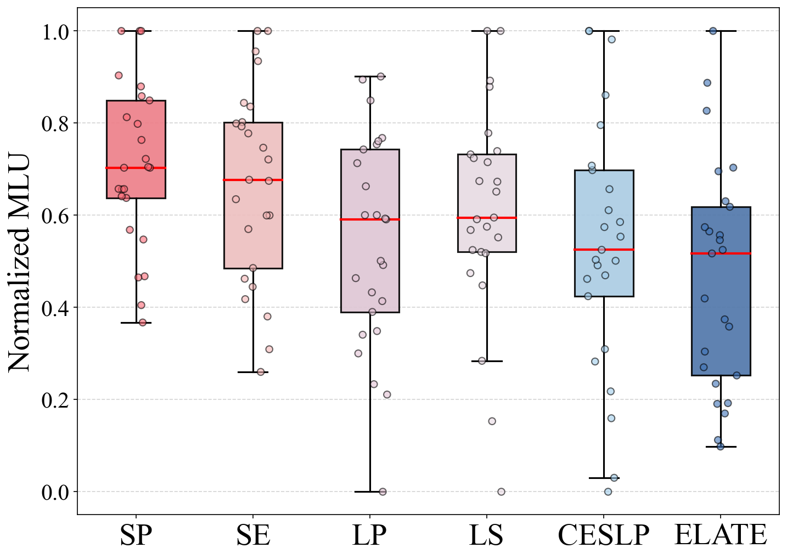
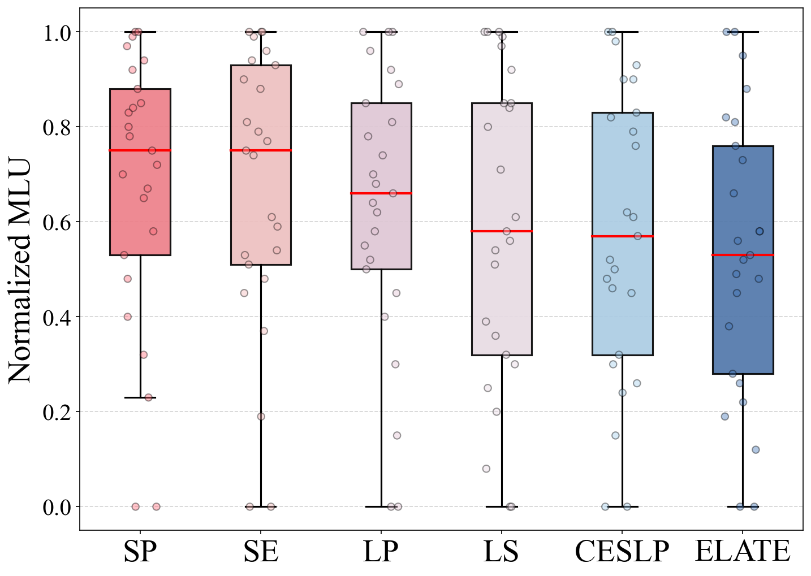
Load Balancing: Normalized MLU
8–29% lower MLU vs. every baseline
GDP-based traffic
POP-based traffic
ELATE (rightmost) achieves the lowest median MLU against SP, SE, LP, LS and CESLP. Lower is better.
17
Notes:
Now the main load-balancing result. These boxplots compare ELATE against five baselines: shortest path, shortest edge, LP, local search, and CESLP. ELATE is the rightmost box — lower is better. ELATE consistently achieves the lowest median MLU, reducing utilization by eight to twenty-nine percent compared with every baseline, including the LP-based optimizer. Our learning-based approach matches or exceeds optimization-based methods in solution quality.

Slide 18
Computational Efficiency
Average Flow-Allocation Time
11–3288×
Scheme
Avg. Runtime
ELATE
10.57 ms
faster — millisecond-scale flow allocation
SP
115.06 ms
SE
122.97 ms
LP (Gurobi)
34.76 s
Why ELATE is so fast
CESLP
> 60 s
Training is offline — inference is pure feedforward.
Fully parallelizable matrix operations on GPU.
No iterative solver bottleneck (unlike LP / CESLP).
LS
> 100 s
18
Notes:
But the most important advantage of ELATE is speed. ELATE allocates a traffic matrix in just ten-point-six milliseconds — that is eleven to over three thousand times faster than the baselines. LP takes nearly thirty-five seconds; local search and CESLP take more than a minute. Why so fast? Because training is done offline. At runtime, inference is a single feedforward pass — fully parallelizable on GPU, with no iterative solver in the loop. This is what makes millisecond-scale traffic engineering feasible for a topology that changes every few seconds.

Slide 19
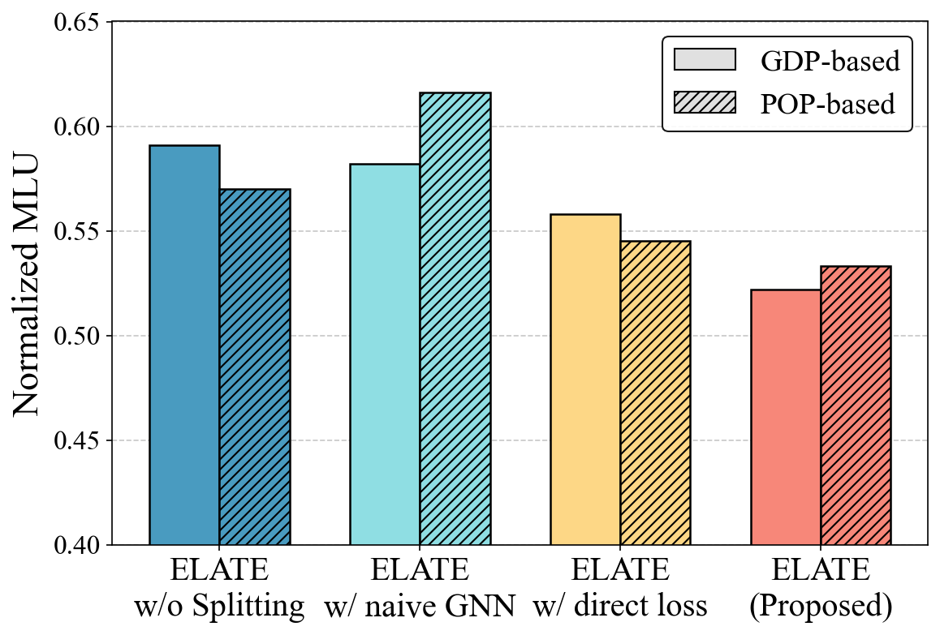
Ablation Study: Every Component Matters
ELATE w/o Flow Splitting
Removing elephant-mice separation overwhelms the network with state complexity.
ELATE w/ Naive GNN
A node-based GNN instead of the edge-centric one drops sharply under POP traffic.
ELATE w/ Direct Loss
Surrogate-loss minimization instead of MARL degrades load balancing and robustness.
Full ELATE consistently reaches the lowest Normalized MLU — validating the synergistic design.
Normalized MLU across ablated variants (GDP vs POP).
19
Notes:
The ablation study confirms that every component is necessary. Removing the elephant-mice split overwhelms the network with state complexity. Replacing our edge-centric GNN with a node-based one degrades performance sharply, especially under population traffic. Replacing RL with direct surrogate-loss minimization hurts both quality and robustness. The full ELATE consistently achieves the lowest MLU, confirming all three components work.

Slide 20
01
Introduction
02
Problem Formulation
CONTENTS
03
Proposed ELATE Method
ELATE
04
Simulation Results
05
Conclusion
20
Notes:
Finally, the conclusion.

Slide 21
Conclusion
1
Heavy-Tailed Exploitation
Elephant/mice flow decomposition drastically reduces solution-space complexity.
2
Topology-Aware Learning
A bipartite GNN captures path-link interference that node-centric models miss.
3
Adaptive Multi-Agent Routing
MARL with counterfactual credit assignment enables robust, decentralized routing.
4
Real-Time Performance
8–29% lower MLU and 11–3288× speedup → millisecond-scale allocation for dynamic LEO.
21
Notes:
First, we exploit the heavy-tailed structure of traffic to reduce solution-space complexity. Second, our topology-aware bipartite GNN captures the path-link interference that node-centric models miss. Third, multi-agent RL with counterfactual credit assignment enables robust decentralized routing. And fourth, ELATE achieves real-time performance — eight to twenty-nine percent MLU reduction, with a speedup of eleven to over three thousand times, enabling millisecond-scale allocation that keeps pace with a constantly moving constellation.

Slide 22
THANK YOU
ELATE: Elephant Flow-aware Learning-Accelerated Traffic Engineering
He Ma | Beijing University of Posts and Telecommunications
Corresponding author: Yumei Wang · ymwang@bupt.edu.cn
Supported by the National Key R&D Program of China (No. 2022YFB2902705).
Notes:
That concludes our presentation on this paper. Thank you all for listening.

