Slide 1
UNDERSTANDING AND FORMULATION OF RESEARCH TOPIC
LESSON 4 PART 2

Slide 2
RESEARCH TOPICS TO BE AVOIDED

Slide 3
Controversial topics. These are topics that depend greatly on the writer’s opinion, which may tend to be biased or prejudicial. Facts cannot support topics like these.

Slide 4
2. Highly technical subjects. For a beginner, researching on topics that require an advanced study, technical knowledge, and vast experience is a very difficult task.

Slide 5
3. Hard-to-investigate subjects. A subject is hard to investigate if there are no available reading materials about it and if such materials are not up-to-date.

Slide 6
4. Too broad subjects. Topics that are too broad will prevent you from giving a concentrated or an in-depth analysis of the subject matter of the paper. The remedy to this is to narrow or limit the topic to a smaller one.

Slide 7
5. Too narrow subjects. These subjects are so limited or specific that an extensive or thorough searching or reading for information about these is necessary.

Slide 8
6. Vague subjects. Choosing topics like these will prevent you from having a clear focus on your paper. For instance, titles beginning with indefinite adjectives such as several, many, some, etc., as in “Some Remarkable Traits of a Filipino” or “Several People’s Comments on the RH Law,” are vague enough to decrease the readers’ interests and curiosity.

Slide 9
SOURCES OF RESEARCH TOPICS

Slide 10
This time, you already have ideas on some factors that affect your process of choosing a researchable topic. It is also necessary for you to know where a good research topic may come from. Knowing some sources of probable research topics could hasten your choosing; thereby, freeing you from a prolonged time of pondering over a problem of knowing which problem is good for you to research on.

Slide 11
The following can help you generate ideas about a good research topic. (Silverman 2013)
Mass media communication – press (newspapers, ads, TV, radio, films, etc.)

Slide 12
2. Books, Internet, peer-reviewed journals, government publications
3. Professional periodicals like College English Language Teaching Forum, English Forum, The Economist, Academia, Business Circle, Law Review, etc.

Slide 13
4. General periodicals such as Readers’ Digest, Women’s Magazine, Panorama Magazine, Time Magazine, World Mission Magazine, etc.
5.Previous reading assignments in your other subjects

Slide 14
6. Work experience – clues to a researchable topic from full-time or part-time jobs, OJT (on-the-job training) experience, fieldwork, etc.

Slide 15
ASSESSMENT
Using the activity from yesterday, have the students form their groups and cross out the topics that needs to be avoided. Once finalized, have them answer the Worksheet no. 1

Slide 16
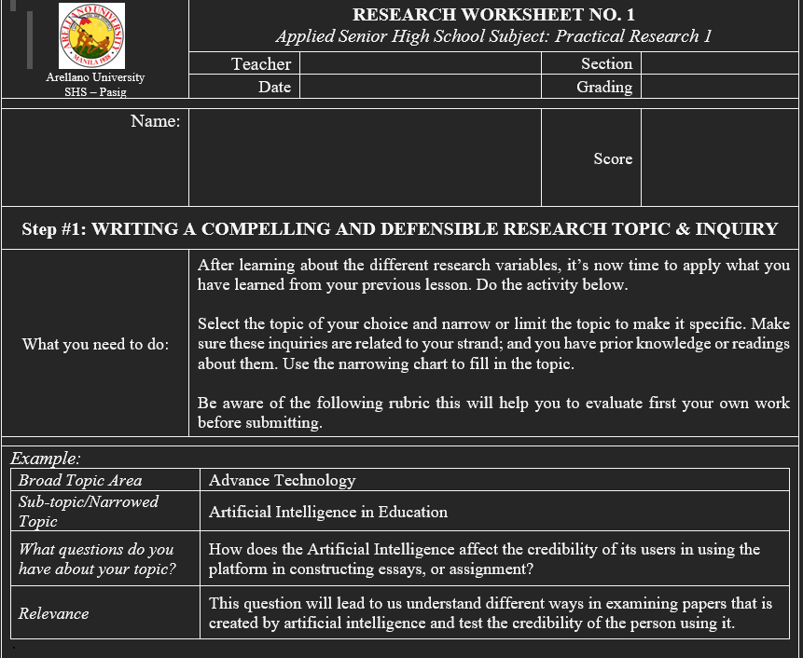

Slide 17
