Slide 1
INTRODUCTION AND THE BACKGROUND OF THE STUDY

Slide 2
RESEARCH PROBLEM

Slide 3
The ultimate aim of research is not merely to suggest ways of examining things, people, places, and events, but also to uncover and introduce new practices, strategies, or techniques to solve a problem. The term "problem" itself often triggers a sense of urgency, motivating you to make significant efforts to find a solution.

Slide 4
When faced with uncertainty or anxiety about a situation you’re unsure of or a question you cannot answer, research becomes your go-to remedy. Through investigation and inquiry, research helps you navigate doubts and challenges.

Slide 5
BACKGROUND OF THE PROBLEM

Slide 6
You must not rush into gathering ideas and information about your topic. First, spend time getting background knowledge about the problem that triggered off your research topic to discover its relation to what the world, particularly the experts, professionals, and learned people know about your topic.

Slide 7
Also, reading for rich background ideas about the problem is also another way to discover some theories or principles to support your study. (Braun 2014; Woodwell 2014)

Slide 8
RESEARCH QUESTIONS

Slide 9
The research problem serves as the foundation for generating a set of research questions. Your ability to identify this problem and formulate questions depends heavily on the background knowledge you have about the topic. To fully grasp the problem, you must acquire

Slide 10
comprehensive background knowledge through the RRL (Review of Related Literature), which involves intensive reading about your topic. This process not only provides a clearer understanding of the topic but also helps you adopt an appropriate research method and gain a thorough knowledge of the area you are researching.

Slide 11
A research problem, acting as the driving force behind your research study, can stem from various sources. Issues arising from social relationships, governmental affairs, institutional practices, cultural patterns, environmental challenges, marketing strategies, and more can lead you to identify a specific topic for research. By focusing on the problem, you can define a general or overarching research problem to guide your work. (Punch 2014)

Slide 12
The following shows you the link among the following: research problem, research topic, research question, and the construction of one general question and specific questions in a research paper.

Slide 13
Research problem: The need to have a safer, comfortable, and healthful walk or transfer of students from place to place in the UST campus.
Research Topic: The Construction of a Covered Pathway in the UST Campus
General Question: What kind of covered path should UST construct in its campus?

Slide 14
Specific Questions:
1. What materials are needed for the construction of the covered pathway in the UST campus?
2. What roofing material is appropriate for the covered path?
3. In what way can the covered pathway link all buildings in the campus?
4. What is the width and height of the covered path?
5. How can the covered path realize green architecture?

Slide 15
Research questions focus on exploring specific aspects of the research problem. While derived from the broader general or "mother" question, each specific question may uncover a sub-problem or lead to another sub-question. This often necessitates employing a different data-gathering technique and steering the research towards a triangulation or mixed-method approach.

Slide 16
By addressing various dimensions of the general problem, research questions play a pivotal role in the research process. They act as the foundation of the study, shaping its design and overall plan. Through sub-questions, you can clearly determine the type of data required and the methods for collecting, analyzing, and presenting it.

Slide 17
Hence, the following are things you have to remember in research question formulation. (Barbie 2013; Litchman 2013; Silverman 2013)

Slide 18
Seven (7) Guidelines in Formulating Research Questions

Slide 19
1. Establish a clear relation between the research questions and the problem or

Slide 20
2. Base your research questions on your RRL or Review of Related Literature because existing published works help you get good background knowledge of the research problem and help you gauge the people's current understanding or unfamiliarity about the topic, as well as the extent of their knowledge and interest in it.

Slide 21
Convincing solutions to research problems or answers to research questions stem from their alignment with what the world already knows or what previous research studies have already discovered about the research problem or topic.

Slide 22
3. Formulate research questions that can arouse your curiosity and surprise you with your discoveries or findings. This is true for research questions asked about a problem that was never investigated upon.

Slide 23
4. State your research questions in such a way that they include all dependent and independent variables referred to by the theories, principles, or concepts underlying your research work.

Slide 24
5. Let the set of research questions or sub-problems be preceded by one question expressing the main problem of the research.

Slide 25
6. Avoid asking research questions that are answerable with "yes" or "no" and use the "how" questions only in a quantitative research.

Slide 26
7. Be guided by the acronym SMART (specific, measurable, attainable, realistic, time-bound) in formulating the research questions. Applying SMART, you must deal with exact answers and observable things, determine the extent or limit of the data collected, be aware of the timeframe and completion period of the study, and endeavor to have your research study arrive at a particular conclusion that is indicative of what are objective, factual, or real in this world.

Slide 27
ASSESSMENT
Accomplish Worksheet #2 “WRITING A COMPREHENSIVE BACKGROUND OF THE STUDY” write it in a clean paper. in this task it also indicates the rubrics below.

Slide 28
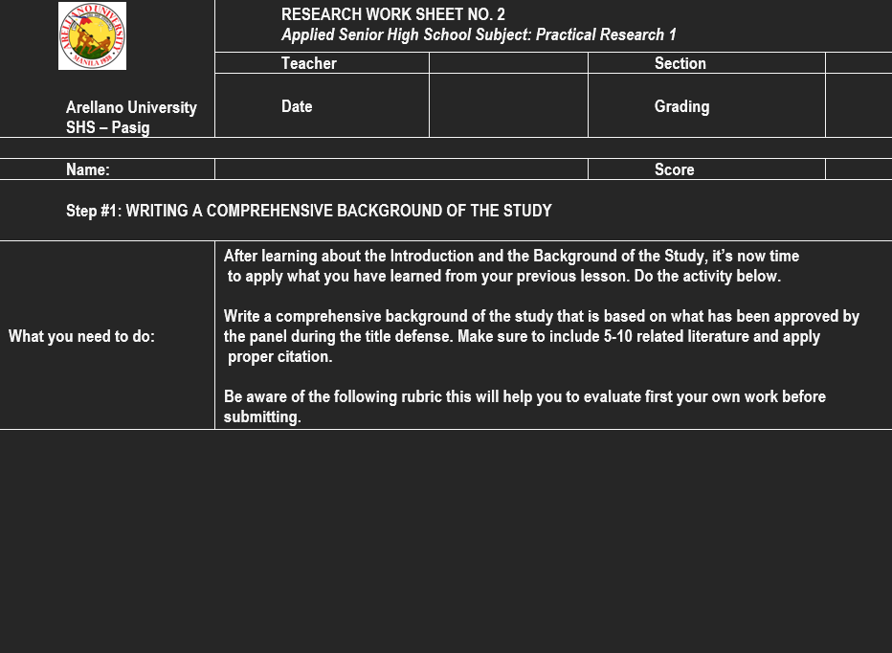

Slide 29


