Slide 1

SCOPE AND DELIMITATION/LIMITATION, SIGNIFICANCE OF THE STUDY AND THE DEFINITION OF TERMS
Lesson 6

Slide 2
WRITING SCOPE AND DELIMITATION
Writing scope and delimitation does not require you extraordinary skills in writing. You just need to have a clear picture on how you are going to do your research. Most probably, if you happened to read other researches, you would notice they have different ways of formulating it. Some begin with the methods of research and end with the instrument, others start with research locale and end with the declaration of the protocols followed.

Slide 3
However, one thing is common among them, their content are the same. Therefore, this implies that there is no prescribed way of making it. As long as the necessary elements are declared and briefly discussed, that is already a good scope and delimitation. It is because this part of research intends to inform the readers about the parameter of your research.

Slide 4
Commonly, scope and delimitation is written in three (3) paragraphs.
The first paragraph contains methods, research design, research locale, time duration, population, sampling and class size.

Slide 5
The second paragraph includes the instrument used, validation and protocols followed in the conduct of the study.
The last paragraph is the declaration of data gathering and analysis. It is important that you need to provide proper justifications of the elements you will be using. It is done through the wisdom of the experts – citation.

Slide 6
SIGNIFICANCE OF THE STUDY
Writing a research paper has its purpose-- may it be for you (as a researcher) or even for others. That is why, you need to identify the key reason/s why you are taking a step forward and make your query into a formal writing. In this stage, your ‘WHYs’ and ‘HOWs’ will be answered and explained.

Slide 7
Significance of the Study
Cristobal and Cristobal (2017) states that research is a very noble undertaking if it makes significant contributions to the community and to the academic field or discipline where the researcher is affiliated with.

Slide 8
This is basically the reason why the researcher needs to determine the relevance of their study. It should apparently identify the purpose that the research will serve and how it will contribute to the society, the country, the government, the institution or agency concerned, and the research community.

Slide 9
Under this section of the research paper, the researcher must be able to present the valuable contribution of the study to a particular body of knowledge or area of specialization.

Slide 10
As Cristobal and Cristobal (2017) noted, it could be in the form of new knowledge in the field, analysis of trends over time, validation of other findings using different methodologies, confirmation of the major findings of other studies, and verification of the validity of findings in a different population.

Slide 11
After identifying the general significance of the study, the researcher also has to determine the beneficiaries who will directly gain from the results of the study. They may be classified as academic or non-academic.

Slide 12
Academic beneficiaries may include educational staff, teachers, students and researchers, while non-academic beneficiaries may include stakeholders, policymakers, agencies and organizations. They should be specifically listed according to the significance of the study’s results to them.

Slide 13
DEFINITION OF TERMS
A word or phrase used to describe a thing or to express a concept, especially In a particular kind of language or branch of study.

Slide 14
Guidelines in defining terms:
1. Definition of terms works like a glossary but has a different twist. It is placed at the beginning of the research paper to tell the meaning of the terms used in the said paper.
2. Only terms, words, or phrases which have special or unique meanings in the study are defined.

Slide 15
3. There are two types of definition of terms. Conceptual and Operational Terms.
Theoretical Definition are based on encyclopedias, books, magazines and newspaper article, dictionaries, and other publications but the researcher must acknowledge his/her sources.
Conceptual Definition are based on how the researcher may develop his own definition from the characteristics of the term define.

Slide 16
4.The term should be arranged alphabetically.
5. When the definition are taken from encyclopedias, books, magazine and newspaper articles, dictionaries and other publications, the researcher must acknowledge his sources.

Slide 17
ASSESSMENT
Accomplish Worksheet #3 “WRITING SCOPE AND DELIMITATION AND SIGNIFICANCE OF THE STUDY” write it in a clean paper. in this task it also indicates the rubrics below.

Slide 18
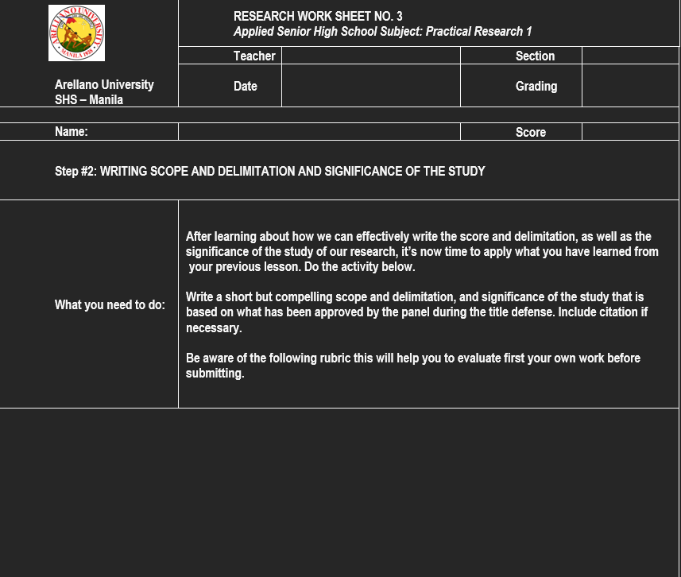

Slide 19
