Slide 1

Genetic Algorithm for Lights Up Puzzles
Adar Ovadya
Liron Avraham

Slide 2
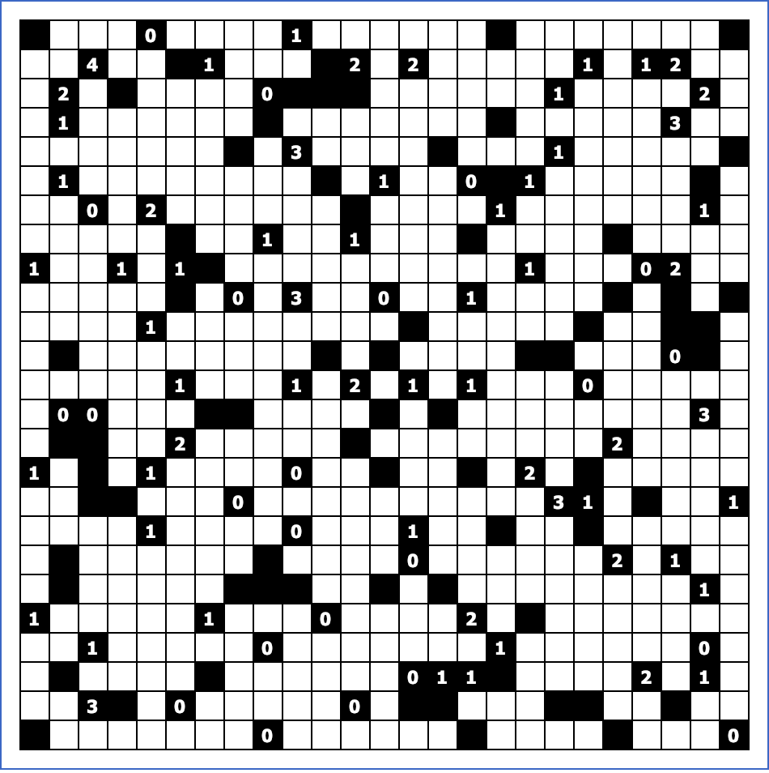





Lights Up Puzzle - Rules
Empty Cell - Is an optional spot for a light bulb
Block – Invalid location for a light bulb
Also blocks light
Number Block – Some blocks contain numbers, They represent how many light bulbs should “touch” that block
Light Bulb – Lights the board vertically and
Horizontally until reaches the end of the
Board or meets a block.
Illuminated Cell – Cells that are already in a direct line with a light bulb. They are invalid spots for light bulbs as it would cause a clash of two light bulbs.

Slide 3
Lights Up Puzzle - Solution
A valid solution for a 14x14 Lights up puzzle:
All cell are illuminated.
Every ”Number Block” have the exact number of light bulbs around it (i.e. 4 bulbs around a 4 block).
No light bulb illuminate another

Slide 4

Lights Up Puzzle - Complexity
NP - Complete[1]
Search space of n*n board is $O(2^{n^{2}})$
Reduction is limited to $O\left(2^{m}\right), m≤n^{2}$
[1] KENDALL, Graham; PARKES, Andrew; SPOERER, Kristian. A survey of NP-complete puzzles. ICGA Journal, 2008, 31.1: 13-34.‏

Slide 5

Title

Slide 6
Slide Title
Product A
Product B
Feature 1
Feature 2
Feature 3
Feature 1
Feature 2
Feature 3

