Slide 1

Genetic Algorithm for Lights Up Puzzles
Adar Ovadya
Liron Avraham

Slide 2
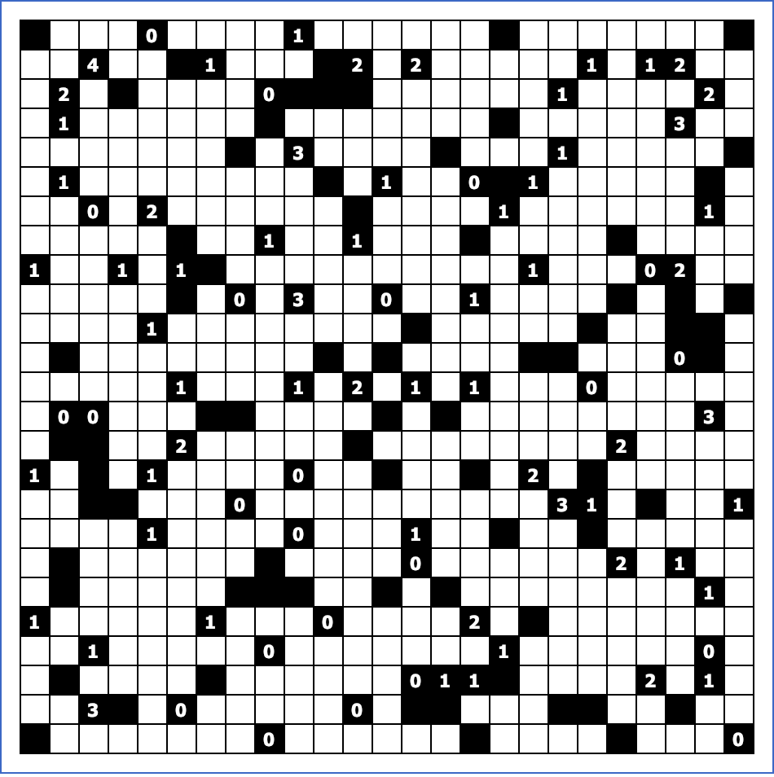





Lights Up Puzzle - Rules
Empty Cell - Is an optional spot for a light bulb
Block – Invalid location for a light bulb
Also blocks light
Number Block – Some blocks contain numbers, They represent how many light bulbs should share edge with that block
Light Bulb – Lights the board vertically and
Horizontally until reaches the end of the
Board or meets a block.
Illuminated Cell – Cells that are already in a direct line with a light bulb. They are invalid spots for light bulbs as it would cause a clash of two light bulbs.

Slide 3
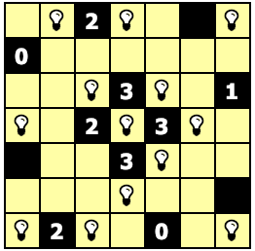
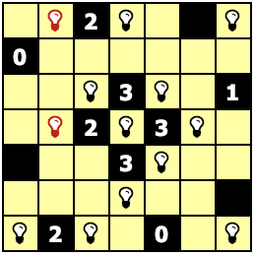
Lights Up Puzzle - Solution
A valid solution for a 14x14 Lights up puzzle:
All cell are illuminated.
Every ”Number Block” have the exact number of light bulbs around it (i.e. 4 bulbs around a 4 block).
No light bulb illuminate another.

Slide 4
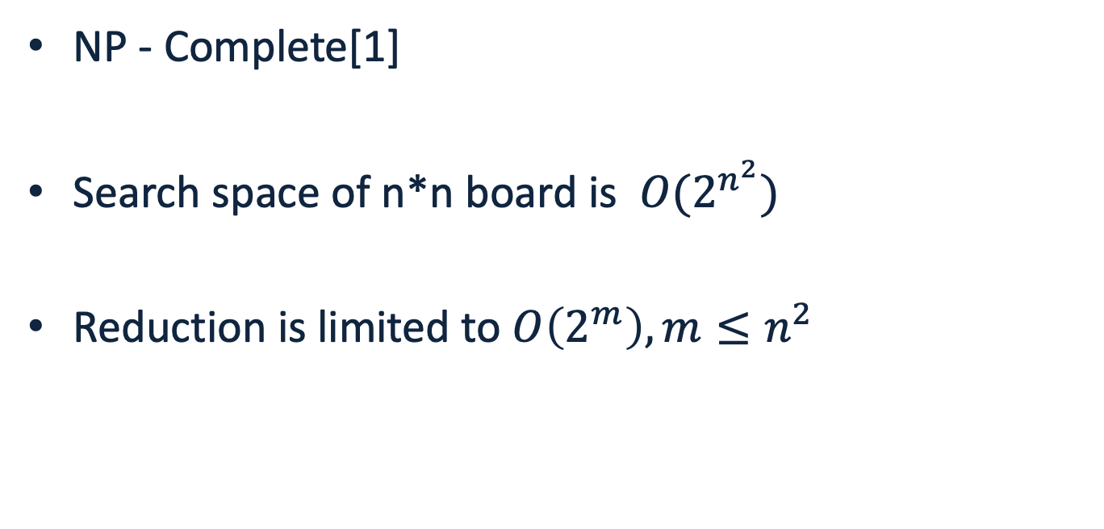
Lights Up Puzzle - Complexity
NP - Complete[1]
Search space of n*n board is $O(2^{n^{2}})$
Reduction is limited to $O\left(2^{m}\right), m≤n^{2}$
[1] KENDALL, Graham; PARKES, Andrew; SPOERER, Kristian. A survey of NP-complete puzzles. ICGA Journal, 2008, 31.1: 13-34.‏
Notes:
משל הקטנה של לוח בגודל 14 על 14 ל – 53 תאים במקום 196 הקטנה של הגנום בכמעט פי 4.

Slide 5
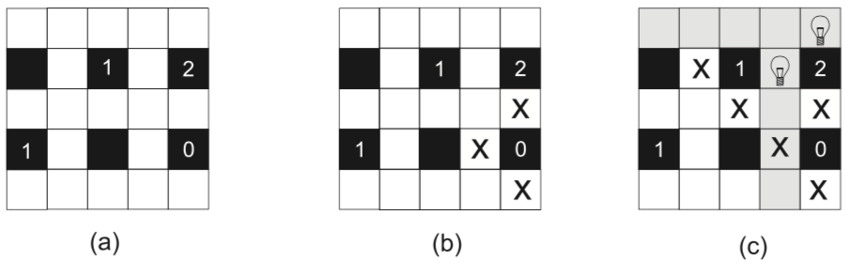

Pre Processing
By preprocessing the board we can avoid occupied or invalid cells in the representation of the individual and reduce the search space.
In this example from $O\left(2^{19}\right) to O(2^{6})$
*
SALCEDO-SANZ, Sancho, et al. A nested two-steps evolutionary algorithm for the Light-up puzzle. Icga Journal, 2009, 32.3: 131-139.‏

Slide 6
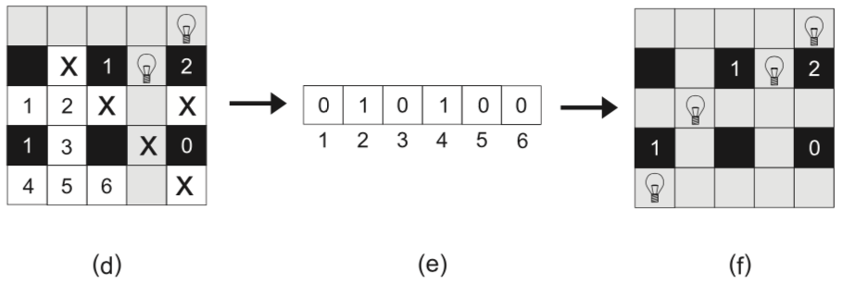
Individual Representation
After preprocessing we have a smaller amount of empty cells, we represent the individual accordingly:
*
SALCEDO-SANZ, Sancho, et al. A nested two-steps evolutionary algorithm for the Light-up puzzle. Icga Journal, 2009, 32.3: 131-139.‏
Notes:
אורך הגנום של האינדיבידואל הוא כמספר התאים הריקים שנשארו בלוח לאחר העיבוד המקדים

Slide 7
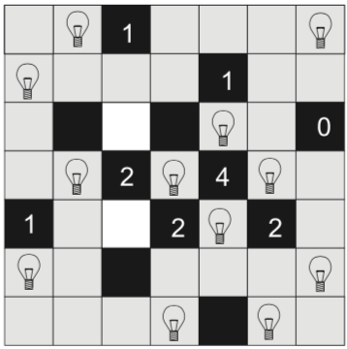
Fitness
Fitness = number of cells which are not illuminated + number of intersections + missing lights
Optimal Fitness = 0
Notes:
הפיטנס כמספר התאים שנותרו חשוכים, בדוגמא להלן למשל הפיטנס הוא 2.
נרצה למזער את הפיטנס עד להגעה לפיטנס 0.
ניתן גם לתת ״קנס״ כלשהו על מקרים בהן יש נורה במקום לא חוקי (מתנגשת עם נורה אחרת), אך בשלב זה בחרנו שלא לממש ככה את פונקציית הפיטנס מהחשש להיתקע באופטימום לוקלי.

Slide 8
Lights Up Board Parser
Built a parser to download and store boards from:
https://www.puzzle-light-up.com
Contains a variety of boards in different sizes of 7x7, 10x10, 14x14 and 25x25.
Several difficulty levels from easy to hard.
Notes:
ה-dataset: איך ייצרתם אותו/הורדתם אותו? כמה דוגמאות יש בו? האם יש כלים/מאמרים באינטרנט שהשתמשו בו? (לא צריך סקירת ספרות, רק אם מצאתם).

Slide 9
Selection
Survivor Selection – Elitism, The best 20% of the generation gets to live another day and continue to the next generation.
Parent Selection – we use the best 20% of the generation for crossovers to create the new individuals (80% of the generation).
Opt1: Choosing 2 completely random individuals (after disposing 80% of the gen).
Opt2: Choosing 5 random individuals and select the best 2 for crossover.

Slide 10
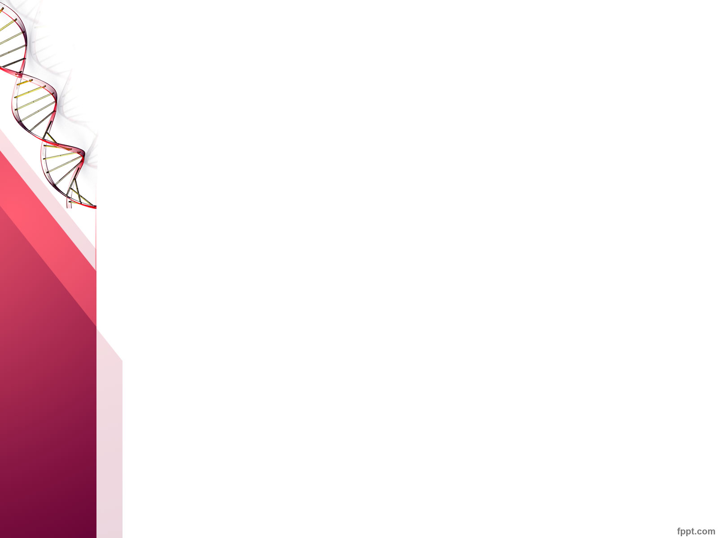
Crossover (Single point)
A1
A2
B1
B2
0.5
0.5
A1
B2
B1
A2

Slide 11
Crossover 2 (Uniform)
A1
A2
A3
A4
B1
B2
B3
B4
*Each bit have 50% of being chosen
A1
B2
B3
A4

Slide 12
Crossover (alt.)
A1
A2
B1
B2
A1
B2
B1
A2
*Choose by lower fitness
A1
B2
Notes:
Random crossover choose

Slide 13
Mutation
Chance of Mutation – P(m) = 0.1
1
0
0
0
1
0
1
0
Randomly flip one bit
1
0
0
0
0
0
1
0
5th bit flipped

Slide 14
Mutation2
Chance of Mutation – P(m) = 0.3
1
0
0
0
1
0
1
0
Each bit has a 30% of flipping
1
0
1
0
0
0
1
0
5th bit flipped
Notes:
Create new individual
Random choose mutation

Slide 15
Initial Results – 7x7
Parameter | Value
Population | 50
Mutation | One bit flip
Mutation Probability | 0.4
Crossover | Uniform
Parent Selection | Random out of 20% best
Survivor Selection | Elitism (20%)
Best Fitness | 10
Generations | 50

Slide 16
Initial Results – 14x14 Hard
Parameter | Value
Population | 50
Mutation | One bit flip
Mutation Probability | 0.4
Crossover | Uniform
Parent Selection | Random out of 20% best
Survivor Selection | Elitism (20%)
Best Fitness | 10
Generations | 50

Slide 17
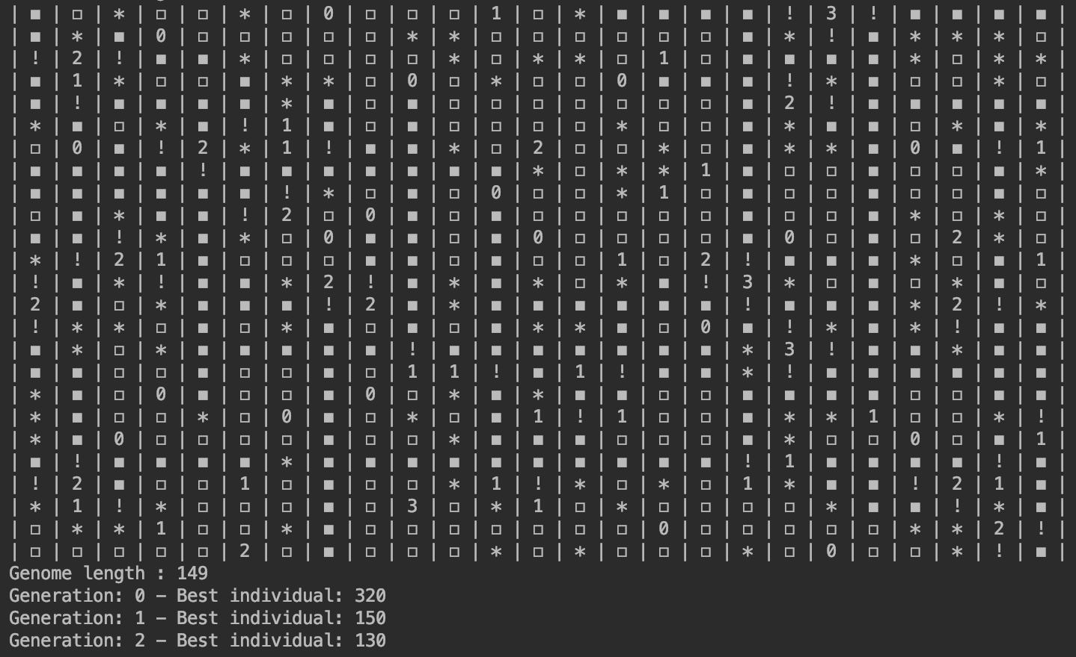
Initial Results
Notes:
מ – 2 בחזקת 625 ל – 2 בחזקת 149

Slide 18
Initial Results – 25x25 Hard
Parameter | Value
Population | 100
Mutation | One bit flip
Mutation Probability | 0.4
Crossover | Uniform
Parent Selection | Random out of 20% best
Survivor Selection | Elitism (20%)
Best Fitness | 30
Generations | 1000

Slide 19
Future Work
Fresh Blood
Different Selection
Every certain number of generations generate some new random individuals for diversity.
Select random 5 and cross best 2
Tournament
Aggressive Mutation
Penalties
Every bit has a probability of flipping.
Increasing mutation rates in case of local optimum.
Notes:
איך לברוח ממינימום לוקאלי?
אחרי השיפורים והאופטימיזציה להשוות למחקרים אחרים

Slide 20
Genetic Algorithm for Lights Up Puzzles
Questions?

