Slide 1

Genetic Algorithm for Lights Up Puzzles
Adar Ovadya
Liron Avraham

Slide 2
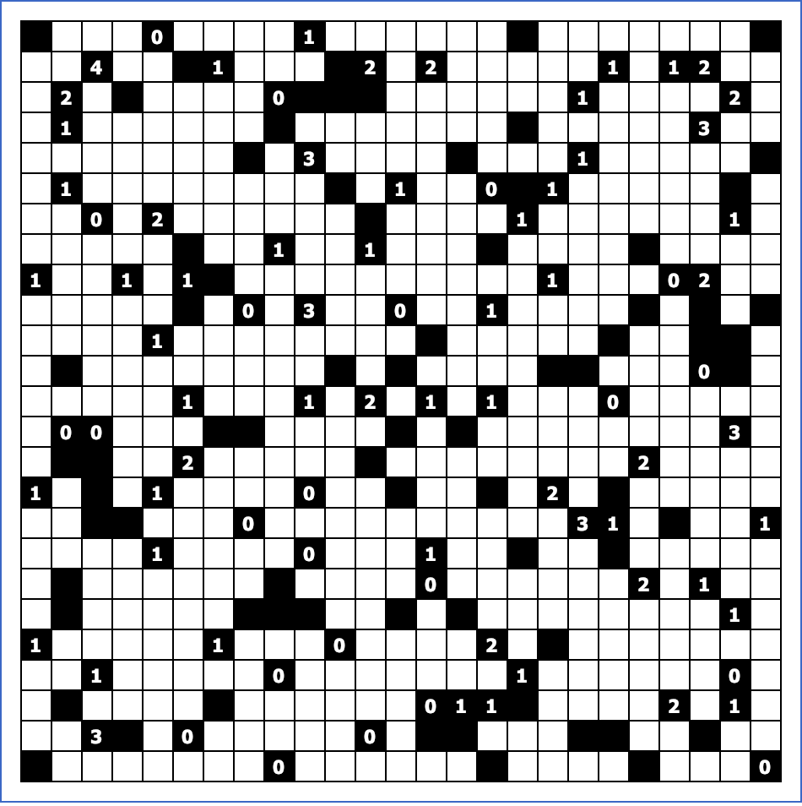





Lights Up Puzzle - Rules
Empty Cell - Is an optional spot for a light bulb
Block – Invalid location for a light bulb
Also blocks light
Number Block – Some blocks contain numbers, They represent how many light bulbs should “touch” that block
Light Bulb – Lights the board vertically and
Horizontally until reaches the end of the
Board or meets a block.
Illuminated Cell – Cells that are already in a direct line with a light bulb. They are invalid spots for light bulbs as it would cause a clash of two light bulbs.

Slide 3
Lights Up Puzzle - Solution
A valid solution for a 14x14 Lights up puzzle:
All cell are illuminated.
Every ”Number Block” have the exact number of light bulbs around it (i.e. 4 bulbs around a 4 block).
No light bulb illuminate another

Slide 4
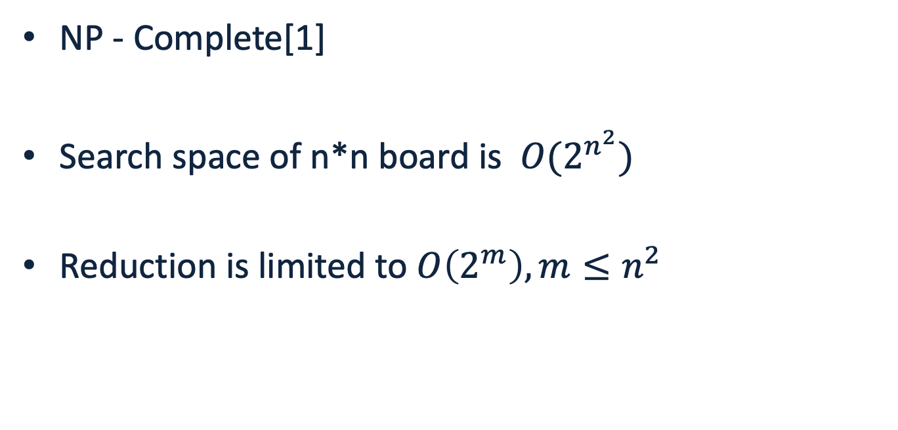
Lights Up Puzzle - Complexity
NP - Complete[1]
Search space of n*n board is $O(2^{n^{2}})$
Reduction is limited to $O\left(2^{m}\right), m≤n^{2}$
[1] KENDALL, Graham; PARKES, Andrew; SPOERER, Kristian. A survey of NP-complete puzzles. ICGA Journal, 2008, 31.1: 13-34.‏

Slide 5
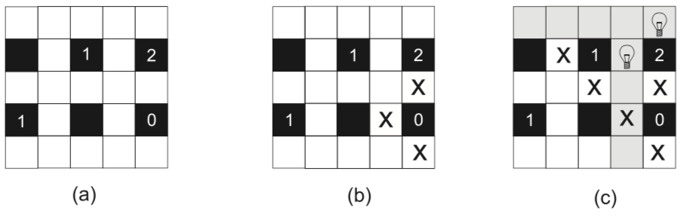
Pre Processing
By preprocessing the board we can avoid occupied or invalid cells in the representation of the individual and reduce the search space.
*
SALCEDO-SANZ, Sancho, et al. A nested two-steps evolutionary algorithm for the Light-up puzzle. Icga Journal, 2009, 32.3: 131-139.‏

Slide 6
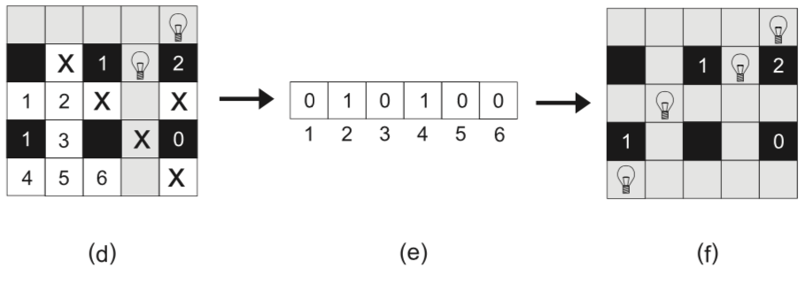
Individual Representation
After preprocessing we have a smaller amount of empty cells, we represent the individual accordingly:
*
SALCEDO-SANZ, Sancho, et al. A nested two-steps evolutionary algorithm for the Light-up puzzle. Icga Journal, 2009, 32.3: 131-139.‏
Notes:
אורך הגנום של האינדיבידואל הוא כמספר התאים הריקים שנשארו בלוח לאחר העיבוד המקדים

Slide 7

Crossover
A1
A2
B1
B2
0.5
0.5
A1
B2
B1
A2

Slide 8
Crossover 2
A1
A2
A3
A4
B1
B2
B3
B4
*Each bit have 50% of being chosen
A1
B2
B3
A4

Slide 9
Crossover (alt.)
A1
A2
B1
B2
A1
B2
B1
A2
*Choose by lower fitness
A1
B2

Slide 10
Mutation
Chance of Mutation – P(m) = 0.1
1
0
0
0
1
0
1
0
Randomly flip one bit
1
0
0
0
0
0
1
0
5th bit flipped

Slide 11
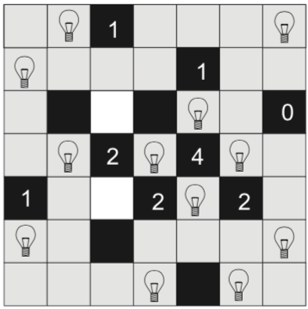
Fitness
Fitness = number of dark cells
Optimal Fitness = 0
Notes:
אורך הגנום של האינדיבידואל הוא כמספר התאים הריקים שנשארו בלוח לאחר העיבוד המקדים

Slide 12
Selection

Slide 13
Experiment Parameters

Slide 14
Initial Results

Slide 15
Slide Title
Product A
Product B
Feature 1
Feature 2
Feature 3
Feature 1
Feature 2
Feature 3

