Slide 1
Woman’s E-commerce Reviews Analysis
Lisa Benamati
Springboard
Data Science Capstone Project

Slide 2
Outline
Aim of the analysis
Dataset
EDA
NLP and Sentimental analysis
Statistical analysis
Predictive model
Conclusions

Slide 3
Aim of the analysis
Understanding the consumer’s preferences and the customer sentiments to improve the services and the products
Predict the rating score through different features and also through review texts

Slide 4
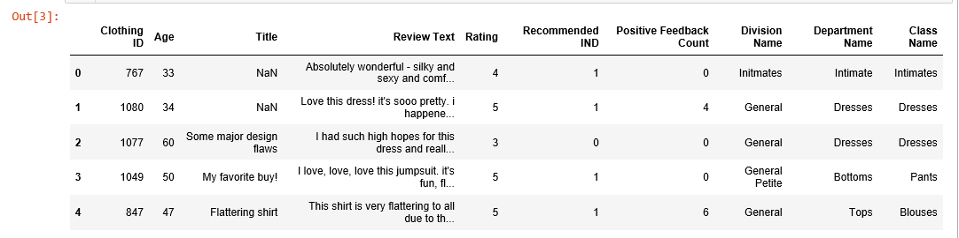
Dataset
The dataset includes 23486 rows and 10 feature variables:
Clothing ID: unique identifier of the product;
Age: age of the reviewer;
Title: title of the review;
Review text: product review;
Rating: product score granted by the customer from 1 worst, to 5 best;
Recommended IND: customer recommends the product where 1 is recommended, 0 is not recommended;
Positive feedback count: number of positive feedback on the review;
Division name: name of the division product is in;
Department name: name of the department product is in;
Class name: type of product.

Slide 5
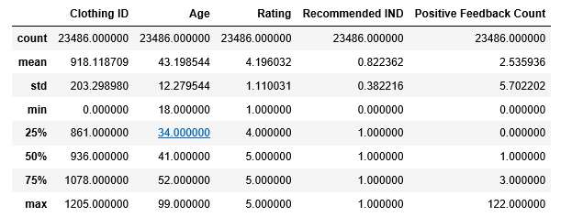
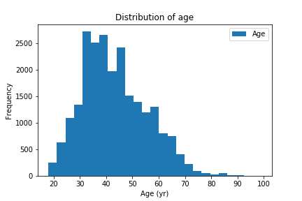
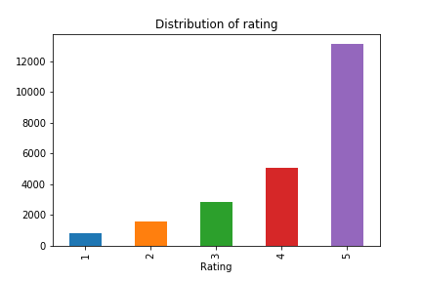
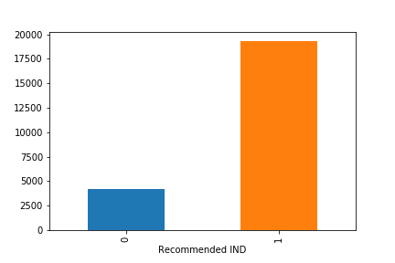
Exploratory data analysis
Age
Recommended cloths: 19314
No recommended cloths: 4172
Rating

Slide 6
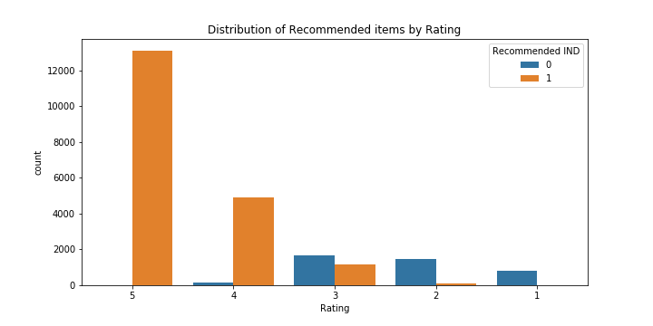
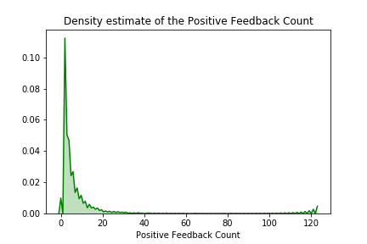
But:
There are low rating also for recommended products and high rating for no recommended items.
The density of number of positive feedback is close to 0.

Slide 7
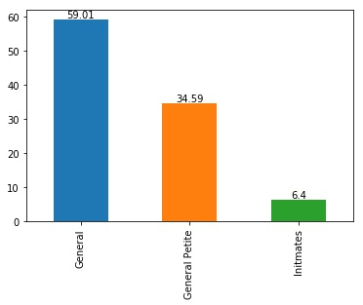
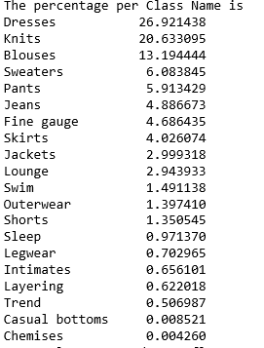
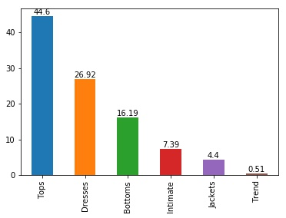
Division Name
Class Name
Department
Name
Distribution of rating by Department Name and Division Name: no different distribution
The age doesn’t influence the distribution of reviews

Slide 8
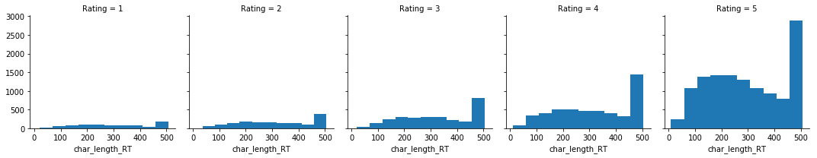
Working with text: NLP
The text probably has limit of around 500 characters length
The two words more frequent:
for rating 1, 2 and 3 are the same : ’dress’ and ’like’;
for rating 4 the first is ’dress’ but the second ’size’;
for rating 5 the first two are ’love’ and ’dress’.

Slide 9
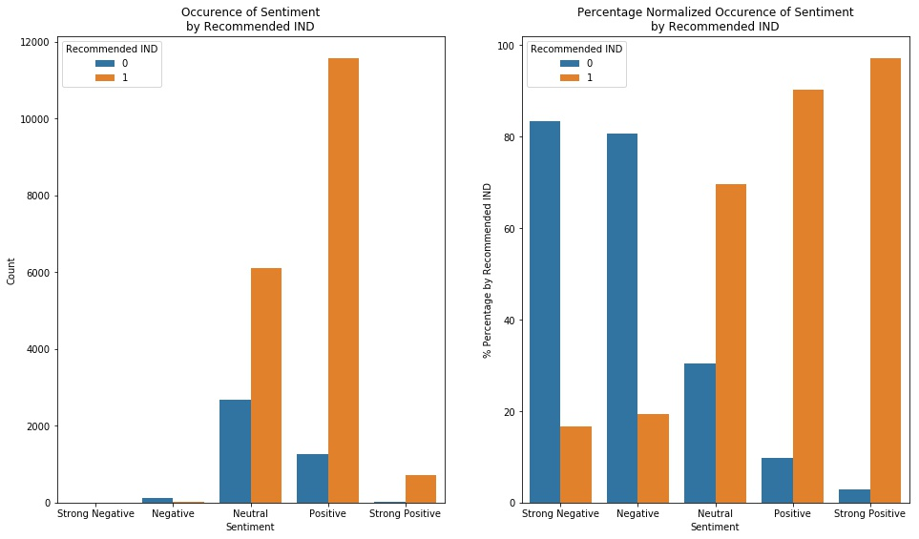
Sentimental Analysis
The recommended cloths have more positive sentiment in the review, while the no recommended items more negative one

Slide 10
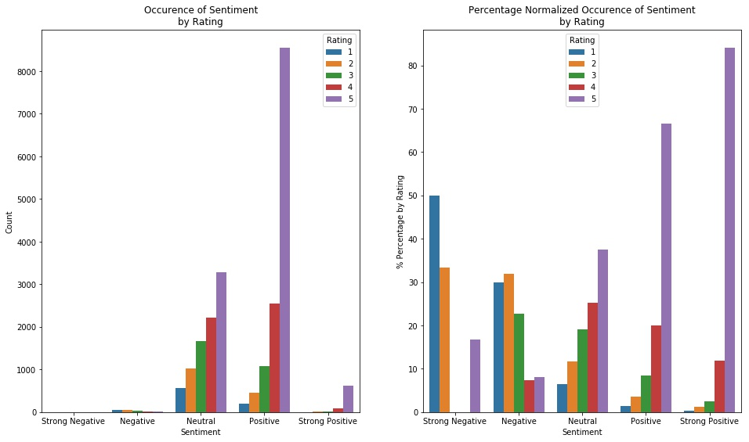
The distribution for the neutral, positive and strong positive sentiment increasing when the rating number increases;
the negative sentiment has more low rating occurrence (1 and 2);
for the strong negative sentiment, the distribution is particular: has a
peak for rating 1 and 2, as expected, but also more or less 15 % of occurrence for rating 5.

Slide 11
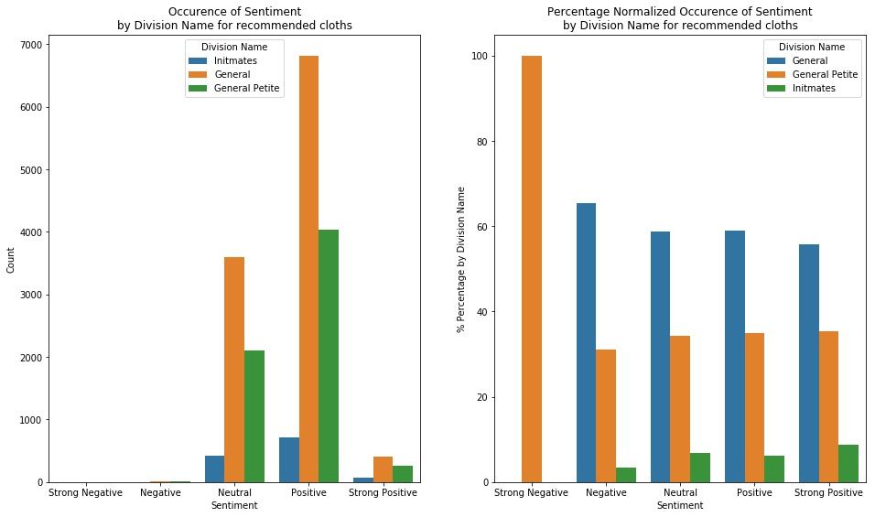
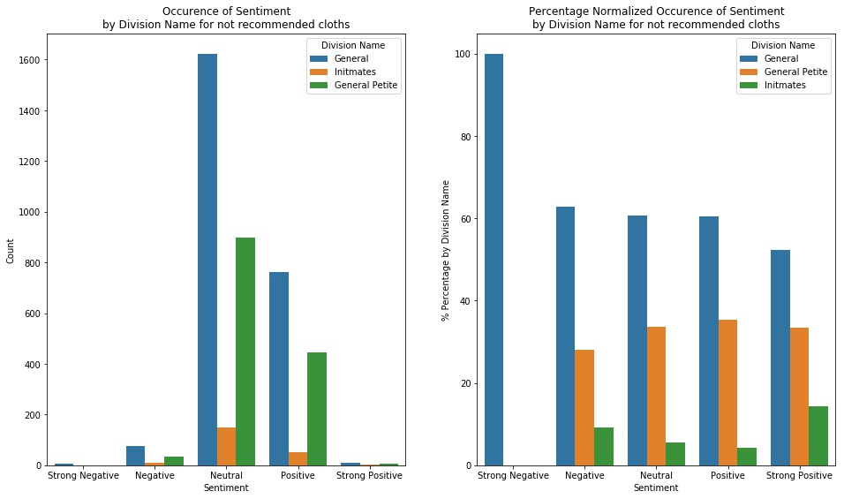
Note:
for the recommended reviews only the ’General Petite’ is shown
Note:
for the non-recommended only the ’General’ Division Name is shown
The distribution of division names for the other sentiments does not seem to change depending on status of recommendation.

Slide 12
Statistical Analysis (1)
Calculate the count and mean of Rating, Recommended IND, Age and Positive Feedback Count grouping by Clothing ID:
no correlation between count and average value, which means that the popularity of the item does not lead to differential treatment when it comes to average scoring.
there is a positive correlation of 0.80 between rating and recommended IND mean.
It means that when the rating is high the item is recommended and vice versa.

Slide 13
Statistical Analysis (2)
Correlations for the dataframe created after the work done on Text Review:
the polarity score has a slightly correlation with Rating (0.39) and also with Recommended IND (0.32). It means that, when the rating are high and the products recommended, the reviews have more positive polarity score.
the negative reviews are longer than the positive one (-0.29).
Dataframe where I processed the Title feature:
there is only a slightly positive correlation between rating and the exclamation points: more ’!’ means higher rating.

Slide 14
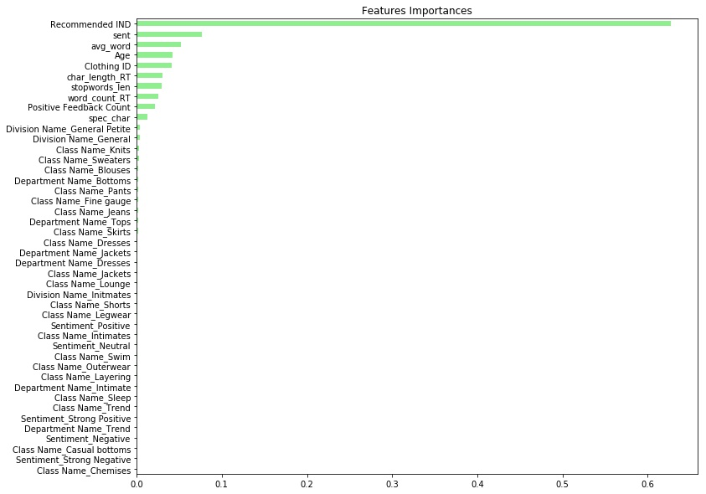
Predictive Model
I used the random forests regressor
The first three most important features are Recommended IND, as expected after the statistical analysis, sentimental score (sent) and average words (avg_word).

Slide 15
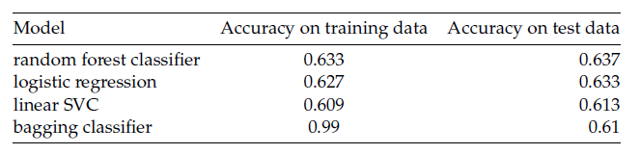
I run different models to choose the best one to do rating prediction
The Random Forest is the best model

Slide 16
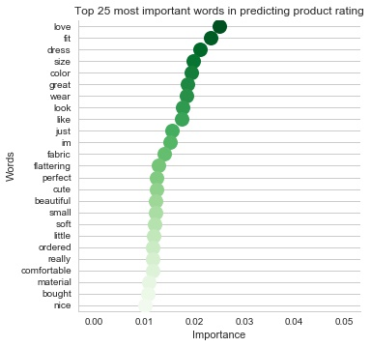
Applying TF-IDF technique , I found the the importance of the first 25 words to predict rating
I used Random Forest Classifier and Naive Bayes Machine Learning Algorithm to predict rating and if a cloth is recommended or not based on the extracted words.
Accuracy for predicting rating: ~56%
Accuracy to predict recommended: ~81%
Do the text features help the performance of the model?
It seems that the text features don't improve the model to predict the rating.
Accuracy: ~62%

Slide 17
Conclusions
The major part of the reviewers is between 30-50 years old
Most of the cloths are recommended and with high rating, but the density of the positive feedback count is close to 0
There is a correlation (0.80) between rating and recommended IND
The Random Forest is the best model to use to predict rating, but the accuracy is low (~60%)
Also adding text features the accuracy of the model doesn’t improve
It is necessary to improve the model to increase the precision in the prediction.
Should be interested to analyze also male’s e-commerce reviews

