Slide 1

4 bit multiplier in Assembly
Lisa Jacklin

Slide 2
Planned Attack
Network
Satellite
Link

Slide 3
VHDL Code

Slide 4
Converting to CPP

Slide 5
Assembly Code Result

Slide 6

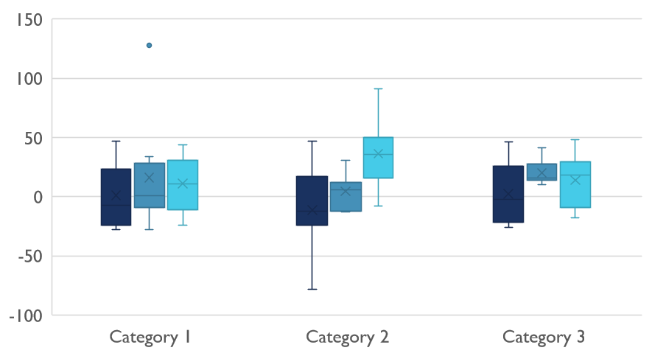
Struggles and Learning things

Slide 7

Thank You
Github Link:

