Slide 1

4 bit multiplier Circuit
Lisa Jacklin

Slide 2
Planned Attack
VHDL
C++/C
Assembly

Slide 3
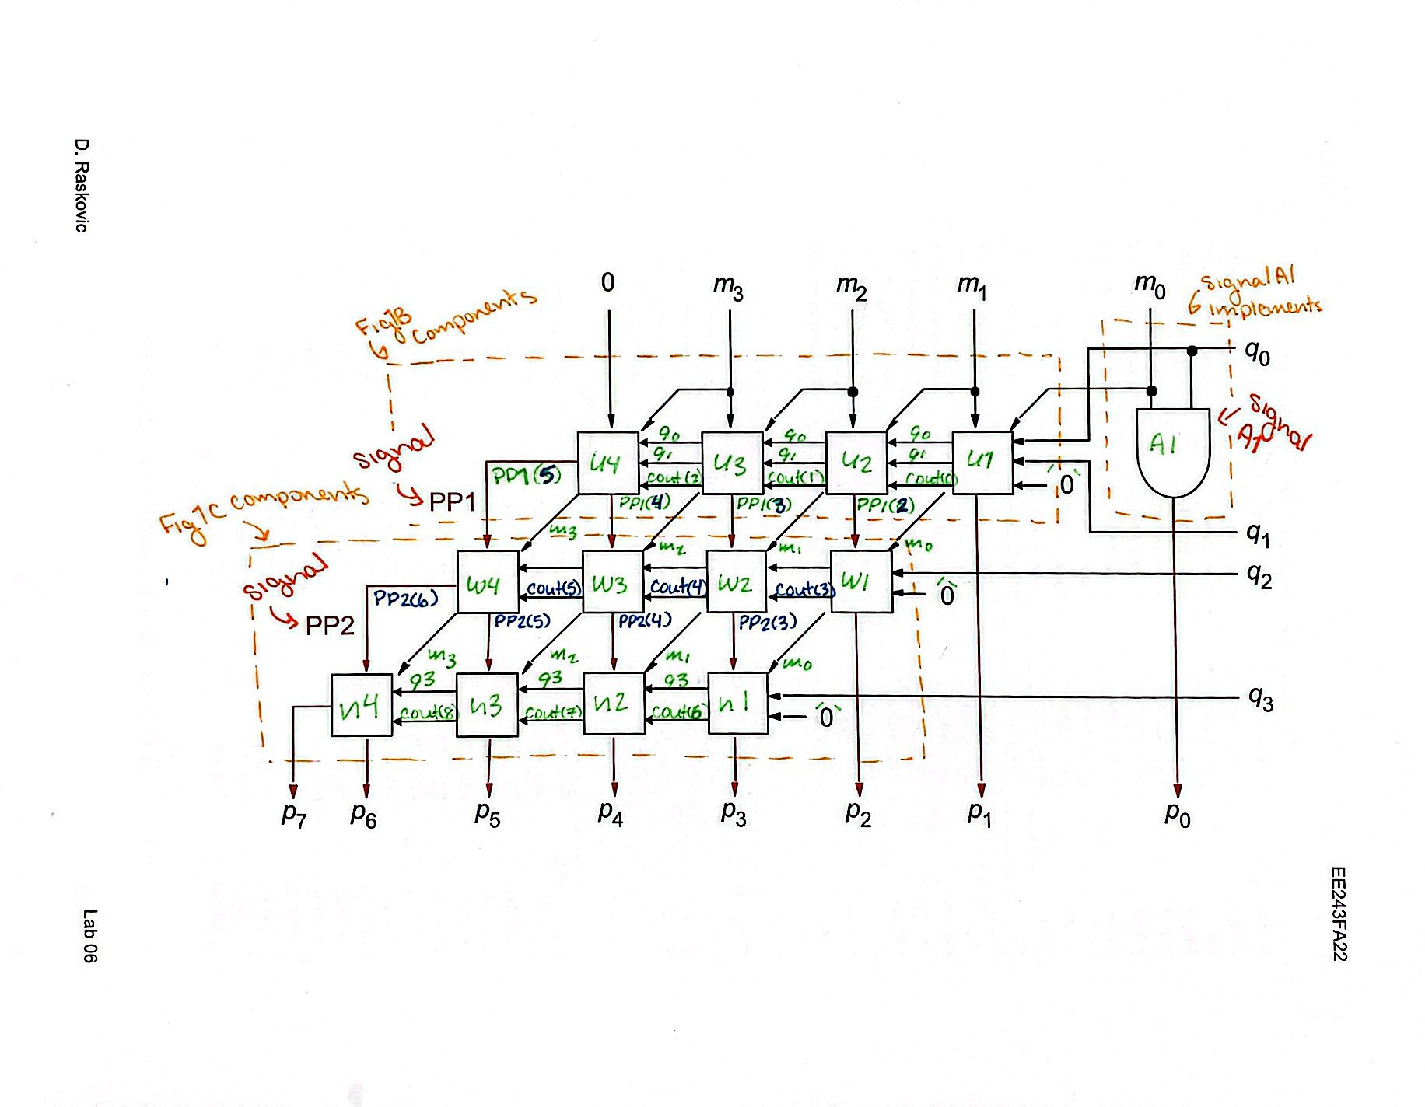
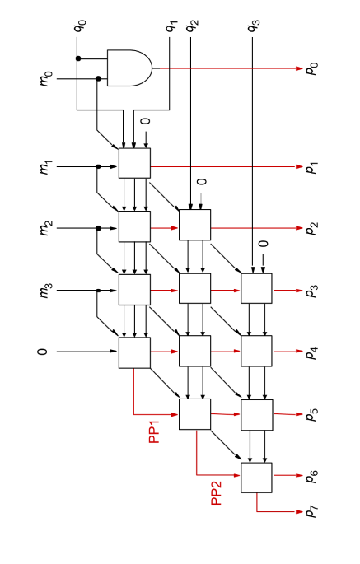
VHDL Code and Circuits

Slide 4
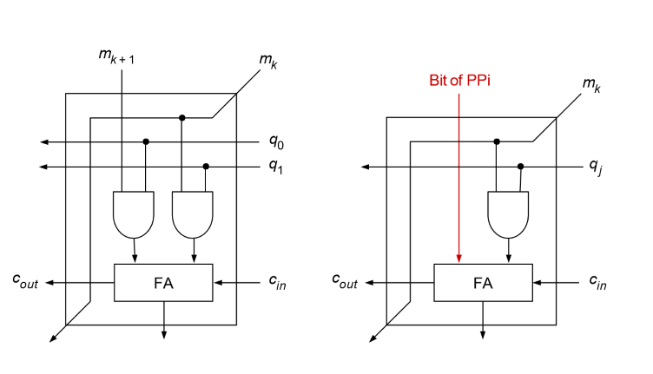
VHDL Subcircuits
Top Row Boxes
U(x) signals
Second and Third Row Boxes
W(x)/N(x) signals

Slide 5
Top Row Code
Second and Third Row Code
ENTITY Fig1B IS
PORT ( M1, M2, Q0, Q1, Cin :In STD_LOGIC;
Cout, S :OUT STD_LOGIC);
END ENTITY;
ARCHITECTURE Block1 OF Fig1B IS
COMPONENT Adder IS
PORT (X1, X2, Cin : IN STD_Logic ; --x and y are inputs of the adder
Cout, S :BUFFER STD_Logic); --c is the carry and s is the sum value
END COMPONENT;
SIGNAL A1, A2, A3 :STD_LOGIC;
BEGIN
A1 <= M1 AND Q0;
A2 <= M2 AND Q1;
A4:Adder PORT MAP (X1 => A1, X2 => A2, Cin => Cin, --INPUTS
Cout => Cout, S => s); --OUTPUT VALUES FROM ADDER
END ARCHITECTURE;
ENTITY Fig1C IS
PORT ( M1, cc, Q1, Cin :In STD_LOGIC;
Cout, S :OUT STD_LOGIC);
END ENTITY;
ARCHITECTURE Block2 OF Fig1C IS
COMPONENT Adder IS
PORT (X1, X2, Cin : IN STD_Logic ; --x and y are inputs of the adder
Cout, S :BUFFER STD_Logic); --c is the carry and s is the sum value
END COMPONENT;
SIGNAL A1 :STD_LOGIC;
BEGIN
A1 <= M1 AND Q1;
A2:Adder PORT MAP (X1 => A1, X2 => cc, Cin => Cin, --inputs
Cout => Cout, S => s); --outputs
END ARCHITECTURE;

Slide 6
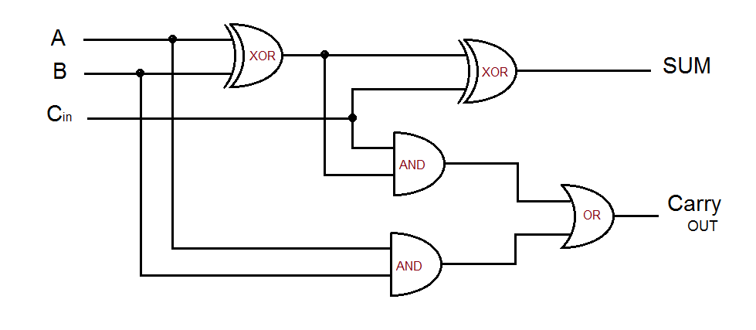
VHDL Full Adder Subcircuit
Adder Code
void Adder(char x, char y, char cin) {
//output integers...
char Co;
char s;
//these give the carry out and sum value for the adder...
//condensed version of the signals
Co = (x & y) | (y & cin) | (x & cin);
s = cin ^ (x ^ y);
//test display to verify adder
//std::cout << Co << s << "\n"; //be careful and make sure to check
};
Entity Adder IS
Port (X1, X2, Cin : IN STD_Logic ; --x and y are inputs of the adder
Cout,S :BUFFER STD_Logic); --c is the carry and s is the sum value
End Adder;
Architecture Adder_Circuit Of Adder is
Signal a1, a2, a3, a4, a5: std_logic;
Begin
a1<=X1 XOR X2;
a2<=x1 XoR Cin;
a3<=x1 AND Cin;
a4<= x2 AND Cin;
a5<= x1 AND x2;
Cout <= a5 or a3 or a4;
S <= a1 xor cin;
End Adder_Circuit;

Slide 7
ASM Full Adder Subcircuit
Adder:
;the values for r8 and r9 are given by the the other subcircuits values
cmp r8, 0
jg Sum
cmp r9, 0
jg Sum
Sum:
cmp r8, r9
je Equal
jg SumNoCout
jl SumNoCout
SumNoCout:
mov r10, 1 ; sum value is one
mov r11, 0
Equal:
mov r11, 1 ; this is the carry value,
mov r10, 0 ; and this is the corresponding sum value

Slide 8
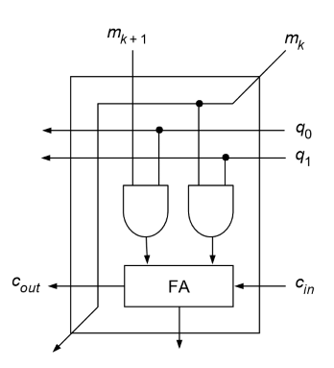
Multiplier Top Circuits in CPP/asm
Cpp
ASM
void Fig1B(char x, char x2, char cin, char y, char y2) {
//signals
char a1 = x & y;
char a2 = x2 & y2;
Adder(a1, a2, cin);
};
TopRow:;fig1b top row values
;first two values
;ADD IN CARRY LATER
mov rax, M ;set to M array mov rdi, Q ; set to Q array
mov r8, QWORD[rcx]
mov r9, QWORD[rcx+16]
;second two values
mov r10, QWORD[rdi+24]
mov r11, QWORD[rdi+16]
cmp r8, r11
je Adder
cmp r9, r10
je Adder

Slide 9
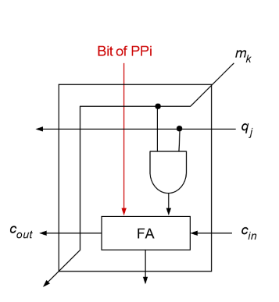
Multiplier Other Rows Circuits in CPP/ASM
Cpp
ASM
void Fig1C(char x, char cc, char y, char cin) {
//signal again
char a1 = x & y;
Adder(a1, cc, cin);
};
SecondRow:
mov rax, M
mov rdi, Q
mov rcx, Cout
;this is where the carry values ;come in...so Cout, PP1, and PP2
mov r8, QWORD[rax]
mov r9, QWORD[rdi]
cmp r8,r9
je A1 ;
cmp r8, rcx ;x1 = M and x2 = cout jmp Adder

Slide 10
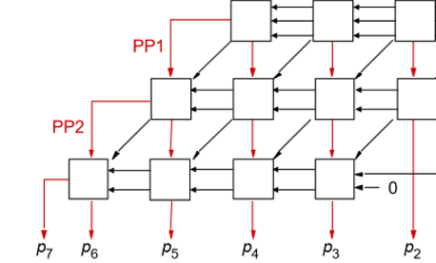
Where things went wrong

Slide 11
VHDL PortMap
u1: Fig1B PORT MAP ( M(0), M(1), Q(1), Q(0), '0', Cout(0), P(1));
u2: Fig1B PORT MAP ( M(1), M(2), Q(1), Q(0), Cout(0), Cout(1), PP1(2));
u3: Fig1B PORT MAP ( M(2), M(3), Q(1), Q(0), Cout(1), Cout(2), PP1(3));
u4: Fig1B PORT MAP ( M(3), '0', Q(1), Q(0), Cout(2), PP1(5), PP1(4));
--Second row
w1:Fig1C PORT MAP (M(0),PP1(2),Q(2),'0',Cout(3),P(2));
w2:Fig1C PORT MAP (M(1),PP1(3),Q(2),Cout(3),Cout(4),PP2(3));
w3:Fig1C PORT MAP (M(2),PP1(4),Q(2),Cout(4),Cout(5),PP2(4));
w4:Fig1C PORT MAP (M(3),PP1(5),Q(2),Cout(5),PP2(6),PP2(5));
--Last line, final output values, P
N1:Fig1C PORT MAP (M(0),PP2(3),Q(3),'0',Cout(6),P(3));
N2:Fig1C PORT MAP (M(1),PP2(4),Q(3),Cout(6),Cout(7),P(4));
N3:Fig1C PORT MAP (M(2),PP2(5),Q(3),Cout(7),Cout(8),P(5));
N4:Fig1C PORT MAP (M(3),PP2(6),Q(3),Cout(8),P(7),P(6));

Slide 12
Future Considerations
Try a different approach
01
Make my own templates that allow for various values input and output and preliminary
02
Maybe try writing my own multiply in assembly
03

Slide 13

Thank You

